Slide 1
An Empirical Analysis of Overfitting and Mode Drop in GAN Training
Yasin Yazici^{1,2}, Chuan Sheng Foo², Stefan Winkler³, Kim Hui Yap¹, Vijay Chandrasekhar²
¹School of Electrical and Electronic Engineering, Nanyang Technological University
²Institute for Infocomm Research, A*STAR
³School of Computing, National University of Singapore

Slide 2
Motivation/ Objective
Do GANs overfit to the training set?
What are the practical reasons for mode drop?
Objective: empirically analyse overfitting and mode drop in GANs training.

Slide 3
Our Contributions
We show GANs can overfit to the training set and show no mode drop.
Link between stochasticity and mode drop.
Link between stochasticity and overfitting.
Trade-off between generalization and mode coverage.

Slide 4
Our Hypothesis
Stochasticity is linked with overfitting and mode drop.
Less stochasticity leads to overfitting.
More stochasticity leads to mode drop.
Trade-off between generalization and mode coverage.

Slide 5
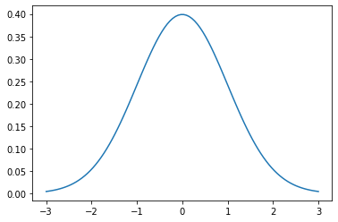
Stochasticity
Stochastic gradient updates.
Random samples from the prior (latent code).

Slide 6
Effect of the Batch Size
First type of stochasticity.
Various batch sizes.
Fixed latent code (Fixed second type of stochasticity).

Slide 7
Overfitting Results (Batch Size)
Increased stochasticity (decreased overfitting)

Slide 8
Mode Drop Results (Batch Size)
Increased stochasticity (increased mode drop)

Slide 9
Effect of the Noisy Latent Code
Second type of stochasticity.
Includes noise to generator input (Analogous to sampling).
Fixed batch-size (Fixed first type of stochasticity).

Slide 10
Overfitting Results (Noisy Latent)
Increase stochasticity (decreased overfitting)

Slide 11
Mode Drop Results (Noisy Latent)
Increase stochasticity (increased mode drop)

Slide 12
Summary
GANs tend to overfit when stochasticity is reduced.
GANs tend to mode drop when stochasticity is increased.
Trade-off between generalization and mode coverage.
Take-away: tune the level of stochasticity for the best trade-off.
Take-away: for mode coverage, decrease stochasticity.
Take-away: for generalization, increase stochasticity.

Slide 13
An Empirical Analysis of Overfitting and Mode Drop in GAN Training
Yasin Yazici^{1,2}, Chuan Sheng Foo², Stefan Winkler³, Kim Hui Yap¹, Vijay Chandrasekhar²
¹School of Electrical and Electronic Engineering, Nanyang Technological University
²Institute for Infocomm Research, A*STAR
³School of Computing, National University of Singapore

Slide 14
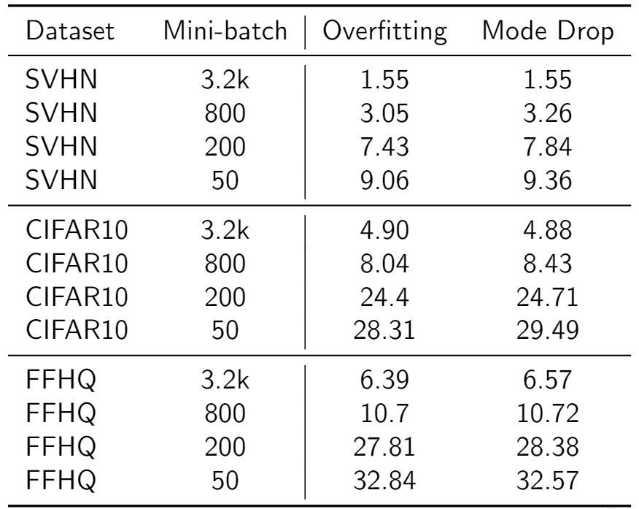
Quantitative Results
The table of overfitting and mode drop with varying batch size on SVHN,CIFAR10 and FFHQ. (visualization)

Slide 15
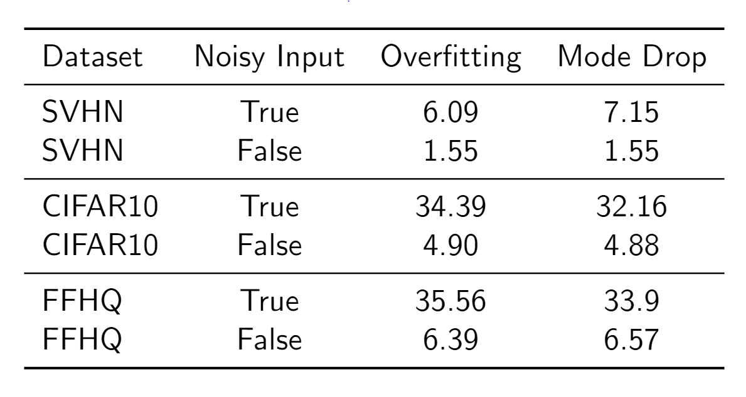
Quantitative Results
The table of overfitting and mode drop on SVHN, CIFAR10 and FFHQw/o and w/- noisy input

Slide 16
Terminology
Overfitting to data samples as the generator produces images nearly indistinguishable from the data samples and cover all of them.
By the definition this generator does not show a mode drop behavior (full recall).

