Slide 1
META REPRESENTATION LEARNING METHOD FOR ROBUST SPEAKER VERIFICATION IN UNSEEN DOMAINS
Video Presentation for ICASSP 2024
Paper Code: SLP-L9.3 Presenter: Jian-Tao Zhang
Notes:
Hi everyone, I am Jian-Tao Zhang, from university of science and technology of China.
It’s my pleasure to share our paper：Meta Representation Learning Method for Robust Speaker Verification in Unseen Domains.

Slide 2
OUTLINE
RELATED WORK
METHOD
EXPERIMENTS
CONCLUSION
Notes:
We will introduce this paper from four parts: the introduction, our proposed methods, experiment results and finally, the conclusion.
Firstly，we will introduce the related work.
We present an introduction to related work as the first aspect of our discussion.

Slide 3
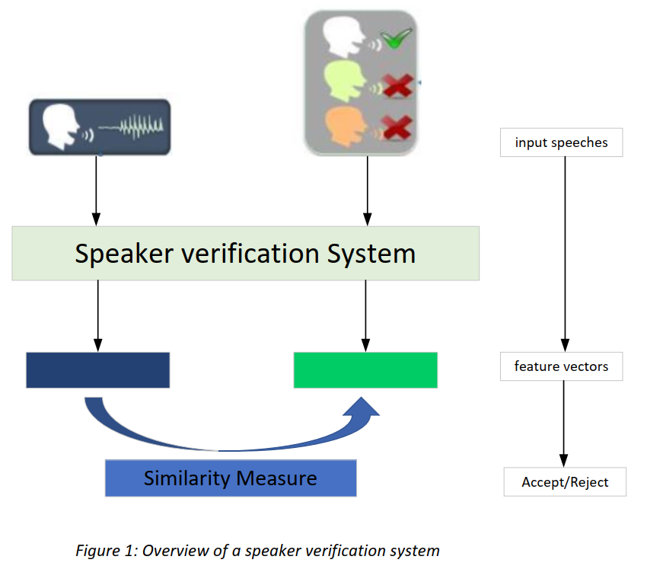
RELATED WORK
Speaker Verification (SV):
Verify whether speech samples belong to the same speaker.
SV is an open-set task.
Notes:
Speaker verification utilizes speaker verification systems to extract feature vectors from speech data, which accurately capture unique characteristics of individual speakers.
Subsequently, similarity measurement techniques are employed to analyze these feature vectors and determine whether the compared speech samples belong to the same speaker.
Therefore, speaker verification is an open-set task.

Slide 4
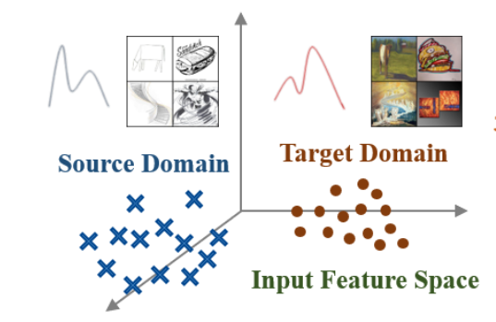
RELATED WORK
Domain shift problem
Speaking Style
Background Noise
Domain
Shift
Emotional State
Channel Variations
Age
...
Notes:
In practical applications, the performance of speaker verification (SV) systems often deteriorates due to the influence of intrinsic physiological factors, such as aging, speaking style, and emotional state of the speakers themselves, as well as external factors like background noise and channel variations. These factors prevent the SV system from ensuring the assumption of independent and identically distributed (i.i.d) training and testing data, leading to a decrease in performance. This phenomenon is commonly referred to as the domain shift problem.

Slide 5
RELATED WORK
Target domain is
known
Domain adaptation methods
Domian shift
problem
Target domain is
unknown
Domain generalization methods
Notes:
Based on whether the data from the target domain is known, the domain shift problem can be divided into domain adaptation and domain generalization problems.

Slide 6
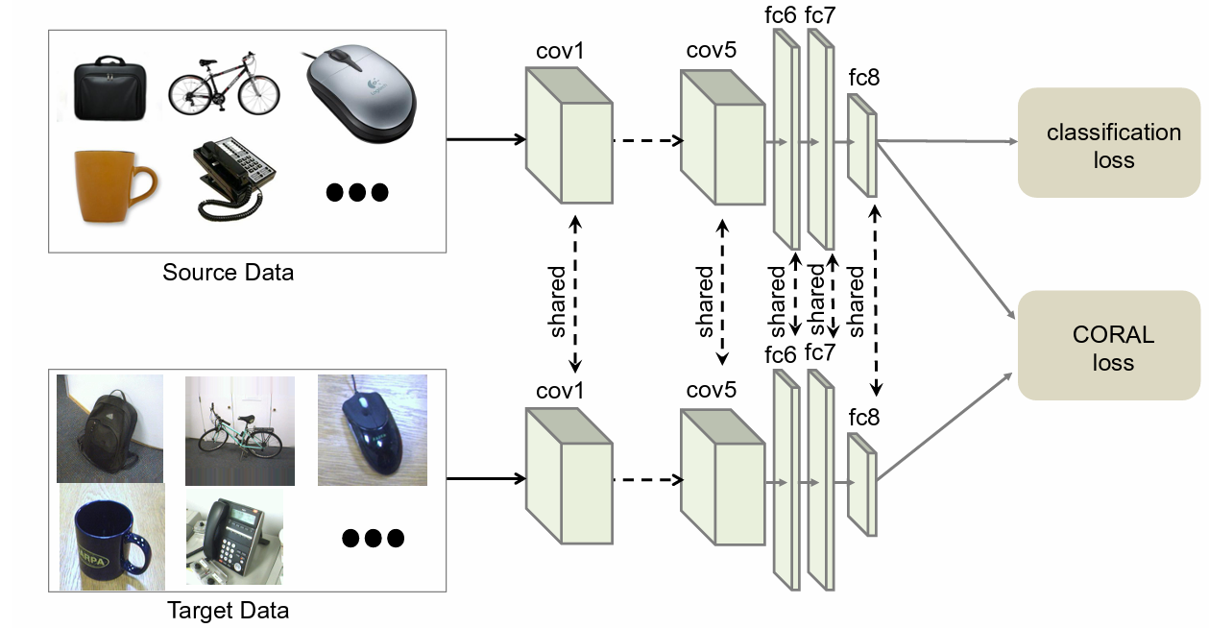
RELATED WORK
Domain Adaptation Methods
Statistical Features Alignment(Deep CORAL[1])
Data Augmentation(eg: StarGAN-Aug [2])
Learn a nonlinear transformation that aligns correlations of layer activations in deep neural networks.
Generate single-speaker multi-condition (SSMC) data.
[1] Sun B, Saenko K. Deep coral: Correlation alignment for deep domain adaptation[C]//Computer Vision–ECCV 2016 Workshops: Amsterdam, The Netherlands, October 8-10 and 15-16, 2016, Proceedings, Part III 14. Springer International Publishing, 2016: 443-450.
[2] Hu H R, Song Y, Zhang J T, et al. Stargan-vc Based Cross-Domain Data Augmentation for Speaker Verification[C]//ICASSP 2023-2023 IEEE International Conference on Acoustics, Speech and Signal Processing (ICASSP). IEEE, 2023: 1-5.
Notes:
In common DA methods ,Deep Coral learned a nonlinear transformation that aligns correlations of layer activations in deep neural networks
Besides, StarGAN-Aug generated single-speaker multi-condition (SSMC) data to enhance the cross-domain consistency of the speaker verification systems.

Slide 7
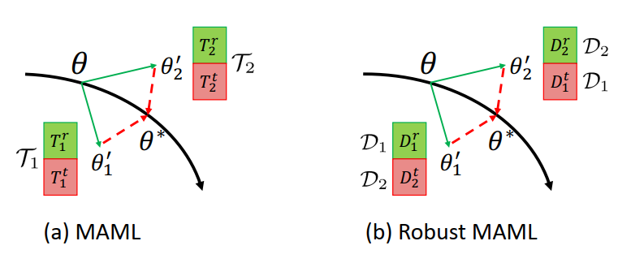
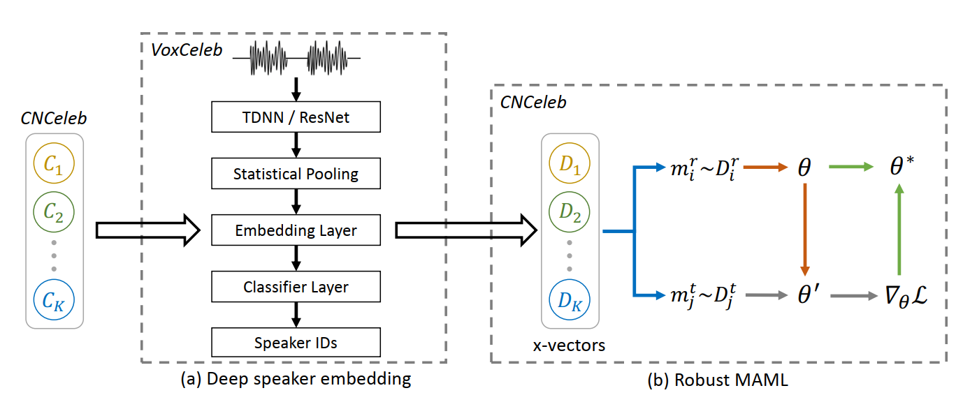
RELATED WORK
Domain Generalization Methods
Based on Meta Learning(Robust MAML[3])
Simulate the train/test domain shift during training and
realized the meta-learning based generalization method.
[3] KANG J, LIU R, LI L, et al. Domain-Invariant Speaker Vector Projection by Model-Agnostic Meta-Learning[C/OL]//Proc. Interspeech 2020. 2020: 3825-3829. DOI: 10.21437/Interspee ch.2020-2562
Notes:
In DG methods , Robust MAML simulated the train/test domain shift during training and realized the meta-learning based generalization method.

Slide 8
RELATED WORK
Domain generalization methods
In DG tasks, ensuring that the test data originates from the same underlying distribution is challenging.
We refer to the situation where the test data exhibits varying distributions as the unconstrained testing condition.
However, previous studies did not explicitly account for these unconstrained conditions during the training process.
We addressed the unconstrained conditions explicitly during the training process and introduced a novel approach called Meta representation learning (MRL).
Constrained testing conditions
Unconstrained
testing conditions
(Our research：MRL)
Notes:
In DG tasks, ensuring that the test data originates from the same underlying distribution is challenging.
We refer to the situation where the test data exhibits varying distributions as the unconstrained testing condition.
However, previous studies did not explicitly account for these unconstrained conditions during the training process.
We addressed the unconstrained conditions explicitly during the training process and introduced a novel approach called Meta representation learning (MRL).

Slide 9
OUTLINE
RELATED WORK
METHOD
EXPERIMENTS
CONCLUSION
Notes:
Scondly，we introduce the proposed methods.

Slide 10
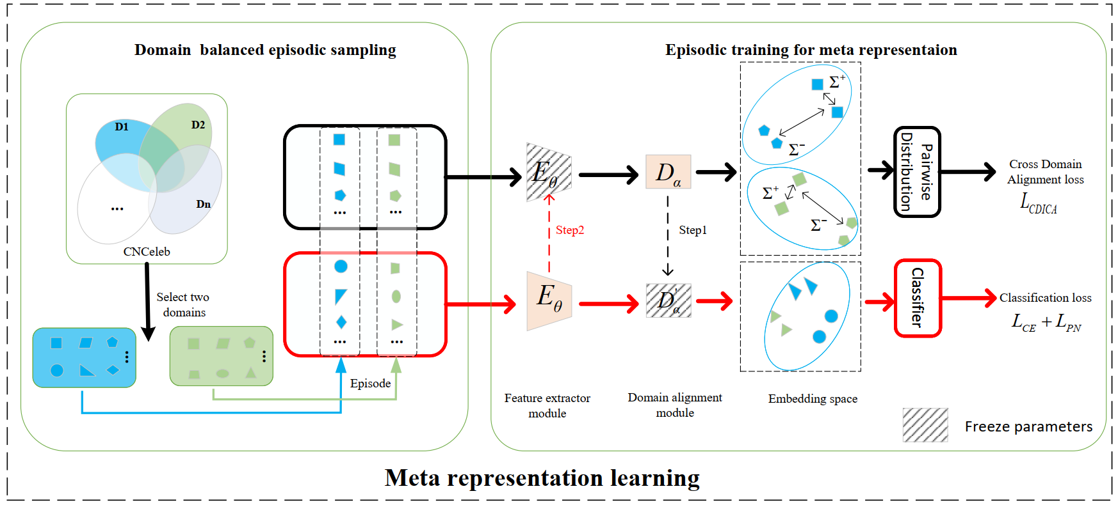
METHOD
Overview of our proposed meta representation learning (MRL) method
We employ domain balanced episodic sampling to decouple the unconstrained generalization task into a series of "episodic training" tasks.
Episodic training is further refined into two stages: "Episodic training for the DA module" (depicted by the black line) and "Episodic training for the FE module" (depicted by the red line).
Notes:
Firstly, allow me to present an overview of Meta-Representation Learning (MRL).
We use domain balanced episodic sampling to decouple the unconstrained generalization task into a series of domain adaptation tasks, as depicted in the diagram as "episodic training".
Episodic training is further refined into two stages: "Episodic training for the DA module" (depicted by the black line) and "Episodic training for the FE module" (represented by the red line).

Slide 11
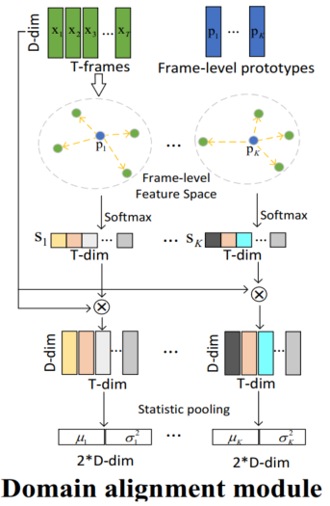
METHOD
Domain alignment(DA) module
The attention weights $S_{ij}$ between each frame-level prototype $p_{i}$ and the extracted feature $x_{j}$ can be calculated as follows:
In details, we use a point-wise convolution and a softmax non-linear activation along the temporal axis effectively to calculated $S_{ij}$
The utterance-level prototypes are used to characterize speaker identity information
Notes:
Within the Domain Alignment (DA) module, we conduct domain-related speaker analysis in both frame-level and utterance -level feature spaces.
We construct frame-level prototypes that effectively describe the domain-related distributions. These prototypes allow us to adjust frame-level features by computing attention weights in relation to the frame-level inputs。
The attention weights S_ij between each frame-level prototype p_i and the extracted feature x_j can be calculated as follows:
In details, we use a point-wise convolution and a softmax non-linear activation along the temporal axis effectively to calculated $S_{ij}$

Slide 12
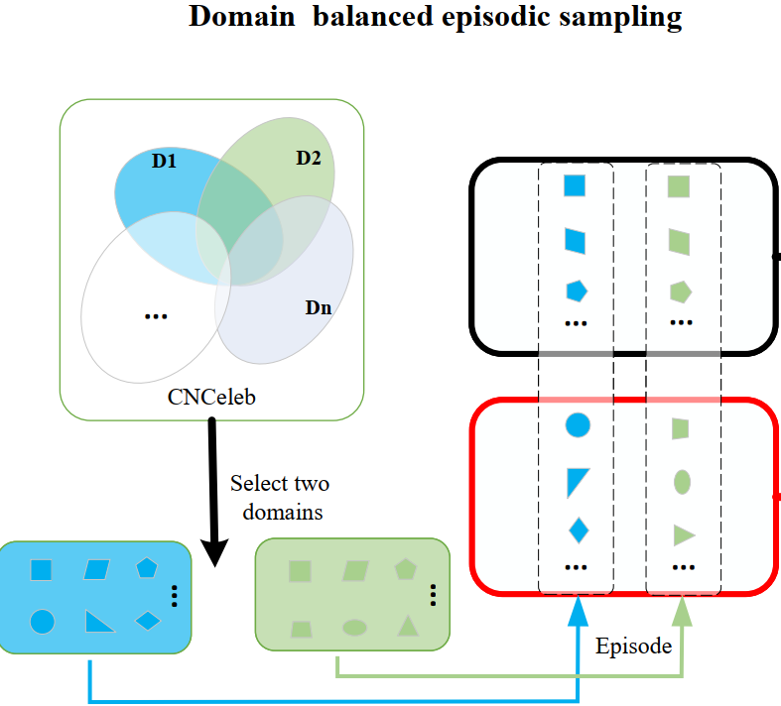
METHOD
Domain balanced episodic sampling
Cross-domain data with overlapping labels
Episodic training for the DA module
(Meta train)
Cross-domain data with non-overlapping labels
Episodic training for the FE module
(Meta test)
Notes:
Considering that the speaker category and domain spaces are partly overlapped in CNCeleb , we build an episode with two subsets: cross domains data with overlapped and non-overlapped labels.
Therefore ,we divide the training procedure of an episode into two stages.

Slide 13
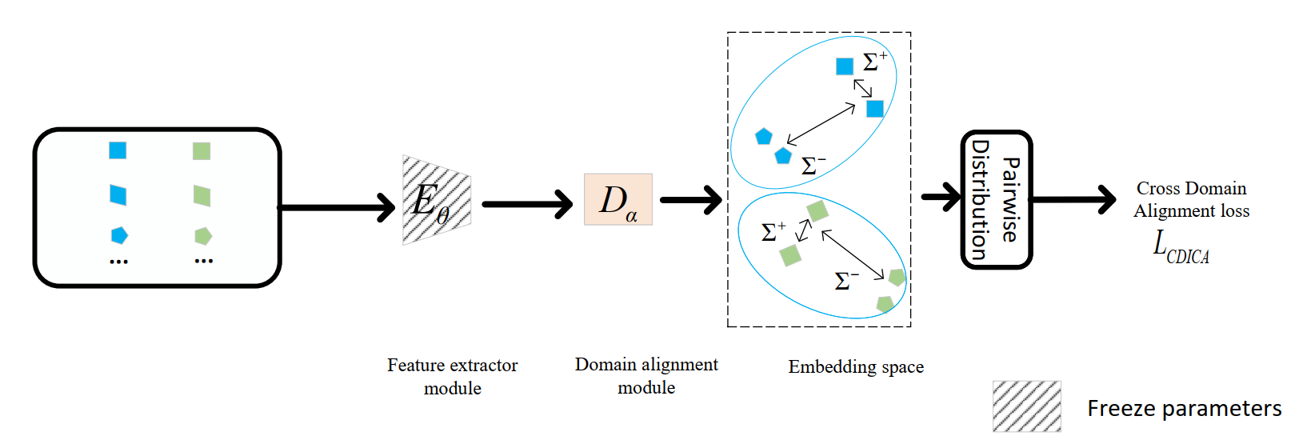
METHOD
Episodic training for the DA module(Meta train)
$Σ_{D1}^{−}$ and $Σ_{D2}^{−}$ denote the two statistics matrices of two different domains
Cross-domain data with overlapping labels
We only use the gradient of $L_{CDICA}$ to optimize the DA module:
Notes:
In Episodic training for the DA module, we introduce the Cross-Domain Inter-Class Alignment Loss (L_CDICA) as our optimization loss.
The optimization goal is to align the inter-class covariance matrices of two distinct domains.
Throughout the training process, we solely utilize the CDICA loss to optimize the DA module.
As a result, we successfully transform the unconstrained task into the constrained task.

Slide 14
METHOD
Episodic training for the FE module(Meta test)
Cross-domain data with non-overlapping labels
We fix the parameters $α_{t}^{’}$ of the DA module, which are temporarily updated from the above stage, and update the FE module’s parameters $θ_{t}$ to $θ_{t}^{’}$ via backward gradients.
Notes:
In Episodic training for the FE module,
we utilize the utterance-level feature outputs of the DA module to construct utterance-level prototypes that describe speaker identity information.
By combining the prototype loss and the cross-entropy loss, we perform domain-robust training on cross-domain data with non-overlapping speaker labels, thereby enhancing the model's generalization capability.

Slide 15
OUTLINE
RELATED WORK
METHOD
EXPERIMENTS
CONCLUSION
Notes:
Next，we will analyze the experiments results.

Slide 16
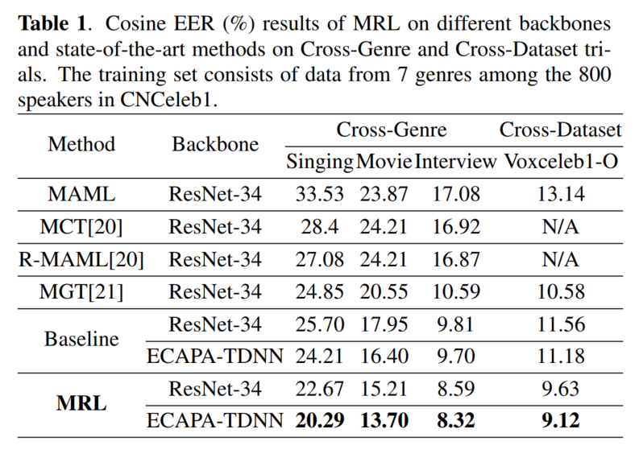
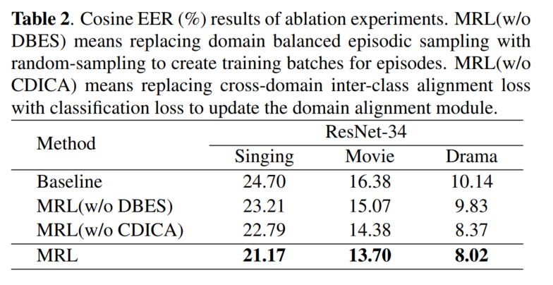
EXPERIMENTS
Ablation study:
Both domain balanced episodic sampling
and CDICA loss lead to improvement
Comparation with other SOTA models:
Conducting experimental comparisons on cross-genres and cross-datasets DG tasks.
MRL demonstrates a significant improvement in performance.
Notes:
We compare our baseline and the designed MRL with other SOTA methods, as shown in the Tabel 1, it can be seen that MRL outperforms our baseline by a large margin, and even achieves competitive results with other SOTA methods on cross-genres and cross-datasets DG tasks.
In Tabel2, we make an ablation study, and shows that both Domain balanced episodic sampling and CDICA loss are helpful.

Slide 17
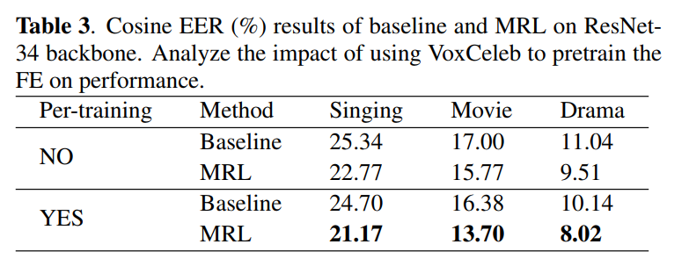
EXPERIMENTS
Analyzing the impact of pre-training on the FE :
After pre-training the FE, the average relative improvement of EER is higher than the improvement without pre-training.
Notes:
We also consider the influence of pre-training in Table 3.
After pre-training the FE, the average relative improvement of EER is higher than theimprovement without pre-training.
It shows our proposed method with pre-training has better domain generalization potential.

Slide 18
outline
RELATED WORK
METHOD
EXPERIMENTS
CONCLUSION
Notes:
Finally,we make a conclusion.

Slide 19
Conclusion
The work in this paper:
Analyze the unconstrained conditions explicitly during the training process.
Decompose MRL into a series of domain-adaptation tasks on constrained conditions (Episodic training).
Propose a strategy for aligning cross-domain category distributions.
Future work:
Utilizing cross-domain data augmentation to further enhance generalization capabilities.
Simplify the training process.
Notes:
In this paper ,we analyze the unconstrained conditions explicitly during the training process.
We decompose MRL into a series of domain-adaptation tasks on constrained conditions，known as episodic training.
Besides, we propose a strategy for aligning cross-domain category distributions.
Finally, SOTA results are achieved.
In the future, we will devote ourselves to utilize cross-domain data augmentation to further enhance generalization capabilities and research how to simplify the training process.

Slide 20
Thank you
Notes:
Thank you

