Slide 1
Rate Distortion Characteristic Modeling for Neural Image Compression
Chuanmin Jia^{1*}, Ziqing Ge^{2,3*}, Shanshe Wang^{1,4}, Siwei Ma^{1,4,5}, Wen Gao^{1,4}
¹School of Computer Science, Peking University
²School of Computer Science and Technology, University of Chinese Academy of Sciences
³Institute of Computing Technology, Chinese Academy of Sciences
⁴Peng Cheng Laboratory
⁵Information Technology R&D Innovation Center of Peking University
^{* Equal contribution}
Paper ID: 129

Slide 2
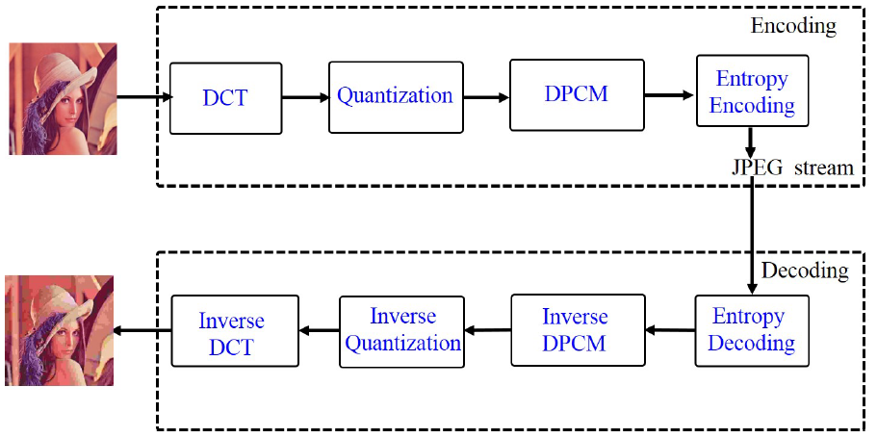
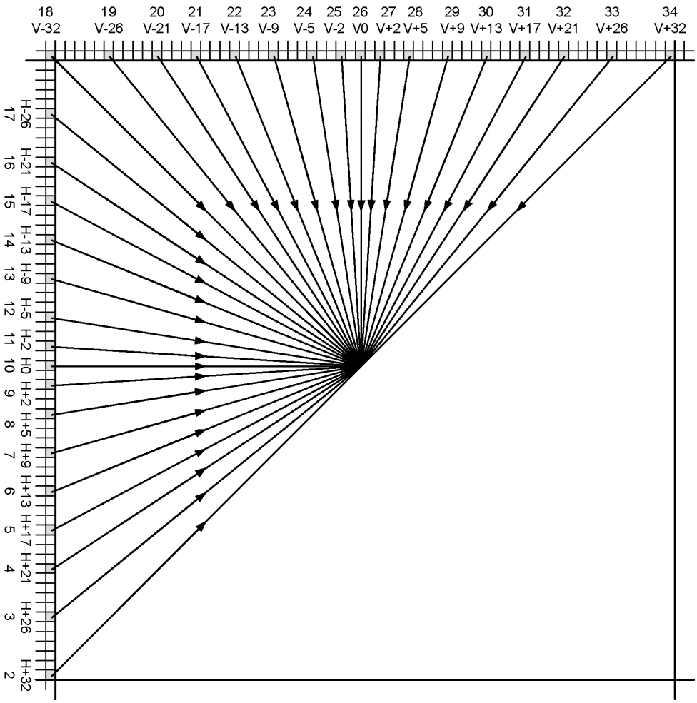
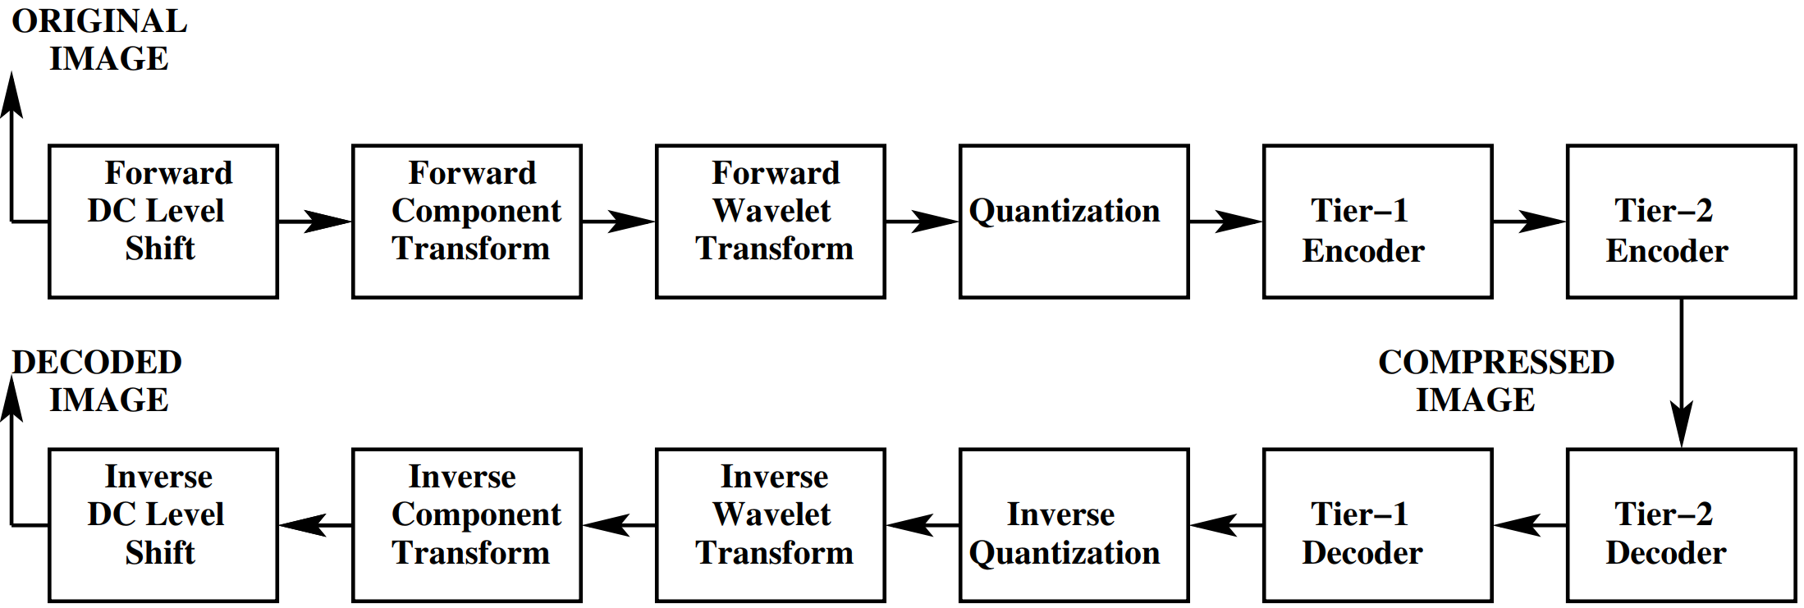
Background & Related Work
Existing image coding standards are locally optimized.
Hybrid framework
JPEG¹
JPEG2000²
HEVC Intra³
[1] Wallace G K. The JPEG still picture compression standard[J]. IEEE transactions on consumer electronics, 1992, 38(1): xviii-xxxiv.
[2] Lian C J, Chen K F, Chen H H, et al. Analysis and architecture design of block-coding engine for EBCOT in JPEG 2000[J]. IEEE Transactions on circuits and systems for video technology, 2003, 13(3): 219-230.
[3] Lainema J, Bossen F, Han W J, et al. Intra coding of the HEVC standard[J]. IEEE Transactions on Circuits and Systems for Video Technology, 2012, 22(12): 1792-1801.

Slide 3
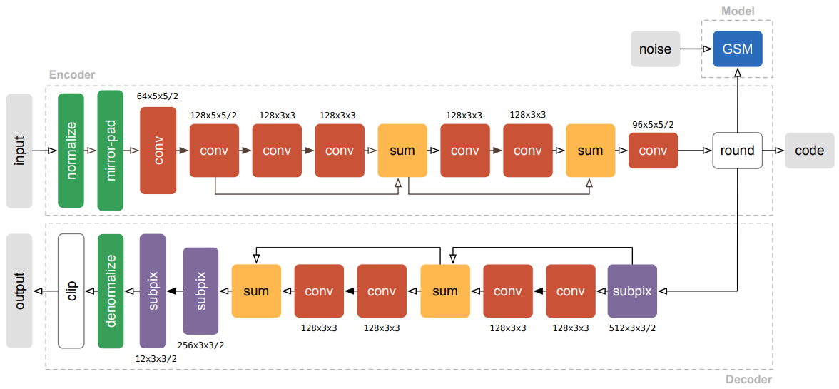
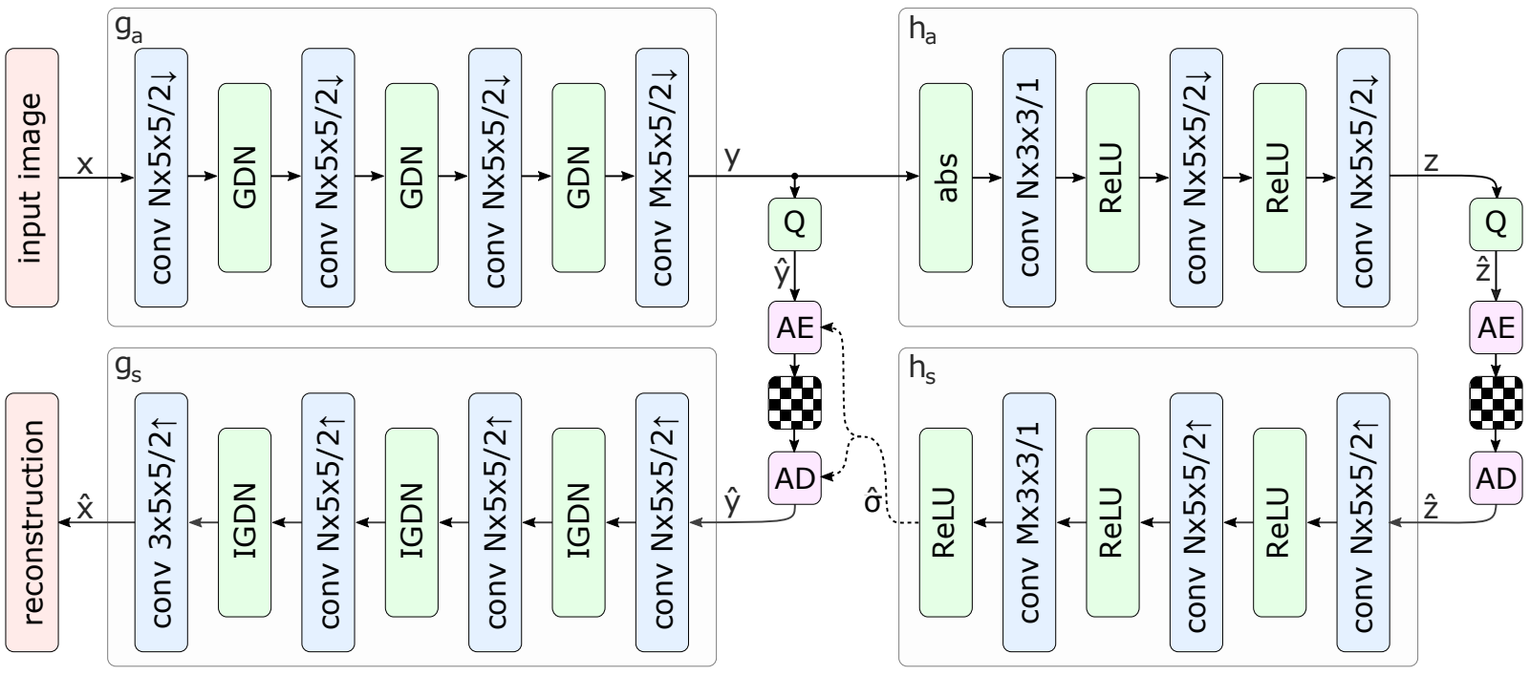
Background & Related Work
Learned image coding
Using an auto-encoder structure to generate features that describes the entire image
Features are quantized and entropy coded
Consider both image reconstruction error and rate during training
Theis et al, ICLR-2017
Balle et al, ICLR-2018

Slide 4
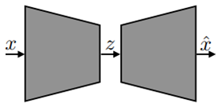
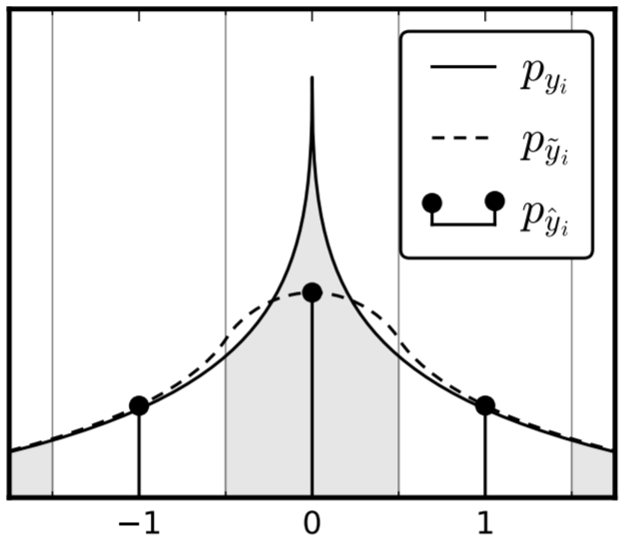
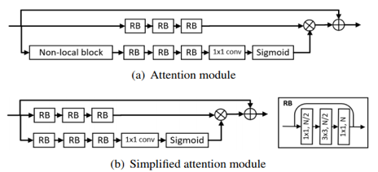
Non-linear Transform Coding
Key Problem: Entropy Model
$$\min_{θ}{D}, s.t. R≤R_{c}, R=−\sum{P\left({\hat{z}}_{i}\right)\log\left(P\left({\hat{z}}_{i}\right)\right)}, D=||x−\hat{x}||_{2}^{2}$$
Interpolation
Auto-regressive model + Hyper-prior
Channel attention + Mixture of Gaussian
Cheng Z, Sun H, Takeuchi M, et al. “Learned image compression with discretized gaussian mixture likelihoods and attention modules.” CVPR. 2020:
Balle J, Laparra V, Simoncelli E P. “End-to-end optimized image compression.” arXiv:1611.01704, 2016.
Minnen D, Balle J, Toderici D, ”Joint autoregressive and hierarchical priors for learned image compression.” NIPS, 2018:

Slide 5
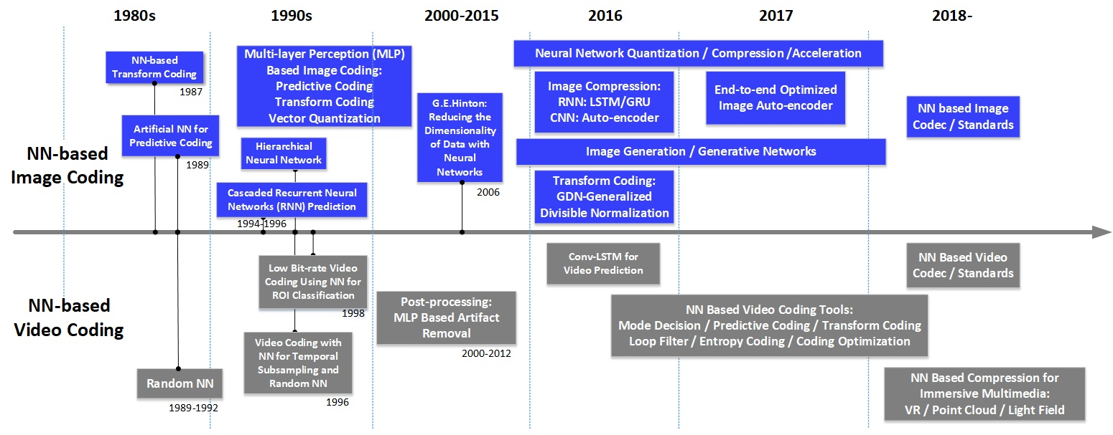
Background of Neural Image Compression (NIC)
S. Ma, X. Zhang, C. Jia, Z. Zhao, S. Wang, and S. Wang, “Image and video compression with neural networks: A review,” IEEE Transactions on Circuits and Systems for Video Technology, DOI: 10.1109/TCSVT.2019.2910119, 2019.

Slide 6
Drawback of Current NIC Approaches
Require one model for each bit-rate point.
High restoration burden
Limited bit-rate options

Slide 7
Contributions of This Paper
We address the issue of one-model-per-rate
Propose Binary Modulator and Modnet
Realize variable bit-rate coding
We study the R-λ model of NIC
Propose the exponential law
Verify our R-λ model by experiments

Slide 8
Table of Contents
Variable bit-rate coding
Binary modulator (BM)
R-λ model for NIC
Modnet
Theoretical analysis
Experiments

Slide 9
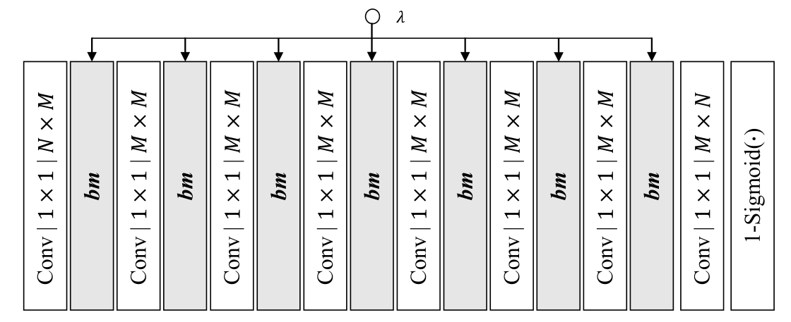
Modnet
Modnet is a sequence of several binary modulators and convolution layers.
Input: latent features of main transform
Output: masked latent features

Slide 10
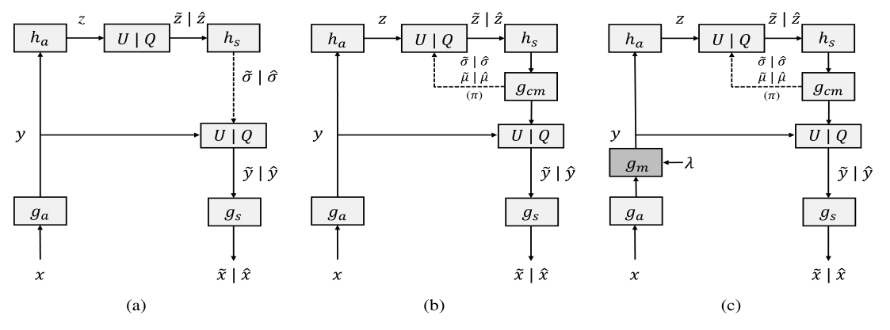
Operation diagram
Variational auto-encoder with scaled hyper-prior
Joint auto-regressive context model plus hyper-prior
Our scheme

Slide 11
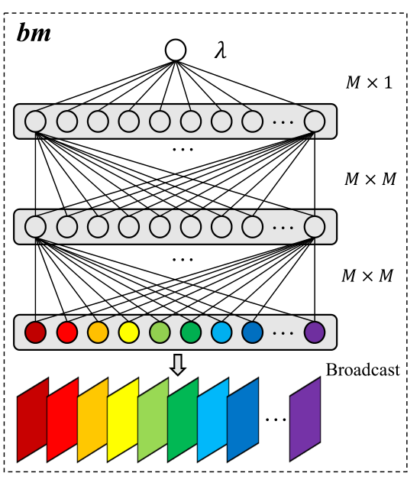
Binary Modulator (BM)
An element-wise 0-1 mask
The essence of the binary modulator is a
measurement of R-D tradeoff for each element.

Slide 12
How to Train Binary Modulator (BM)
An element-wise pass-or-mask threshold
The essence of the binary modulator is a
measurement of R-D tradeoff for each pixel.

Slide 13
Table of Contents
Variable bit-rate coding
Binary modulator (BM)
R-λ model for NIC
Modnet
Theoretical analysis
Experiments

Slide 14
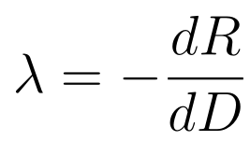
R-λ Model for NIC
Theoretical analysis
The training of neural network minimizes the loss function R+λD
Hypothesize R-λ obeys the exponential law
Solve the PDE

Slide 15
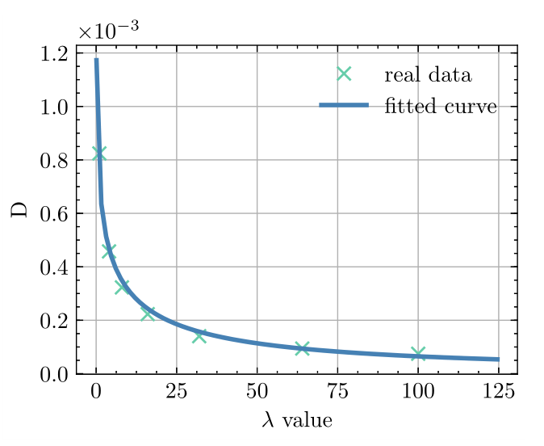
R-λ Model for NIC
Experimental verification of our hypothesis
Well Fitted!

Slide 16
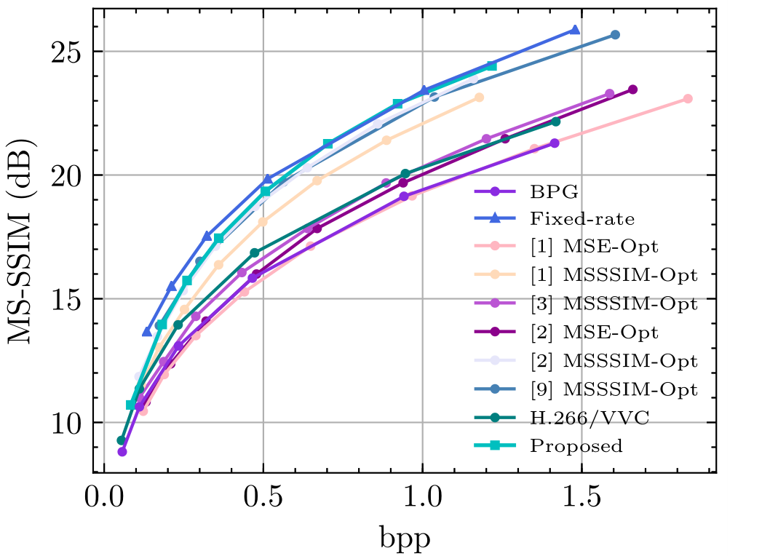
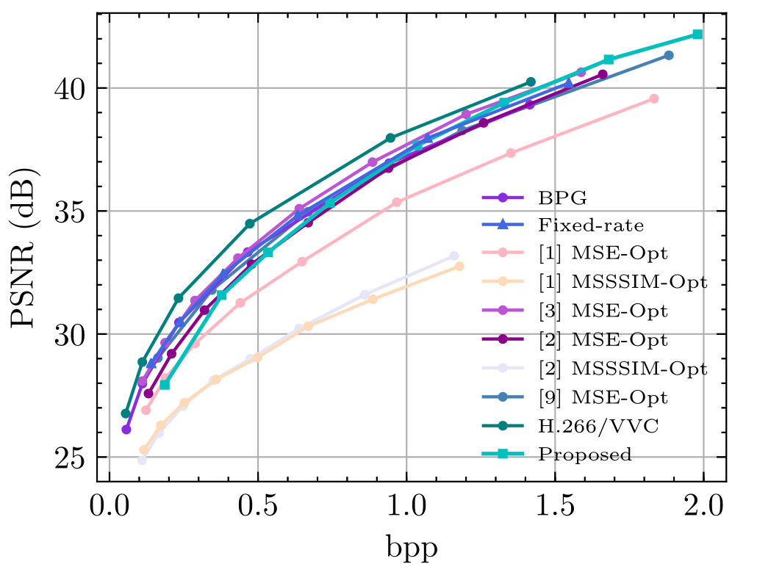
Performance of Variable Bit-rate Coding
Through the proposed BM and Modnet, we realize variable bit-rate coding with minor rate-distortion (RD) loss.
Kodak dataset

Slide 17
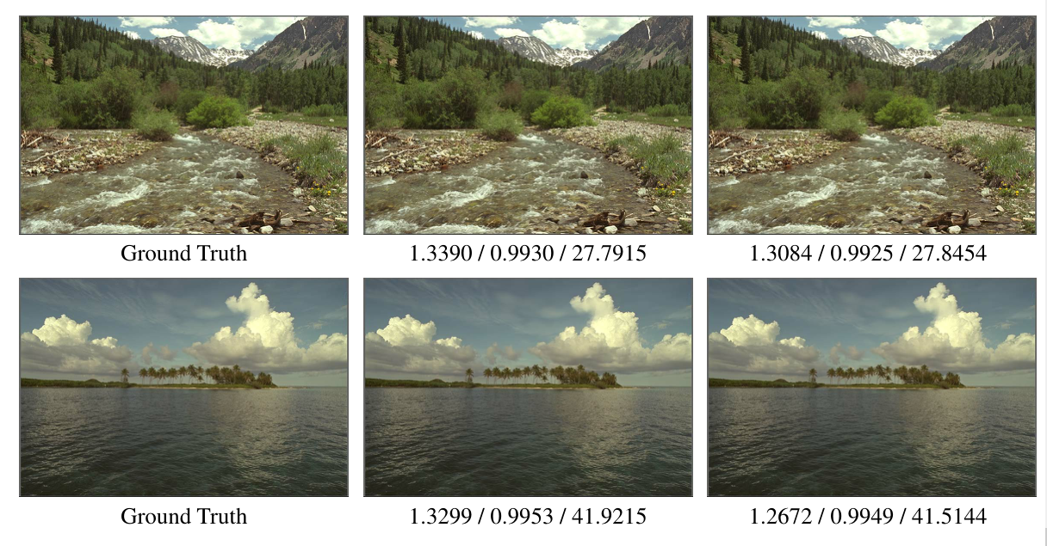
Some Visualizations of Our Variable Bit-rate Coding
Experimental verification of our hypothesis
Fixed rate
Variable rate

Slide 18
Thanks!

