Slide 1
Multi-Stream Scale-Insensitive Convolutional and Recurrent Neural Networks for Liver Tumor Detection in Dynamic CT Images
Dong Liang, Lanfen Lin, Xiao Chen. Zhejiang University
Hongjie Hu, Qiaowei Zhang, Qingqing Chen. Sir Run Run Shaw Hospital
Yutaro lwamoto, Xianhua Han, Yen-Wei Chen. Ritsumeikan University
E-mail:cs_cs_liangdong@zju.edu.cn
R RITSUMEIKAN

Slide 2
1
Introduction
2
Methodology
Content
3
Experiments
4
Conclusion
Notes:
Introduction:
background: describe the importance of liver cancer and its worth.
what is the multi-phase: describe the detail of the multiphase CT liver image.
The difficult of this problem. And the current method.
Our attribution.
Methodology:
Experiments

Slide 3
Introduction
Backgrounds
Multi-Stream Scale-Insensitive Convolutional and Recurrent Neural Networks (MSCR) for Liver Tumor Detection in Dynamic CT Images.
High mortality rate
Rapidly increasing the amount of dynamic CT scan
The CAD system has the potential to assist radiologists
Notes:
1、Liver cancer is the second most common cause of cancer-related deaths among men and sixty among women.
2、Ever-expanding patient data bring about burdens for clinical radiologists
3、A computer-aided diagnosis system has been verified to have the potential to assist radiologists in clinical diagnosis

Slide 4
Introduction
Backgrounds
Multi-Stream Scale-Insensitive Convolutional and Recurrent Neural Networks (MSCR) for Liver Tumor Detection in Dynamic CT Images.
Focus
Liver segmentation and lesions detection (Step 1)
CAD System
Representation of the detected lesions followed by classification (Step )

Slide 5
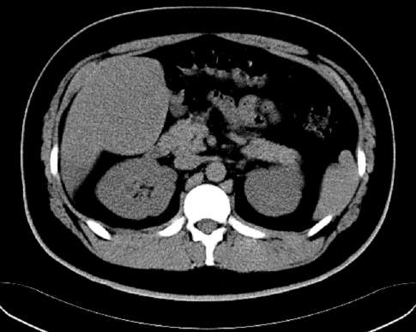
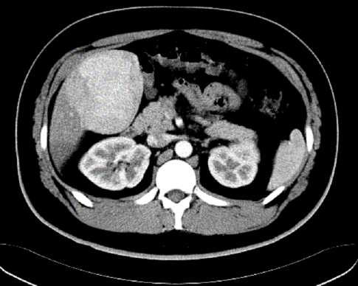
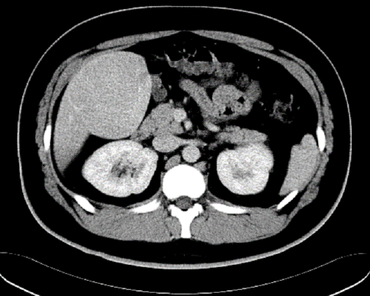
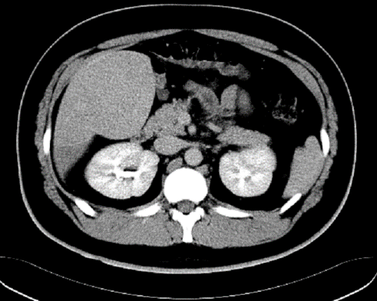
Motivation
Backgrounds
Multi-Stream Scale-Insensitive Convolutional and Recurrent Neural Networks (MSCR) for Liver Tumor Detection in Dynamic CT Images.
Contrast Injection
NC
ART
PV
DL
Before injection
30–40 s after injection
70–80 s after injection
3–5 m after injection
NC Phase
ART Phase
PV Phase
DL Phase
Notes:
CT is the most important imaging modality employed in detecting and characterizing focal liver lesions.

Slide 6
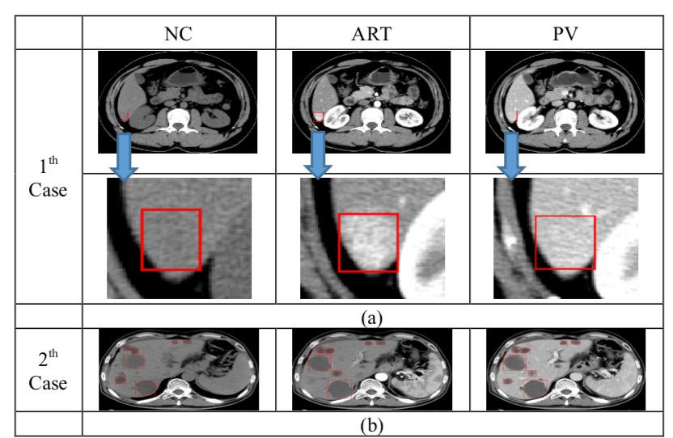
Motivation
Challenges
Multi-Stream Scale-Insensitive Convolutional and Recurrent Neural Networks (MSCR) for Liver Tumor Detection in Dynamic CT Images.
How to develop a method for effectively distilling enhancement patterns from the dynamic CT images which contains important clinical diagnosis information.
How to detect liver lesion with a widely variable scale is another challenge.

Slide 7
Motivation
Related Work
Object Detection
Faster RCNN [3] can set the anchor size to fit various object sizes. The IoU threshold determines whether two bounding boxes are merged.
For the different object scales, the SSD [4] fuses the convolutional feature maps from different stages to predict offsets and confidences. Second, for medical images
for medical images, Ke et al [5] proposed a 3D context-enhanced region-based convolutional neural network (CNN) (3DCE) to incorporate 3D context in 2D regional CNNs.
Yasaka et al. proposed a convolutional neural networks with three channels corresponding to three phases for classification.
The require a set anchor size to fit different datasets
Integrating Dynamic CT Images
The methods do not fully exploit the enhanced pattern hidden in the dynamic CT images.
Sanggil et al [6] proposed a grouped SSD to leverage multi-phase CT images using grouped CNNs containing a 1×1 convolutional layer to extract information.

Slide 8
Motivation
Contributions
Multi-Stream Scale-Insensitive Convolutional and Recurrent Neural Networks (MSCR) for Liver Tumor Detection in Dynamic CT Images.
Proposed MSCR framework which is insensitive to the size of liver tumors and can also effectively utilize 4D information.
Proposed GCLSTM block to extract the enhancement information from multi-phase CT images.
Notes:
We propose the MSCR framework, which is insensitive to the size of liver tumors and can also effectively utilize 4D information.
We propose the use of grouped convolutional long short-term memory (GCLSTM) to extract the enhancement information from multi-phase CT images.
Experimental results show that the proposed method achieves superior performance compared to state-of-the-art approaches.

Slide 9
1
Introduction
2
Methodology
Content
3
Experiments
4
Conclusion

Slide 10
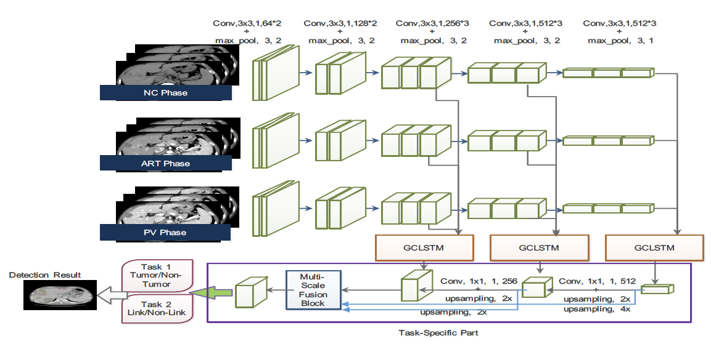
Methodology
Flowchart of the MSCR Net
Notes:
We tackle the tumor detection task as the segmentation task which need not set the anchor size. Multi-scale features are fused together to realize scale-insensitive tumor detection

Slide 11
Methodology
Flowchart of the GCLSTM block
Notes:
We use the grouped convolutional long short-term memory (GCLSTM) to extract the enhancement information from multi-phase CT images.

Slide 12
Methodology
The Joint Loss Function
instance-balanced weight is adopted to make the balance between tumors with different scale.
Multi-task training strategy is used to optimize the proposed netrowk.

Slide 13
1
Introduction
2
Content
Methodology
3
Experiments
4
Conclusion

Slide 14
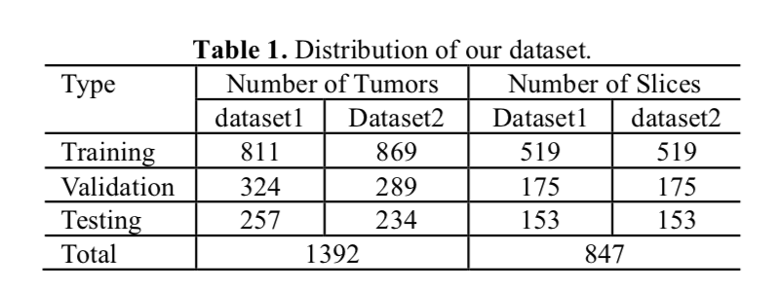
Experiments
Dataset
A total of 847 CT liver slice images containing 1392 tumors are used, which are extracted from the 130 patients’ scans (volumes).
Notes:
A total of 847 CT liver slice images containing 1392 tumors are used, which are extracted from the 130 patients’ scans (volumes). In order to incorporate 3D context information, the slice image with its two neighboring slices (z-1 and z+1) are used as one data. Thus, our approach is a 2.5D method [5]. The distribution of our dataset is shown in Table 1.

Slide 15
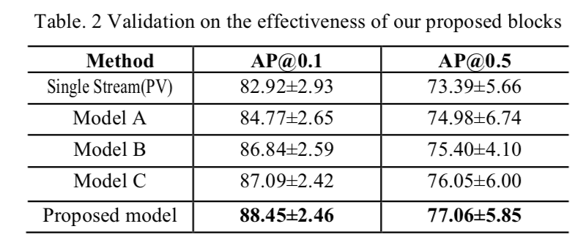
Experiments
Ablation Study
Methods | Multi-scale Feature fusion | GCLSTM
Model A
Model B | ○
Model C |  | ○
Proposed Medthod | ○ | ○
It can be seen that the proposed model outperforms the other models.
Both the GCLSTM and the multi-scale feature fusion block significantly improve the performance.
Notes:
The results are shown in Table 2. It can be seen that the proposed model outperforms the other models. That means both the GCLSTM and the multi-scale feature fusion block significantly improve the performance and they are effective for liver tumor detection in multi-phase CT images.

Slide 16
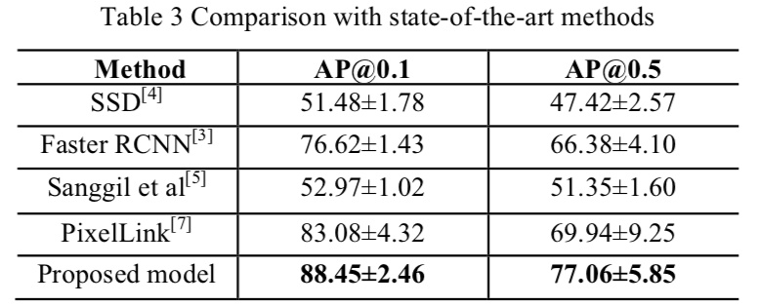
Experiments
Comparison to other methods
Notes:
SSD [3]: This approach utilizes several feature layers for the end of a base network (e.g. VGG16), which predict the offsets for default boxes of different scales and aspect ratios and their associated confidences.
Faster RCNN [4]: This approach performs the detection via a two-stage method. In the first stage, the anchor size is set to (8, 16, 32).
Lee. et al. [6]: As mentioned in the Section 1, this approach is based on multi-stream SSD to process multi- phase CT images.
PixelLink [5]: In this method, the link concept is developed to resolve the overlap problem.

Slide 17
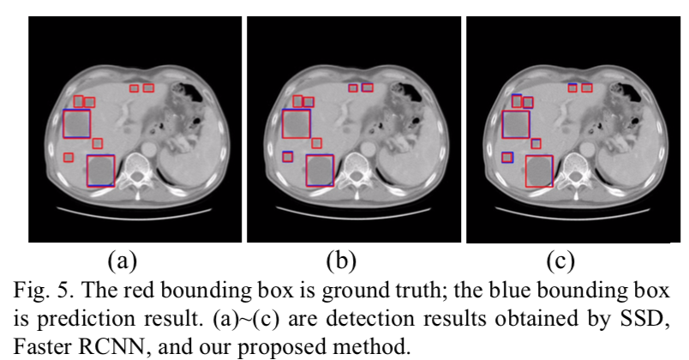
Experiments
Visualization

Slide 18
Experiments
Visualization

Slide 19
1
Introduction
2
Methodology
Content
3
Experiments
4
Conclusion

Slide 20
Conclusion
We proposed a scale-insensitive method to perform liver tumor detection in multi-phase CT images and GCLSTM block.
The experimental results demonstrated that our framework outperforms other state-of-the-art methods.
A larger-scale liver lesion dataset and the ability to classify tumor objects.
Notes:
- We proposed a scale-insensitive method to perform liver tumor detection in multi-phase CT images. Moreover, we extract enhancement patterns among three phases via GCLSTM. We also proposed a feature-fusion block to fuse different features extracted from different stages.
- The experimental results demonstrated that our framework outperforms other state-of-the-art methods.
- In the future work, we plan to build a larger-scale liver lesion dataset. We also aim to improve the proposed model by incorporating the ability to classify tumor objects.

Slide 21
?
T
hank
you
R RITSUMEIKAN

