Slide 1
中国科学院 声学研究所
Institute of Acoustics, Chinese Academy of Sciences
The ThinkIT System for ICASSP2021 M2VoC challenge
Zengqiang Shang, Haozhe Zhang, Ziyi Chen, Bolin Zhou, Pengyuan Zhang
Key Laboratory of Speech Acoustics and Content Understanding, Institute of Acoustics, CAS, China
University of Chinese Academy of Sciences, Beijing, China
IEEE ICASSP 2021
Notes:
Hello, everyone! My name is Shang Zengqiang. I came from Key Laboratory of Speech Acoustics and Content Understanding in the Institute of Acoustics, Chinese academy science. Today, I will introduce our submitted system to ICASSP 2021 multi-speaker multi-style voice cloning challenge.

Slide 2
Outline
Background
Introduction
M2VoC Challenge description
System description
Results
Notes:
We wil present in the following points.

Slide 3
Background:
Current TTS are contrained in several aspects:
Large amount of training data
Consistent speaking style
High-quality recording environment
Voice cloning pose a important role in the scene of smart home
Provide personalized customization tts
Reduce building costs
Notes:
Contempory speech synthesis system have obtain good performance but constrained in several aspects; including large amount of training data, consistent speaking style and high-quality recording environment. The M2VoC challange are hold to dealing with low-resource conditon, refered as voice cloing. The M2VoC challenge is the first told to provide a common sizable dataset as well as a fair testbed for benchmarking the voice cloning task. voice cloning pose a important role in the scene of smart home. it aims to reducing building costs and provide personalized customization tts

Slide 4
Introduction: previous method
Speaker embedding versus speaker adaptation
Mels
Mels
Decoder
Decoder
Speaker
Encoder
Encoder
Encoder
text input
text input
Pertrained speaker embedding
Discriminative model
Generative model: (Adain-VC VQVC)
Jointly trained speaker embedding
Finetune whole parameters
Only decoder
Notes:
Fewshot approaches for TTS are roughly divided into two categories. Including speaker embedding and speaker adaptation.
Speaker information can be disentangled and represented by the speaker embedding such as i-vector, d-vector, or x-vector, which are all byproducts of speaker recognition systems. This approach has a computational advantage in that it does not involve an optimization loop. The speaker similarity seems to stop improving when more than a few seconds of speech is used. Not robust, low speaker similarity
For speaker adaptation method. The initial model can be trained on the data of single or multi speakers. The fine-tuning can produce a high-quality model when data of the target speaker is sufficient. But when data are limited, we can restrict the tuning to specific components instead of the entire network to prevent over-fitting. it requires the additional fine-tuning process.

Slide 5
Outline
Background
Introduction
M2VoC Challenge description
System description
Results
Notes:
We wil present in the following points.

Slide 6
Challenge description:
M2VoC (ICASSP2021 Signal Processing Grand Challenge)
The challenge has two tasks: Few-shot track1 provides 100 samples for each person and one-shot track2 offers 5 samples only. Each track contains two sub-tracks A and B. Instead of sub-track A, sub-track B can use extra public data besides the released data
Track1 evaluates three aspects, including quality, similarity, and style, while Track2 only evaluates quality and similarity.

Slide 7
Outline
Background
Introduction
M2VoC Challenge description
System description
Results
Notes:
We wil present in the following points.

Slide 8
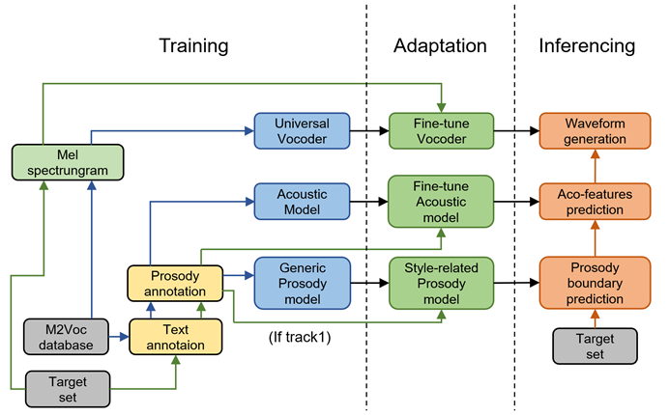
System description: workflow
Notes:
our system consists of three parts, training, adaptation, and synthesis. We first preprocess the origin data at the training phase and then train our generic prosody boundary prediction model, multi-speaker acoustic model, and universal vocoder model based on this preprocessed data. In the adaptation phase, we adapt to a pre-train acoustic model using the target set and finetune the vocoder. Besides, we also finetune the prosody boundary prediction model using the text of style set for track1. At the synthesis phase, we first do the text analysis, which converts the test manuscript to phoneme sequence with prosody boundary. The acoustic model and the vocoder model are used to get the final synthesized waveforms.

Slide 9
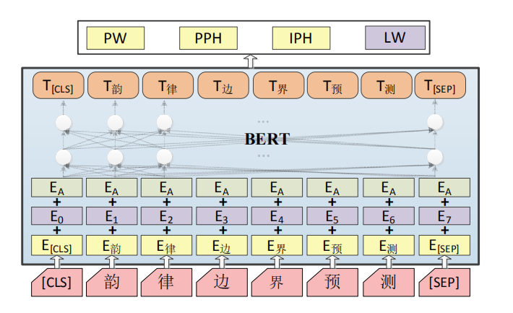
System description:
Prosody boundary prediction network
including prosodic word (PW), prosodic phrase (PPH), short sentence (SS), and long sentence (LS),
Notes:
following our previous work, we treated hierarchical prosodic boundary prediction as related tasks and predicted them simultaneously by using multitask learning. Specifically, for each task, we added a task-specific output layer to a pre-trained BERT model.

Slide 10
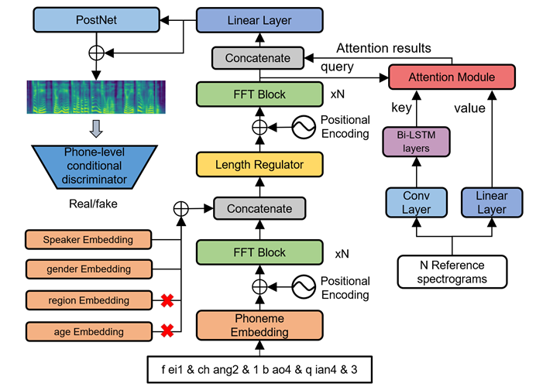
System description:
Acoustic model
Notes:
We also made some optimization on the basicFastSpeech model for a few-shot synthesis.
First, we use speaker-related prior knowledge when generating, like gender, age and region.
Second, a fine-grained encoder is add at the decoder’s tailor. which extracts variable-length detail style information from multiple reference samples via an attention mechanism.
Third, another phone-level condition discriminator to amend the mismatch between real and predicted Mel-spectrogram.
When adapting to a new voice, we fix the phoneme encoder’s parameter and continue train the rest of the model parameters.

Slide 11
System description:
Universal Vocoder
We modified HIFIGAN to 24k sampling rate.
Due to Mel spectrogram’s mismatch between training and inferencing, We use the features generated by the acoustic model for fine-tuning the vocoder to alleviate resonance noise.
We adopted the linear schedule with warmup from hugging face Transformer for fine-tuning vocoder.

Slide 12
Outline
Background
Introduction
M2VoC Challenge description
System description
Results
Notes:
We wil present in the following points.

Slide 13
Results: Subjective evaluation
Quality: our system (T15) achieves an average score of 4.02 (rank 4th) and 3.96 (rank 2nd) in the combined results of Track 1a and Track 2a.
Similarity: our system achieves an average score of 4.14 (rank 3rd) and 3.13 (4th) in the combined results of Track 1a and Track 2a.
Style: our system achieves an average score of 4.12 in the combined results of Track 1a. Among the 18 systems participating in this track, our system is outperformed by only one system (T22).
Notes:
Challenge organizers evaluate the system in quality, similarity and style.
For quality performance,
For similarity performance,
For style performance,

Slide 14
Results: Accuracy on prosody boundary prediction
For example, repeated words like “我我” frequently appear in TT_chat. After finetuning,PPH are more likely to appear within repeated words which is line to her speaking habit.
Notes:
As shown in table 1 evaluation on splited style set indicates finetuning the BERT-based four-level prosody boundary model for the style set improves the accuracy of style-related prediction.

Slide 15
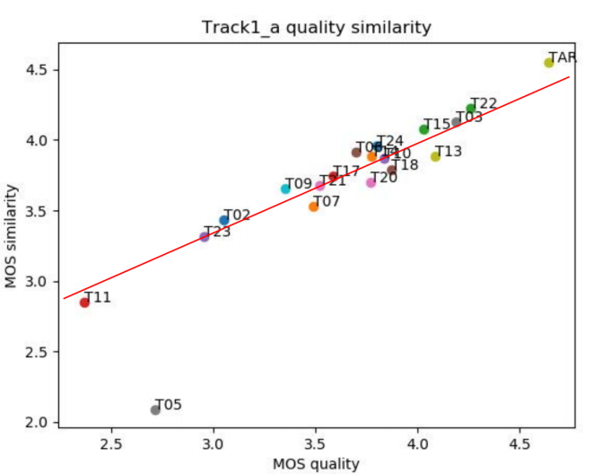
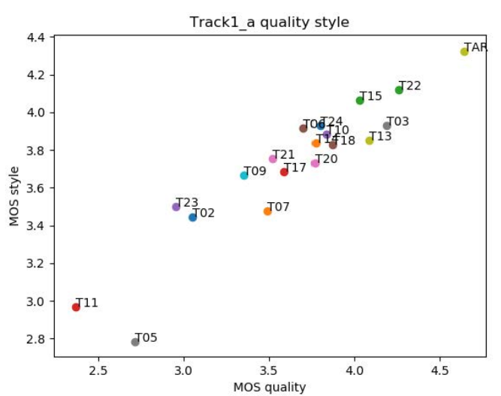
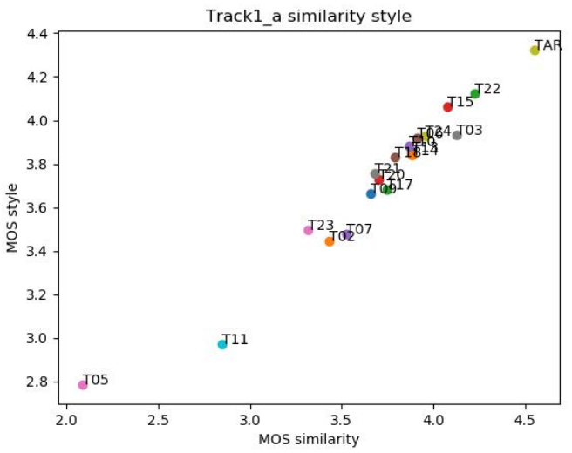
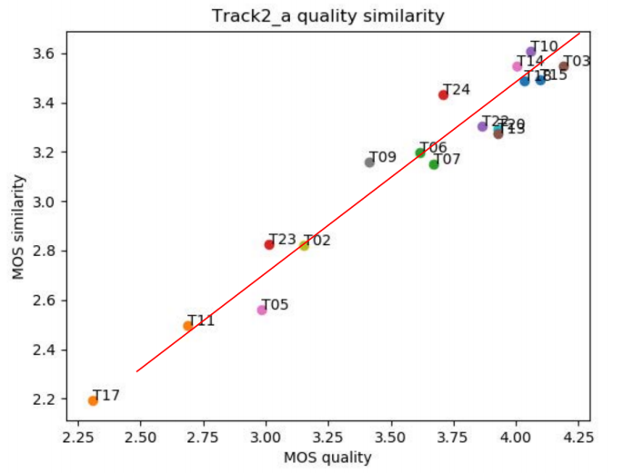
Results: Analysis of fitting situation
Notes:
it is the MOS scatter plot on track1 and track2. It can be seen that the variance of the scatter plots is large in quality-style and quality-similarity, while small in style-similarity plot, which shows that there is a strong correlation between style and similarity scores.
Comparing the quality-similarity distributions, our system T15 is above the red line on track1 and below the red line on track2. It indicates that the similarity of the model for track1 is slightly higher than the sound quality, while it is the opposite in track2, which is consistent with our selected model. Our models for track1 are finetuned around 2000 steps. However, models for track2 are around 200 steps finetuned with a little bit of underfitting.

Slide 16
Thanks！
Notes:
Thanks for your listening

