Slide 1
Introduction
Optimization Model
Unfolding Scheme
Experiment results
Conclusion
HMNet: Hierarchical Microscale-aware Network for Infrared Small Target Detection
Yueqian Quan, Honghui Xu, Yidong Yan, Hang Zheng, Jianwei Zheng*
Notes:
Hello everyone, good afternoon, I am glad to have the opportunity to give a lecture. I come from Zhejiang University of Technology. The topic of our paper is titled "Hierarchical Microscale-aware Network for Infrared Small Target Detection." First, let me briefly introduce the concept of small targets in infrared images.

Slide 2
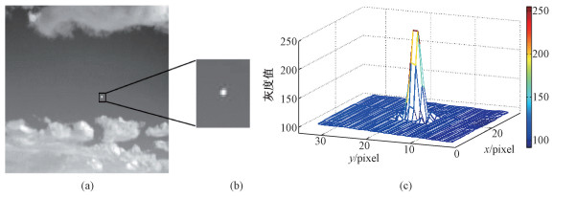
Introduction
Optimization Model
Unfolding Scheme
Experiment results
Conclusion
Infrared small target detection
Background and motivations
Infrared small target detection
Infrared images
Target region
3D distribution map
The weak target appears centrosymmetric and radial in shape, resembling a two-dimensional Gaussian function!
$$f_{T}(x,y)=A∙exp1\{−\frac{1}{2}[{(\frac{x−x_{c}}{θ_{x}})}^{2}+{(\frac{y−y_{c}}{θ_{y}})}^{2}]\}$$
Notes:
When an infrared target occupies an area no larger than 9 pixels × 9 pixels, it's termed as an infrared small target. As illustrated in the figure, such weak targets typically appears centrosymmetric and radial in shape, resembling a two-dimensional Gaussian function. Detecting small targets in infrared images presents unique challenges, despite their widespread applications in real-world scenarios such as early warning systems, precision guidance, and autonomous driving.

Slide 3
Introduction
Optimization Model
Unfolding Scheme
Experiment results
Conclusion
Infrared small target detection
Background and motivations
Infrared small target detection
Small Size
Low contrast
Noisy environment
Detecting infrared small targets presents distinctive challenges!
Notes:
As shown in the figure, firstly, due to long imaging distances, infrared small targets appear extremely tiny within the overall scenes. Secondly, infrared small targets easily blend into cluttered backgrounds due to low contrast. Additionally, atmospheric scattering, refraction, and sensor misalignment contribute to low signal-to-noise ratios in infrared images. so these factors make infrared small targets detection an extremely challenging task.

Slide 4
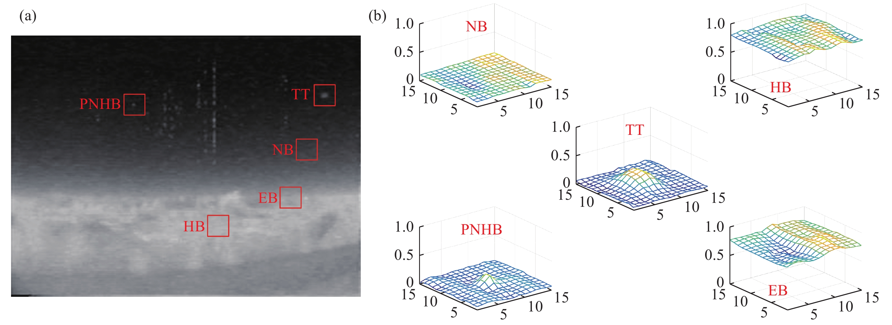
Introduction
Optimization Model
Unfolding Scheme
Experiment results
Conclusion
Infrared small target detection
Background and motivations
Infrared small target detection
TT: True Target; NB: Normal Backgrounfd; HB: High-brightness Background;
EB:Edge of Background; PNHB: Pixel-sized Noise with High Brightness;
The real target typically appears as clustered, with varying gray levels, gradually fading from the center outward.
Notes:
Next, let's analyze the characteristics of infrared small target images. As seen in this figure, compared to NB, HB, EB, and PNHM, infrared small targets typically appear clustered, with varying gray levels, gradually fading from the center outward.

Slide 5
Introduction
Optimization Model
Unfolding Scheme
Experiment results
Conclusion
Infrared small target detection
Background and motivations
Background and motivations
Traditional methods:
filtering-based
local contrast-based
low rank-based
suppress external disturbance and focus on target regions
utilize differential information to inhibit background
interferences
rely on visual properties of given inputs to collect target contour
Dependency on prior knowledge
Uncertain performance in cluttered, noisy images.
Notes:
Based on this characteristic, many traditional methods have been proposed, such as filtering-based, local contrast-based, and low rank-based approaches. However, these methods rely on manually set prior knowledge and exhibit unstable performance in cluttered, noisy images.

Slide 6
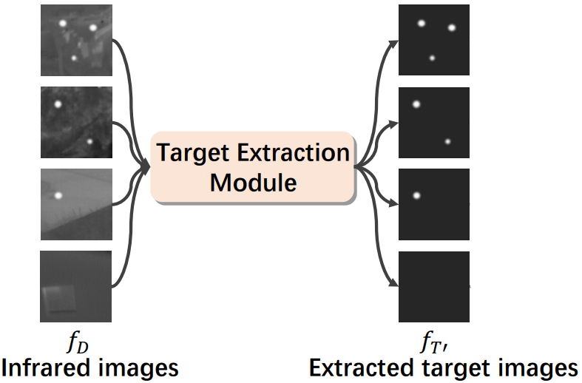
Introduction
Optimization Model
Unfolding Scheme
Experiment results
Conclusion
Infrared small target detection
Background and motivations
Background and motivations
CNN-based methods:
data-driven manner
deep network
Due to the small size of infrared small targets, multiple down-sampling operations can lead to target loss, which is irreversible
Limited by the local receptive field of the convolution operation, and lack the ability of global information perception
Unable to avoid target loss and background interference.
Notes:
Subsequently, CNN-based methods have also been introduced to this task. Due to the small size of infrared small targets, multiple down-sampling operations can result in irreversible target loss. Additionally, the limited receptive field of CNN methods prevents the establishment of global information perception, leading to weak recognition capabilities for targets with scale variations. These issues render CNNs unable to avoid target loss and background interference.

Slide 7
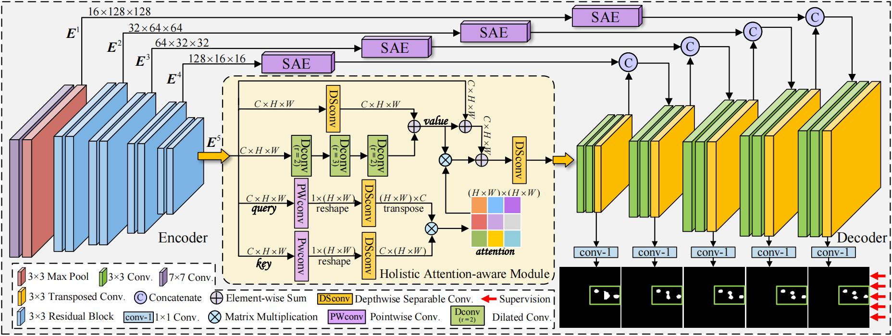
Introduction
Optimization Model
Unfolding Scheme
Experiment results
Conclusion
Framework
Framework
The Hierarchical Microscale-aware Network following an encoder-decoder framework.
The HAA module is utilized for global context modeling to enhance targeting precision.
Input
Notes:
Motivated by these considerations, we aim to design a network with global information perception capabilities while possessing good adaptability to multi-scale targets. The diagram illustrates the overall framework of our network. Following the encoder-decoder architecture, we introduce a holistic attention-aware (HAA) module. It splits the encoder's output into five branches, conducts attention computations internally, and outputs them as input to the encoder. This effectively integrates global context from self-attention with local features extracted by convolutional operations.

Slide 8
Introduction
Optimization Model
Unfolding Scheme
Experiment results
Conclusion
Unfolding components
The SAE module s used to refine texture information.
To dynamically extract multi-scale features across various receptive field sizes, the input feature undergoes convolutional operations in layers with multiple kernel sizes.
Notes:
To address issues such as low signal-to-noise ratio and insufficient texture details in the feature maps, we have incorporated an SAE module into the skip connections. The SAE module employs multi-scale feature adaptive fusion and attention mechanisms to enhance edge precision and spatial detail. To extract multi-scale features across different receptive field sizes, the input feature undergoes convolution in layers with different kernel sizes. Subsequently, the feature passes through channel and spatial attention units.

Slide 9
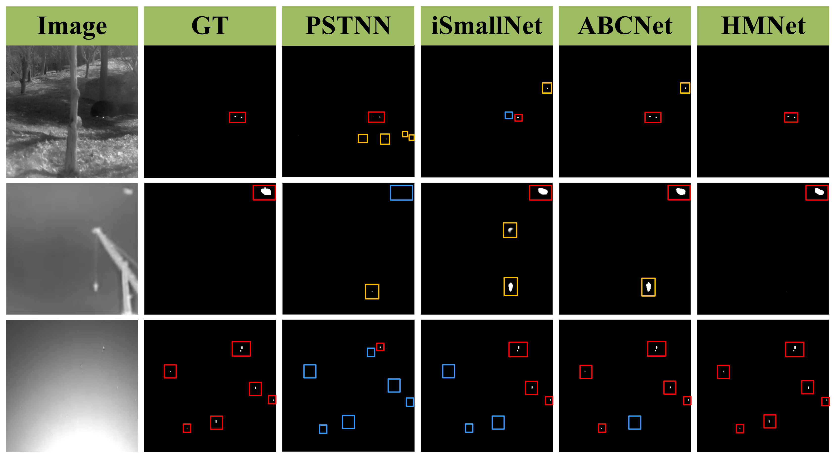
Introduction
Optimization Model
Unfolding Scheme
Experiment results
Conclusion
Experiment results
Red box: correct detection
Yellow box: false
detection
Blue box: missed detection
Notes:
We compared our method with some state-of-the-art algorithms, and here are our experimental results. In the results, the red box represents correct detection, the yellow box represents false detection, and the blue box represents missed detection. Our HMNet demonstrates the capability to detect extremely small and dim targets, achieving precise target localization and shape segmentation.

Slide 10
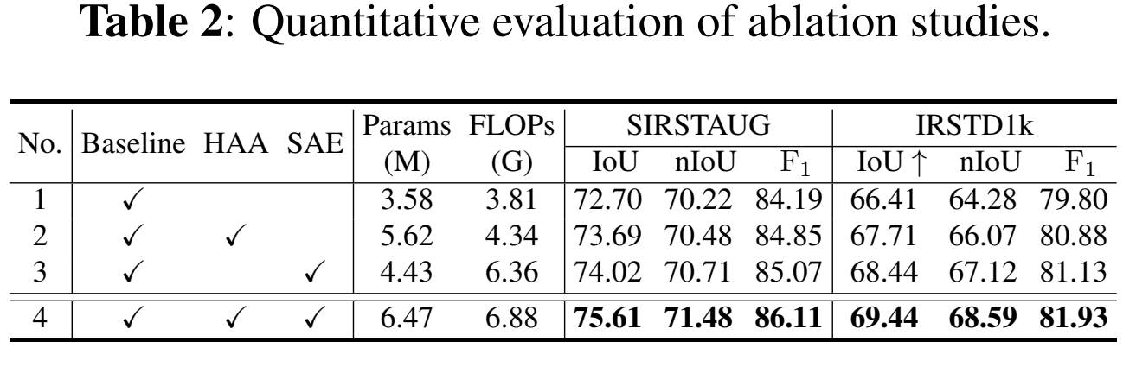
Introduction
Optimization Model
Unfolding Scheme
Experiment results
Conclusion
Experiment results
Notes:
Table 1 presents the experimental results on three datasets, showing that our method leads in almost all metrics, except for the nIoU metric on the NUAA dataset, possibly due to the limited number of images in the NUAA dataset, leading to potentially unstable results. Tables 2 and 3 show some of our ablation experiments, involving the usage of certain modules and hyperparameters, which helped us determine the final network architecture.

Slide 11
Thanks
Email: qyq@zjut.edu.cn
Notes:
That’s all for my presentation. please feel free to contact me.

