Slide 1
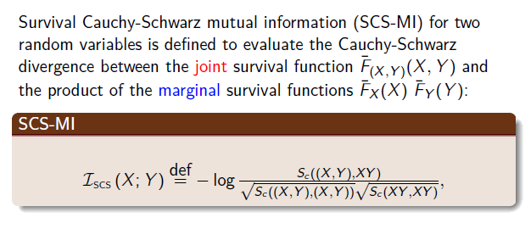
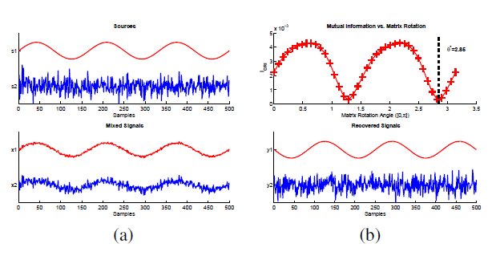
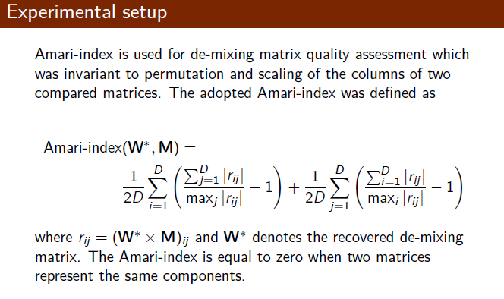
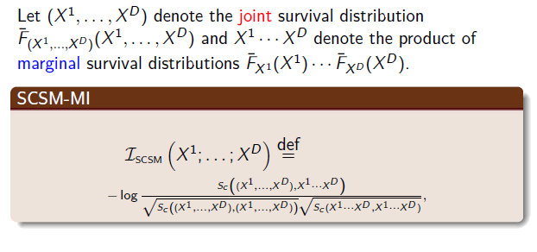
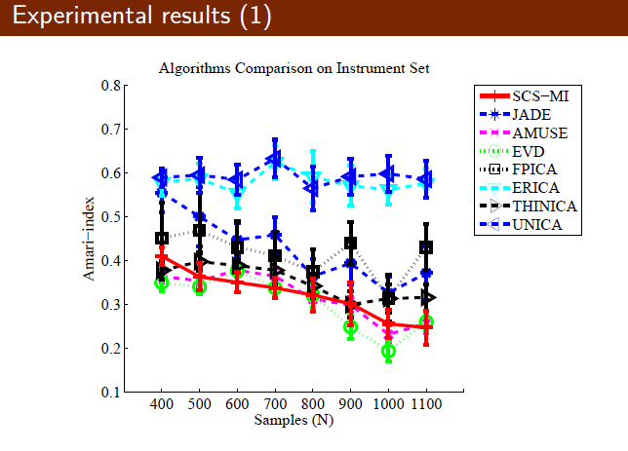
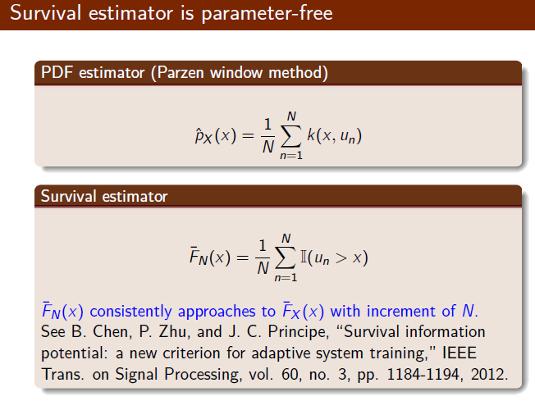
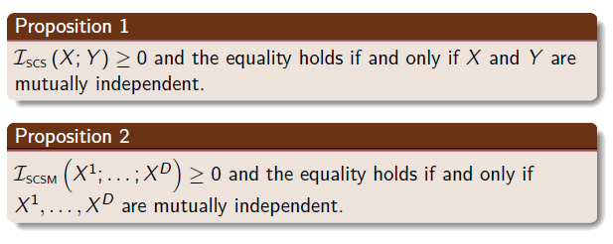
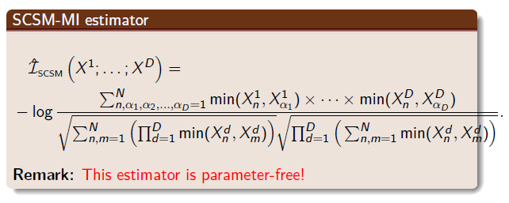
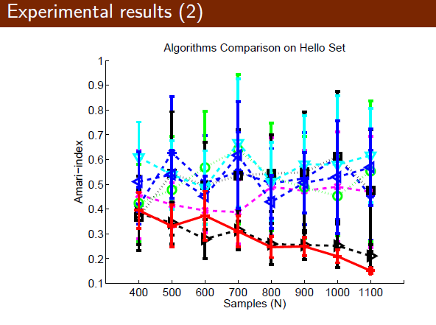
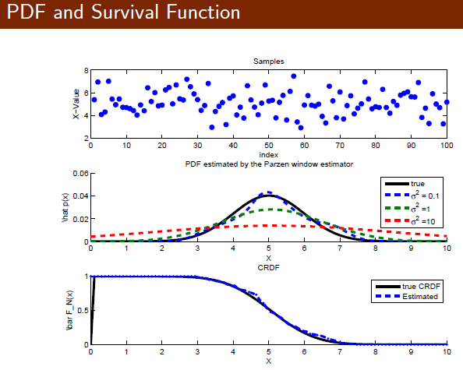
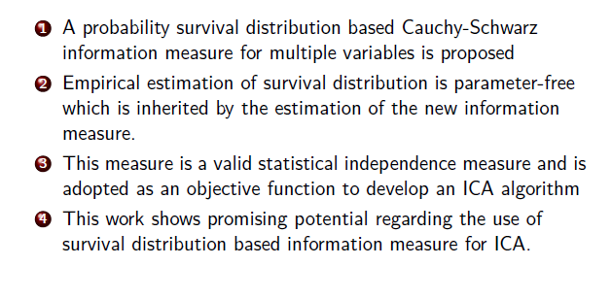
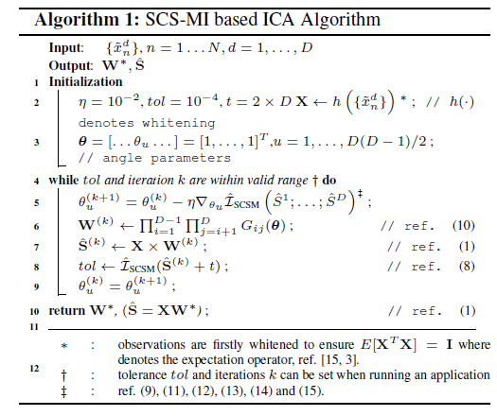
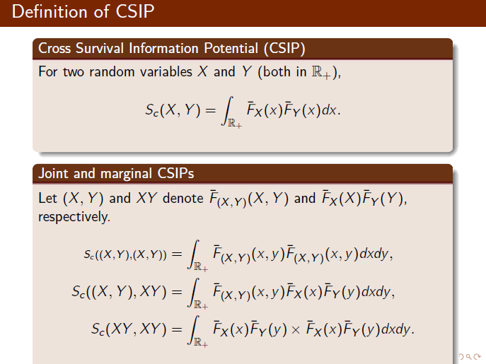
A Parameter-Free Cauchy-Schwarz Information Measure for Independent Component Analysis
Lei Sun†, Badong Chen‡, Kar-Ann Toh⋆, Zhiping Lin⁺
† Beijing Institute of Technology, Beijing 100081, PR China. (e-mail: sunlei@bit.edu.cn) ‡ Xi’an Jiaotong University, Xi’an 710049, PR China.
⋆ Yonsei University, Seoul 120-749, Republic of Korea. + Nanyang Technological University,Singapore 639798, Singapore.
Abstract
Independent component analysis (ICA) by an information measure has seen wide applications in engineering. Different from traditional probability density function based in formation measures, a probability survival distribution based Cauchy-Schwarz information measure for multiple variables is proposed in this paper. Empirical estimation of survival distribution is parameter-free which is inherited by the estimation of the new information measure. This measure is proved to be a valid statistical independence measure and is adopted as an objective function to develop an ICA algorithm which is validated by an experiment. This work shows promising potential regarding the use of survival distribution based information measure for ICA.
Method
Experiments
Outline
Parameter-free survival distribution estimation
Survival Cauchy-Schwarz Mutual Information (SCS-MI) is a valid Statistical Independence measure
An empirical SCS-MI estimator for multiple variables
Proposed ICA algorithm based on SCS-MI estimator
Experimental result and conclusion
Algorithm
Conclusion
References
[1] B. Chen, P. Zhu, and J. C. Principe, “Survival informa-
tion potential: a new criterion for adaptive system train-
ing,” IEEE Trans. on Signal Processing, vol. 60, no. 3,
pp. 1184–1194, 2012.
[2] B. Chen, N. Zheng, and J.C. Principe, “Survival k-
ernel with application to kernel adaptive filtering,” in
The 2013 International Joint Conference on Neural Net-
works. IEEE, 2013, pp. 1–6.

