Slide 1
Deep Learning Architecture for Pedestrian 3-D Localization and Tracking using Multiple cameras
KiKyung Kim, Byeongho Heo, Moonsub Byeon, Jin Young Choi

Slide 2
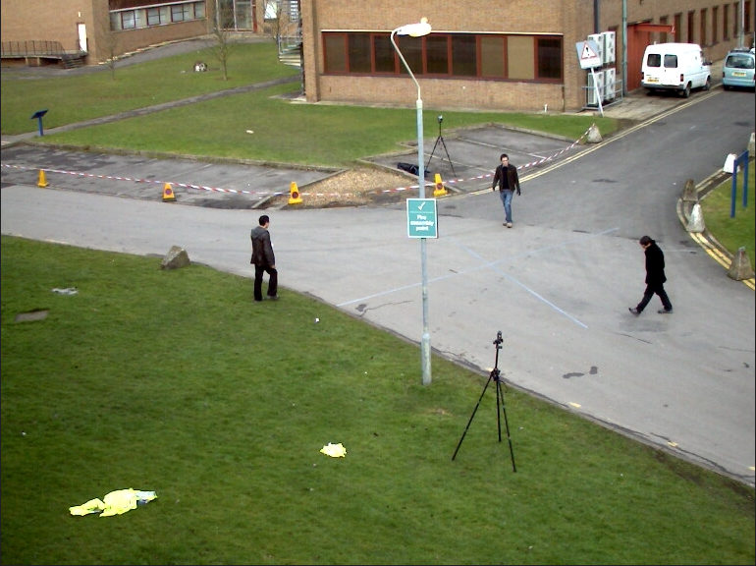
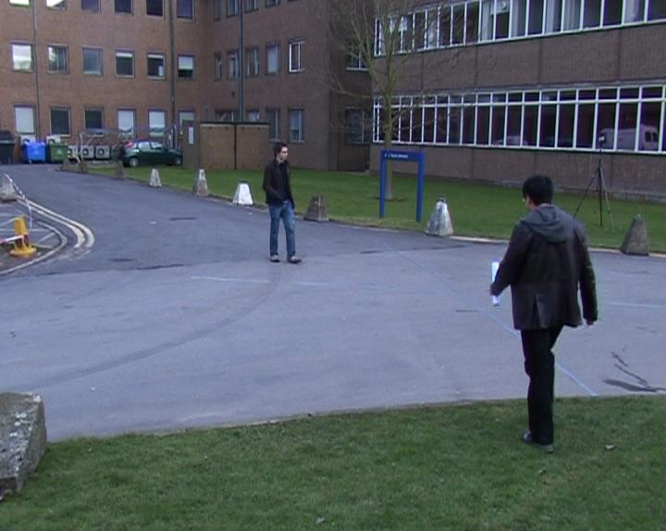
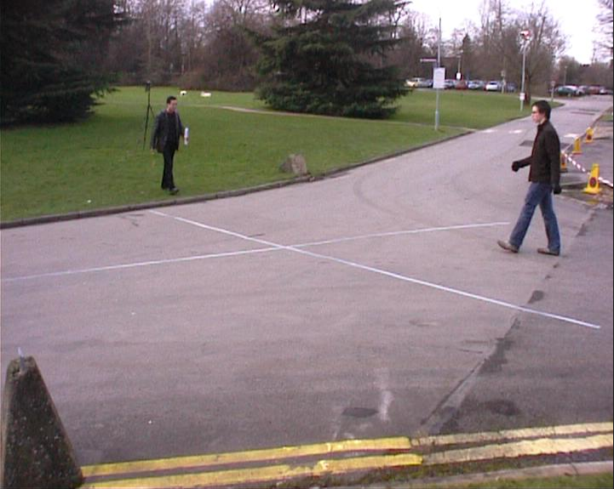
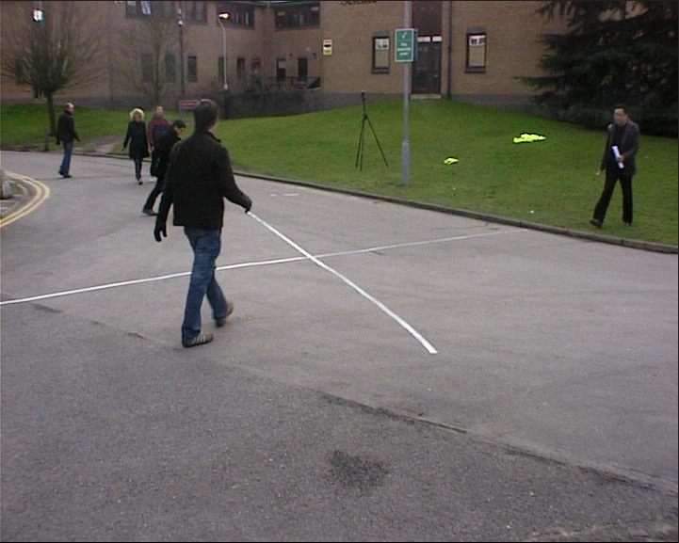
Introduction
Multi-Camera Multi-Target Tracking?
Multi-Camera
Multi-Target

Slide 3
Introduction
Tracking-by-Detection framework
2. Solve data association problem.
1. Find pedestrian in images.
3. Multi-target labeling

Slide 4
Introduction
In tracking-by-detection framework, detection performance is an crucial factor of tracking performance.
Recall
Precision
How accurately detector find the 2-D and 3-D position of a person (Localization)
In this paper, we focus on the fact that finding the precise 3-D position of the pedestrian affects the tracking performance.

Slide 5
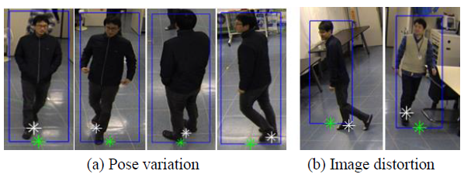
Introduction
Previous tracking-by-detection framework methods use the bottom center of bounding box.
Assume that the bottom center of bounding box represents the grounding position of pedestrian
Usually, this assumption is not true.

Slide 6
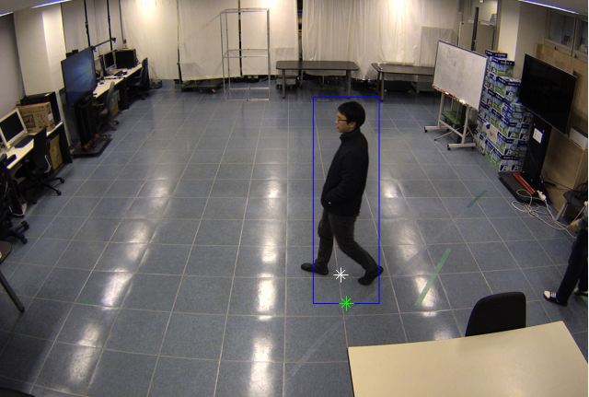
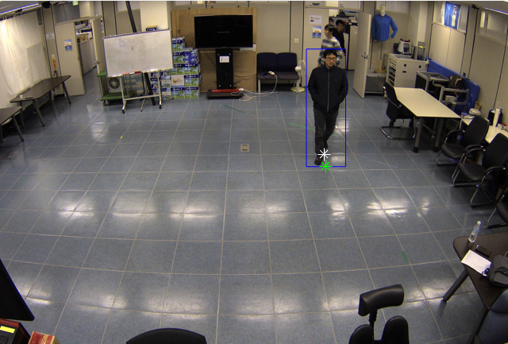
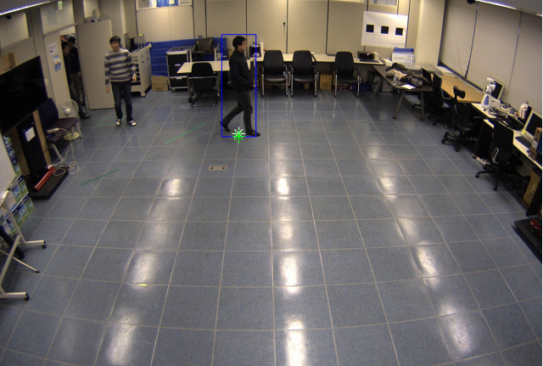
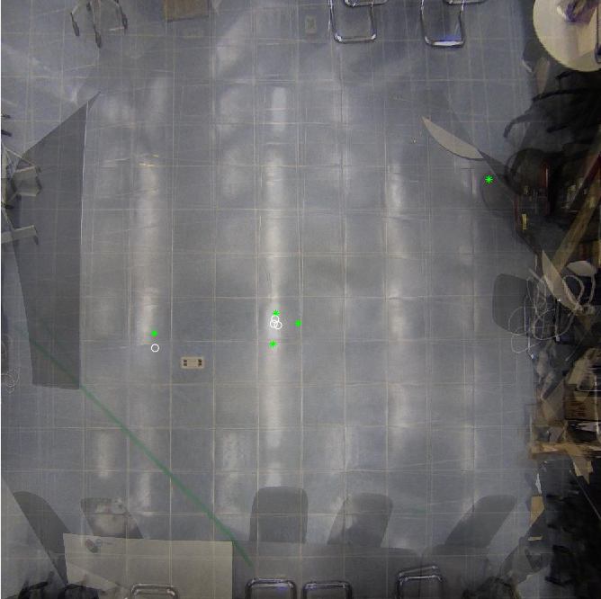
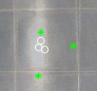
Introduction
3-D localization error
GT
DPM [1]
[1] “A discriminatively trained, multiscale, deformable part model,”
Pedro Felzenszwalb, David McAllester, and Deva Ramanan, CVPR 2008

Slide 7
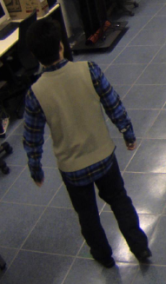
Introduction
In this paper…
We define the 2-D Pedestrian Grounding Position (2-D PGP)
Intersection between ground plane and center line of pedestrian
We learn 2-D PGP from pedestrian appearance in bounding box.
We use 2-D PGP as the 2-D location of pedestrian, instead using a bottom center of bounding box.
We found that tracking performance improves by accurately finding 2-D PGP.

Slide 8
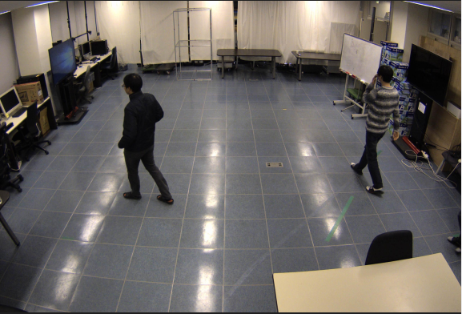
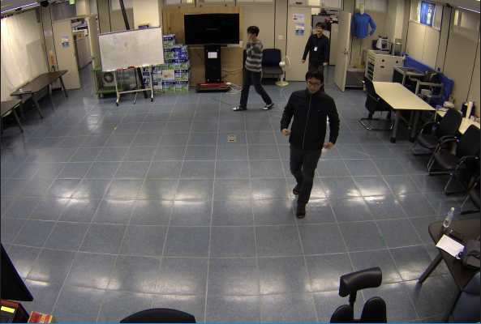
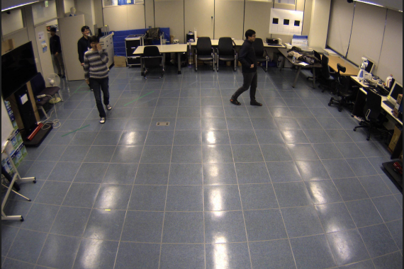
Framework
Our strategy
Input images
Detection results
Find 2-D PGPs
Tracking results
Detection Network
(D-Net)
Localization Network
(L-Net)
Min-Cost Network Flow based MCMTT

Slide 9
DL-Net
Proposed Network

Slide 10
Framework
Our strategy
Input images
Detection results
Find 2-D PGPs
Tracking results
Detection Network
(D-Net)
Localization Network
(L-Net)
Min-Cost Network Flow based MCMTT

Slide 11
Tracking Algorithm
Min-cost Network Flow
S
T

Slide 12
Tracking Algorithm
Min-cost Network Flow
: one possible detection association in a frame
S
T

Slide 13
Tracking Algorithm
Min-cost Network Flow
2-D point $g_{i}$ to line in 3-D space $l_{i}$.
$$l_{i}$$
$$g_{i}$$

Slide 14
Tracking Algorithm
Min-cost Network Flow
2-D point $g_{i}$ to line in 3-D space $l_{i}$.
$$l_{1}$$
$$l_{2}$$
Center point of 3 lines
$$l_{3}$$

Slide 15
Tracking Algorithm
Min-cost Network Flow
Define 3-D PGP
Design new reconstruction cost
Center point of 3 lines
Sum of distance from 3-D PGP to each line

Slide 16
Tracking Algorithm
Optimization
New reconstruction cost $C_{k}$
Pairwise cost $C_{k,l}$ : Euclidean distance between 3-D PGP
Binary integer programming problem
Using Gurobi optimization solver

Slide 17
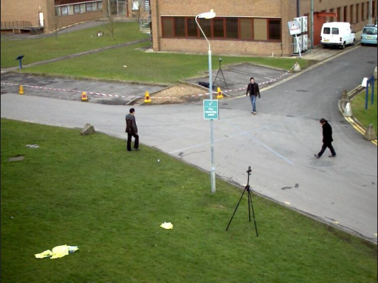
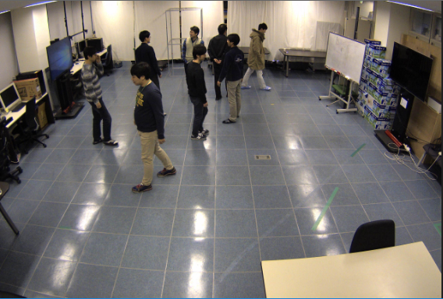
Experiments
Dataset
Pets 2009
SNUPIL

Slide 18
Experiments
2-D PGP error

Slide 19
Experiments
MCMTT performance

Slide 20
Conclusion
In this paper, we have proposed a deep-learning network that simultaneously detects pedestrians and estimates their ground positions.
We have focused on the importance of pedestrian localization accuracy.
It is meaningful that enhancing the localization accuracy of detections significantly improves the performance.

Slide 21
The End
Thank you

