Slide 1
Deep Regression Forest with Soft-Attention for Head Pose Estimation Xiangtian Ma, Nan Sang, Xupeng Wang*, Shihua Xiao
Xiangtian Ma
School of Information and Software Engineering
University of Electronic Science and Technology of China
xiangtian.ma@std.uestc.edu.cn
Three-Dimensional Image and Video Processing ——3D Image and Video Analysis and Compression

Slide 2
Contents
1
Background
2
Motivation
3
Our work
4
Conclusion

Slide 3
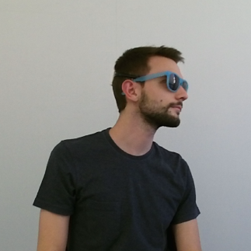
Background
Head pose estimation has been an active research direction in computer vision for decades, because it has wide applications in human-computer interaction, human behavior analysis and augmented reality.
* The illustration refers to the Pandora dataset.

Slide 4
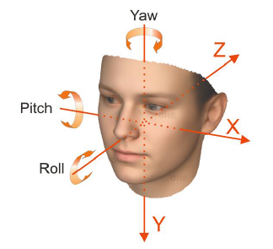
Background
What is the head pose estimation?
Given an image of a head, head pose estimation refers to the prediction of the pose angle in the camera reference frame.
How to represent the head pose?
Euler angle.
Quaternion.
…

Slide 5
Contents
1
Background
2
Motivation
3
Our work
4
Conclusion

Slide 6
Motivation
Point cloud
Deep learning of point cloud becomes more and more popular.
Popular models: PointNet, PointNet++, PointCNN, PU-Net, etc.
Advantages
3D geometry information of target can be obtained.
Less affected by the change of external light and imaging distance.
There is no projection transformation from 3D space to 2D imaging plane.

Slide 7
Motivation
Challenges
Head pose in large variations makes the distinguished facial features, such as nose or lips, invisible, especially in extreme cases.
Features extracted from a head do not change in a stationary manner with respect to the head pose, which results in an inhomogeneous feature space.

Slide 8
Motivation
Our solutions
First, we present a convolutional neural network for 3D head pose estimation in an end-to-end manner.
Second, to the best of our knowledge, this is the first work to apply deep regression forest to 3D head pose estimation.
Third, a deep regression forest facilitated with soft-attention modules is proposed to perform head pose estimation in a multi-task learning setup.

Slide 9
Contents
1
Background
2
Motivation
3
Our work
4
Conclusion

Slide 10
Our work
We propose a deep regression network for head pose estimation, which consists of a general feature learning net and task-specific nets.

Slide 11
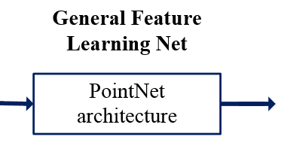
Our work
General feature learning net
The PointNet architecture is adopted.
Advantages
The network is able to automatically select distinguished facial feature points from visible surface of a head and to extract discriminative features.
PointNet is capable of approximating any continuous set function, as long as sufficient neurons provided.
The architecture of the PointNet is compact and can be implemented in a highly efficient manner.

Slide 12
Our work
Task-specific nets
The task-specific nets utilize a set of deep regression forests with Soft-attention (SA-DRF) to regress head pose, where each forest is designed for one dimension of pose angles.

Slide 13
Our work
Soft-attention module
It is designed to select features from general feature pool for a particular task.

Slide 14
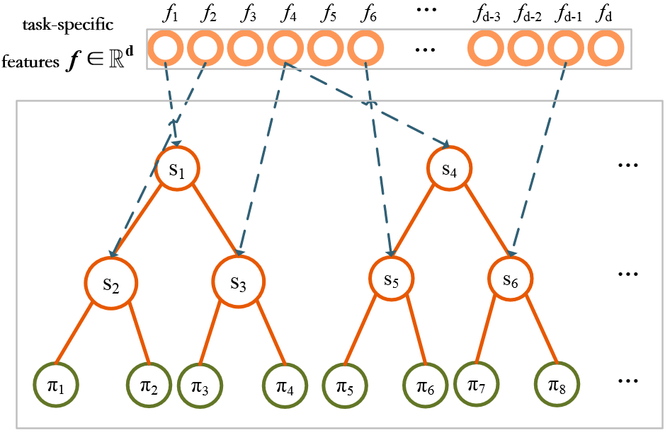
Our work
Deep regression forest
Deep regression forest is utilized to deal with the inhomogeneous feature space and to learn the latent label distributions.
Split nodes: data partition
Leaf nodes: data abstraction

Slide 15
Our work
Loss function
The loss function for the training of a forest is defined by L2 loss, as follows:
Since the network is designed in a multi-task learning setup, the loss function of the network is defined as:

Slide 16
Our work
Experiments
Datasets: Biwi Head Pose Dataset and Pandora Dataset
Sample frames from the Pandora dataset. As depicted, extreme poses and challenging camouflage can be present.

Slide 17
Our work
Ablation Study
A deep network is designed for comparison, in which SA-DRF is replaced by three fully connected layers.

Slide 18
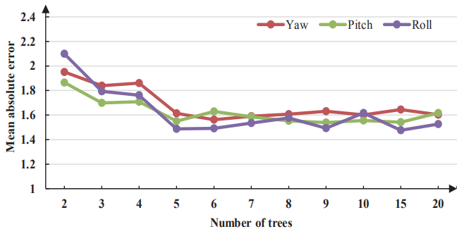
Our work
Ablation Study
The effect of number of trees on the framework measured by mean absolute error (MAE).

Slide 19
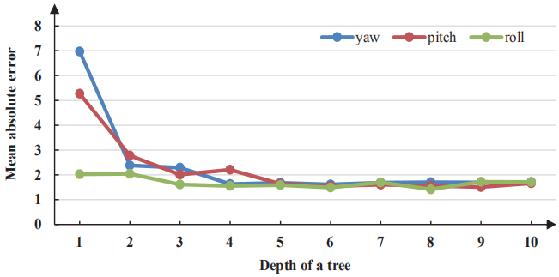
Our work
Ablation Study
The effect of tree depth on the framework measured by mean absolute error (MAE).

Slide 20
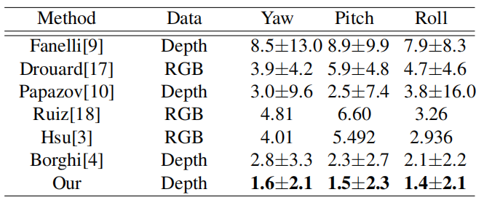
Our work
Quantitative Results
Performance comparisons on the Biwi dataset and the Pandora dataset.

Slide 21
Contents
1
Background
2
Motivation
3
Our work
4
Conclusion

Slide 22
Conclusion
A deep regression network is proposed for 3D head pose estimation, which extracts features from point cloud data and utilizes deep regression forest to regress pose angles.
A soft-attention module is equipped with the deep regression forest, which learns soft masks from general features and feeds the forest with task-specific features to boost performance.

Slide 23
Thank you!

