Slide 1
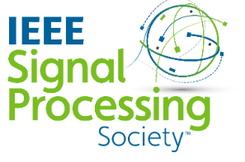
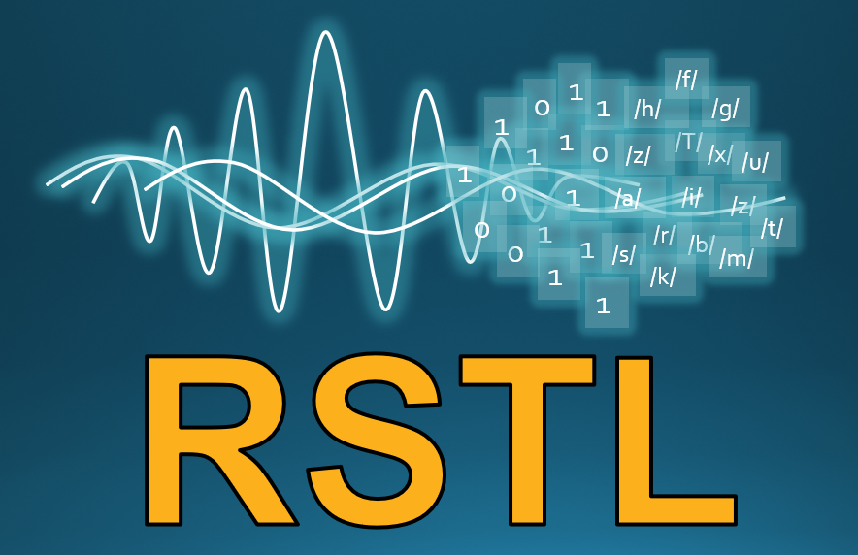
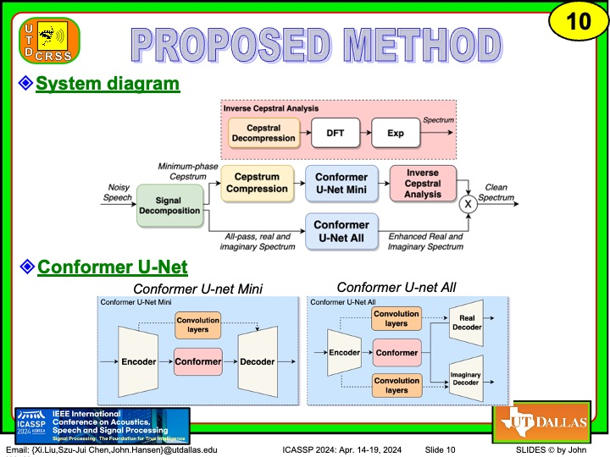
Dual-path Minimum-Phase and All-Pass Decomposition Network for Single Channel Speech Dereverberation
Xi Liu, Szu-Jui Chen and John H.L. Hansen
Xi.Liu@utdallas.edu, Szu-Jui.Chen@utdallas.edu John.Hansen@utdallas.edu
Robust Speech Technologies Lab (RSTL)
Center for Robust Speech Systems (CRSS)
Erik Jonsson School of Engineering & Computer Science
The University of Texas at Dallas; Richardson, Texas 75080-3021, U.S.A.
IEEE ICASSP 2024 Apr. 14-19, 2024 Seoul, Korea
This work was supported by National Science Foundation under
Grant Award number 2016725

