Slide 1
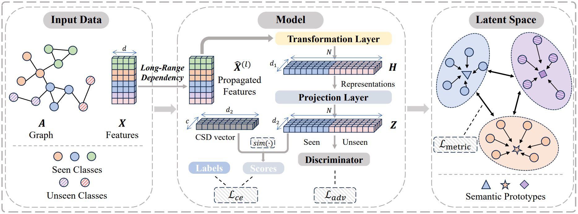
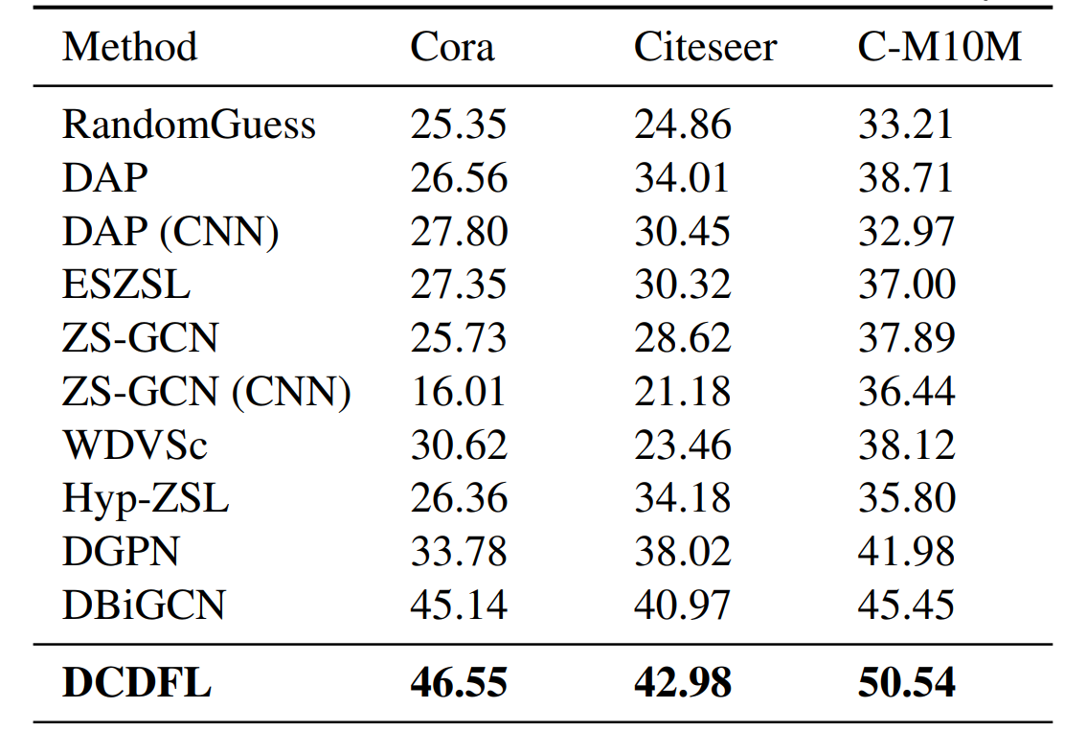
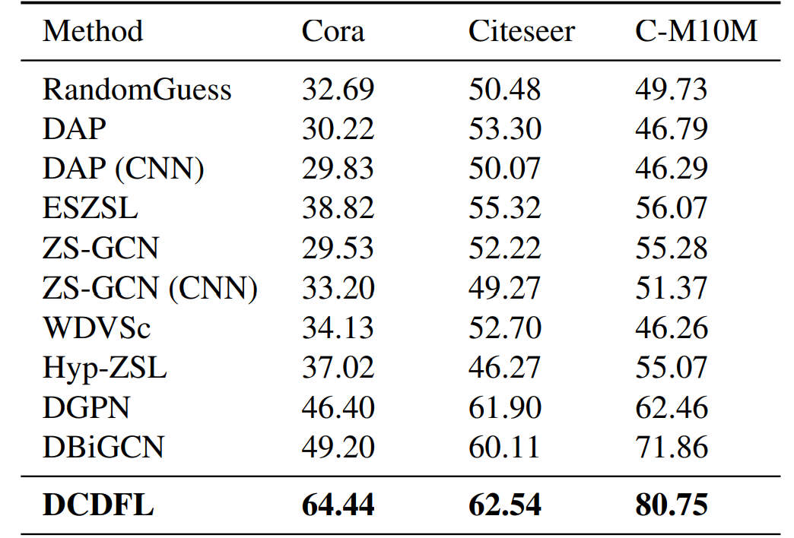
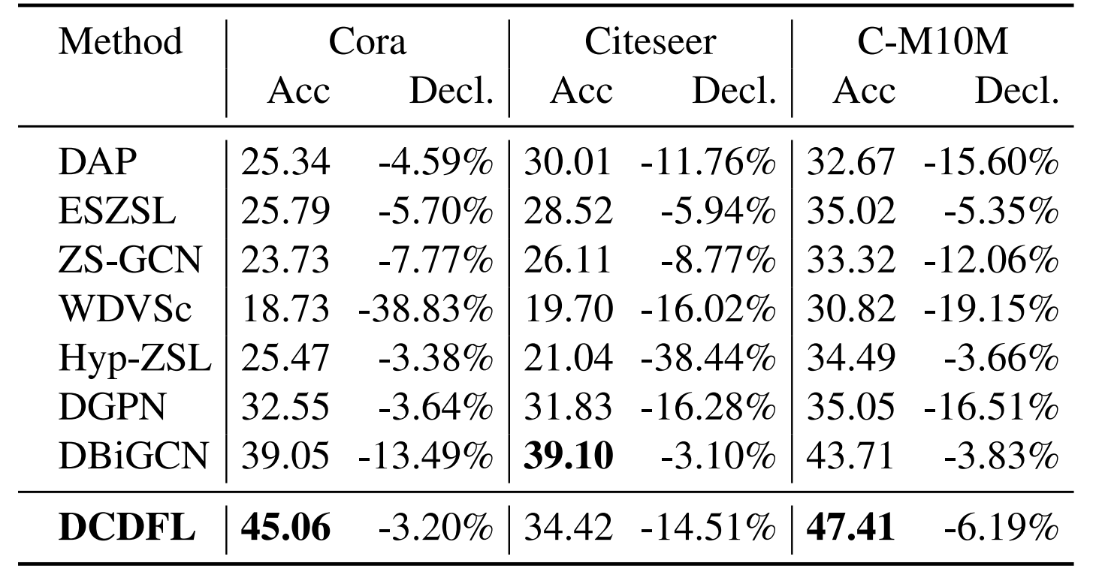
Boosting Zero-shot Node Classification via Dependency Capture and Discriminative Feature Learning
Wenxin Liang¹, Zhiliang Hao¹, Han Liu¹, Hongyang Chen²,
¹ Dalian University of Technology ² Zhejiang Lab
1. The Framework
Zero-shot node classification
Relation-aware
Long-range dependency
Domain-invariant
Geometric relationships
Enhancing Representations
2. Problem Formulation
4. Long-Range Dependency Between Nodes
Input:
$G=(𝒱,ℰ)$, graph
$X$, feature matrix
Y, seen class labels
S, class semantic description
Output:
unseen class labels
Task:
Assuming that all labeled nodes belong to seen classes, the goal of zero-shot node classification is to classify the rest testing nodes.
GCN can be disentangled into two independent operations:
Propagation (P) and Transformation (T).
$$X_{P}=Propagation\left(X\right)=\tilde{A}X \\ X_{T}=Transformation\left(X\right)=σ(XW)$$
A refined iterative update mechanism
$${\overset{ˆ}{X}}^{(0)}=X$$
$${\overset{ˆ}{X}}^{(l)}=(1−λ)\overset{˜}{A}{\overset{ˆ}{X}}^{(l−1)}+λX$$
The predicted probability
$${\overset{ˆ}{y}}_{ij}=sim⁡\left(z_{i},s_{j}\right)$$
5. Domain Bias Mitigation
For the label data of seen classes, the standard cross entropy loss is used to calculate the loss:
$$ℒ_{ce}=−\frac{1}{N_{s}}\frac{1}{\left|𝒞_{s}\right|}∑_{i∈𝒱_{s}} ∑_{j∈𝒞_{s}} y_{ij}log⁡\left({\overset{ˆ}{y}}_{ij}\right)$$
3. Three Key Points
To mitigate the domain bias problem, we introduce a domain-invariant adversarial loss:
How to effectively use the dependency between nodes?
$$ℒ_{adv}=−\frac{1}{N}\left(∑_{i=1}^{N_{s}} log⁡\left(D\left(Z_{i}\right)\right)+∑_{j=1}^{N_{u}} log⁡\left(1−D\left(Z_{j}\right)\right)\right)$$
A relation-aware network to capture potentially long-range dependency between nodes, which can fully exploit the observed information.
6. Enhancing Discriminative Representations
How to alleviate the domain bias when transferring knowledge?
Given class prototype $p$ and distance function $d$
Total loss function
Introducing a domain-invariant adversarial loss.
A novel metric loss function fosters separation among different classes by:
$$ℒ=ℒ_{ce}+αℒ_{adv}+βℒ_{metric}$$
How to generate discriminative and transferable features?
$$ℒ_{\text{metric} }=−\frac{1}{\left|C_{s}\right|\left(\left|C_{s}\right|−1\right)}∑_{c_{1}∈C_{s}} ∑_{c_{2}∈C_{s},c_{1}≠c_{2}} d\left(p_{c_{1}},p_{c_{2}}\right)$$
Considering the geometric relationships to handle inter-class separability.
7. Experiments
Class Split I
Class Split II
Using LABEL-CSDs under Class Spilt I

