Slide 1
Robust Plane-based Calibration for linear cameras
department of telecommunication and information processing
research group Image processing and interpretation
Simon Donné, ICIP 2017, 18/09/2017

Slide 2
Presentation overview
Linear cameras and applications
Existing work
Proposed approach
Experiments and results
Conclusion

Slide 3
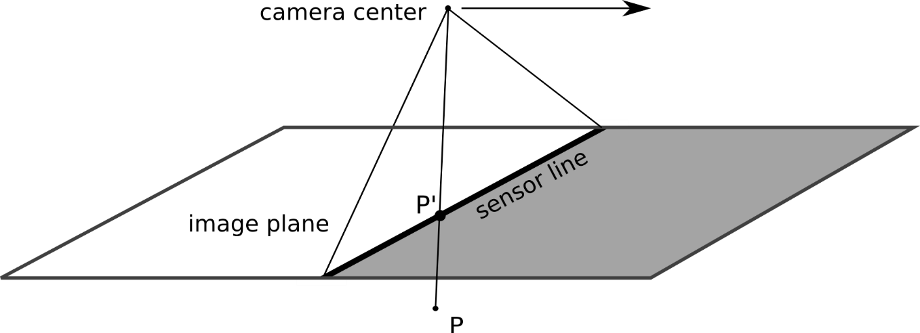
linear cameras
Single sensor line
Camera moving orthogonally to the sensor line
(parallel to the image plane)

Slide 4
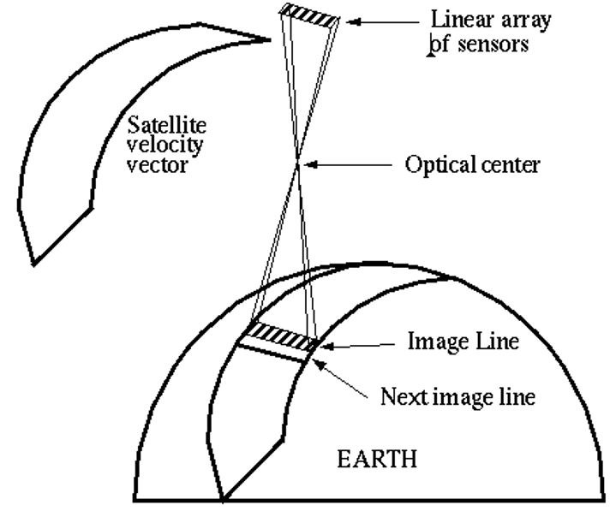
linear cameras
Applications: satellite cameras
smaller (lighter) cameras
‘free’ ‘linear’ movement

Slide 5
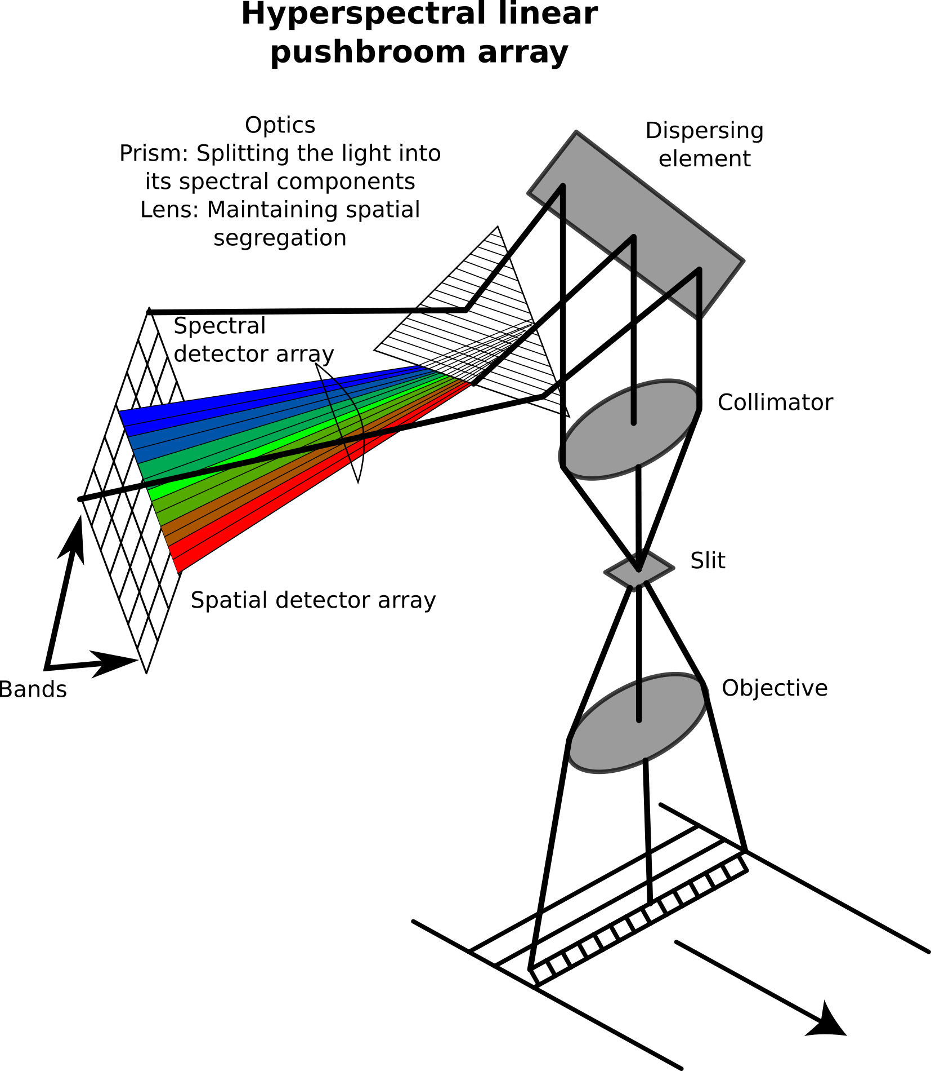
linear cameras
Applications: hyperspectral cameras
2D sensor grid:
wavelength (diffraction)
width
height through movement

Slide 6
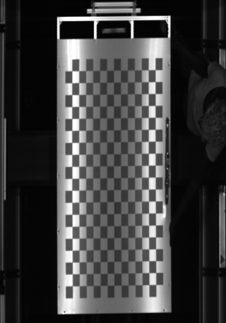
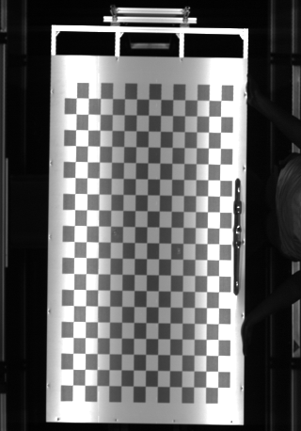
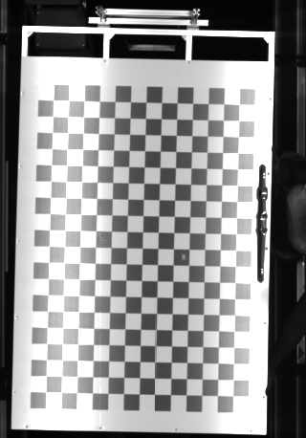
linear cameras
The camera model is given be
$$\left[\begin{aligned}u \\ v \\ 1\end{aligned}\right]∼\left[\begin{aligned}fX+u_{0}Z \\ sYZ \\ Z\end{aligned}\right]=\left[\begin{matrix}f & 0 & u_{0} \\ 0 & s & 0 \\ 0 & 0 & 1\end{matrix}\right]\left[\begin{aligned}X \\ YZ \\ Z\end{aligned}\right]$$
nonlinearity $YZ$!

Slide 7
Existing work
Given the capture of a planar pattern ${\left[a_{n},b_{n},0\right]}^{T}$
the projection from the Veronese mapping:
$$\left[\begin{matrix}u \\ v \\ 1\end{matrix}\right]∼K\left[\begin{matrix}r_{11} & r_{12} & t_{1} & 0 & 0 & 0 \\ r_{21}t_{3}+r_{31}t_{2} & r_{22}t_{3}+r_{32}t_{2} & t_{2}t_{3} & r_{21}r_{31} & r_{22}r_{32} & r_{21}r_{32}+r_{22}r_{31} \\ r_{31} & r_{32} & t_{3} & 0 & 0 & 0\end{matrix}\right]\left[\begin{matrix}a \\ b \\ 1 \\ a^{2} \\ b^{2} \\ ab\end{matrix}\right]$$

Slide 8
Existing work
Given the capture of a planar pattern ${\left[a_{n},b_{n},0\right]}^{T}$
yields a homography-like matrix H
$$\left[\begin{matrix}u \\ v \\ 1\end{matrix}\right]∼H\left[\begin{matrix}a \\ b \\ 1 \\ a^{2} \\ b^{2} \\ ab\end{matrix}\right]= K\left[\begin{aligned}P_{1}& | P_{2}\end{aligned}\right]\left[\begin{matrix}a \\ b \\ 1 \\ a^{2} \\ b^{2} \\ ab\end{matrix}\right]$$

Slide 9
Existing work
Multiplication with the skew matrix of each observation yields a homogeneous system in H
Given the structure of H, Drareni et al. define:
$$\left[R_{i,1} | R_{i,2}\right]=\frac{t_{i,3}}{sf}L_{i}M_{i}=\left[\begin{matrix}s & 0 & {−su}_{0} \\ 0 & \frac{f}{t_{i,3}} & 0 \\ 0 & 0 & sf\end{matrix}\right]\left[\begin{matrix}h_{11} & h_{12} \\ \begin{aligned}h_{24}/h_{31} \\ h_{31}\end{aligned} & \begin{aligned}h_{25}/h_{32} \\ h_{32}\end{aligned}\end{matrix}\right]$$

Slide 10
Proposed approach
However, this entails dividing by entries of the rotation matrix
We propose using another alternative:
$$\left[R_{i,1} | R_{i,2}\right]=\frac{t_{i,3}}{sf}L_{i}M_{i}=\left[\begin{matrix}s & 0 & {−su}_{0} \\ 0 & \frac{f}{t_{i,3}} & 0 \\ 0 & 0 & sf\end{matrix}\right]\left[\begin{matrix}h_{11} & h_{12} \\ \begin{aligned}h_{21}−h_{31}h_{23} \\ h_{31}\end{aligned} & \begin{aligned}h_{22}−h_{32}h_{23} \\ h_{32}\end{aligned}\end{matrix}\right]$$

Slide 11
Proposed approach
Our proposed formulation is theoretically equivalent but behaves much better near ‘degenerate’ horizontal poses
Using this factorization we can estimate $s,f,t_{i,3}$ and $R_{i}$.
$$\left[R_{i,1} | R_{i,2}\right]=\frac{t_{i,3}}{sf}L_{i}M_{i}=\left[\begin{matrix}s & 0 & {−su}_{0} \\ 0 & \frac{f}{t_{i,3}} & 0 \\ 0 & 0 & sf\end{matrix}\right]\left[\begin{matrix}h_{11} & h_{12} \\ \begin{aligned}h_{21}−h_{31}h_{23} \\ h_{31}\end{aligned} & \begin{aligned}h_{22}−h_{32}h_{23} \\ h_{32}\end{aligned}\end{matrix}\right]$$

Slide 12
Results and experiments
The result is not only a more robust method (applicable in our real experiments with a horizontal robot arm)
But also a more accurate estimate!

Slide 13
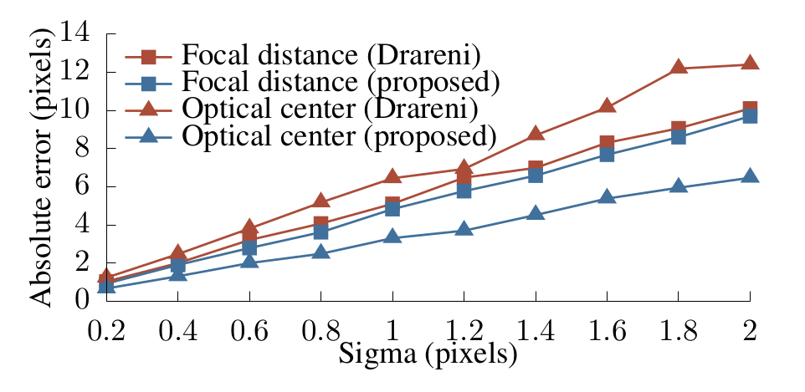
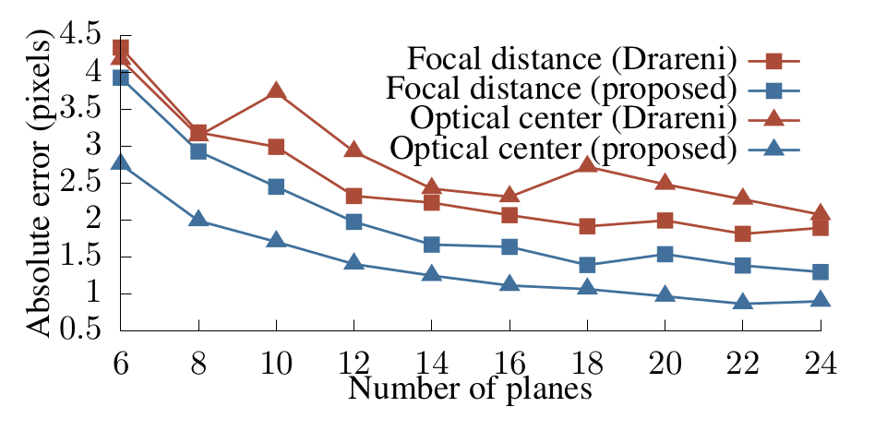
Results and experiments
Synthetic datasets:

Slide 14
Results and experiments
Real experiments: those elements were always zero!
Absolute error on 200 mm offsets: 1,19mm

Slide 15
Conclusion
We formulate a more stable and robust estimation for the rotation matrix from the homography that does not entail dividing by elements of the rotation matrices.
The result is a more accurate camera calibration that is robust to planar objects parallel to the image plane – which do occur in practical set-ups.

Slide 16
Simon Donné PhD Student Department of telecommunication and information processing Image processing and interpretation E Simon.Donne@ugent.be T +32 9 264 32 70 telin.ugent.be/~sdonn

