Slide 1
Transmitter Optimization for MISO System with Service Integration of Multicasting and Confidential Broadcasting
Shiyu Chen, Zhi Chen, Weidong Mei, and Shaoqian Li
National Key Lab of Science and Technology on Communications, University of Electronic Science and Technology of China

Slide 2
Background
Traditionally multicast transmission and confidential transmission are usually independently investigated in the field of physical (PHY) layer signal processing.
PHY multicasting offers a way to efficiently transmit common messages that all receivers can decode.
PHY security can overcome the inherent difficulties of cryptographic methods, i.e., the distribution and management of secrecy keys in wireless networks.
Notes:
Different from conventional cryptographic approaches used to address wireless security issues, physical layer secrecy utilizes channel coding and signal processing techniques to communicate secret messages between the source and the destination while maintaining confidentiality against the eavesdropper.

Slide 3
Background
A brief review of PHY security
h
Information signal
y_{lr}=hx+n_{b}
x=vs
Transmitted signal
g
Beamforming
vector
y_{e}=gx+n_{e}
Fig.1. MISO Wiretap System Model
Achievable secrecy rate is given by
The maximization of C_{b} admits closed-form expressions.
Notes:
For MISOSE with imperfect ECSI, AN can be adopted to facilitate a high-quality security performance. [li'dʒitimeit]

Slide 4
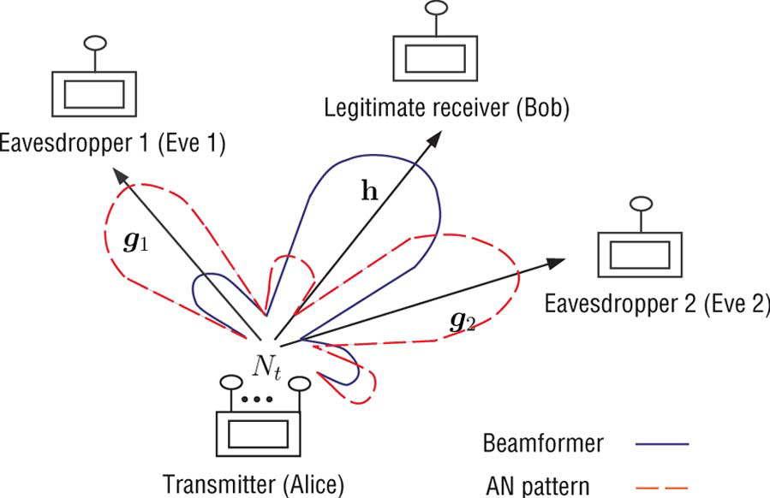
Background
A brief review of PHY security (AN-aided)
Bob’s channel nulls out the artificial noise.
Fig.2. The idea of AN-aided transmit beamforming^{[1]}
[1]W.-C. Liao, T.-H. Chang, W.-K. Ma and C.-Y. Chi, “QoS-based transmit beamforming in the presence of eavesdroppers: an optimized artificial-noise-aided approach”, IEEE Trans. Signal Process., vol. 59, no. 3, pp. 1202-1216, Mar., 2011
Notes:
To prevent AN interference at the destination and also to make the optimization problem easier to handle, AN is always assumed to be placed in the null space of the destination’s channel. legitimate [li'dʒitimeit]

Slide 5
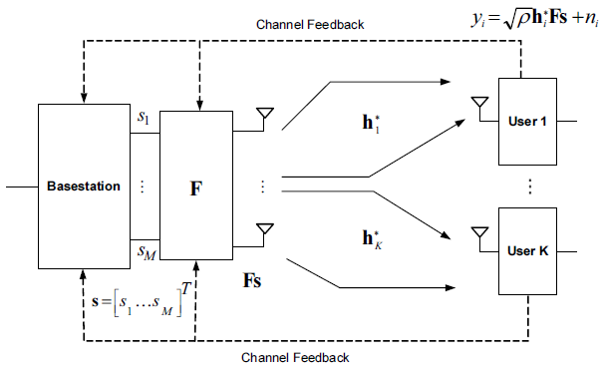
Background
A brief review of PHY multicasting (perfect CSI)
h₁
y₁=h₁Fs+n₁
h_{k}
y_{K}=h_{K}Fs+n_{K}
transmitted symbol vector
Fig.3. MISO Multicasting System Model^{[2]}
[2]I. H. Kim, D. J. Love, and S. Y. Park, “Optimal and successive approaches to signal design for multiple antenna physical layer multicasting,” IEEE Trans. Commun., vol. 59, no. 8, pp. 2316–2327, 2011.
Notes:
M is the number of simultaneously transmitted data streams. simultaneously [saiməl'teiniəsli]

Slide 6
Background
A brief review of PHY multicasting
Achievable rate of multicasting system is given by
The multicast capacity in the presence of CSIT is given by
This maximization problem can be recast as an SDP problem [3].
[3] S. X. Wu, W.-K. Ma, and A. M.-C. So, “Physical-layer multicasting by stochastic transmit beamforming and Alamouti
space-time coding,” IEEE Trans. Signal Process., vol. 61, no. 17, pp. 4230–4245, Sep. 2013.

Slide 7
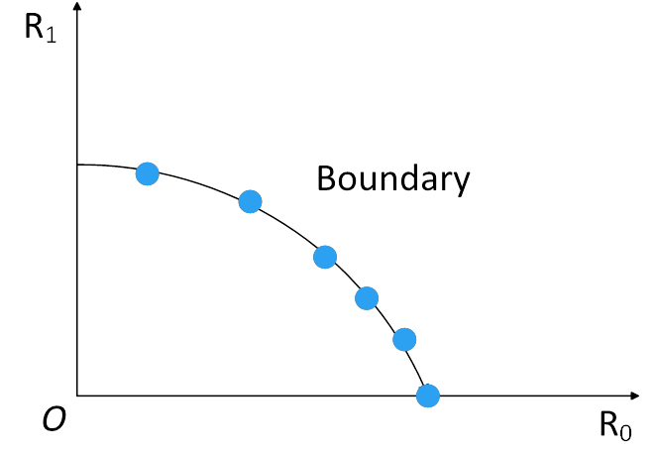
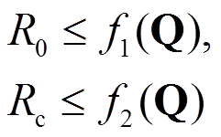
Motivation
Recently a heuristic and interesting way is to merge multiple services, e.g., multicast service and confidential service, into one integral service for one-time transmission.
Service integration in the physical (PHY) layer enables coexisting services to share the same resources, thereby significantly increasing the spectral efficiency.
Many works focused on PHY service integration from the viewpoint of information theory, i.e., derived capacity results or characterized coding strategies that result in certain rate regions.
Few works focused on the transmit design to achieve the capacity region, i.e., designing the input covariance matrices of different service information.
Specific coding scheme
Design the input covariance matrices to find and achieve these boundary points.
Information-theory result
Fig.1. Secrecy rate region
Notes:
Along with this comes the unsatisfying fact that most activities end when a certain rate region is obtained. Such descriptions are usually given by a union over all possible transmit covariance matrices satisfying certain power constraints. A numerical search over all feasible covariance matrices is needed to obtain the secrecy capacity.

Slide 8
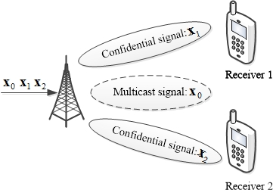
System model
A multi-antenna transmitter serves two-user, and each receiver has a single antenna.
Both users have ordered the multicast service, user 1 and user 2 further ordered their respective confidential service.
The channel state information (CSI) of all receivers is assumed to be available at the transmitter.
MISO two-user Gaussian broadcast channel
Fig.2. System model
Notes:
In general, both coding and signal processing aspects of the problem must be taken into consideration in order to achieve the secrecy capacity region. However, when the optimal joint design is unknown, signal processing techniques can also be used to help increase the achievable secrecy rate or reduce the complexity of the channel coding operations. It is acceptable from the viewpoint of signal processing.

Slide 9
Problem Formulation
The achievable rate region C_{s} is given as the set of nonnegative rate triples (R₀,R₁,R₂) satisfying [1]
Q₀ (resp. Q₁, Q₂) represents the covariance matrix of multicast message (resp. the first user’s confidential message, the second user’s confidential message);
Notes:
The secrecy rate region implies that all receivers first decode their common multicast message by treating the confidential message as noise, and then receiver 1 acquires a clean link for the transmission of its exclusive confidential message, where there is no interference from the multicast message. This can be achieved by utilizing the Gaussian codebooks.

Slide 10
Problem Formulation
The problem of interest in this paper is to determine the optimal precoding matrix Q₀, Q₁ and Q₂ in the following optimization problem
(1)
Demand for QoMS
Demand for QoCS
Total power constraint
Remarks: This optimization problem also provides us a way to determine the boundary points of the secrecy rate region.

Slide 11
Problem Formulation
Further simplify the denominator of the objective function (1) by introducing a slack variable μ, then we obtain
Nonconvex objective function!!
(2)
Nonconvex constraint!!
To deal with the non-convexity in (2), next we develop a two-stage reformulation of (2).

Slide 12
A Two-stage Reformulation of (2)
Outer problem w.r.t α
(3)
α's range can be determined by
One-dimensional search, e.g., the golden section algorithm, can handle the outer problem.
Bisection method and CVX solver can collectively solve the inner problem.
Inner problem w.r.t Q₀,Q₁,Q₂
Quasiconvex optimization problem [Boyd’09]
Affine constraint
(4)

Slide 13
Charnes-Cooper transformation-based reformulation of (4)
By applying the Charnes-Cooper transformation
We rewrite (4) as
Convex optimization problem!!
(5)

Slide 14
The optimality of transmit beamforming
Proposition 1: The optimal transmit covariance matrices of the multicast message and the confidential messages are of rank one.
Proof: It suffices to prove the optimal Q_{0,} Q_{1,} Q₂ to (4) is of rank one, for any given α.
Recall (4)
Optimal solution
Optimal objective value

Slide 15
The optimality of transmit beamforming
Step 1: We prove (4) has identical solutions to a power minimization problem (6).
The optimal value of (4)
(6)
Same constraints as (4)
Optimal solution

Slide 16
The optimality of transmit beamforming
Some quick implications
The definition of
(7)
The feasibility of to (6)
The feasibility of to (6)
From (6)
The optimality of to (4)

Slide 17
The optimality of transmit beamforming
Step 2: According to the rank reduction result presented in [4, Theorem 3.2]
M denotes the total number of linear equalities and inequalities in (6)
For (6), M=4
It is straightforward to see
which completes the proof.
[4] Y. Huang and D. Palomar, “Rank-constrained separable semidefinite programming with applications to optimal beamforming,” IEEE Trans. Signal Process., vol. 58, no. 2, pp. 664–678, Sep. 2010.

Slide 18
Complexity Analysis
The total arithmetic computation cost is on the order of
T denotes the number of searches involved in seeking the optimal α
ϵ is solution accuracy
[5, Lecture 6]
The golden section search
The arithmetic complexity is polynomial with regard to the dimension of the optimization variables.
[5] A. Ben-Tal and A. Nemirovski, Lectures on modern convex optimization: analysis, algorithms, and engineering applications. Philadelphia, PA, USA: SIAM, 2001, vol. 2.

Slide 19
Complexity Analysis
The uniform sampling method
Proposition 2: Let be an ϵ-suboptimal solution of (3), satisfying
for some small positive constant ϵ. If an uniform sampling search over is exploited, one can find such with a maximum number of searches given by
Proof: Suppose that is an optimal solution of problem (3), and that
is an optimal solution of problem (6). For any Δ > 0 such that we must have
(8)

Slide 20
Complexity Analysis
Let , and
is feasible to (8)
characterize the rate gap
The arithmetic complexity is still polynomial w.r.t. the problem size for achieving at least ϵ-suboptimality.

Slide 21
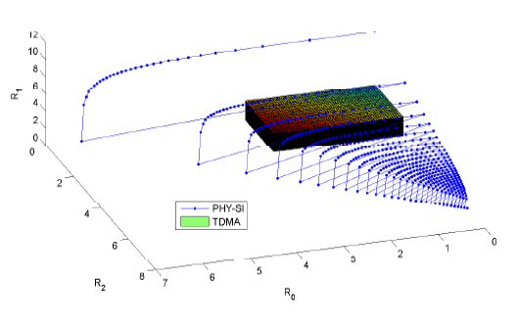
Numerical Results
Some observations from Fig.3
Our proposed scheme achieves a larger region than the TDMA-based one.
Reason: It is the advantage of PHY-SI over the traditional service integration.
The projection of the secrecy capacity region onto the R₀-R₁ or R₀-R₂ is the secrecy capacity region with only one confidential message and the multicast message.
The projection onto the R₁-R₂ plane gives rise to the secrecy capacity region with only confidential broadcasting.
Fig.3. Secrecy capacity regions

Slide 22
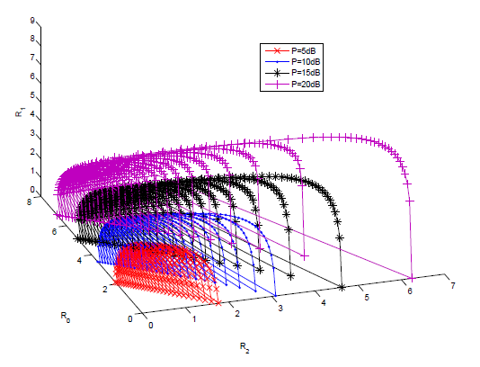
Numerical Results
Some observations from Fig.4
With the increase in transmit power, the rates R₀, R₁ and R₂ increase simultaneously, and the secrecy capacity region becomes larger.
The PHY-SI still yields better security performance than TDMA. Here we do not plot the TDMA results.
Fig.4. Secrecy capacity regions versus the transmit power

