Slide 1
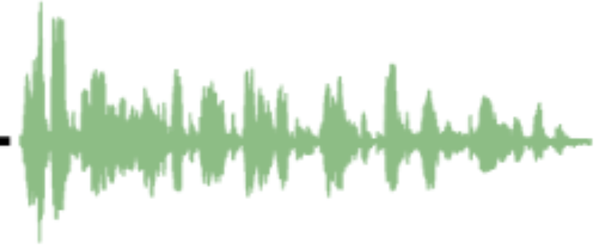
Event:
train whistling
Multiscale Transformer
Time
Spectrogram
Audio Signal
Multiscale Audio Transformer
Given an audio signal sequence, multiscale audio Transformer gradually reduces
the number of tokens. It is 5x more efficient in terms of MACs with 42% reduction
in terms of parameters and 5% better accuracy on 4 event classification datasets
compared with previous state-of-the-art audio Transformer.
Multiscale Audio Spectrogram Transformer for Efficient Audio Classification
Wentao Zhu and Mohamed Omar, Amazon

Slide 2
Introduction
Manually designed feature based audio classification [1, 2]
Convolutional neural network based methods [3, 4]
Model fixed lengths of dependencies
Transformer based audio classification [5]
Without inductive bias, i.e., spatial locality and translation equivariance
Current state-of-the-art on various audio classification benchmarks, e.g., AudioSet, VGGSound.
[1] Recent developments in opensmile, the munich open-source multimedia feature extractor, ACM MM 2013
[2] The INTERSPEECH 2013 computational paralinguistics challenge: Social signals, conﬂict, emotion, autism, Interspeech 2013
[3] CNN architectures for large-scale audio classiﬁcation, ICASSP 2017
[4] SpeechNAS: Towards better trade-off between latency and accuracy for large-scale speaker veriﬁcation, ASRU 2021
[5] AST: Audio spectrogram transformer, Interspeech 2021

Slide 3
Related Work
Audio Transformer
AST [5], SSAST [6]
Multiscale language Transformer
Funnel-Transformer [7]
Multiscale vision Transformer
Swin Transformer [8]
Multiscale multimodal Transformer
AVT [9], MMT [10]
[6] SSAST: Self-supervised audio spectrogram transformer, AAAI 2022
[7] Funnel-transformer: Filtering out sequential redundancy for efﬁcient language processing, NeurIPS 2020
[8] Swin transformer: Hierarchical vision transformer using shifted windows, ICCV 2021
[9] AVT: Audio-Video Transformer for Multimodal Action Recognition, 2022
[10] Multiscale Multimodal Transformer for Multimodal Action Recognition, 2022

Slide 4
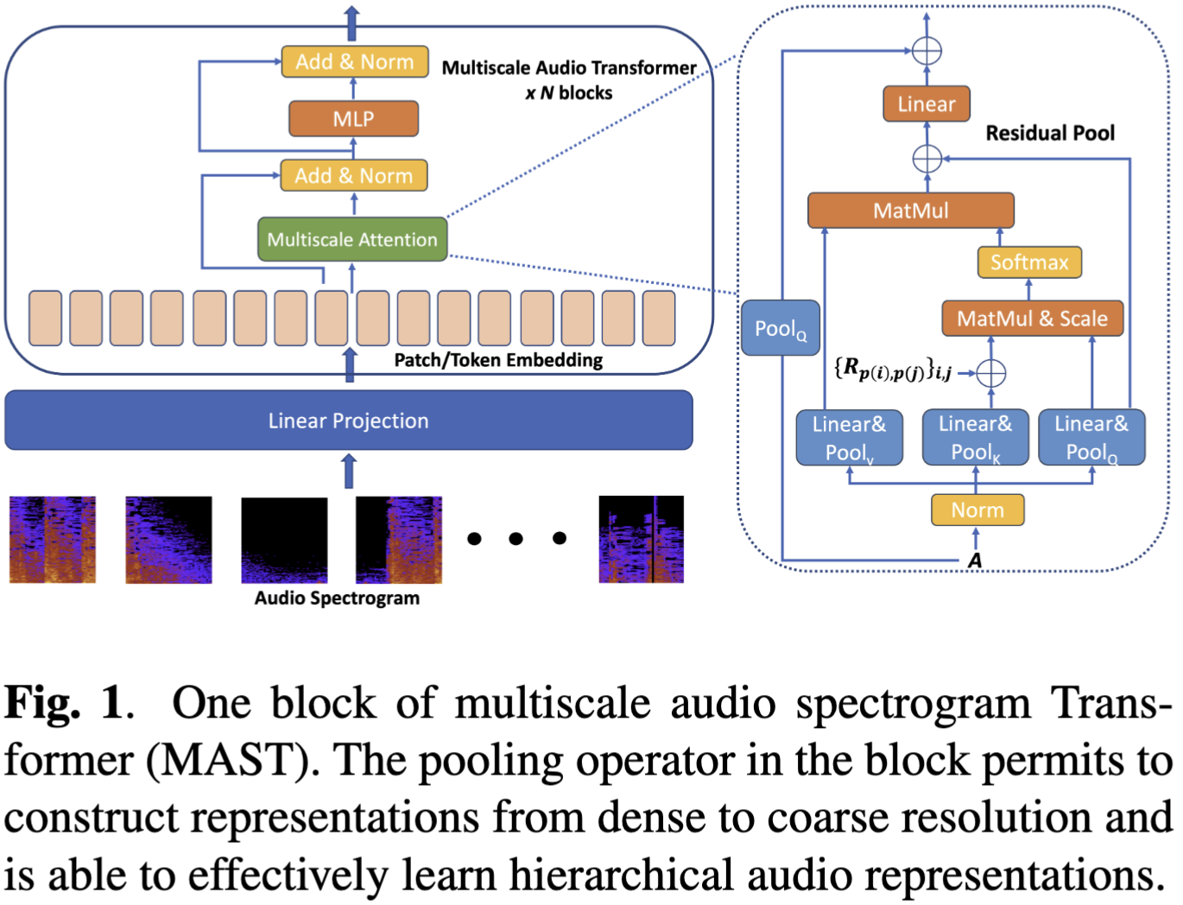
Method
One block
One head

Slide 5
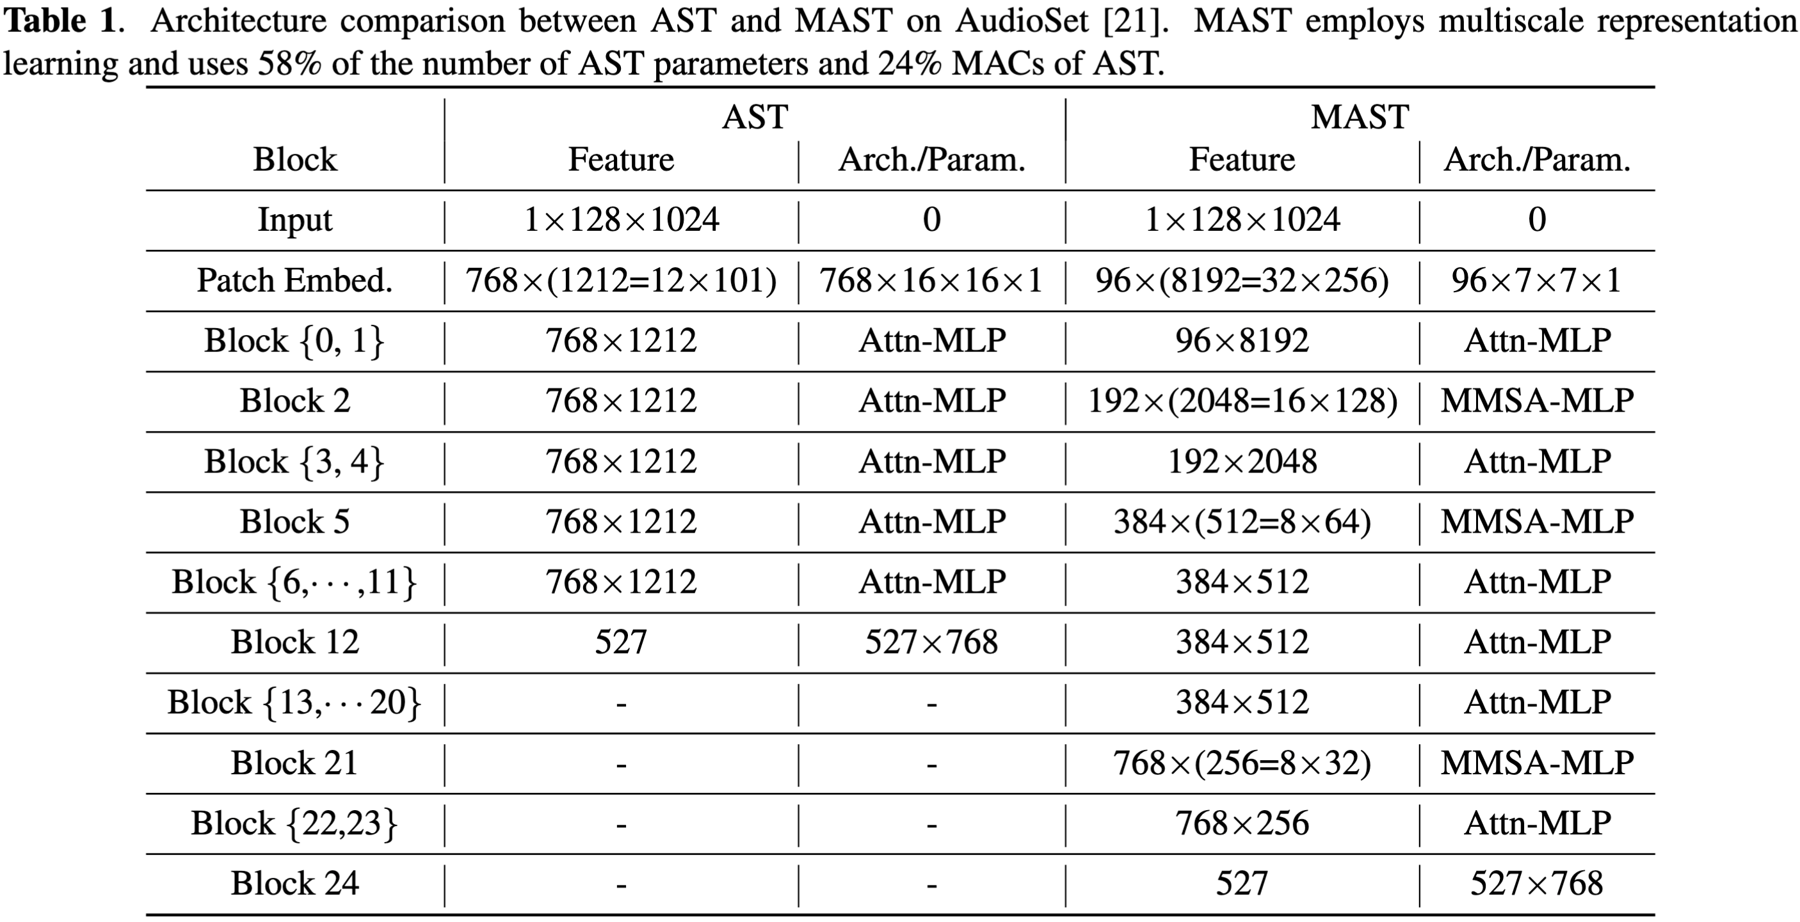
Method

Slide 6
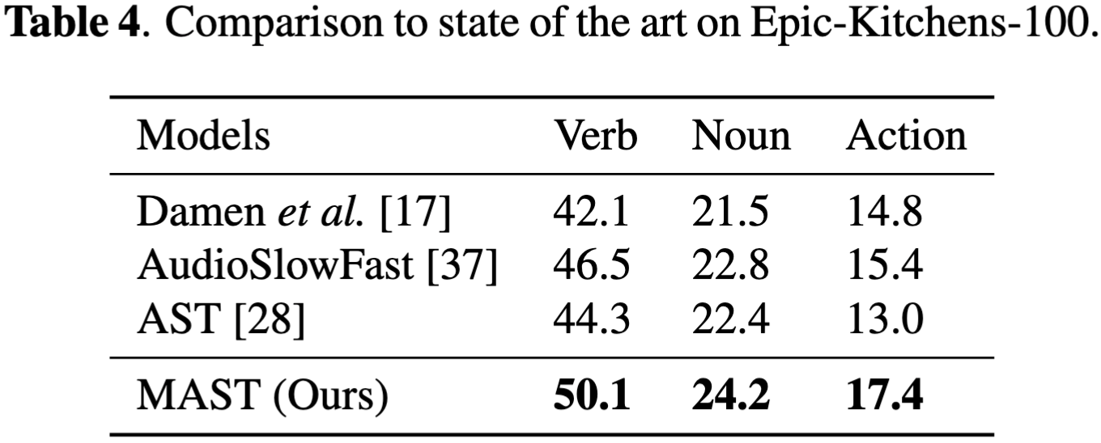
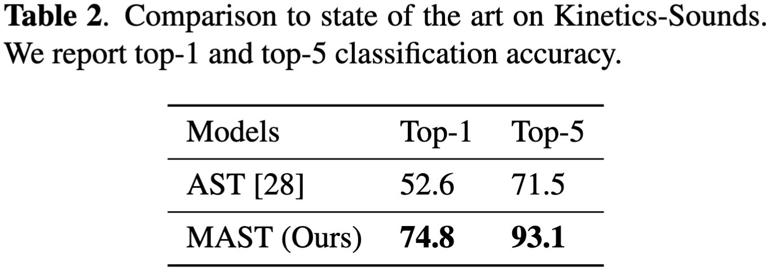
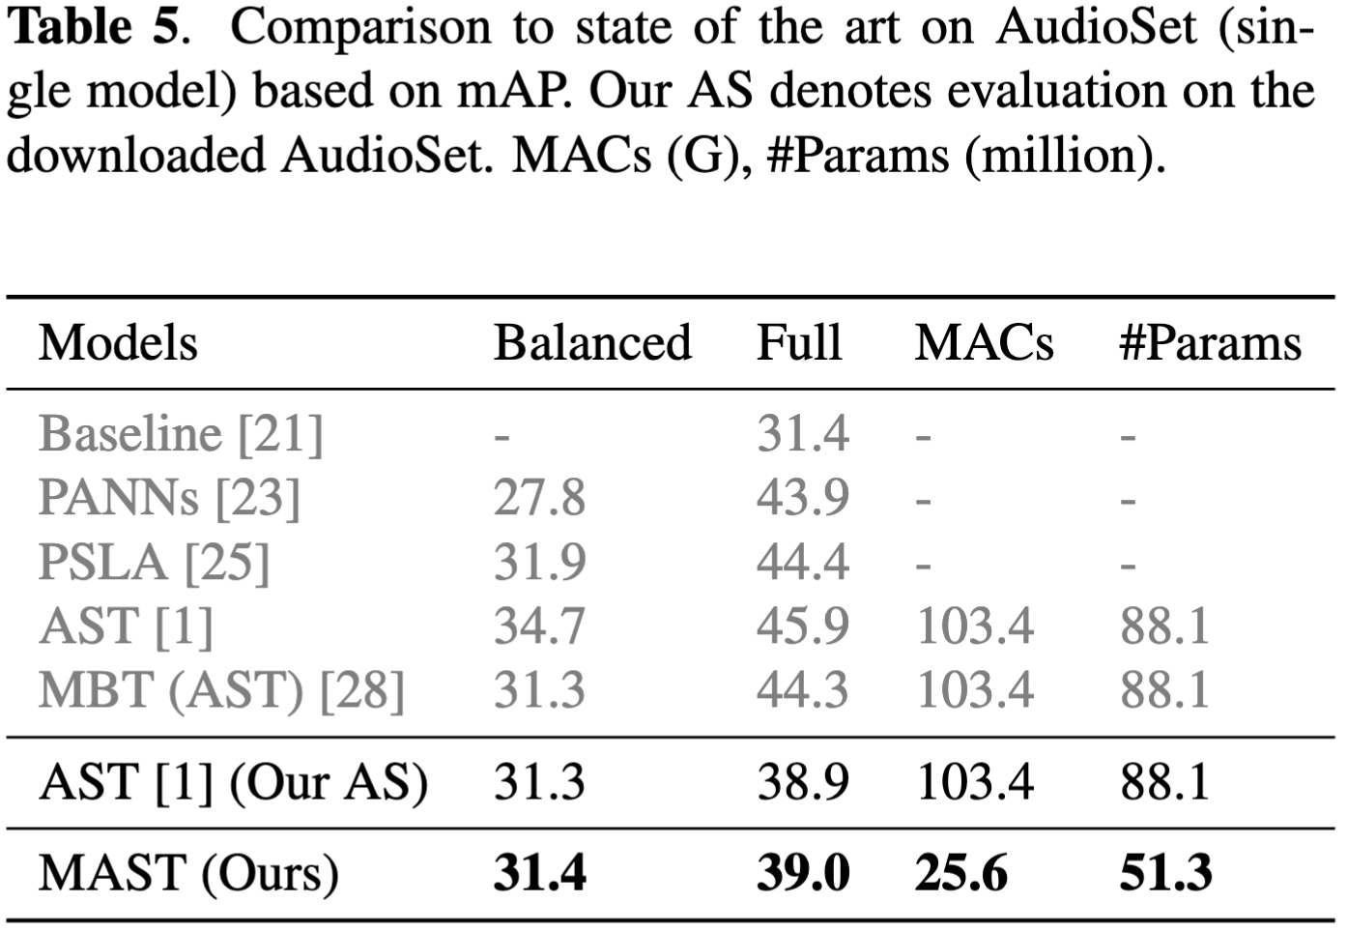
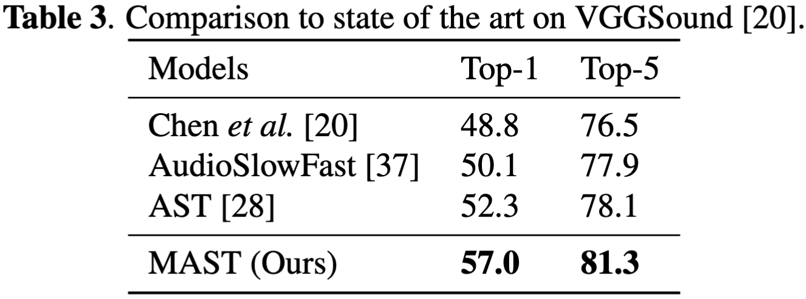
Results

Slide 7
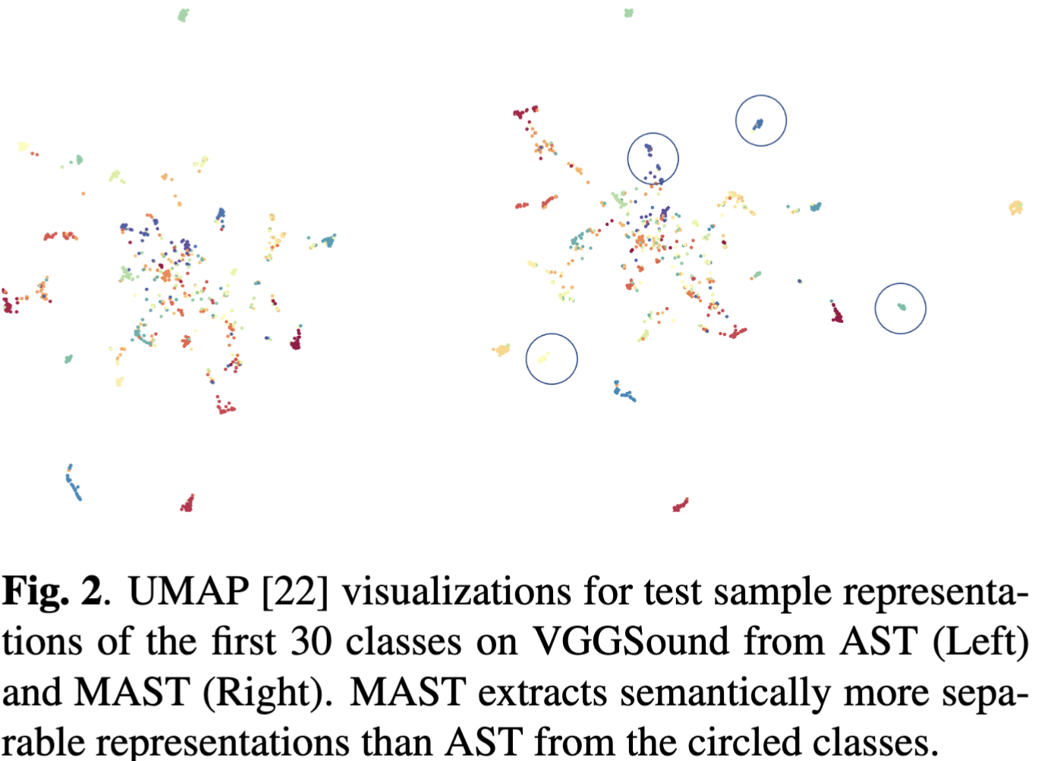
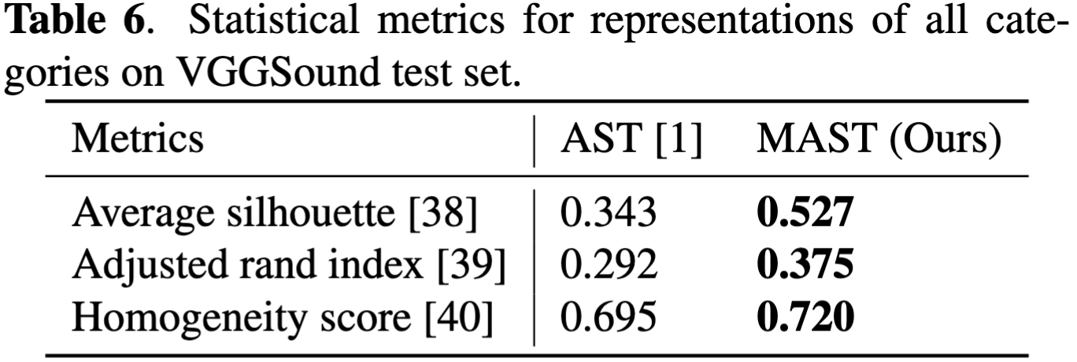
Results

Slide 8
Conclusion & Takeaway
Multiscale audio spectrum Transformer (MAST): a multiscale Transformer for audio classiﬁcation
MAST learns hierarchical representations from dense and simple to coarse and complex.
It outperforms AST by a large margin on 4 widely used datasets with only 24% MACs and 58% parameter numbers.
MAST is efﬁcient, light-weighted and high accurate, and it can be utilized as an essential building component for other applications, e.g., multimodal classiﬁcation [9, 10].
[9] AVT: Audio-Video Transformer for Multimodal Action Recognition, 2022
[10] Multiscale Multimodal Transformer for Multimodal Action Recognition, 2022

