Slide 1
Research on Knowledge Distillation of Generative Adversarial Networks
Wei Wang, Baohua Zhang, Tao Cui, Yimeng Chai, Yue Li
College of Computer Science, Tianjin Key Lab of Network and Data Security Technology, Nankai University

Slide 2
Proposed Method
Figure1

Slide 3
Proposed Method
STOS. As shown in Figure 1 a), there is only the soft target when the student generator is trained. STOS ignores the hard target and expects the student G could be well-trained only by soft target, both in approaching teacher network and achieving the distribution of the real samples. However, we find it is difficult to make the student network achieve the desired distribution.
$ℒ_{Full}=E_{z\sim P\left(z\right)}[f(G_{T}\left(z\right),G_{S}(z))]$ where f is distillation loss function
IHTS. As shown in Figure 1 b), it requires the student discriminator to inherit the teacher discriminator parameters. We define the student network generator loss as the hard target of knowledge distillation when the discriminator is fixed, and the output of the teacher network generator as the soft target to distill GANs. The objective of IHTS is as following:
$$ℒ_{Full}=E_{x\sim P\left(x\right)}[logD(x)]+E_{z\sim P\left(z\right)}[log⁡(1−D(G(z)))]+L_{Soft}$$
We define $P_{g}|θ_{T}^{D}$ as the conditional probabilistic difference given condition of the inheriting $D_{T}$. So, in the training process, the optimal G is as following:
$$C\left(G\right)=−log4+2∙JSD(P_{Data}{||(P_{g}|θ}_{T}^{D}))+L_{Soft}$$
According to the Jensen-Shannon divergence(JSD) definition, the only solution for C(G) to reach the global minimum is $P_{Data}{=(P_{g}|θ}_{T}^{D})$. However our goal is to make $P_{Data}=P_{g}$, so IHTS achieves good solution if and only if $P_{g}⊥θ_{T}^{D}$.
RHTS. After the above analysis, the student network achieves good solution only if $P_{g}⊥θ_{T}^{D}$. So $D_{s}$ parameters are initialized randomly in RHTS as shown in Figure 1 c). the optimal G is as following:
$$C\left(G\right)=−log4+2∙JSD(P_{Data}||P_{g})+L_{Soft}$$
As analyzed above, C(G) achieves the global minimum, i.e. $P_{g}\left(x\right)=P_{Data}(x)$.

Slide 4
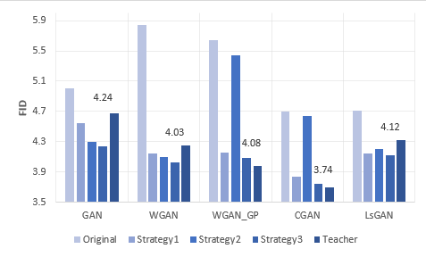
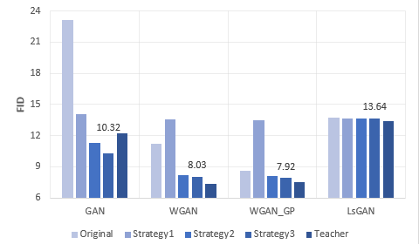
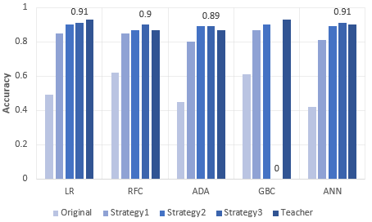
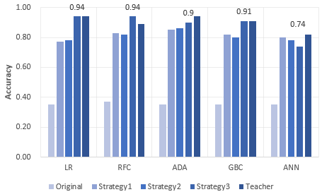
Results
MNIST CIFAR-10
Australian Credit
Figure2

Slide 5
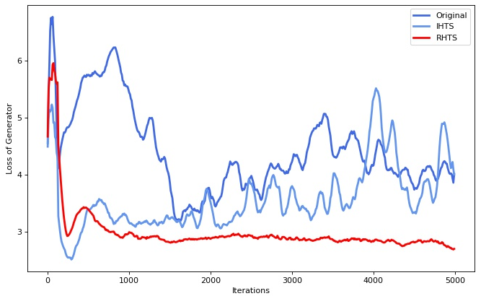
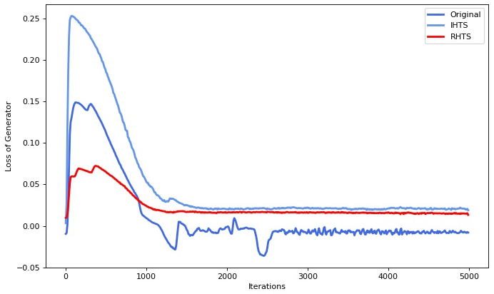
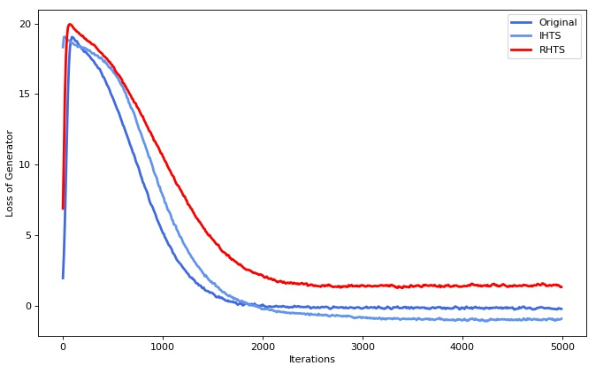
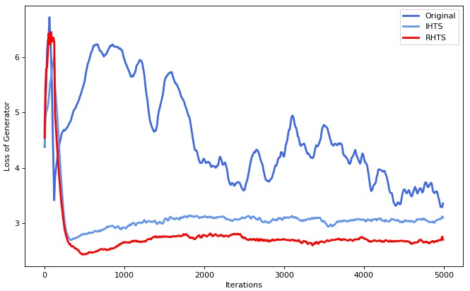
Results
CGAN WGAN
WGAN-GP LSGAN
Figure3

Slide 6
Results
From Figure 2, we conclude that the three training strategies achieve the purpose of distilling the teacher network. On the four data sets, the performance of the Student network networks is better than the GANs trained by conventional way. The FID is lower by about 10%, and the Accuracy rate improved by about 50 percent. In the experiment, we also found that the compression strategies are also very robust to the adjustment of some hyperparameters, working under various hyperparameters. In some models, the performance of the student network even surpasses the teacher network, such as the GAN, WGAN and LSGAN models on the MNIST dataset and the WGAN model on the CIFAR-10 dataset.
Comparison of the three strategies. It can be concluded from Figure 3 that RHTS is the best. Among the multiple GANs models on the four data sets, the performance of the student network distilled by RHTS is better than STOS, IHTS. In experiments, we also found that the student network with RHTS compression has greater stability and hardly collapsed. This is consistent with our expectations in the theoretical part.
Stability. It can be seen from Figure 3 that the loss of the student generator trained with IHTS and RHTS are smoother than the generator trained with the conventional method. And the final convergence point is lower. In the experiment, we found that the student network trained with IHTS and RHTS basically does not experience model collapse, and GANs trained in the conventional way are more likely to collapse.

