Slide 1
ICASSP 2024
The Multimodal Information based Speech Processing (MISP) 2023
Challenge: Audio-visual Target Speaker Extraction
Shilong Wu¹, Chenxi Wang¹, Hang Chen¹, Yusheng Dai¹, Chenyue Zhang¹,
Ruoyu Wang¹, Hongbo Lan¹, Jun Du^{1,*}, Chin-Hui Lee², Jingdong Chen³,
Sabato Marco Siniscalchi^{2,5}, Odette Scharenborg⁶, Zhong-Qiu Wang⁴, Jia Pan⁷, Jianqing Gao⁷
¹University of Science and Technology of China, China; ²Georgia Institute of Technology, USA;
³Northwestern Polytechnical University, China; ⁴Carnegie Mellon University, USA;
⁵Kore University of Enna, Italy; ⁶Delft University of Technology, The Netherlands; ⁷iFlytek, China

Slide 2
Contents
1 Background & Motivation
2 Dataset & Task Setting
3 Baseline System
3.1 Data Preparation
3.2 System Architecture
3.3 Training Process
4 Results & Analysis
5 Conclusion

Slide 3
Contents
1 Background & Motivation
2 Dataset & Task Setting
3 Baseline System
3.1 Data Preparation
3.2 System Architecture
3.3 Training Process
4 Results & Analysis
5 Conclusion

Slide 4
Background & Motivation
Audio-visual Target Speaker Extraction (AVTSE) refers to the estimation of the target speaker's speech from a mixed audio stream using both audio and visual cues.
Recently, an increasing number of researches focus on AVTSE task. However, no publicly available benchmark exists.
To fill this gap, the Multi-modal Information based Speech Processing (MISP) 2023 challenge focuses on the AVTSE task.
Notes:
In real-world scenarios, the complex and adverse acoustic environment is one of the main challenges of automatic speech recognition (ASR) and other back-end tasks.
The strong noise, reverberation, and multi-speaker interference result in a serious impact on the system performance. Effective front-end speech processing technologies, like speech enhancement and speech separation, have been proven to play a significant role in improving speech quality, thereby enhancing the performance of back-end systems.
Audio-visual Target Speaker Extraction (AVTSE) refers to the estimation of the target speaker‘s speech from a mixed audio stream using both audio and visual cues. In real-world scenarios, acquiring visual clues is common, which can effectively overcome the challenges encountered by Audio-only TSE. As a result, an increasing number of researches focus on audio-visual TSE (AVTSE). However, no publicly available benchmark exists.
To fill this gap, the Multi-modal Information based Speech Processing (MISP) 2023 challenge focuses on the AVTSE task.

Slide 5
Background & Motivation
Expanding the scope to front-end speech processing technology, there are already several relevant challenges within the field of speech enhancement.
The MISP2023 challenge differs from previous speech enhancement challenge in two significant aspects.
The performance of the system in real-world scenarios.
The impact of the system on back-end speech recognition.
Notes:
Expanding the scope to front-end speech processing technology, there are already several relevant challenges within the field of speech enhancement. The MISP2023 challenge differs from previous speech enhancement challenge in two significant aspects.
The performance of the system in real-world scenarios.
The impact of the system on back-end speech recognition.

Slide 6
Background & Motivation
In the previous MISP challenges, we released a large distant multi-microphone conversational Chinese audio-visual corpus that focuses on real home-TV scenarios, where 2-6 speakers freely converse without specific topics.
Building upon the above analysis, the MISP 2023 challenge aims to improve the accuracy of the back-end ASR system through the AVTSE system in real-world scenarios using the MISP corpus. More details can be found on the website¹.
¹https://mispchallenge.github.io/mispchallenge2023
Notes:
In the previous MISP challenges, we released a large distant multi-microphone conversational Chinese audio-visual corpus that focuses on real home-TV scenarios, where 2-6 speakers freely converse without specific topics.
Building upon the above analysis, the MISP 2023 challenge aims to improve the accuracy of the back-end ASR system through the AVTSE system in real-world scenarios using the MISP corpus.

Slide 7
Contents
1 Background & Motivation
2 Dataset & Task Setting
3 Baseline System
3.1 Data Preparation
3.2 System Architecture
3.3 Training Process
4 Results & Analysis
5 Conclusion

Slide 8
Dataset & Task Setting
The MISP corpus focuses on real home-TV scenarios. Speakers engage in spontaneous conversations without specific topics, posing a challenge due to the significant speech overlap and diversity. The data set has the following features:
Simultaneous recordings from multiple microphone arrays and video cameras;
30+ real room acoustics and 250+ native Chinese, speaking Mandarin;
High overlaps ratios (20%-40%) in multi-talker conversions;
Real domestic noise backgrounds, e.g., TV, air conditioning, movement, etc.;
Strong reverberation that varies depending on different rooms
Notes:
The MISP corpus focuses on real home-TV scenarios. Speakers engage in spontaneous conversations without specific topics, posing a challenge due to the significant speech overlap and diversity. The data set has the following features:
Simultaneous recordings from multiple microphone arrays and video cameras;
30+ real room acoustics and 250+ native Chinese, speaking Mandarin;
High overlaps ratios (20%-40%) in multi-talker conversions;
Real domestic noise backgrounds, e.g., TV, air conditioning, movement, etc.;
Strong reverberation that varies depending on different rooms

Slide 9
Dataset & Task Setting
The specific statistics of the dataset are as follows. We have performed data cleaning on the raw training set, and the cleaning process will be described in the baseline section
Table 1 Dataset information

Slide 10
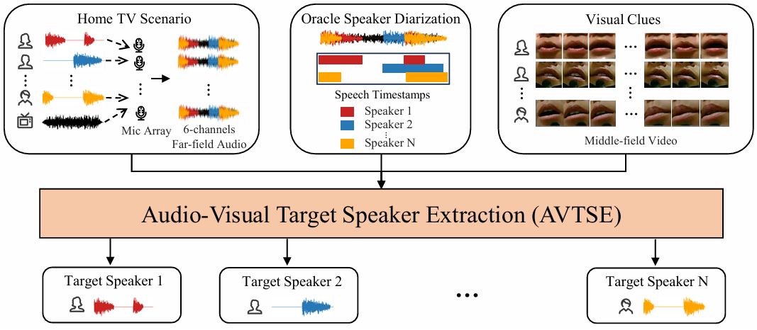
Dataset & Task Setting
Fig. 1. Overview of the AVTSE task in MISP 2023 challenge.
The MISP 2023 challenge focuses on the AVTSE task, as shown in Figure 1. Participants must utilize multi-channel far-field audio along with the target speaker’s middle-field video to extract the target speaker’s speech from audio recording. In one session, each speaker is sequentially treated as the target speaker.
Notes:
The MISP 2023 challenge focuses on the AVTSE task, as shown in Figure 1. Participants must utilize multi-channel far-field audio along with the target speaker’s middle-field video to extract the target speaker’s speech from audio recording. In one session, each speaker is sequentially treated as the target speaker. In addition, we will also provide the oracle diarization results because this is the first edition of the AVTSE challenge, and not providing them would bring greater difficulties to participants.

Slide 11
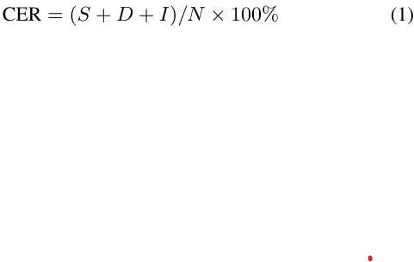
Dataset & Task Setting
The objective of the MISP 2023 challenge is to enhance the front-end AVTSE system to extract clearer speech of the target speaker, thereby improving the accuracy of speech recognition while keeping the back-end ASR system unaltered.
We will provide a pre-trained ASR model, including both model parameters and code. Participants can test the extracted speech in the development set to make adjustments to the AVTSE model.
For ranking, we use the character error rate (CER) as the evaluation metric:
where, S, D, and I represent the number of substitutions, deletions, and insertions. N is the number of characters in ground truth.
During the evaluation stage, participants must submit the extracted speech, which we will decode and use to calculate CER.
Notes:
The objective of the MISP 2023 challenge is to enhance the front-end AVTSE system to extract clearer speech of the target speaker, thereby improving the accuracy of speech recognition while keeping the back-end ASR system unaltered. We will provide a pre-trained ASR model, including both model parameters and code. Participants can test the extracted speech in the development set to make adjustments to the AVTSE model.
For ranking, we use the character error rate (CER) as the evaluation metric.
During the evaluation stage, participants must submit the extracted speech, which we will decode and use to calculate CER. Therefore, participants do not need to modify the ASR model. However, they can still conduct joint training on the front-end and backend systems with fixed back-end parameters. This is also an avenue we encourage participants to explore. Furthermore, we will calculate the DNSMOS P.835 [15] as a reference to explore the relationship between speech auditory quality and back-end tasks.

Slide 12
Contents
1 Background & Motivation
2 Dataset & Task Setting
3 Baseline System
3.1 Data Preparation
3.2 System Architecture
3.3 Training Process
4 Results & Analysis
5 Conclusion

Slide 13
Baseline System - Data Preparation
To achieve complete alignment between speech signals, the initial step involves utilizing near-field data to simulate far-field conditions as the training data.
Data cleaning:
1. Segment the near-field speech based on timestamps, ensuring that each segment contains the speech of a single speaker;
2. Employ the DNSMOS P.835 to identify segments with high speech quality, resulting in the inclusion of a total of 22.13 hours of high-quality near-field speech segments.
Data simulation:
1. Randomly combine near-field speech;
2. Add noise with different signal-to-noise ratios (SNR) from -10dB to +20dB and reverberation related to room parameters to simulate 6-channels far-field audio.
Notes:
To achieve complete alignment between speech signals, the initial step involves utilizing near-field data to simulate far-field conditions as the training data.
Data cleaning:
1. Segment the near-field speech based on timestamps, ensuring that each segment contains the speech of a single speaker;
2. Employ the DNSMOS to identify segments with high speech quality, resulting in the inclusion of a total of 22.13 hours of high-quality near-field speech segments.
Data simulation:
1. Randomly combine near-field speech;
2. Add noise with different signal-to-noise ratios (SNR) from -10dB to +20dB and reverberation related to room parameters to simulate 6-channels far-field audio.

Slide 14
Contents
1 Background & Motivation
2 Dataset & Task Setting
3 Baseline System
3.1 Data Preparation
3.2 System Architecture
3.3 Training Process
4 Results & Analysis
5 Conclusion

Slide 15
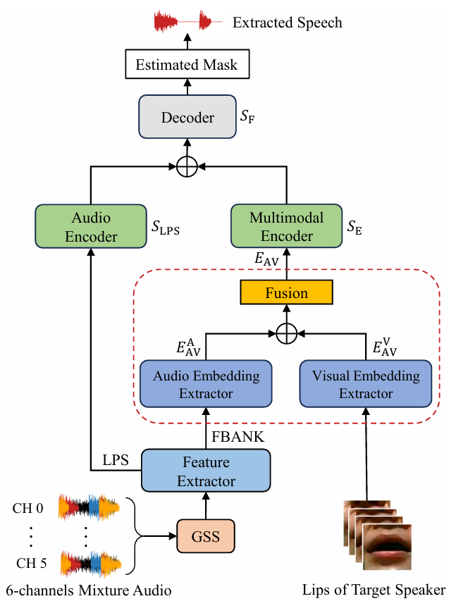
Baseline System – System Architecture
As shown in Figure 2, the baseline system is mainly based on our recent work - the multimodal embedding aware speech enhancement (MEASE) ^{[1]} model, which has achieved “SOTA” in the field of audio-visual speech enhancement (AVSE).
Firstly, we leveraged the oracle diarization results to conduct guided source separation (GSS) on 6-channels mixture audio to initially mitigate the impact of the overlapping speech. Then we use the MEASE model to further extract the speech of the target speaker.
Fig. 2. Diagram of the baseline system.
[1]Hang Chen, Jun Du, Yu Hu, et al., “Correlating subword articulation with lip shapes for embedding aware audio-visual speech enhancement,” Neural Networks, vol. 143, pp. 171–182, 2021.
Notes:
As shown in Figure 2, the baseline system is mainly based on our recent work - the multimodal embedding aware speech enhancement (MEASE) ^{[1]} model, which has achieved “SOTA” in the field of audio-visual speech enhancement (AVSE).
Firstly, we leveraged the oracle diarization results to conduct guided source separation (GSS) on 6-channels mixture audio to initially mitigate the impact of the overlapping speech. Then we use the MEASE model to further extract the speech of the target speaker.
The detailed structure of the network can be referred to in the paper.

Slide 16
Contents
1 Background & Motivation
2 Dataset & Task Setting
3 Baseline System
3.1 Data Preparation
3.2 System Architecture
3.3 Training Process
4 Results & Analysis
5 Conclusion

Slide 17
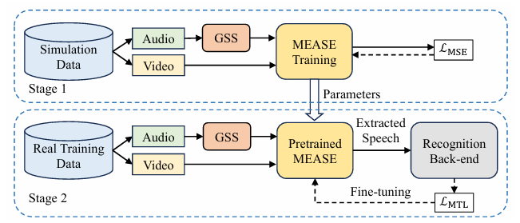
Baseline System – Training Process
Fig. 3. The two-stage training process of the baseline system.
As shown in Figure 3, the training process of the baseline system encompasses two stages:
Firstly, we trained the MEASE model using the simulated data with MSE loss. However, this training method can distort the extracted speech by not accounting for back-end recognition task, affecting accuracy.
In the second stage, we fine-tuned the pre-trained MEASE model using the recognition back-end. Furthermore, to mitigate the issue of mismatch between simulated data and real-world scenarios, we utilized the real far-field data from the training set in the second stage.
Notes:
As shown in Figure 3, the training process of the baseline system encompasses two stages:
Firstly, we trained the MEASE model using the simulated data with MSE loss. However, this training method can distort the extracted speech by not accounting for back-end recognition task, affecting accuracy.
In the second stage, we fine-tuned the pre-trained MEASE model using the recognition back-end. Furthermore, to mitigate the issue of mismatch between simulated data and real-world scenarios, we utilized the real far-field data from the training set in the second stage.
Because we require that the parameters of the back-end system cannot be changed, we freeze the recognition model and only use the loss returned by it.

Slide 18
Contents
1 Background & Motivation
2 Dataset & Task Setting
3 Baseline System
3.1 Data Preparation
3.2 System Architecture
3.3 Training Process
4 Results & Analysis
5 Conclusion

Slide 19
Results & Analysis
Table 1. Detailed CER (%) and DNSMOS results of different front-end systems on the development set.
Table 1 shows the results of different front-end systems in the speech recognition evaluation metric and DNSMOS P.835. Among these systems, AEASE is a simplified version of MEASE, as it does not utilize the visual modality. The results of “GSS+MEASE+Finetune” serve as our final baseline results. The results show that the model can better preserve the target speaker’s speech and remove more irrelevant noise, while the speech recognition results are also improved.
However, although our baseline system surpasses GSS in terms of DNSMOS, its speech recognition performance is only comparable to that of GSS. Due to noise suppression, it is inevitable to introduce more deletion errors. This is sufficient to demonstrate that in real scenarios, our task is very challenging.
Notes:
Table 1 shows the results of different front-end systems in the speech recognition evaluation metric and DNSMOS. Among these systems, AEASE is a simplified version of MEASE, as it does not utilize the visual modality. The results of “GSS+MEASE+Finetune” serve as our final baseline results. The results show that the model can better preserve the target speaker’s speech and remove more irrelevant noise, while the speech recognition results are also improved.
However, although our baseline system surpasses GSS in terms of DNSMOS, its speech recognition performance is only comparable to that of GSS. Due to noise suppression, it is inevitable to introduce more deletion errors. This is sufficient to demonstrate that in real scenarios, our task is very challenging.

Slide 20
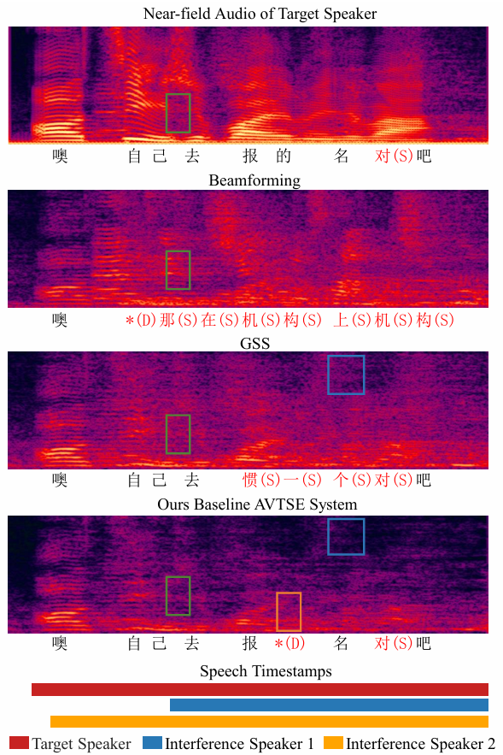
Results & Analysis
Figure 4 is an example of a mixture with multi-speaker interference and strong TV background noise. We compared the spectrograms and the recognition results obtained from different systems.
Firstly, we directly perform ASR decoding on near-field audio and obtain the result that is likely to be at the theoretical limit. Then, we compared beamforming, GSS, and baseline AVTSE system for far-field audio.
Our baseline AVTSE system can further reduced noise, resulting in the best recognition results on far-field audio. However, there is still a significant quality gap between the extracted speech and near-field audio.
Fig. 4. Spectrograms and recognition results of an example.
Notes:
Figure 4 is an example of a mixture with multi-speaker interference and strong TV background noise. We compared the spectrograms and the recognition results obtained from different systems.
Firstly, we directly perform ASR decoding on near-field audio and obtain the result that is likely to be at the theoretical limit. Then, we compared beamforming, GSS, and baseline AVTSE system for far-field audio.
Our baseline AVTSE system can further reduced noise, resulting in the best recognition results on far-field audio. However, there is still a significant quality gap between the extracted speech and near-field audio.

Slide 21
Results & Analysis
As shown in the green boxes in Figure 4, there is a notable presence of the interference speakers’ speech in the far-field audio. However, due to the influence of the visual modality, AVTSE has the capability to filter out this interference.
As demonstrated in the blue boxes, the certain background noise that remains in GSS output will largely be eliminated by AVTSE, consequently correcting the back-end recognition results.
Nevertheless, as shown in the yellow box, our baseline system inevitably filters out some vocal components while suppressing noise, resulting in deletion errors. Therefore, there is still significant potential for improvement within the AVTSE system.
Therefore, extracting the target speaker’s speech while suppressing noise is challenging.
Fig. 4. Spectrograms and recognition results of an example.
Notes:
As shown in the green boxes in Figure 4, there is a notable presence of the interference speakers’ speech in the far-field audio. However, due to the influence of the visual modality, AVTSE has the capability to filter out this interference.
As demonstrated in the blue boxes, the certain background noise that remains in GSS output will largely be eliminated by AVTSE, consequently correcting the back-end recognition results.
Nevertheless, as shown in the yellow box, our baseline system inevitably filters out some vocal components while suppressing noise, resulting in deletion errors. Therefore, there is still significant potential for improvement within the AVTSE system.
Therefore, extracting the target speaker’s speech while suppressing noise is challenging.

Slide 22
Contents
1 Background & Motivation
2 Dataset & Task Setting
3 Baseline System
3.1 Data Preparation
3.2 System Architecture
3.3 Training Process
4 Results & Analysis
5 Conclusion

Slide 23
Conclusion
In this paper, we provide a detailed description of the dataset, task setting, and baseline system for the MISP 2023 challenge, which is the first benchmark of the AVTSE task.
We also conducted a deep analysis of the baseline experimental results, highlighting that the AVTSE task continues to hold significant research potential in real- world scenarios.
In the future, we plan to explore the solutions for AVTSE systems on long recordings and incorporate the subjective listening test to further research the relationship between the real speech auditory quality and the performance of back-end tasks.
Notes:
In this paper, we provide a detailed description of the dataset, task setting, and baseline system for the MISP 2023 challenge, which is the first benchmark of the AVTSE task.
We also conducted a deep analysis of the baseline experimental results, highlighting that the AVTSE task continues to hold significant research potential in real- world scenarios.
In the future, we plan to explore the solutions for AVTSE systems on long recordings and incorporate the subjective listening test to further research the relationship between the real speech auditory quality and the performance of back-end tasks.

Slide 24
Q&A
Thanks for listening!
If you have any questions about this paper, welcome to leave a comment and I will answer them.

