Slide 1
IMPROVING MEDICAL DIALOGUE GENERATION WITH ABSTRACT MEANING REPRESENTATIONS
Bohao Yang∗, Chen Tang∗, Chenghua Lin†
University of Manchester, United Kingdom
University of Surrey, United Kingdom
Notes:
Hello, everyone, I am very pleased to present our work, which is about automatic evaluation on open-domain dialogue

Slide 2
Outline
Background and Motivation
Methodology
Experimental Results
Conclusion

Slide 3
Background and Motivation
The goal of telemedicine is to provide patients with digital access to medical information, particularly when direct access to a medical professional is limited.
Existing studies focus on incorporating textual representations, limiting the ability to represent the semantics of text, such as ignoring important medical entities.
Sequential features in text struggle to represent the intricate medical grounds and principles of diagnosis in medical dialogues.
We introduce Abstract Meaning Representations (AMR) to enhance the under_x0002_standing of the textual semantics and the medical knowledge includ_x0002_ing entities and relations.
Notes:
Medical Dialogue Generation serves a critical role in telemedicine by facilitating the dissemination of medical expertise to patients
The overarching goal of telemedicine is to provide patients with digital access to medical information, particularly in situations where direct access to a medical professional may be limited [1, 2]. Prior research in this field has predominantly focused on incorpo_x0002_rating medical knowledge by leveraging various types of additional annotations, including frequent items [3], named entities [4], entity relations [5], etc.
However, unlike open-domain dialogue generation, the sequential features provided by text annotations struggle to comprehensively represent the intricate medical grounds and principles of diagnosis contained within medical dialogues.
therefore, To enhance the model’s under_x0002_standing of the textual semantics and the medical knowledge includ_x0002_ing entities and relations, we introduce the use of Abstract Meaning
Representations (AMR) to construct graphical representations that describe the roles of language component and medical entities within the dialogues.

Slide 4
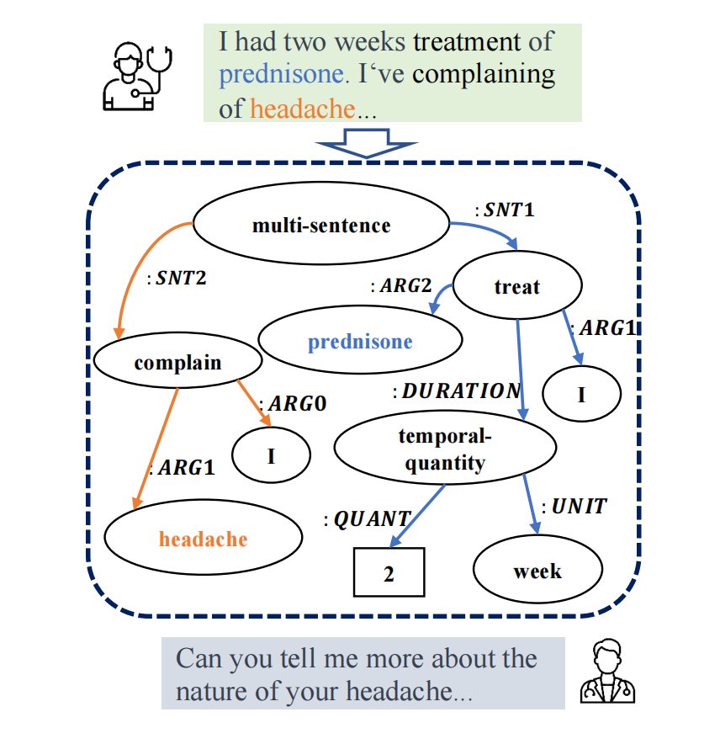
Novelty
We construct dialogue-level AMR graphs that represents medical entities and relations within the dialogue
We exploit both textual and graph-based features to enhance the language model on medical dialogue generation.
Notes:
We construct dialogue-level AMR graphs that represents medical entities and relations within the dialogue
We exploit both textual and graph-based features to enhance the language model on medical dialogue generation.
An example showing how an AMR graph represents the dialogues of a patient. Terminologies from different sentences are shown in blue and orange colour
AMR graphs provide a structured and semantically rich representation of language [6]. In the com_x0002_plex and critically important field of medicine, clear and precise communication is paramount. AMR graphs offer a standardised way to capture the relationships between words, entities, and their corresponding meanings, reducing ambiguity and potential misunderstandings in medical conversations. This enables medical professionals and patients to more easily interpret and trust the information conveyed, facilitating better decision-making, treatment adherence, and overall patient care
The incorporation of AMR graphs into the medical dialogue generation system enhances its capacity to comprehend the intricate semantics and contextual nuances embedded within textual content.
Consequently, this integration empowers the system to generate context-aware medical dialogues.

Slide 5
Methodology
Our framework models dialogues between patients and healthcare professionals using both textual and AMR graphical knowledge.
Notes:
the goal of this task is to generate doctor-like responses in a medical dialogue context.
the framework models dialogues between patients and healthcare professionals using AMR graphs by incorporating textual and graphical knowledge with a dual attention mechanism.
then This combined representation is then used for the subsequent response decoding in an autoregressive manner.
Our framework benefit the vanilla language models on achieving more precise and naturally articulated medical dialogue generation via incorporating the textual representations with the
rich graph knowledge encapsulated by AMR graphs.

Slide 6
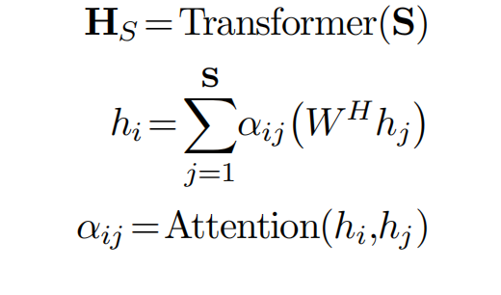
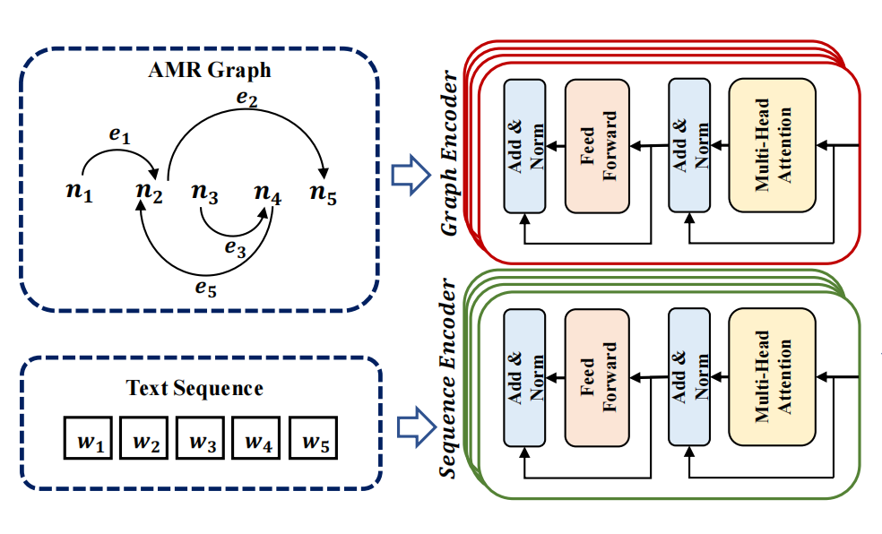
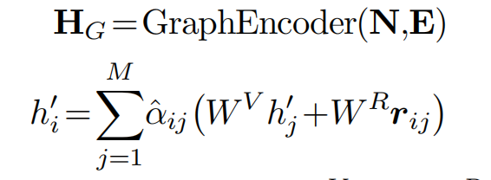
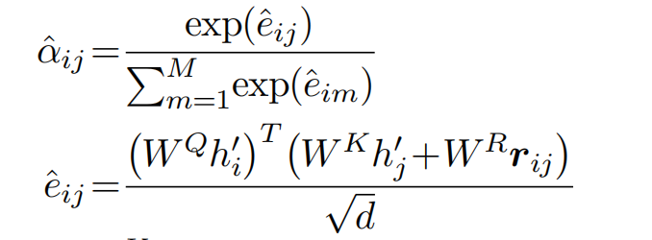
Text Encoder
Graph Encoder
Graph Attention
Text and Graph Encoders
Notes:
The Sequence encoder employed in this study adheres to the conven_x0002_tional Transformer architecturer, which is designed to take the input patient’s inquiry, denoted as Si= {w1,w2,...,wS}, and subse_x0002_quently generates a corresponding sentence representation, denoted as HS. Formally, the sequence encoder is defined as follows:
graph
We employ a Graph Transformer to encode AMR graphs. An AMR graph G which consists of graph nodes denoted by N and graph edges denoted by E.
. The Graph encoder processes these nodes and relations as input and is formally defined as follows:
The graph attention of the Graph Transformer module is formally
represented as follows
The Graph Transformer effectively encodes structural information, represented by rij, for all pairs of nodes within the AMR graphs. This incorporation of graph edge information enriches
the node representations, enhancing the overall encoding process.

Slide 7
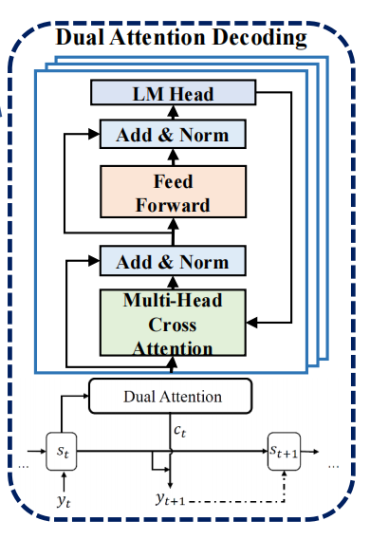
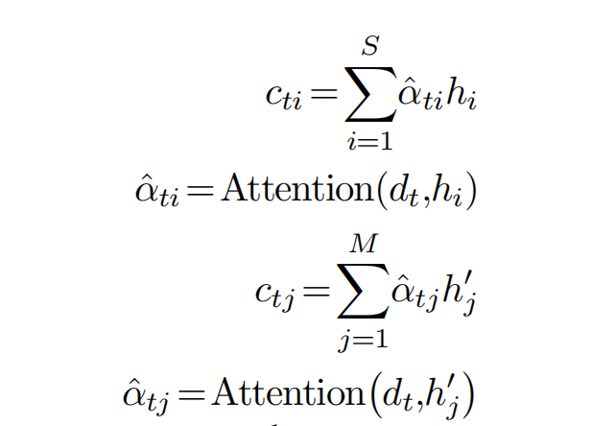
Dual Attention
NSP probability
Fused feature
Notes:
Once we obtained the sentence representation HS and graph
representation HG, we proceed to input them into the decoder
equipped with a dual attention mechanism. For each decoder hidden
state dt, the dual-attention mechanism produce a sequence context
vector ctS and a graph context vector ctG at each time step t :
Subsequently, we concatenate the sequence context vector ctS and
the graph context vector ctG to compose the ultimate context vector
ˆct. This combination is formally represented as:

Slide 8
Result
BLEU (B-n), ROUGE (R-n) and Diversity (D-n),
Notes:
We conduct the experiments on an open-sourced medical dialogue generation datasets. To get the AMR graphs, we adopt an open-source pre-trined AMR parser [9] in transforming utterances into corresponding AMR
we employ a range of both referenced and unreferenced metrics in our experiments. BLEU (B-n) [20] and ROUGE (R-n) measure the quality of generated responses by assessing their n-gram
overlaps with reference responses. Additionally, we employ diversity, following the approach outlined in [22],
by quantifying the n-gram distinction, denoted as Diversity (D-n),
BART and T5 A language model distinguished by its encoder-decoder architecture, successfully adapted for diverse
generation tasks.
GPT-2 [18]: A popular pre-trained language model widely applied in dialogue generation tasks.
DialoGPT [19]: A dialogue-oriented pre-trained GPT-2 model known for its strong performance in dialogue generation tasks. Term-BART [19]:
An advanced framework specifically tailored for medical dialogue generation, representing the state-of-the-art in the field.
our proposed framework outperforms all baseline models across both referenced and unreferenced evaluation metrics. This results illustreate the positive effect of introducing (AMR) on enhancing the knowl_x0002_edge incorporating capabilities of the language model. Specifically, the marked enhancement in referenced metrics, such as BLEU and ROUGE, indicates the model’s capacity to generate responses that encapsulate medical knowledge grounds as the gold references do. In addition, the substantial improvement on the unreferenced metrics, i.e. Dist-1 and Dist-4, signifies that the diversity of generated text is also improved via the incorporation of the graph representations. We posit that this outcome can be attributed to the improved flexibility inherent in the graph representations of the dialogue context.

Slide 9
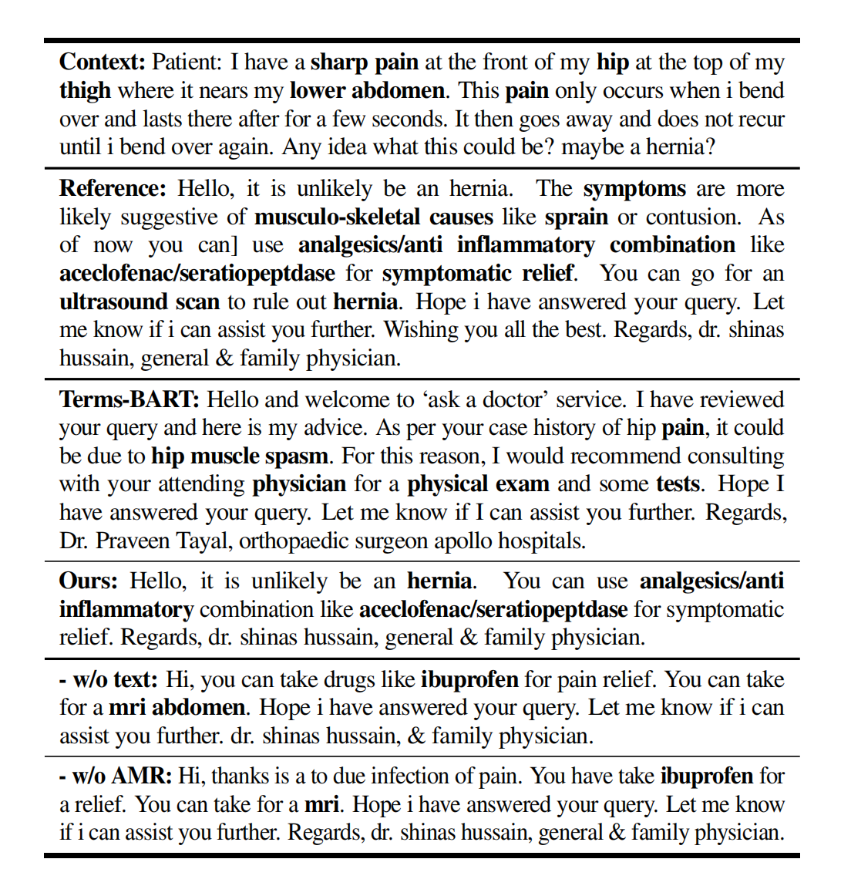
Case Study
Notes:
For qualitative analysis, we present the generated dialogues from different models in Table 2. It can be observed that even though the previous state-of-the-art model Terms-BART uses more terminolog_x0002_ical knowledge when answering the question, dialogues generated by ours address the patient’s queries more effectively, where the terminologies in the response are more related to the context. This improvement can be attributed to our model’s enhanced capability in capturing semantics and logical structures, which are attained from the additional Abstract Meaning Representation (AMR) graphs.The performance improvement of our model is further demonstrated via a comparison with the response generated by the model variant that does not utilise AMR representations (- w/o AMR).

Slide 10
Conclusion
In this paper, we propose
(1)a novel framework incorporate AMR graph into medical dialogue generation to better model the patient-doctor dialogues.
(2) Our model outperforms a wide range of baseline methods including SOTA, which enhancing the quality of medical dialogue generation by leveraging medical knowledge and logical relationships.
Notes:
In conclusion, our approach, which are the first to integrates Ab_x0002_stract Meaning Representations (AMR) to capture the semantics and medical terminologies embedded within dialogues, offers a novel and effective framework for modeling patient-doctor dialogues. Through incorporating the textual and graphical knowledge into a unified language model, our proposed framework achieves the state-of-the-art performance, and the experimental results show a substantial performance improvement over baseline models in the domain of medical dialogue generation. This demonstrates the strong potential of our framework in empowering language models to leverage medical knowledge and logical relationships, ultimately enhancing the quality of medical dialogue generation.

Slide 11
Thanks!

