Slide 1
Parameter-Efficient Adaptation for Computational Imaging
Nebiyou Yismaw^{UCR}, Ulugbek Kamilov^{WUSTL}, M. Salman Asif^{UCR}

Slide 2
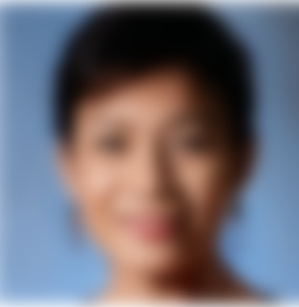
Inverse problems in Computational Imaging
Applications
Magnetic Resonance Imaging (MRI)
Inverse Computation
Subsampled k space
Output reconstruction
Image Super-Resolution
Inverse Computation
Low resolution image
High-resolution image
Notes:
Inverse problems are fundamental in computational imaging, where numerous imaging applications can be characterized as inverse problems.
These problems find applications across various domains, including magnetic resonance imaging (MRI), where instruments are utilized to capture anatomical data.
Computational algorithms play a vital role in reconstructing the original image from these measurements. Additionally, inverse problems are integral to image restoration tasks such as super-resolution, which aims to enhance and upscale low-resolution images.

Slide 3
Inverse problems in Computational Imaging
Image
Measurement
Measurement Process
: Forward model
: Measurement noise
Notes:
An inverse problem involves the challenging task of retrieving an unknown image or signal of interest from a noisy measurements. This requires computational algorithms and techniques to accurately reconstruct the original data.
The measurement process is modeled using an operator A(x), often termed the forward model. This operator simulates a physical process by taking the true image or signal x as input and producing measurements y as output. Typically, measurement noise is incorporated into the model using additive noise η.

Slide 4
Inverse problems in Computational imaging
Image
Measurement
Inverse Problem
End-to-end reconstruction
Iterative methods
Notes:
When it comes to reconstructing images from measurements, we face a challenging task due to the ill-conditioned nature of the inverse problem. Various techniques have been developed to tackle this issue over the years. In this paper, we'll focus on deep learning-based methods. Among these methods are end-to-end reconstruction networks that are trained to directly map measurements to images. Additionally, there are iterative methods that solve optimization problems involving data consistency and denoising steps.

Slide 5
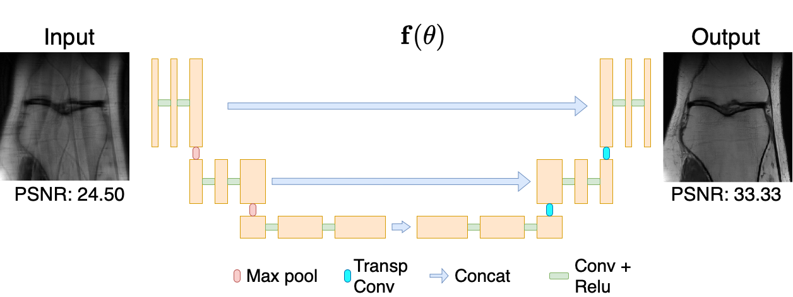
Deep networks for inverse problems
End-to-end networks
Learn a direct mapping 'f' from measurements to reconstructed images.
Ronneberger et al., “U-net: Convolutional networks for biomedical image segmentation. In Medical Image Computing and Computer-Assisted Intervention”–MICCAI 2015.
Notes:
An example of an end-to-end reconstruction network is a U-Net model that is trained to map an initial zero filled estimate from 4x sub-sampled radial MRI measurements to high quality knee images.
U-Net is a widely used architecture in medical image reconstruction. It uses a convolutional backbone, which forms the foundation of its architecture. This backbone consists of convolutional layers arranged in a U-shaped structure. This enables effective feature extraction and hierarchical representation learning essential for accurate reconstruction and segmentation tasks in medical imaging.
The effectiveness of this approach is evident in the reconstruction performance displayed in the figure, where the U-Net model successfully recovers the original knee scans with high fidelity.

Slide 6
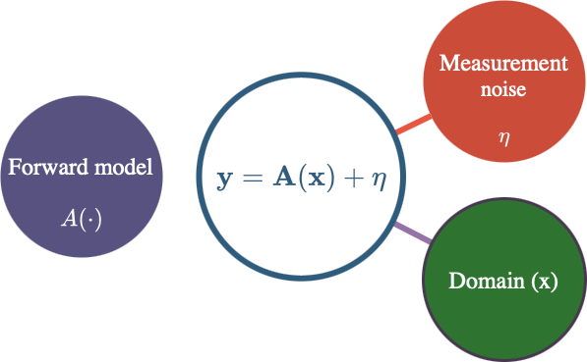
Inverse problems in Computational Imaging
Despite their impressive performance, deep learning-based methods lack robustness to shifts in:
The domain
The forward model
The noise level
Yismaw et al., "Domain Expansion via Network Adaptation for Solving Inverse Problems," in IEEE Transactions on Computational Imaging.
Notes:
Although deep learning-based methods show remarkable in-domain performance, they often exhibit a lack of robustness when faced with shifts in domain, forward model, and noise level. For instance, a network trained on knee MRI measurements may not perform well on brain scans. Similarly, changes in specific operators within the forward model can lead to a significant drop in performance.
Today, our focus will be on domain and forward model shifts. For a more extensive experiments covering a wider range of shifts in all three areas, please refer to our recent paper linked below.

Slide 7
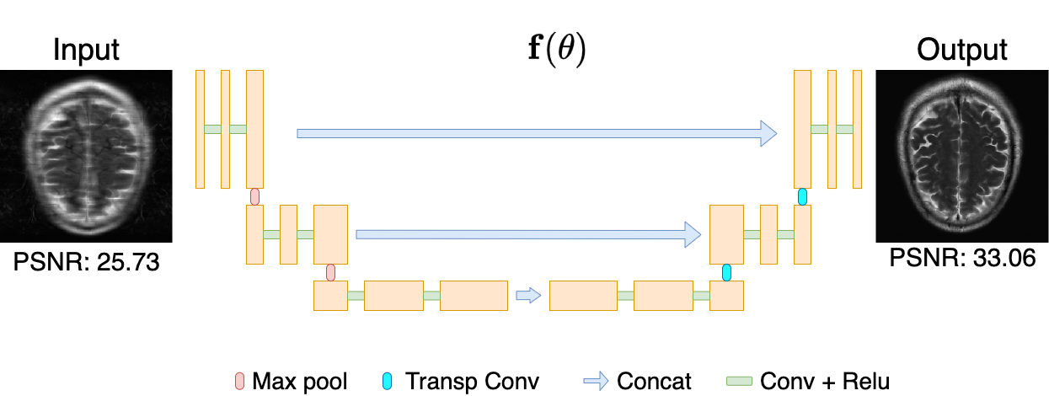
Performance under domain shift
In-domain testing
Train on Brain test on Brain
Notes:
Let's explore the effects of domain shift, starting with in-domain testing. For the following set of experiments, we will focus on MRI reconstruction from 4x subsampled radial measurements.
In this figure, we observe a network trained on brain MRI scans demonstrates strong performance when tested on measurements from the same distribution.

Slide 8
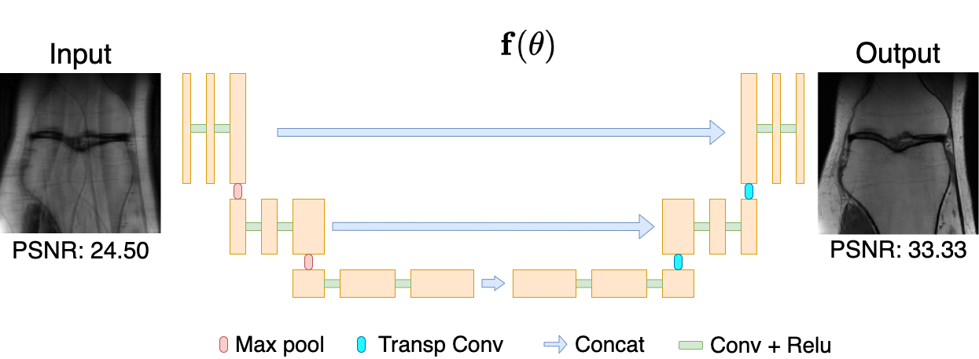
Performance under domain shift
In-domain testing
Train on Knee test on Knee
Notes:
Similarly, let's explore another in-domain test by utilizing knee MRI scans for the same reconstruction task. The results indicate that networks trained on knee measurements perform effectively in reconstructing knee MRI scans, showcasing their capability to handle domain-specific data with proficiency.

Slide 9
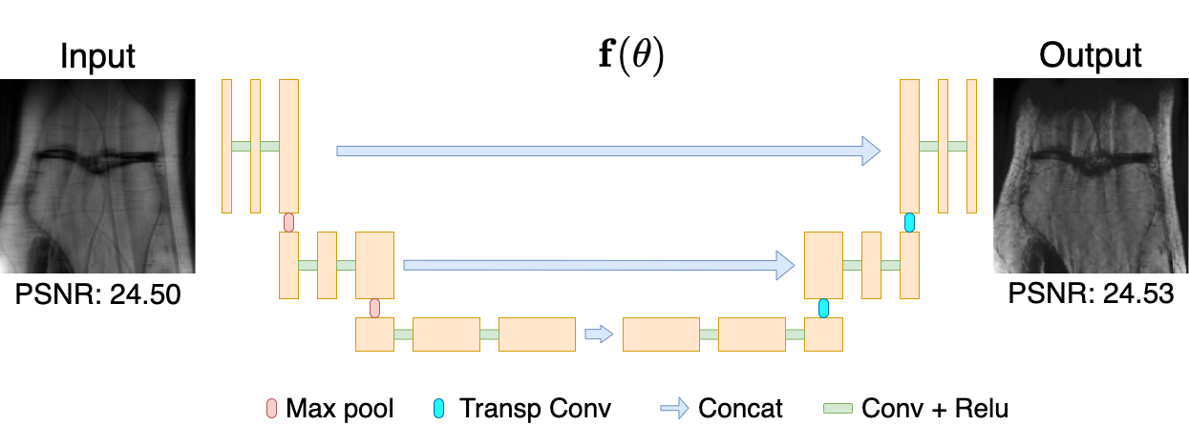
Performance under domain shift
Out-of-domain testing
Train on Brain test on Knee
! End-to-end networks are not robust to distribution shifts
Zalbagi et al, "Measuring robustness in deep learning based compressive sensing." International Conference on Machine Learning. PMLR, 2021.
Notes:
Now, the problem arises when we try to reconstruct knee scans using a network trained on brain measurements. This results in severe artifacts in the reconstructed output and a degradation in performance. This presents a significant challenge as we need to retrain the network from scratch for each target domain. To circumvent this, we seek methods capable of adapting pre-trained networks to target domains while preserving previously acquired knowledge.

Slide 10
Performance under domain shift
Artifact removal networks under domain and forward model shift
Train on MRI test on MRI
Train on faces test on faces
Train on MRI test on faces
Train on faces test on MRI
! Artifact removal networks are not robust to distribution shifts
Yismaw et al., "Domain Expansion via Network Adaptation for Solving Inverse Problems," in IEEE Transactions on Computational Imaging.
Notes:
The lack of robustness is also evident in artifact removal networks trained to solve optimization problems iteratively. In our related paper, where we thoroughly investigate the robustness of artifact removal networks, we observed remarkable performance during in-domain testing. However, performance degradation occurs when shifts arise, whether in the domain, the forward model, or the noise level. These findings highlight the need for domain adaptation techniques to bridge performance gaps across a wide range of learning based methods.

Slide 11
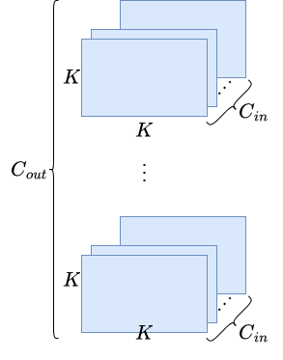
Parameter-efficient domain adaptation
Using few parameters update a network trained to different target domains
Convolution layer
Notes:
To address this problem, we propose a parameter-efficient domain adaptation technique. To demonstrate the functionality of our proposed method, let’s first consider a single convolution layer with k by k kernels for every input and output feature. Let C_in denote the number of input features and C_out denote the number of output features. Note that the number of trainable parameters in this layer is equal to K^2 times C_in times C_out.
We aim to efficiently modify or update these feature kernel for our target task and domain.

Slide 12
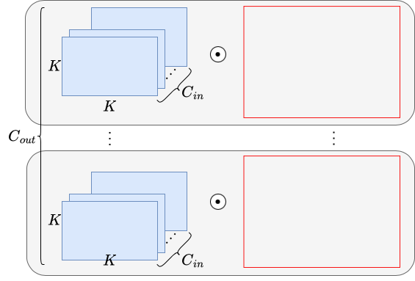
Parameter-efficient domain adaptation
Using few parameters update a network trained to different target domains
Convolution layer
Filter modulator
Notes:
We use modulation to update the feature kernels of the pre-trained or base network. We can treat the base convolution weights as 4-dimensional tensors and implement modulation as an element-wise product between the base and modulating tensors. However, we do not want the number of parameters in the modulating tensors to be of the same size as the base convolution weights. Hence, to enhance efficiency, we aim to learn compact representations of these modulations while still being able to apply them in a similar manner.

Slide 13
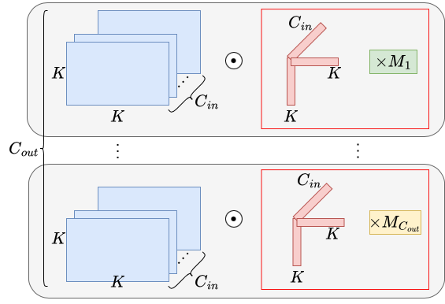
Parameter-efficient domain adaptation
Using few parameters update a network trained to different target domains
Convolution layer
Filter modulator
Input modulator
Output modulator
During adaptation, we only learn the modulators.
Only 11.9K parameters required to adapt a network with 31M params
Shared
Notes:
We decompose the modulators into rank-1 factors across the kernel and input feature axis, which are shared across the output channel. By combining these factors using an outer product, we obtain modulators for each input filter, we referred to these factors as input kernel modulators. Additionally, we introduce a scaling factor, M, for each output channel. These scaling factors are then combined with the shared input kernel modulators to obtain the final modulation kernels for the entire convolution layer..
This representation is highly parameter-efficient. The number of parameters in our modulations equals 2K + c_in + c_out, which is much much fewer than the number parameters in the base convolution layer.
During training, we only learn the modulators in a supervised manner while freezing the base convolution layers.
In our experiments, we observed that to adapt a trained network with 31 million parameters, we only require 12 thousand factors.

Slide 14
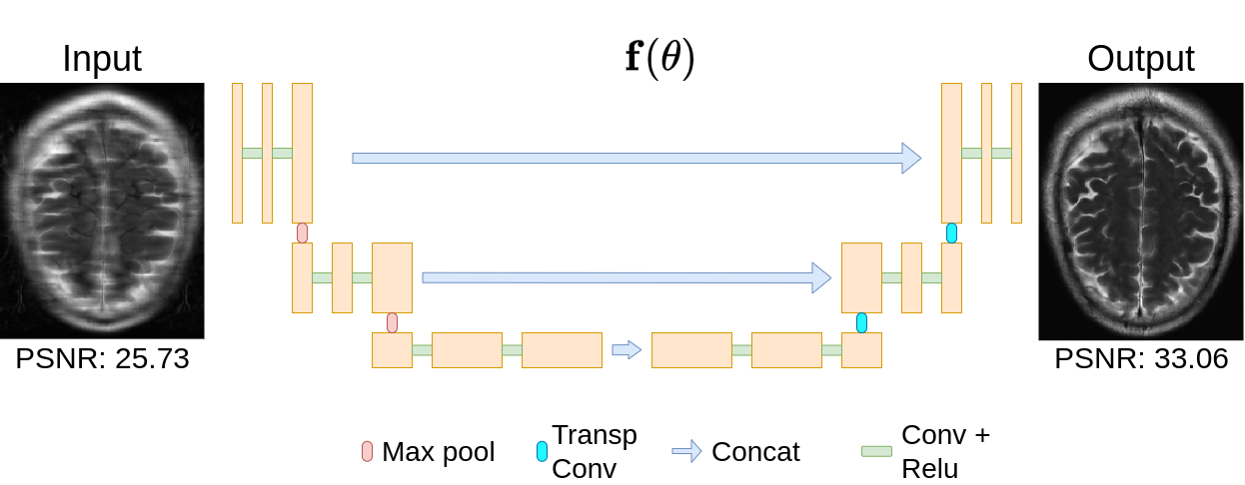
Parameter efficient domain adaptation
Domain shift
Adapting reconstruction network trained on brain to knee MRI scans
Train on Brain test on Brain
Notes:
Now let’s bring back our reconstruction network that was trained to reconstruct brain scans. In the previous slides we have seen that this network has a poor reconstruction performance on knee measurements.

Slide 15
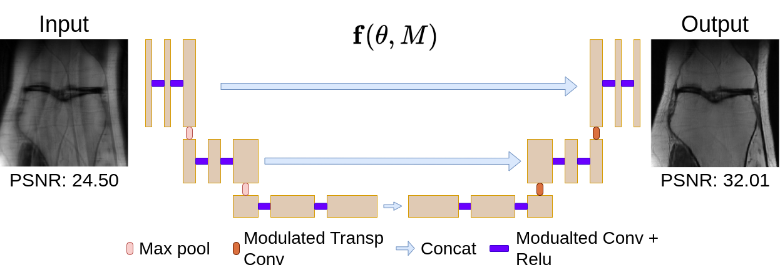
Parameter efficient domain adaptation
Domain shift
Adapting reconstruction network trained on brain to knee MRI scans
Adapt network trained on Brain to Knee
Output prior to network modulation
Notes:
We apply our adaptation technique to the same network to enhance its performance on knee scans. This involves replacing the base convolution blocks at each layer with our modulated convolution layer and learning the modulating factors in a supervised manner while keeping the base network parameters fixed
This approach successfully bridges the performance gap and eliminates reconstruction artifacts, as shown in the figure. Compared to the previous output, we observe a significant performance improvement with modulation. Now, let's examine some detailed quantitative results across a set of validation of images.

Slide 16
Parameter efficient domain adaptation
Domain shift
Networks trained only on Knee and Brain domains are not robust to domain shifts.
Notes:
The table shows the average reconstruction performance of networks trained on brain and knee scans from the FastMRI dataset, indicated by the blue and green columns. We achieve the best performance when there is a match between training and testing domains, as demonstrated by the diagonal entries. However, we observe a performance drop during out-of-domain testing as shown in the off-diagonal entries, highlighted by the red rectangles.

Slide 17
Parameter efficient domain adaptation
Domain shift
Our proposed method effectively adapted these networks to each target domain, as demonstrated in the last two columns.
Notes:
After applying our proposed method to adapt the networks to each target domain, we obtain the modulated networks shown in the last two columns. Both networks were able to provide competitive performance compared to the networks trained independently on knee and brain domains.

Slide 18
Parameter efficient domain adaptation
Sampling pattern shift
We trained networks on Cartesian and Radial patterns separately and tested them on both patterns. Our adapted networks mitigated the performance drop caused by the pattern shift.
Notes:
Continuing our investigation, we conducted an experiment focusing on adapting to changes in the forward model. Specifically, we looked into shifts in the sampling pattern, where we trained networks on Cartesian and Radial fourier sub-sampling patterns.
Similar to other experiments, we observed a performance drop when testing networks using measurement obtained by sampling patterns different from those used during training, this is highlighted using the red rectangles in the second and third columns.
Subsequently, we applied our adaptation technique to obtain the modulated networks, shown in the last two columns. These networks successfully bridged the performance gap resulting from domain shift.

Slide 19
Parameter efficient domain adaptation
Sampling ratio shift
The performance of networks trained on 2x and 4x acceleration factors during sampling ratio shift. Our adapted network shows an overall superior performance across all sampling ratios.
Notes:
Another related cause for forward model shift can be changes in the under-sampling ratio during MRI reconstruction. We observe a similar pattern in lack of robustness due to shifts in the sampling ratio. We adapted the network trained on 2 times under-sampled data to improve its performance on 4 times under-sampled data, and vice versa. As shown in the last two columns, our adapted networks demonstrate an overall superior performance across all sampling ratios.

Slide 20
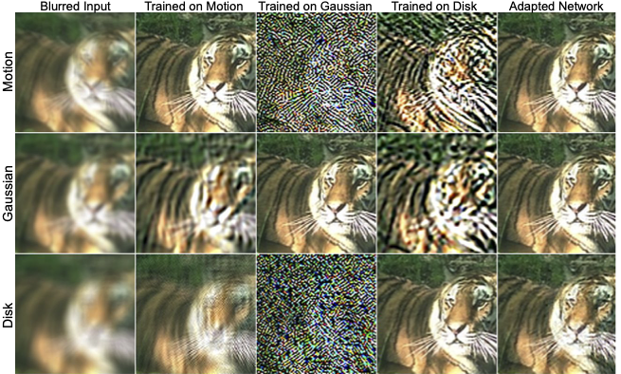
Parameter efficient blur kernel adaptation
Train and test kernel matching
Train and test kernel mismatching
Notes:
Now, let's turn our attention to an image restoration problem, namely image deblurring, where we adapt to shifts in degradation models. We trained independent networks to restore images degraded using motion, disk, and Gaussian blur kernels. Then, we tested each of these networks using samples obtained from each of the blur kernels.
As demonstrated in the off-diagonal entries in the last three columns, the networks perform poorly when tested on images blurred with unseen kernels during training.

Slide 21
Parameter efficient blur kernel adaptation
Single domain networks
Adapted network
Notes:
To address this performance degradation, we applied our modulation technique to the network trained on motion blur to adapt it to Gaussian and disk blurred images. The output of our proposed method is shown in the last column. Our adapted network significantly outperforms the blur-specific network when tested on unseen kernels, yielding an overall superior performance.

Slide 22
Summary
We proposed a simple and parameter-efficient method for network adaptation.
Our method learns domain-specific modulation parameters for a fixed network.
We demonstrated the effectiveness of our approach in adapting to various data distribution and forward model shifts.
For more details, please visit:
Project page: https://csiplab.github.io/DomainExpansionInverseProblems/
Nebiyou Yismaw (nyism001@ucr.edu)
Notes:
In summary, we explored the effects of domain and forward model shifts on deep learning-based end-to-end reconstruction networks for solving inverse problems. We observed that these shifts often lead to a severe performance degradation.
To overcome this, we proposed a flexible and parameter-efficient domain adaptation method.
We demonstrated the effectiveness of our method on a variety of image reconstruction and restoration problems, encompassing different network architectures.
Our adapted networks achieve competitive performance compared to single-domain fully trained networks while requiring only a fraction of the number of parameters.

