Slide 1
Investigation of the Effects of Automatic Scoring Technology on Human Raters' Performances in L2 Speech Proficiency Assessment
Dean Luo, Wentao Gu, Ruxin Luo and Lixin Wang

Slide 2
Background
English speaking tests have become mandatory in college and senior high school entrance examinations in many cities in China
Most of them are assessed manually
Cost a lot time and efforts
Difficult to recruit enough qualified experts
Recent advances in automatic scoring based on ASR
Used in high-stakes English tests (J. Cheng, 2011)
Comparable performances with human raters
Many educators remain skeptical about the technology

Slide 3
Objectives of this research
Try to find out the answers to these research questions:
1) how different are non-expert teachers' performances compared to experts?
2) Will showing them the ‘facts’ of different aspects of pronunciation proficency based on acoustic features and experts’ judgement changes their minds?
3) How can we better utilize automatic scorings technology to assist human raters instead of replacing them?

Slide 4
Experiments
Examined how experts and non-experts perform in assessing real speaking tests
Extracted acoustic features and conducted automatic scoring on the same data
Presented to the non-expert teachers the results of multi-dimensional automatic scores on different aspects of pronunciation fluency when assessing an utterance, and examined how that might change their judgments.

Slide 5
Speech data
The recording data of the English speaking test in Shenzhen High School Unified Examination
repeating of a one-minute-long video clip
Watch and listen to a video clip with English subtitles twice
Read aloud the subtitles on the video
300 utterances
50 from each of the 6 proficiency level groups
Develop set : 150; Test set 150

Slide 6
Proficiency Level Groups of the Test-takers
Proficiency Level | Scoring Standards
5 | Fluent and native-like in pronunciation and intonation without any mistakes
4 | Fluent and intelligible with minor unnaturalness in pronunciation or intonation. Very few linguistic or phonetic mistakes
3 | Have some errors in pronunciation or unnaturalness in intonation, but most part of the speech is intelligible.
2 | Large amount of pronunciation errors and unnatural intonation, but parts of the speech are still intelligible
1 | Severe errors in pronunciation and most part of the speech is unintelligible
0 | Completely unintelligible, silence or speaking something unrelated to the presented subtitle text

Slide 7
Human Assessment
Participants
2 phonetically trained experts
14 non-expert high school English teachers
10 college students majored in English education
Results
The correlation between the two experts is 0.821. The 24 non-experts were clustered into 4 groups according to similarity of the scores among raters
 | Group A | Group B | Group C | Group D
Expert A | 0.801 | 0.775 | 0.743 | 0.734
Expert B | 0.810 | 0.769 | 0.751 | 0.725

Slide 8
Expert Annotation
Perceptual dimensions annotated by an experienced expert include:
1) Intelligibility: understanding of what has been said (0: very poor,5:excellent)
2) Fluency: indicate the level of interruptions, hesitations, filled pauses (0: very poor, 5:excellent)
3) Correctness: indicate if all the phonemes have been correctly pronounced (0: very poor, 5: excellent)
4) Intonation: indicate to which extent the pitch and stress patterns clearly resembles the ones in English (0: unnatural , 5: natural)
5) Rhythm: indicate to which extent the timing resembles the one in English ( 0: unnatural, 5:natural)
60 utterances (10 from each proficiency level group) from the development data were annotated

Slide 9
Acoustic Models
Data from Wall Street Journal CSR Corpus and TIMIT were used to train CD-DNN-HMM and CD-GMM-HMM
The DNN training in this study follow the procedure described in (G.E. Dahl. et al, 2012) using KAIDI.
Similar word error rate reduction has been achieved on test set of WSJ corpus as reported in (W. Hu, et al, 2013)

Slide 10
GOP(Goodness of Pronunciation) Scores
The GOP score is defined as follows
W. Hu, et al proposed a better implementation of GOP by calculating the average frame posteriors of a phone with the output of DNN model:
Where is the posterior probability that the speaker uttered phoneme p given speech observation , Q is the full set of phonemes
Where is an output of DNN. are the start and end frame of phone P

Slide 11
Other feature scores
Word and Phone Correctness
Pitch and Energy Features
The Euclidean distances of F0 and energy contours between students’ speech and correct models
Timing Features
rate of speech (ROS)
phoneme duration
pauses
Unsupervised Clustering
Starting from each frame of the acoustic features, any adjacent feature frames that are similar to each other will be clustered as a group. If an utterance is distinctly pronounced, there will be more clusters in a given sentence than those that are not clearly pronounced.

Slide 12
Correlations between Feature Scores and the Average of Experts’ Scores
Features | Correlations
Average GOP | 0.79
Word_Acc | 0.74
Phone_Acc | 0.60
Pitch distance | 0.51
Energy distance | 0.55
Clustering | 0.58
ROS | 0.39
Phoneme duration | 0.42
Pause duration | 0.57
Linear Regression | 0.80

Slide 13
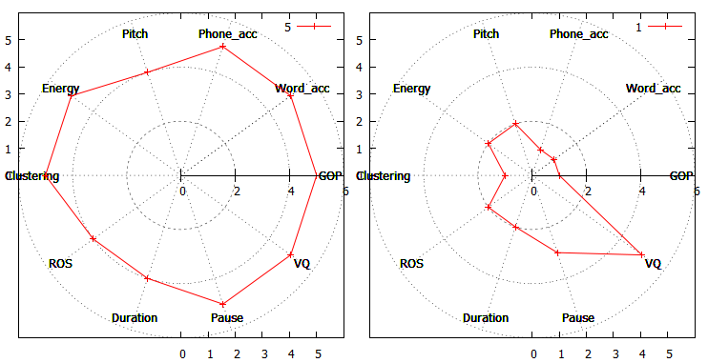
Human-machine Hybrid Scoring
Examine whether non-experts’ performance would change by presenting multidimensional automatic scores during assessment.
Radar Chart Analysis
Use a Gnuplot script to generate a 10-point radar chart for each utterance of all the development and test data

Slide 14
Scoring Procedure
Training
Can view radar chart plots of any utterances from development data set.
The reference score is presented
Can listen to the utterance to check pronunciation.
Participants can view different shapes of radar charts from the same proficiency group or compare radar charts from different proficient level groups
Assessment
The radar charts of the utterances from test set are randomly presented together with a link to the corresponding utterance file.
Raters are instructed to first look at the chart and then click on the link to check the audio before making the final decision.
They are required to give an overall fluency score for the utterance.

Slide 15
Results
Correlations between non-experts and experts’ scores in human-machine hybrid scoring
Rates of agreement with experts in human rating and human-machine hybrid rating
 | Group A | Group B | Group C | Group D
Expert A | 0.811 | 0.805 | 0.810 | 0.802
Expert B | 0.821 | 0.814 | 0.820 | 0.817
 | Group A | Group B | Group C | Group D
Human only | 80.5% | 73.5% | 72.2% | 71.3%
Hybrid rating | 87.0% | 85.4% | 87.5% | 86.4%

Slide 16
Conclusion
Investigated how non-expert and expert human raters perform in the assessment of speaking test
Found inconsistencies in non-experts' ratings compared with the experts
Proposed a radar chart based multi-dimensional automatic scoring to assist non-expert human raters
Experimental results show that presenting the automatic analysis of different fluency aspects can affects human raters' judgement
The proposed human-machine hybrid scoring system can help human raters give more consistent and reliable assessment

Slide 17
Thank you for your kind attention!

Slide 18
Clustering
Speech
…
Frame sequence
``
Log-spectrum
Acoustic analysis （MCEP）
Clustering
Stopping condition
Spectral envelope
Output of phoneme segments

Slide 19
Time-constrained: only 2 adjacent clusters can be merged
…
…
…
…

Slide 20
Ward’s method：
( )
:within-group error sum of squares
Based on Euclid distances
(q)
(p)
×
×
×
•
•

