Slide 1
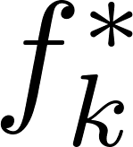
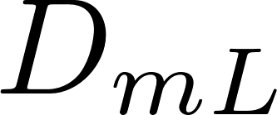
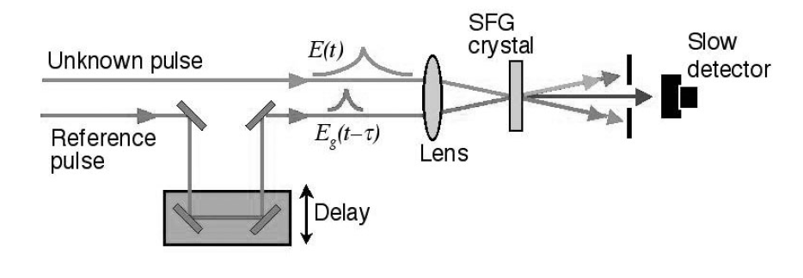
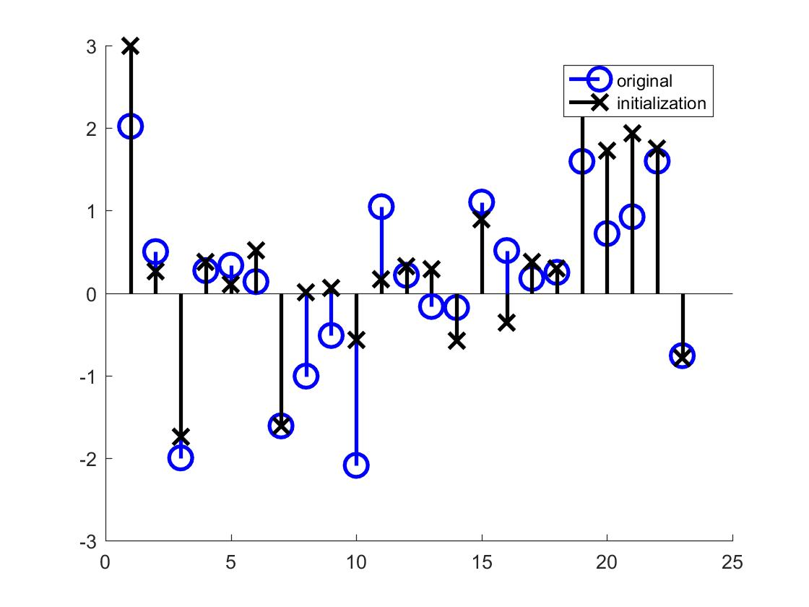
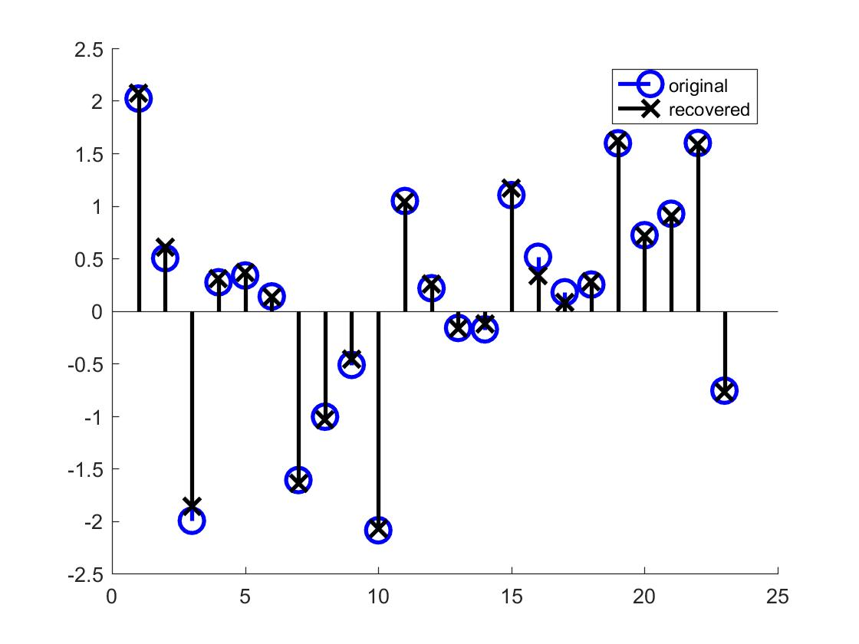
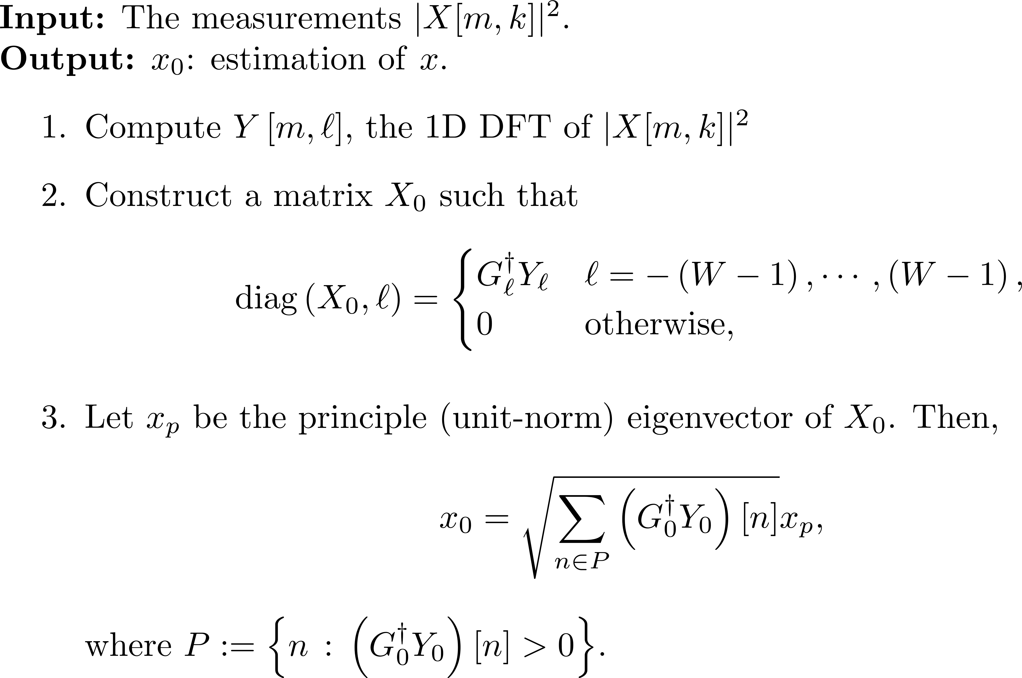
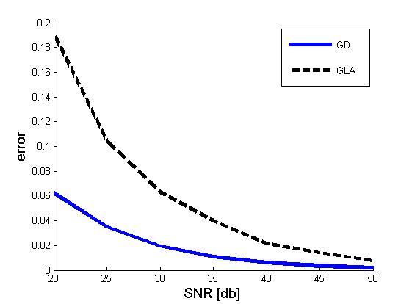
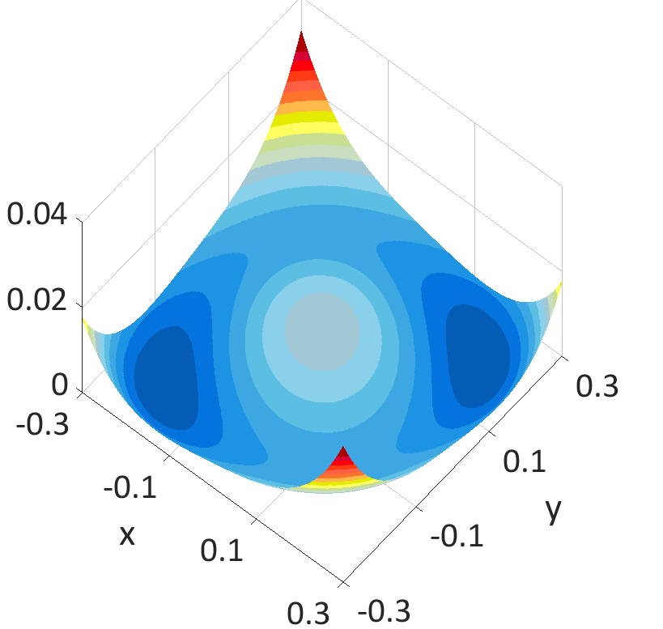
NON-CONVEX PHASE RETRIEVAL FROM STFT MEASUREMENTS
Tamir Bendory (PACM, Princeton University) and Yonina C. Eldar (EE, Technion – Israel Institute of Technology)
Phase retrieval from STFT measurements
Burer–Monteiro for SDP’s
Contribution
theory
We can solve semidefinite programs in poly time:
gf
Goal:
Recovering from its phaseless short-time Fourier transform (STFT) measurements
- kth row of a DFT matrix, - STFT window of length W
- diagonal matrix with the entries
Applications¹:
Ptychography
(High-resolution microscopy)
XFROG
(Measuring ultra-short laser pulses)
Challenge:
Designing an efficient algorithm with theoretical analysis.
Proposed solution:
Recovery by minimizing the non-convex least-squares
Previous works considered random setups or inefficient algorithms. We propose an efficient algorithm for a deterministic setup, followed by theoretical analysis.
Theorem:
Suppose that L=1, for some
(and some mild additional conditions). Then,
Initialization algorithm
gf
Corollary:
For L=1 and - efficient and stable recovery.
Core idea: By taking the 1D DFT of the data with respect to the frequency variable, the measurements can be written as multiple systems of linear equations
Numerical examples
We aim at constructing a matrix that estimates .
For L=1, the initialization algorithm is as follows:
(left) initialization (right) final estimation (N=23, W=7, L=1 and SNR of 20 db).
Comparison of the gradient algorithm (GD) with the classical Griffin-Lim algorithm (GLA).
Observation:
While the loss function is non-convex, it has a non-trivial basin of attraction
References
Key for recovery:
Initializing within the basin of attraction
T. Bendory and Y. C. Eldar, "Non-Convex Phase Retrieval from STFT Measurements“. arXiv preprint arXiv:1607.08218 (2016)
T. Bendory and Y. C. Eldar, "Phase Retrieval from STFT Measurements via Non-convex Optimization", The 42nd IEEE International Conference on Acoustics, Speech and Signal Processing (ICASSP), March 2017.
The extension of the algorithm for L>1 is based on the smoothness of typical STFT window.

