Slide 1
Unconstrained Flood Event Detection Using Adversarial Data Augmentation
Samira Pouyanfar¹, Yudong Tao², Saad Sadiq², Haiman Tian¹, Yuexuan Tu², Tianyi Wang¹, Shu-Ching Chen¹, Mei-Ling Shyu²
¹ School of Computing and Information Sciences
Florida International University
Miami, FL, USA
² Department of Electrical and Computer Engineering
University of Miami
Coral Gables, FL, USA

Slide 2
Agenda
Introduction
Related Work
Proposed Framework
Experiments & Analysis
Conclusion and Future Work

Slide 3
Agenda
Introduction
Related Work
Proposed Framework
Experiments & Analysis
Conclusion and Future Work

Slide 4
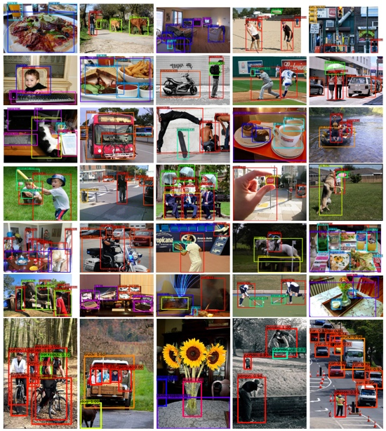
Introduction
Deep learning achievements heavily depend on the existence of clean, annotated, and large-scale datasets
Collecting such datasets is expensive and laborious
However, in many real-world applications, it is challenging to collect large-scale clean data for a diverse set of scenarios and conditions

Slide 5
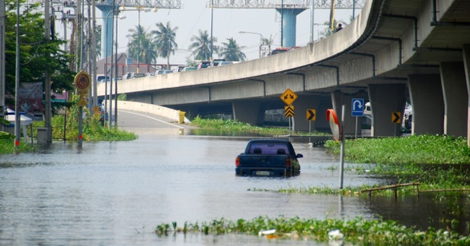
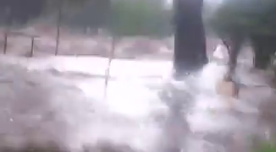
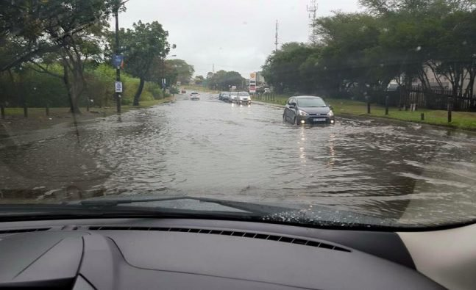
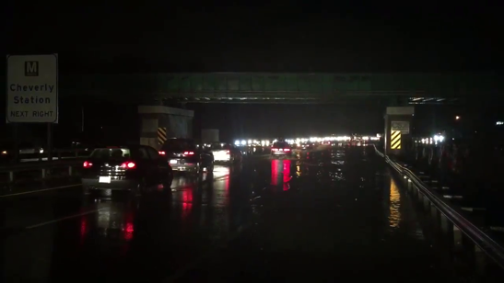
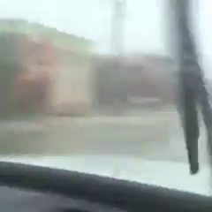
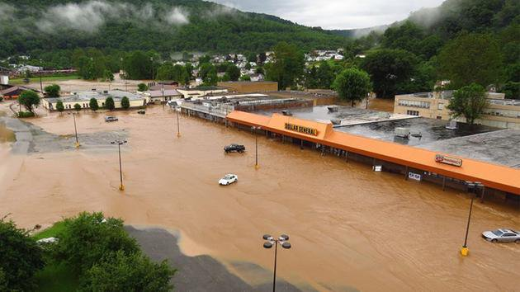
Exemplary Real-World Application
Flood Event Detection

Slide 6
Flood Event Detection in Different Scenarios
Daytime vs. Nighttime

Slide 7
Flood Event Detection in Different Scenarios
Rainy and Blurry

Slide 8
Flood Event Detection in Different Scenarios
Different Views
Notes:
The image on top is from inside of a car and the one in the bottom is aerial view

Slide 9
Objective
Train a flood event detection model
Require:
Tens of thousands of training images in various scenarios with or without flood event
Manual label for all the training images
Is it possible to train a flood event detection model with reduced human efforts to build the dataset?
Yes, by using synthetic images

Slide 10
Agenda
Introduction
Related Work
Proposed Framework
Experiments & Analysis
Conclusion and Future Work

Slide 11
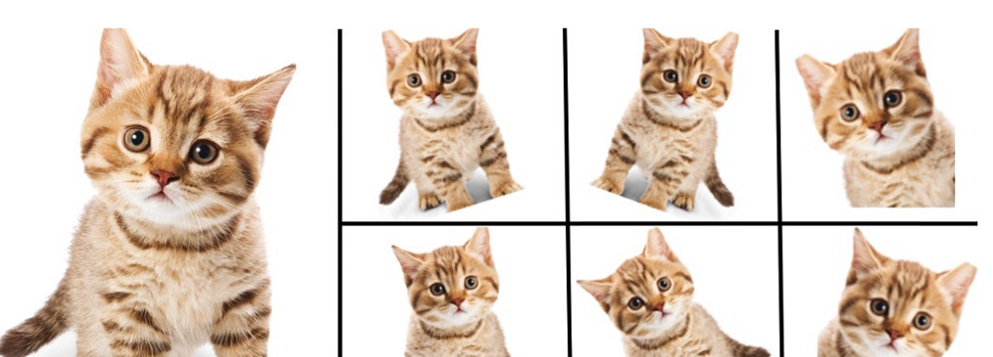
Conventional Data Augmentation
It is a strategy that enables us to significantly increase the diversity of data available for training models, without actually collecting new data
Rotation
Shear
Flip
Shift
Brightness
...
Original
Image
Augmented
Images

Slide 12
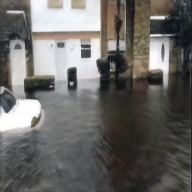
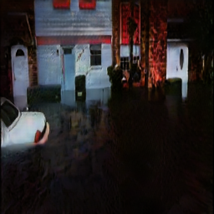
Limitations of Conventional Data Augmentation
Limited types of modifications
Changes in shape
Changes in color
Modify images as a whole
Cannot generate nighttime images from daytime ones
Notes:
Limitation: the changes are simple and high-level. Data are changed as a whole. Changes in style and

Slide 13
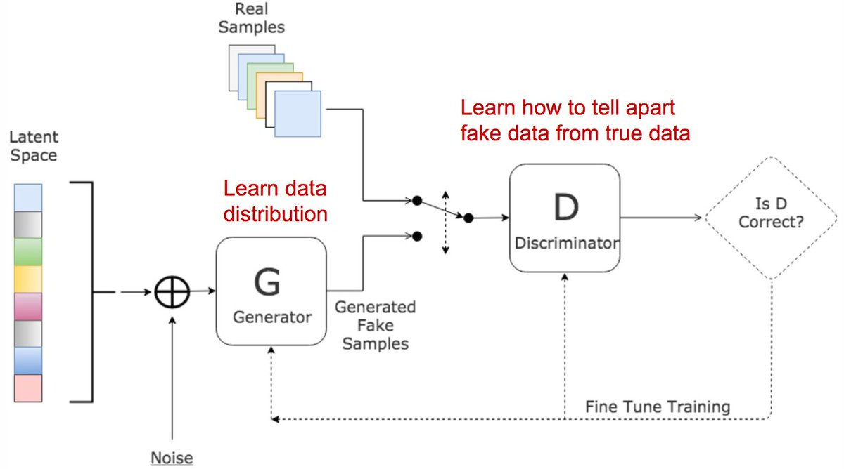
Generative Adversarial Network (GAN)
Generator: generates fake samples and tries to fool the Discriminator
Discriminator: tries to distinguish between real and fake samples
Train them against each other
Repeat this to get better Generator and Discriminator

Slide 14
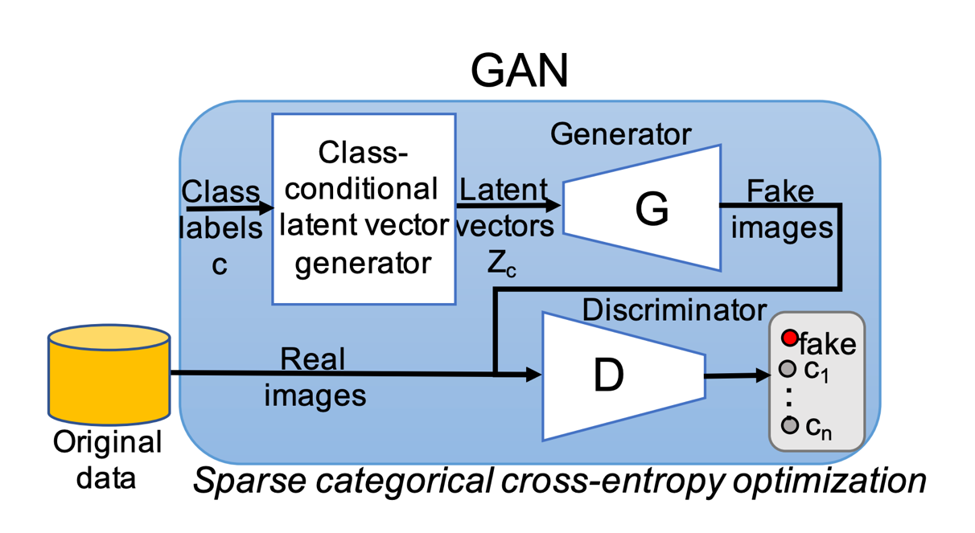
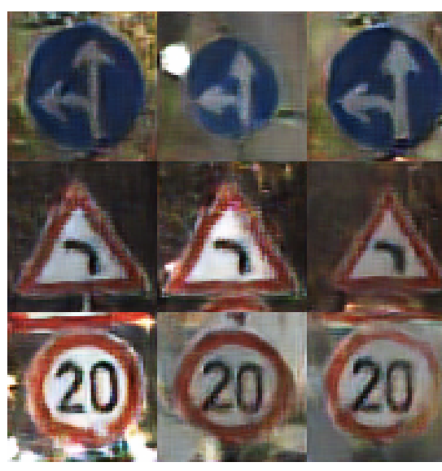
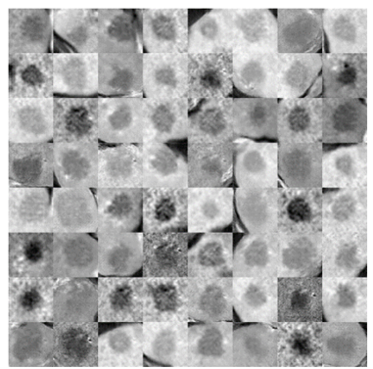
GAN for Data Augmentation
Using GAN to generate class-conditional fake images to improve the performance of classification and handle class imbalance
Used to improve Liver Lesion Classification
Limitation:
Small size images
Grey Scale images
Image sources: [1] Mariani, Giovanni, et al. "BAGAN: Data Augmentation with Balancing GAN." CoRR, abs/1803.09655 (2018), and
[2] Frid-Adar, Maayan, et al. "GAN-based synthetic medical image augmentation for increased CNN performance in liver lesion classification." Neurocomputing321 (2018): 321-331.

Slide 15
CycleGAN
Style transfer with unpaired image data
Can we use style transfer for image augmentation?
Notes:
Using GAN for data augmentation

Slide 16
Agenda
Introduction
Related Work
Proposed Framework
Experiments & Analysis
Conclusion and Future Work

Slide 17
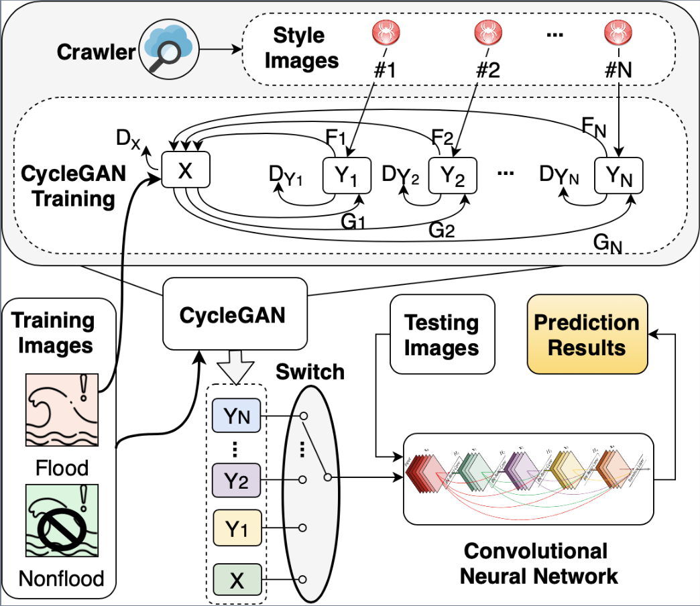
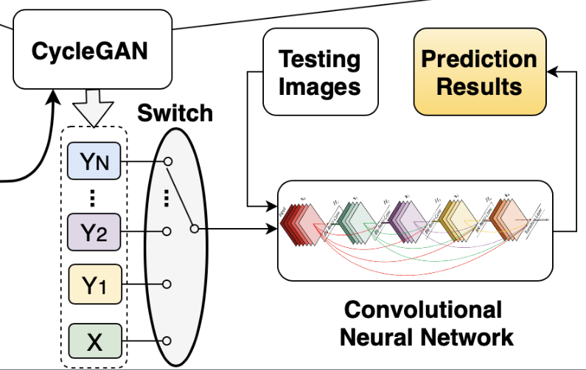
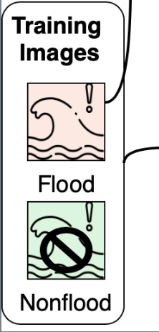
Proposed Framework
Given a flood detection dataset
Crawl images of each target style (e.g., nighttime)
Train CycleGAN for data augmentation
Train a classification model with the augmented dataset

Slide 18
Style Image Crawling
Style images are all collected from Google Images with manual cleaning
Automatically crawled based on keywords of the desired context, including night, rainy, etc.

Slide 19
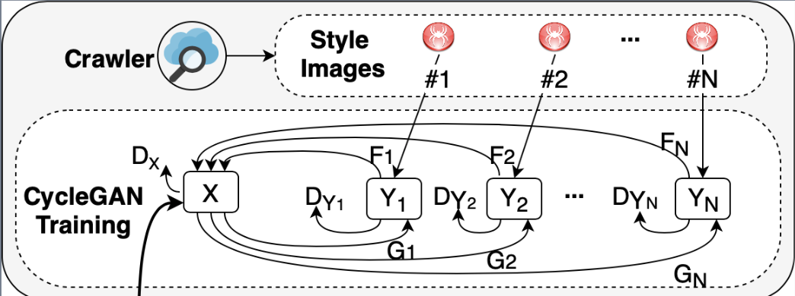
Train CycleGAN for Image Augmentation
Train Discriminator in CycleGAN

Slide 20
Train CycleGAN for Image Augmentation
Train Generator in CycleGAN

Slide 21
CNN Classification
Online Augmentation: Randomly select from one of the styles during training
ResNet50 is applied here for classification
Test images are directly fed into the trained CNN model to produce the prediction result

Slide 22
Agenda
Introduction
Related Work
Proposed Framework
Experiments & Analysis
Conclusion and Future Work

Slide 23
Flood Detection Datasets
Image dataset collected from Youtube and Twitter using keyword “Harvey”
Manual annotation of “Flood” vs. “Non-Flood”
Manual annotation of styles for the testing set
 |  | Training | Testing | Style
Non-Flood | Total | 1866 | 1364 | -
Flood | Total | 8645 | 5072 | 21000
 | Regular | - | 3627 | -
 | Night | - | 294 | 7000
 | Rainy | - | 799 | 7000
 | Blurry | - | 434 | 7000

Slide 24
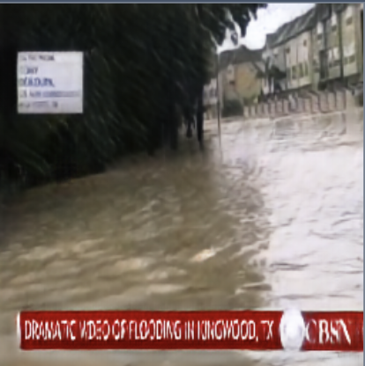
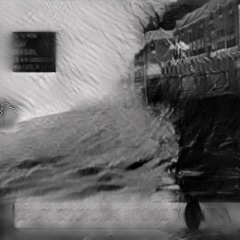
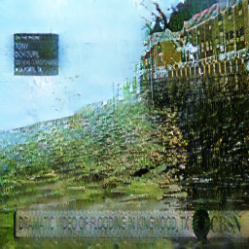
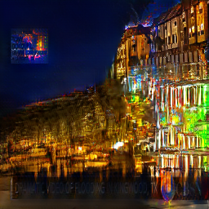
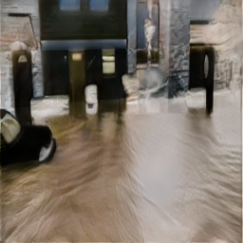
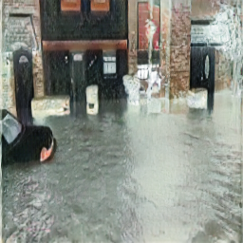
Examples of Synthetic Data
original
blurry
rainy
night

Slide 25
Improved Recall on Rare Contexts
Recall scores on the flood testing dataset separated by style
Method | night | rainy | blurry | avg. noisy | flood (total)
ResNet50 | 0.785 | 0.795 | 0.791 | 0.790 | 0.898
Ours | 0.831 | 0.927 | 0.873 | 0.877 | 0.936

Slide 26
Comparison with Other Style Transfer Models
Method | Precision | Recall | F1 | Accuracy
ResNet50 | 0.916 | 0.898 | 0.907 | 0.855
MSGNet [1] | 0.855 | 0.970 | 0.909 | 0.847
Style transfer [2] | 0.853 | 0.978 | 0.911 | 0.849
Ours | 0.896 | 0.936 | 0.916 | 0.864
[1] Hang Zhang and Kristin Dana, “Multi-style generative network for real-time transfer,” in European Conference on Computer Vision, 2018, pp. 349–365. [2] Leon A Gatys, Alexander S Ecker, and Matthias Bethge, “A neural algorithm of artistic style,” CoRR, vol. abs/1508.06576, 2015.

Slide 27
Agenda
Introduction
Related Work
Proposed Framework
Experiments & Analysis
Conclusion and Future Work

Slide 28
Conclusion
We employed CycleGAN for style transfer to improve the generalizability of a deep learning model
Reduce annotation and collection effort to build large-scale datasets to train a deep learning model that works for various contexts
The proposed model can detect flood from real-time images collected from public cameras (e.g. network cameras) and assist the community for better decision-making and faster and more reliable emergency responses during a disastrous event

Slide 29
Future Work
Automatically clean the style images to improve the performance
Integrate classification into style transfer to build an end-to-end model
Extend the current model to various disastrous events

Slide 30
Thanks!
Yudong Tao
yxt128@miami.edu

