Slide 1
RARE EVENT SIMULATION FOR GIBBS DISTRIBUTIONS AND ITS APPLICATION TO GRAIN GROWTH IN CRYSTALS
IEEE GlobalSIP, Orlando, FL
December 16, 2015
Shruthi Kubatur
Prof. Mary L. Comer
School of Electrical and Computer Engineering
Purdue University

Slide 2
Roadmap of Our Work
Many physical phenomena are modeled by Gibbs distribution.
e.g., grain growth in polycrystalline materials
Characterizing rare events for these phenomena is very important.
We propose a method for simulating rare events in images using importance sampling for Gibbs based image models.
We demonstrate the use of this method for grain growth.

Slide 3
Importance Sampling for Gibbs Random Field
Recall: Gibbs distribution: $p\left(x\right)= \frac{1}{Z}e^{\frac{−E(x)}{k_{B}T}}$
Importance sampling density for Gibbs distribution:
$$q_{g}\left(x\right)= \frac{1}{Z}e^{\frac{−(E\left(x\right)−gG\left(x\right))}{k_{B}T}}$$
where $g$ s.t. $E_{q_{g}}\left[T_{n}\left(x\right)\right]=t$
Notation:
$x:$ 2D grain configuration
$n:$ lattice size
$T_{n}\left(x\right):$ size of the largest grain in $x$
$t$: pre-set threshold (typically ~ 0.3-0.5)
$G\left(⋅\right):$ potential related to abnormal growth
* P. Baldi, et al., “Importance sampling for gibbs random fields," The Annals of Applied Probability, 1993.
Notes:
At the end: How do we formulate G(x)?

Slide 4
Polycrystalline Microstructure
Polycrystalline materials are made up of “grains” that have varying sizes and 3D orientations.
A typical polycrystalline microstructure
(with several grains)
Segmented image of the microstructure
Notes:
Tell them: The grain structure you see has already undergrown some growth from an initial structure containing many tiny grains.

Slide 5
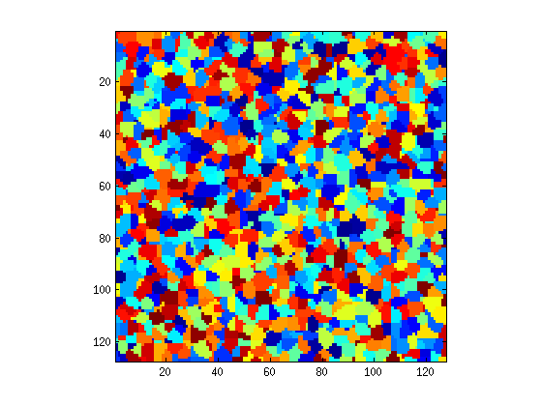
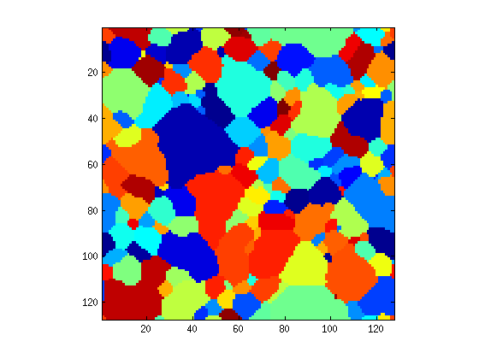
Microstructure Evolution¹
These grains undergo evolution in a process known as grain growth.
Each grain has a different orientation
But the materials science community does not model grain growth with modern probability theory².
grains
Initial structure
(from “Dream3D”)
Structure after grain growth
¹ used interchangeably with “grain growth” in this presentation.
² Rollett et al, “Abnormal grain growth in Potts model incorporating grain boundary complexion transitions that increase mobility of individual boundaries”

Slide 6
Why Study Microstructure Evolution?
Materials can undergo stress, growth, fractures, etc.
=> Material failure is a prominent problem.
Accurate models of material behavior helps analysis and prevention of failure.
=> Better models lead to better materials system design.
It is important to model impactful abnormalities like abnormal grain growth
In piezoelectric ceramics, occurrence of AGG may bring about the degradation of piezoelectric effect.
AGG causes silicon carbide fractures to toughen – with applications in ballistic armor design.

Slide 7
Need for Simulating Grain Growth
Modeling grain growth through physical experimentation is very slow => direct observation is impractical
Solution: Computational simulation.
Computational simulation models: Potts model, phase-field model, etc.
We use Potts model¹ with Metropolis algorithm.
¹ Holm et al, “On abnormal subgrain growth and the origin of recrystallization nuclei”, Acta Materialia, 2003.
Notes:
Note: Phase-field model: Models interfacial dynamics. Usually helpful when we want to reconstruct the interface between 2 regions in a material.
Definitely not helpful to study the size of grains in a Q-state system.

Slide 8
Potts Model + Gibbs Random Field
2D material is represented on a $N_{1}×N_{2}$ lattice $L$.
Given (vectorized) configuration is called X $=(S_{1}, S_{2},.., S_{N_{1}∗N_{2}})$.
Each lattice site, $i$, has an “orientation” (or “state”), $O_{i},$labeled by $S_{i}.$
$S_{i}∈\{1, 2,….., Q\}$ since there are $Q$ distinct orientations.
$S_{i}$ depends conditionally only on states of neighboring lattice sites
=> $X$ has Markov property
=> $p(x)$ is a Gibbs distribution
Recall:
Markov property: $P\left(S_{i} | S_{j≠i}\right)=P\left(S_{i}\right|S_{j∈∂i, j≠i})$
Gibbs distribution: $p\left(x\right)= \frac{1}{Z}e^{\frac{−E(x)}{k_{B}T}}$
Energy: $E\left(x\right)= \frac{1}{2} \sum_{i=1}^{n}{\sum_{j∈∂i}{(1− δ(S_{i},S_{j}))}}$ => Potts model
“Gibbs Random Field”
Z: partition fn.
E(x): Hamiltonian of $x$
k_{B}: Boltzmann const.
T: Temperature
$$n=N_{1}N_{2}$$
Notes:
Hammersley-Clifford Theorem states: x can be modeled by Markov property ⬄ p(x) is Gibbs density function.
Boltzmann constant, $k_{B}=1.38064852 × 10−23 m2 kg s−2 K−1$
Note: Z is a function of T.

Slide 9
Metropolis Sampling for Grain Growth¹
A site, $i$, is chosen at random; current state = $S_{i}^{}$
Among all unlike states in neighborhood of i, say $S_{j}^{}$ is chosen at random.
$ΔE=E\left(x^{(j)}\right)−E\left(x^{(i)}\right)$ is computed.
If $ΔE≤0:{ S}_{i}^{\left(next\right)}←S_{j}^{}$ with probability${ p}_{0}$
Else: ${ S}_{i}^{\left(next\right)}←\left\{\begin{matrix}S_{j}^{} \text{with} \text{probability} { p}_{0}e^{\frac{−ΔE}{k_{B}T}} \\ S_{i}^{} \text{with} \text{probability} 1 −p_{0}e^{\frac{−ΔE}{k_{B}T}}\end{matrix} \right.$
$E(⋅)$: computed using
grain boundary energy
$p_{0}≤1$: computed using
grain boundary mobility
¹ Holm et al, “On abnormal subgrain growth and the origin of recrystallization nuclei”, Acta Materialia, 2003.
Notes:
Say that this is generic Metropolis sampling. Mention that, that is how it done in Prof. Holm’s paper.

Slide 10
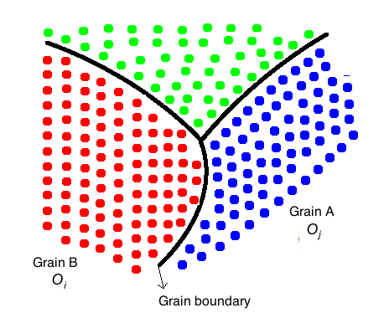
Concepts Needed to Define Grain Boundary Energy and Mobility
Boundaries between grains have important properties: boundary energy and boundary mobility.
The orientation at site $i$is represented by the 3-tuple:
$O_{i}=[φ_{i}, ψ_{i}, Θ_{i}]$
Boundary misorientation
angle:
$θ_{ij}={\left\|O_{i}−O_{j}\right\|}_{2}$
“Euler angles”
Notes:
Explain that the orientation is a 3-tuple

Slide 11
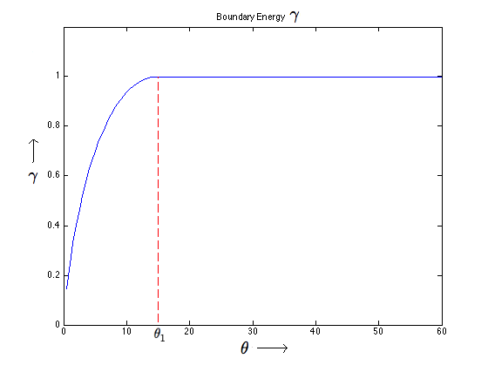
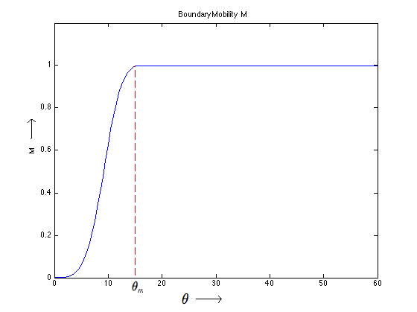
Grain Boundary Energy + Mobility
Boundary energy: Read-Shockley function
Boundary mobility: Huang and Humphreys function
$$n = 5, d = 4$$
Notes:
Theta1 and theta_m are models for the grain.
Theta is in degrees
Energy is in Joule
Mobility is in

Slide 12
Adapting the Hamiltonian and the acceptance probability
Total system energy is redefined to reflect boundary energy of all grains:
Acceptance probability, $a$, is redefined to reflect boundary mobility:
$$a\left(S_{i}^{\left(next\right)}=S_{j}^{} | S_{i}^{}\right)=\min\left(p_{0}, p_{0}e^{\frac{−\left(E\left(x^{(j)}\right)−E\left(x^{(i)}\right)\right)}{k_{B}T}}\right)$$
where, $p_{0}= \frac{M_{ij}}{M_{m}}$, $M_{ij}$ is the mobility between lattice sites $i$ and $j$,
$M_{m}$ is the maximum mobility in system
$$E\left(x\right)= \frac{1}{2}\sum_{i=1}^{n}{\sum_{j∈∂i}{γ_{ij}}}$$

Slide 13
Abnormal Grain Growth (AGG)
Very rarely grains can grow abnormally large and it is an important phenomenon.
We turn to importance sampling to simulate AGG.
*
In-situ SEM-EBSD image of abnormal grain growth in nanocrystalline nickel
* Image courtesy of Dept. of Materials Science and Engineering, Kumamoto University, Japan.

Slide 14
Importance Sampling: The Basics
Let $𝕏$ be a R.V. describing an experiment, with PDF $p\left(x\right).$
Let $𝕏$ $∈$A be an event of interest.
Want to calculate: $ρ≔P\left(𝕏 ∈ \text{A}\right)=E_{p}\left[1_{A}\left(x\right)\right]$
Monte-Carlo: Draw $m$ ind. samples $x_{1},…, x_{m}$from $p(⋅)$
$\hat{ρ}=\frac{1}{m}\sum_{k=1}^{m}{1_{A}(x_{k})}$
Imp. Sampling: Draw $m_{IS}$ ind. samples, $x_{1},…, x_{m_{IS}}$from $q(⋅)$
${\hat{ρ}}_{IS}=\frac{1}{m_{IS}}\sum_{k=1}^{m_{IS}}{1_{A}(x_{k})}\frac{p\left(x_{k}\right)}{q(x_{k})}$
Goal of IS: can use significantly fewer samples
(i.e., typically, $m_{IS}≪m)$

Slide 15
Our Importance Sampling Density
$$q\left(x\right)=\frac{1}{Z}e^{\frac{−W(x)}{k_{B}T}}$$
$$where W(x)=\sum_{i=1}^{n}{\sum_{j∈∂i}{γ_{ij}} −}g\sum_{i=1}^{n}{c_{i}(α_{i}+1)}$$
Note: The form E – gG leads to
asymptotically efficient importance sampling¹
$$E(x)$$
$$G(x)$$
$$c_{i}=\left\{\begin{aligned} 1, if site i belongs to the abnormal grain \\ −1, otherwise \end{aligned}\right.$$
$α_{i}=\#$ of neighboring sites of $i$ belonging to the abnormal grain
We use Metropolis sampling to draw 2D samples from this density by replacing $E\left(x\right)$ by $W(x)$.
¹ P. Baldi, et al., “Importance sampling for gibbs random fields," The Annals of Applied Probability, 1993.
Notes:
Note: $G\left(x\right)∝largest grain size in x.$
Note: Z is a function of T.

Slide 16
Experimental Results
We vary the IS parameter $(g)$ to observe effects on largest grain size achieved.
All simulation parameters (except $g$) are kept constant.
$k_{B}T=0.1$ (temperature)
$w=0.8$ (velocity weight to identify abnormal grain)
$p=5$ (determines how instantaneous the grain velocity is)
$θ_{1}=0°$ (Read-Schockley threshold)
$θ_{m}=45°$ (Huang-Humphreys threshold)
Notes:
largest grain size desired = t
In fact, t is the minimum size of the largest grain size desired.

Slide 17
Normal Grain Growth ($g=0$)
This is a special case where $W\left(x\right)=E\left(x\right)−0⋅G\left(x\right)=E(x)$.
Randomly colored grains
Grain boundaries
Grain growth after 20,000 MCS of Metropolis algorithm

Slide 18
Abnormal Grain Growth ($g=0.03$)
Largest grain size (as a fraction of the whole area) = 0.081
Randomly colored grains
Grain boundaries
Grain growth after 20,000 MCS of Metropolis algorithm

Slide 19
Abnormal Grain Growth ($g=0.24$)
Largest grain size (as a fraction of the whole area) = 0.667
Randomly colored grains
Grain boundaries
Grain growth after 20,000 MCS of Metropolis algorithm

Slide 20
Conclusion
Introduced the phenomenon of microstructure evolution / grain growth in polycrystalline materials.
Expressed grain growth simulation in a signal processing framework.
Introduced a general importance sampling (I.S.) framework for Gibbs random fields.
Applied our I.S. framework to solve a specific materials science problem: simulation of abnormal grain growth.

Slide 21
Thank you!
For more on our importance sampling simulation of abnormal grain growth, come to our talk at Electronic Imaging in San Francisco, Feb 2016.
S. Kubatur, M. Comer, “Simulation of abnormal grain growth in polycrystalline materials”, Accepted at Computational Imaging Symposium, Electronic Imaging, Feb 2016.

Slide 22
“Just in case” slides

Slide 23
Finding a “Good” IS Distribution
Good IS distribution: one which is “asymptotically efficient”.
Asymptotic efficiency: $\lim_{m_{IS}→∞ }var\left({\hat{ρ}}_{IS}\right)=0.$
Condition for an IS distribution, $q(⋅)$, to be efficient:
$$R_{q}\left(A\right)=2I(A)$$
where $R_{q}\left(A\right)$ is the rate fn. of $E_{q}\left[1_{A}(𝕏)\frac{p^{2}\left(𝕏\right)}{q^{2}(𝕏)}\right]$,
$I(A)$ is the rate fn. of $P\left(A\right)=E_{p}\left[1_{A}(𝕏)\right]$.
Notes:
Proof for this condition is in the “In case” section of this PPT.

Slide 24
Advantages of This Choice of $G$
The form of $G(x)$ allows us to update its value locally
(by just considering the immediate neighborhood of the lattice site in question)
$G$ penalizes shrinking of abnormal grain.
$G$ encourages growth of abnormal grain.
computationally
efficient!
Normal grain
Abnormal grain
$$c_{i}=1$$
$$α_{i}=1$$
$$c_{i}=−1$$
$$α_{i}=1$$
$$c_{i}=1$$
$$α_{i}=7$$
$$c_{i}=−1$$
$$α_{i}=7$$
$$ΔG\left(x\right)=(−1)\left(1+1\right)−1\left(1+1\right)=−4$$
$$ΔG\left(x\right)=(−1)\left(7+1\right)−1\left(7+1\right)=−16$$
$$c_{i}=−1$$
$$α_{i}=1$$
$$c_{i}=1$$
$$α_{i}=1$$
$$c_{i}=−1$$
$$α_{i}=7$$
$$c_{i}=1$$
$$α_{i}=7$$
$$ΔG\left(x\right)=1\left(1+1\right)−(−1)\left(1+1\right)=4$$
$$ΔG\left(x\right)=1\left(7+1\right)−(−1)\left(7+1\right)=16$$

Slide 25
Degree-3 polynomial ($t$ vs. $g$)
Suppose we want $t≈0.3$, then the required value of $g≈0.16$
Notes:
Have used MATLAB’s “polyfit” function.

Slide 26
Comparison of Coin-tossing Experiment and Grain Growth Experiment
Coin-tossing | Grain growth
X – ($F^{(1)}, F^{(2)}, .., F^{(n)}$) | X – lattice of size n = $N_{1}∗N_{2}$
$$T_{n}= \frac{1}{n} \sum_{i=1}^{n}{F^{(i)}}$$ | $$T_{n}=\frac{1}{n}\max_{k}\left(\sum_{i=1}^{n}{1_{[g\left(i\right)=k]}(i)}\right)$$
IS: Biased coin | IS: Baldi’s choice

Slide 27
Influence of $T$ and $ΔE$ on system equilibrium

Slide 28
Euler Angle Visualization
http://aluminium.matter.org.uk/content/html/eng/default.asp?catid=100&pageid=1050080039

