Slide 1
Graph Dictionary Learning for 3-D Point Cloud Compression
Xin Li*, Wenrui Dai, Shaohui Li, Chenglin Li, Junni Zou, Hongkai Xiong
School of Electronic Information and Electrical Engineering,
Shanghai Jiao Tong University, Shanghai 200240, lixin_lx@sjtu.edu.cn
Notes:
Hello, everyone. I am Xin Li, a PhD candidate from Shanghai Jiao Tong University. I am sorry for the absence because of COVID-19. So I make presentation here to show my work about Graph Dictionary Learning for 3-D Point Cloud Compression.

Slide 2
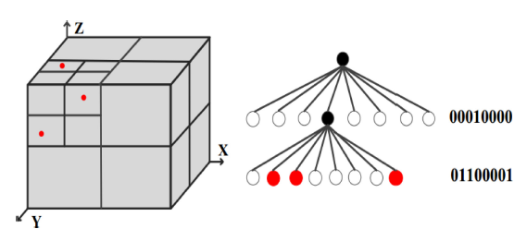
Background
3D Point Clouds
Immersive communication
Virtual reality
Autonomous navigation
Problem
The cost for transmission and storage of 3-D point clouds is too high!
Point Cloud Compression
Geometry Compression
Octree (k-d tree) based geometry coding
Deep learning based method
Attributes Compression:
Transform-based methods
Lossless geometry + Lossy attributes
Notes:
Let’s begin with the background. 3-D point clouds have become popular in applications like immersive communication, virtual reality and autonomous navigation. A point cloud usually contains millions of points so that the cost for transmission and storage of 3-D point clouds is too high! Thus, there are increasing demands for high-performance compression schemes. Usually, 3-D point cloud compression involves geometry and attributes. Geometry compression has been well addressed using octree structure and recent deep learning techniques. In our work, we mainly focus on transform-based attributes compression using losslessly decoded geometry.

Slide 3
Motivation
Attributes Compression:
Lossless geometry + Lossy attributes
Graph Fourier Transform
[C.Zhang et.al. ICIP 2014]
Region-adaptive Hierachical Transform
[D.Queiroz et.al. TIP 2016]
Geometry-Guided Sparse Representation [S.Gu et.al. TIP 2020]
Multi-Scale Structured Dictionary Learning [Y.Shen et.al. TCSVT 2020]
Problems: The tailored analytical transforms ignore the varying statistics of point clouds, while the multi-scale dictionary learning method doesn’t consider the underlying topological structure of 3-D point clouds such that ignores some important characteristics (such as smoothness) of the signals.
Graph Dictionary Learning
Parametric Graph Dictionaries
[X.Zhang et. al. ICASSP2012, D.Thanou et. al. TSP2014]
Dual Graph Regularized Dictionary Learning (DGRDL) [Y.Yankelevsky et. al. TSIPN 2016]
Graph Enhanced Multi-Scale dictionary learning (GEMS)
[Y.Yankelevsky et. al. TSP2019]
Problems: The standard graph Laplacian has limited extrapolation capability because its geodesic function in the null space is constant [K. I. Kim et.al. NIPS 2009], meaning that its ability to exploit the local geometry structure of data manifold beyond the scope of the training datasets is limited.
Notes:
Next, let me introduce the motivation. The current state-of-the-art transform-based attributes compression methods like GFT、RAHT、GSR consider pre-defined transforms that ignore the varying statistics of point clouds. Although the MSSDL method utilizes the statistical prior to learn a well-suited dictionary for sparse coding of 3-D point clouds, it doesn’t consider some important characteristics such as smoothness along the underlying structure of 3-D point clouds.
We consider Graph dictionary learning to improve sparse representation of 3D point clouds because it can jointly exploit the underlying topology and statistics of signals.
The current graph dictionary learning model like Parametric Graph Dictionaries、DGRDL、GEMS focus on the graph Laplacian to introduce the graph topology. However, the graph Laplacian is limited in exploiting local structures, as its geodesic function in the null space is constant. So it is still challenging to extend graph dictionary learning to 3-D point cloud compression.

Slide 4
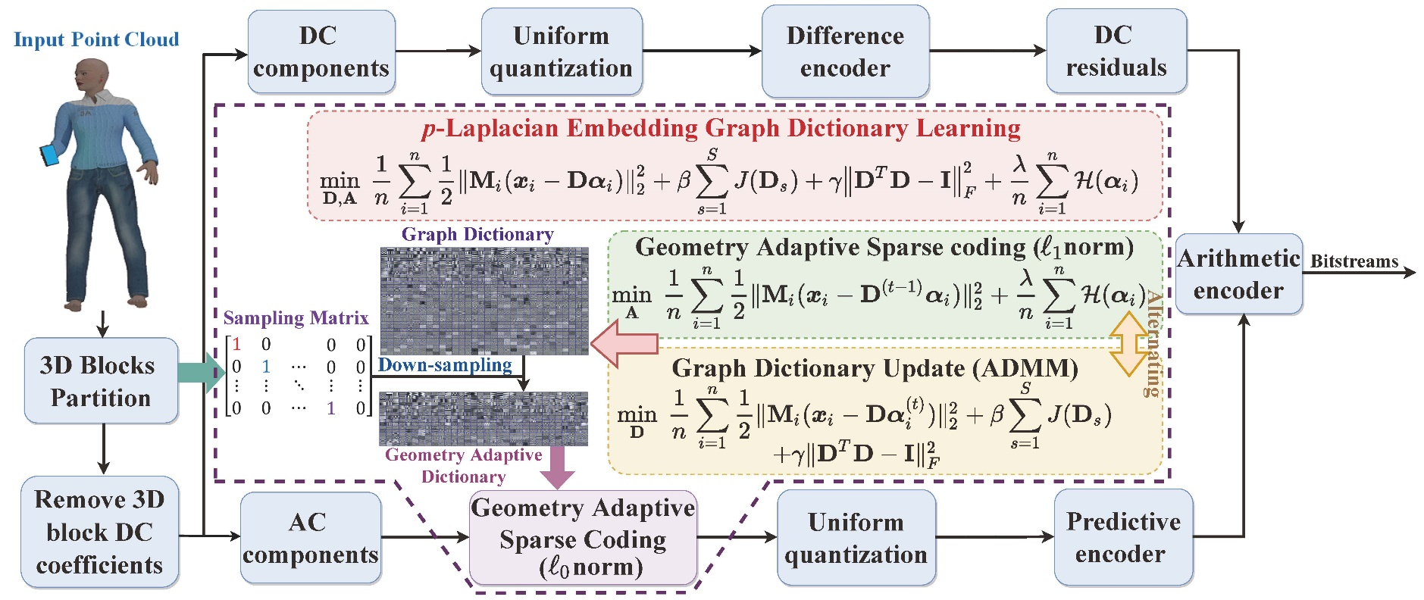
The Proposed Method
We propose a novel graph dictionary learning algorithm having well generalization capability of capturing the topological structure of point clouds with $p$-Laplacian eigen-functions to improve 3-D point cloud attribute compression. We adopt the commonly used overcomplete dictionary and model it to be composed of $S$ complete sub-dictionaries, each of which is expected to approach the eigenvectors of $p$-Laplacian operator due to its superior ability to exploit geometry correlations [T. Bühler et.al. ICML 2019].
Framework overview of the proposed compression method
Notes:
Then, let me introduce the proposed method. The figure in this slide shows the proposed compression framework. We propose a novel graph dictionary learning algorithm as shown in the dotted box to improve 3-D point cloud attribute compression. We adopt the commonly used overcomplete dictionary and model it to be composed of $S$ complete sub-dictionaries, each of which is expected to approach the eigenvectors of $p$-Laplacian operator due to its superior ability to exploit geometry correlations. To be specific, we introduce two regularization terms as shown in the blue box to the common dictionary learning problem which restrict the sub-dictionaries to approach the eigenvectors of $p$-Laplacian operator. Besides, the first term in the dictionary learning problem is the commonly used “data-fitting” cost function and the fourth term represents the sparsity-inducing function which is l1 norm constraint in training stage and l0 norm constraint in test. To solve the resulting non-convex minimization problem, we alternately solve the geometry adaptive sparse coding problem with least angle regression and graph dictionary update with ADMM. The graph dictionary is trained off-line firstly.
Then, we divide the input point cloud into blocks and coding the dc components and the residual ac components of each block separately. The ac terms are transformed by solving the geometry adaptive sparse coding problem using the off-line graph dictionary. Both the DC signal and AC coeﬀicients are uniformly quantized. And The differences between quantized DC coeﬀicients of adjacent blocks are submitted for entropy coding. While the non-zero quantized AC coeﬀicients and their index in the coefficients matrix are submitted for entropy coding separately.

Slide 5
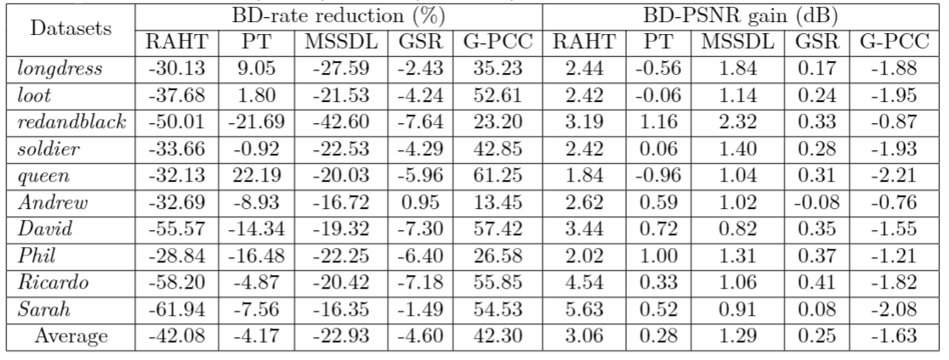
Graph Dictionary Learning for 3D PCC
Experimental Results
Average BD-rate reductions (%) and BD-PSNR gains (dB) by the proposed method in comparison to RAHT, geometry-guided sparse representation (GSR), multi-scale structured dictionary learning (MSSDL), predicting transform (PT) and G-PCC on ten widely used point clouds extracted from the 8iVFB and MVUB databases
Notes:
Next, I will show the experimental results. This table shows the BD-PSNR gains and BD-rate reductions of the proposed method in comparison to five state-of-the-art and recent transform based method and G-PCC on ten widely used point clouds. We can see that the proposed method outperforms state-of-the-art and recent transform-based methods, demonstrating the superior decorrelation ability of the proposed method. Although the proposed framework is inferior to G-PCC, it significantly outperforms RAHT adopted in G-PCC. It is worth mentioning that G-PCC integrates the inter depth up-sampling prediction and sophisticated quantizer and entropy coder for improved performance. It is potential to enhance the proposed framework with these strategies in future.

Slide 6
Conclusions
We propose a novel framework based on $p$-Laplacian embedding graph dictionary learning that leverages the underlying structures for 3-D point cloud attribute compression.
An alternating optimization algorithm is developed to eﬀiciently solve the formulated minimization problem.
Experimental results show that the proposed method outperforms state-of-the-art transform-based methods in rate-distortion performance.
In future, we will integrate the proposed framework with sophisticated quantization and entropy coding to improve compression performance.
Notes:
Finally, I will draw a conclusion.

Slide 7
Q & A
Thanks !
Notes:
That’s all.
Thank you for listening.
If you have any question, please contact me via e-mail.

