Slide 1
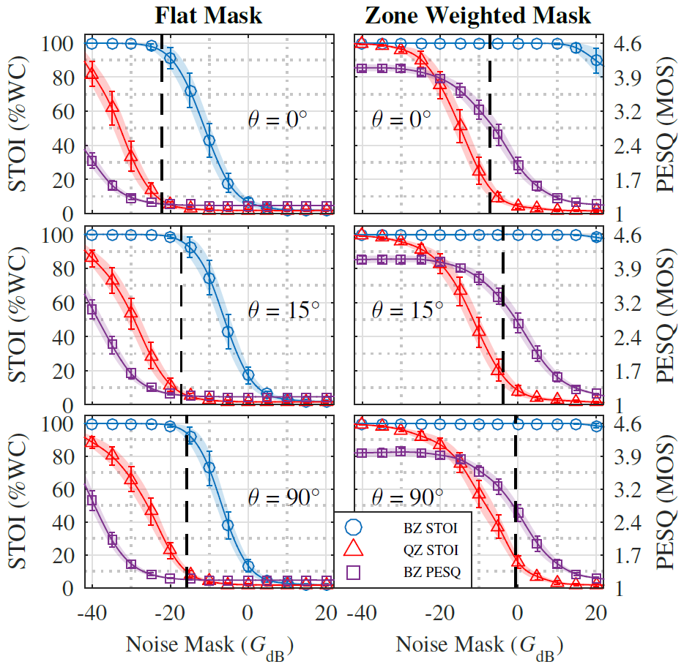
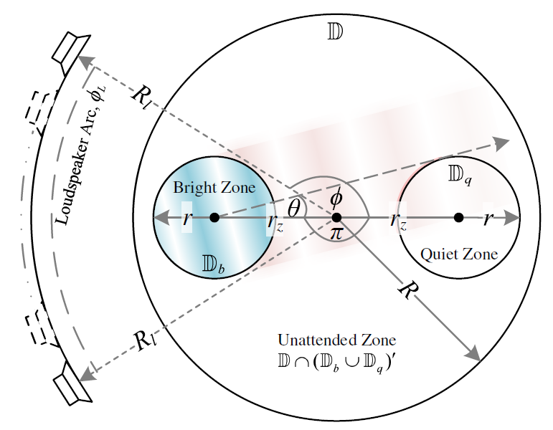
Improving speech privacy in personal sound zones
Jacob Donley ⃰, Christian Ritz ⃰ and W. Bastiaan Kleijn †
⃰ School of Electrical, Computer and Telecommunications Engineering, University of Wollongong, Wollongong, NSW, Australia
† School of Engineering and Computer Science, Victoria University of Wellington, New Zealand
jrd089@uowmail.edu.au, critz@uow.edu.au, bastiaan.kleijn@vuw.ac.nz
The figure to the right is from [1] and shows results for various masking levels ($G_{dB}$).
Below is the reproduction layout where evaluated geometry can be found in [1].
The next slide contains example audio snippets for some given values of $G_{dB}$.
Optimum $G_{dB}$
BZ STI
QZ STI
BZ PESQ
Fig. 1. – STOI and PESQ for anechoic. Black dashed lines are optimum and = 1.
[1] J. Donley, C. Ritz and W. B. Kleijn, “Improving Speech Privacy in Personal Sound Zones,” in Int. Conf. on Acoust., Speech and Signal Process. (ICASSP). 2016, pp. 311-315, IEEE.

Slide 2
Improving speech privacy in personal sound zones
Jacob Donley ⃰, Christian Ritz ⃰ and W. Bastiaan Kleijn †
⃰ School of Electrical, Computer and Telecommunications Engineering, University of Wollongong, Wollongong, NSW, Australia
† School of Engineering and Computer Science, Victoria University of Wellington, New Zealand
jrd089@uowmail.edu.au, critz@uow.edu.au, bastiaan.kleijn@vuw.ac.nz
Male
Original (reference):
Bright Zone
$$θ=0°$$
The closest noise mask levels to the optimal $G_{dB}$ for $λ=1$ are enclosed in green for each case.
Quiet Zone
Bright Zone
$$θ=15°$$
Quiet Zone
Bright Zone
$$θ=90°$$
Quiet Zone

Slide 3
Improving speech privacy in personal sound zones
Jacob Donley ⃰, Christian Ritz ⃰ and W. Bastiaan Kleijn †
⃰ School of Electrical, Computer and Telecommunications Engineering, University of Wollongong, Wollongong, NSW, Australia
† School of Engineering and Computer Science, Victoria University of Wellington, New Zealand
jrd089@uowmail.edu.au, critz@uow.edu.au, bastiaan.kleijn@vuw.ac.nz
Female
Original (reference):
Bright Zone
$$θ=0°$$
The closest noise mask levels to the optimal $G_{dB}$ for $λ=1$ are enclosed in green for each case.
Quiet Zone
Bright Zone
$$θ=15°$$
Quiet Zone
Bright Zone
$$θ=90°$$
Quiet Zone

