Slide 1
AN ENHANCED LOCAL TEXTURE DESCRIPTOR FOR IMAGE SEGMENTATION
Authors: Sheikh Tania, Manzur Murshed, Shyh Wei Teng, Gour Karmakar
Federation University Australia, Gippsland Campus, Churchill Vic 3842, Australia
Presented by
Sheikh Tania

Slide 2
Overview of the presentation
Motivation and major contribution
Proposed Technique
Types of texture features & their limitations
Overview of Iterative Contraction and Merging (ICM) and Weber Local Descriptor(WLD)
Proposed technique to reduce the length of texture feature
Results
Quantitative results and comparison
Conclusion

Slide 3
Motivation
Image segmentation is a prerequisite in many real time applications.
Incorporating lots of features in region-based segmentation algorithms results in more storage and computational cost.
Reducing the size of any feature accelerates the efficiency of real time systems.

Slide 4
Sparse Vs. Dense Descriptor
Sparse Descriptor:
Scale invariant feature transform (SIFT)
Rotation invariant feature transform (RIFT)
Intensity Domain Spin Image
Dense Descriptor:
Local Binary Pattern (LBP)
Local Ternary Pattern (LTP)
Weber Local Descriptor(WLD)
https://bit.ly/309GPJ7

Slide 5
Iterative contraction and Merging (ICM)
A hierarchical image segmentation algorithm
First step is pixel based contraction and merging
Second step is region based contraction and merging
Region features used:
colour
region size
Texture
spatial intertwining
border colour

Slide 6
Weber Local Descriptor (WLD)
Two major components:
Differential Excitation
Gradient Orientation
http://www.ee.oulu.fi/~gyzhao/Papers/2010/WLD.pdf

Slide 7
Weber Local Descriptor (WLD)
 |  | • | • | •
 |  | • | X | •
 |  | • | • | •
 | • | • | • | • | •
 | • |  |  |  | •
 | • |  | X |  | •
 | • |  |  |  | •
 | • | • | • | • | •
• | • | • | • | • | • | •
• |  |  |  |  |  | •
• |  |  |  |  |  | •
• |  |  | X |  |  | •
• |  |  |  |  |  | •
• |  |  |  |  |  | •
• | • | • | • | • | • | •
Number of bin for excitation, T: 6
Number of bin for orientation, D: 8
Total Length of WLD feature : 144 (48 + 48 + 48)

Slide 8
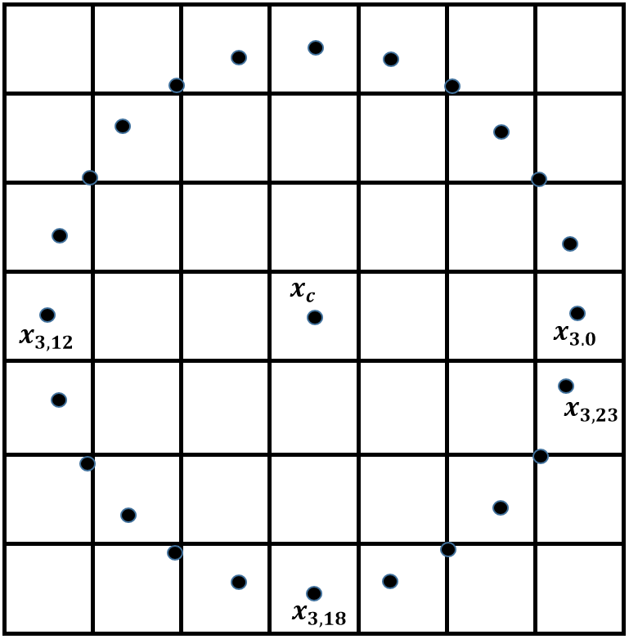
Proposed Radial Mean WLD (RM_WLD)
Radial average of pixel intensities represent complementary information of the pixel intensities of three different circular neighbourhood.
Total Length of RM_WLD feature : 48

Slide 9
Performance comparison of ICM and ICMRM_WLD using BSDS500
Combination of feature | Algorithm | SC↑ | PRI↑ | VI↓ | Time↓
Colour + Size + Texture | ICM ICMRM_WLD(T:6, D:8) ICMRM_WLD(T:8, D:6) ICMRM_WLD(T:8, D:1) | 0.640 0.642 0.640 0.638 | 0.839 0.841 0.839 0.840 | 1.597 1.582 1.585 1.602 | 1.6 s 1.4 s 1.4 s 1.3 s
Colour + Size + Texture+ Spatial intertwining | ICM ICMRM_WLD(T:6, D:8) ICMRM_WLD(T:8, D:6) ICMRM_WLD(T:8, D:1) | 0.651 0.651 0.651 0.650 | 0.846 0.847 0.847 0.848 | 1.531 1.531 1.531 1.535 | 1.8 s 1.6 s 1.6 s 1.5 s
Colour + Size + Texture+ Spatial intertwining + Border colour | ICM ICMRM_WLD(T:6, D:8) ICMRM_WLD(T:8, D:6) ICMRM_WLD(T:8, D:1) | 0.678 0.680 0.682 0.683 | 0.860 0.862 0.862 0.861 | 1.402 1.405 1.400 1.400 | 1.8 s 1.6 s 1.6 s 1.5 s

Slide 10
Performance comparison of ICM and ICMRM_WLD using BSDS500 and MSRC
Dataset | Algorithm | SC↑ | PRI↑ | VI↓ | Time↓
BSDS | ICM ICMRM_WLD(T:6, D:8) ICMRM_WLD(T:8, D:6) | 0.673 0.673 0.676 | 0.859 0.861 0.862 | 1.426 1.431 1.419 | 1.8 s 1.6 s 1.6 s
MSRC | ICM ICMRM_WLD(T:6, D:8) ICMRM_WLD(T:8, D:6) | 0.761 0.764 0.763 | 0.854 0.854 0.854 | 0.955 0.949 0.951 | 1.1 s 1.0 s 1.0 s

Slide 11
Thank you all…

