Slide 1
FM-Indexing Grammars Induced by Suffix Sorting for Long Patterns
Jin-Jie Deng¹, Wing-Kai Hon¹, Dominik Köppl², Kunihiko Sadakane³
Tsing Hua University¹
Hsinchu, Taiwan
Tokyo Medical and Dental University²
Tokyo, Japan
The University of Tokyo³
Tokyo, Japan

Slide 2
Text index
Given an input text T on integer alphabet Σ
A text index is a data structure built on T supporting the following query for a pattern P:
count(T,P): return number of occurrences of P in T
Example:
T = abbabbababbab$
P = abbab
count(T,P) = 3
Special character being smaller than all characters in text

Slide 3
(compressed) Text indexes
BWT-based
FM-index [Ferragina & Manzini ‘00]
RLFM [Mäkinen & Navarro ‘05]
RLCSA [Sirén ‘12]
Geometric BWT [Chien et al ‘15]
Faster-Minuter [Gog et al. ‘16]
r-index [Gagie et al. ‘20]
sr-index [Cobas et al. ‘21]
Grammar-based
GCIIS [Akagi et al. ‘21] [Diaź et al. ‘21]
Optimal-time dictionary-compressed indexes [Christiansen et al. ‘20]
ESP-index [Maruyama et al. ‘13]
LZ-index [Navarro ‘09]

Slide 4
FM-index [Ferragina & Manzini ‘00]: construction
BWT of T
[Burrows & Wheeler ‘94]
T = abbabbababbab$
|T| rotations of T
sorted in lexicographic order
FM-index
F L
$₁abbabbababbab₁
a₁b$abbabbababb₂
a₂babbab$abbabb₃
a₃bbab$abbabbab₄
a₄bbababbab$abb₅
a₅bbabbababbab$₁
b₁$abbabbababba₁
b₂ab$abbabbabab₆
b₃ababbab$abbab₇
b₄abbab$abbabba₂
b₅abbababbab$ab₈
b₆bab$abbabbaba₃
b₇bababbab$abba₄
b₈babbababbab$a₅
abbabbababbab$
bbabbababbab$a
babbababbab$ab
abbababbab$abb
bbababbab$abba
bababbab$abbab
ababbab$abbabb
babbab$abbabba
abbab$abbabbab
bbab$abbabbaba
bab$abbabbabab
ab$abbabbababb
b$abbabbababba
$abbabbababbab
$abbabbababbab
ab$abbabbababb
ababbab$abbabb
abbab$abbabbab
abbababbab$abb
abbabbababbab$
b$abbabbababba
bab$abbabbabab
bababbab$abbab
babbab$abbabba
babbababbab$ab
bbab$abbabbaba
bbababbab$abba
bbabbababbab$a

Slide 5
FM-index: counting
count(T,P) is reduced to |P| steps of backward-searching
F L
$₁abbabbababbab₁
a₁b$abbabbababb₂
a₂babbab$abbabb₃
a₃bbab$abbabbab₄
a₄bbababbab$abb₅
a₅bbabbababbab$₁
b₁$abbabbababba₁
b₂ab$abbabbabab₆
b₃ababbab$abbab₇
b₄abbab$abbabba₂
b₅abbababbab$ab₈
b₆bab$abbabbaba₃
b₇bababbab$abba₄
b₈babbababbab$a₅
Example:
T = abbabbababbab$
P = a b b a b
count(T,P) = 3

Slide 6
RLFM [Mäkinen & Navarro ‘05]
Storing run-length-encoded L to improve space
Example:
L = bbbbb$abbabaaa
b $ a b a b a (run-characters)
5 1 1 2 1 1 3 (lengths)

Slide 7
λ-factorization
Grouping λ consecutive characters to a meta-character fitting into a single machine word
λ : fixed integer
a
Random access is in unit of machine word (e.g. 8 bytes),
but single character only occupy partial word (e.g. 1 byte)
Example:
T = abbabbababbab$
λ = 3
T = abb·abb·aba·bba·b##·$##
Separator of λ-factorization
(only for visualization)
Whitespace character
(only for visualization)
λ-factor

Slide 8
Geometric BWT [Chien et al. ‘15]: construction
FM-index on λ-factorized T
Universal table for count of all substrings of λ-factors
Example:
λ = 3
T = abb·abb·aba·bba·b##·$##
a :5
b :8
ab :3
ba :2
bb :3
aba:1
abb:2
bba:1
F L
$##₁·abb·abb·aba·bba·b##₁
aba₁·bba·b##·$##·abb·abb₁
abb₁·aba·bba·b##·$##·abb₂
abb₂·abb·aba·bba·b##·$##₁
b##₁·$##·abb·abb·aba·bba₁
bba₁·b##·$##·abb·abb·aba₁

Slide 9
Geometric BWT: counting long patterns
Long: multiple λ-factors
At most λ types of possible occurrences for P
≈ |P| / λ steps of backward-searching for each type of occurrence
Example:
λ = 3
T = abb·abb·aba·bba·b##·$##
P = abbab
count(T,P) = 3:
count(T,abb·ab#) = 2
count(T,#ab·bab) = 0
count(T,##a·bba·b##) = 1
F L
$##₁·abb·abb·aba·bba·b##₁
aba₁·bba·b##·$##·abb·abb₁
abb₁·aba·bba·b##·$##·abb₂
abb₂·abb·aba·bba·b##·$##₁
b##₁·$##·abb·abb·aba·bba₁
bba₁·b##·$##·abb·abb·aba₁

Slide 10
Geometric BWT: counting long patterns
Counting characters in co-lexicographic order for last step in counting
Example:
λ = 3
T = abb·abb·aba·bba·b##·$##
P = abbab
count(T,P) = 3:
count(T,abb·ab#) = 2
count(T,#ab·bab) = 0
count(T,##a·bba·b##) = 1
F L
$##₁·abb·abb·aba·bba·b##₁
aba₁·bba·b##·$##·abb·abb₁
abb₁·aba·bba·b##·$##·abb₂
abb₂·abb·aba·bba·b##·$##₁
b##₁·$##·abb·abb·aba·bba₁
bba₁·b##·$##·abb·abb·aba₁

Slide 11
Geometric BWT: counting short patterns
Short: single λ-factor
Table lookup
Example:
λ = 3
T = abb·abb·aba·bba·b##·$##
P = bb
count(T,P) = 3
a :5
b :8
ab :3
ba :2
bb :3
aba:1
abb:2
bba:1

Slide 12
S*-factorization
Borrowed from SAIS [Nong et al. ‘09] and applied in GCIS [Nunes et al. ‘18]
S-type
T [i] < T [i + 1] or
T [i] = T [i + 1] and T [i + 1] is S-type
L-type
T [i] > T [i + 1] or
T [i] = T [i + 1] and T [i + 1] is L-type
S*-type
$ or
T [i] is S-type or T [i - 1] is L-type
S*-factor
T [i .. j]
T [i] is S*-type and T [j + 1] is S*-type, or
i = 1 and T [j + 1] is S*-type
S*-factor
Example:
T = b | a a b | a b b | a b | $
L S* S L S* L L S* L S*
Separator of S*-factorization
(only for visualization)

Slide 13
FIGISS: construction
S*-λ-Factorization
Geometric-BWT using (S*-λ-)factors instead
T = a b b a b b a b a b b a b $
S* L L S* L L S* L S* L L S* L S*
applying S*-factorization on text
T = a b b | a b b | a b | a b b | a b | $
S* L L S* L L S* L S* L L S* L S*
(S*-λ-)factor
(contiguous characters in between separators)
applying λ-factorization on S*-factors
(e. g. λ = 2)
T = a b · b # | a b · b # | a b | a b · b # | a b | $ #
S* L L S* L L S* L S* L L S* L S*

Slide 14
FIGISS: counting
Applying S*-λ-factorization on P
At most 2 different rightmost factors due to S- and L- types
Factors in the middle part of factorization are deterministic
At most λ different leftmost factors
Counting patterns is similar to what geometric BWT does but on (S*-λ-)factors
Example:
T = a b · b # | a b · b # | a b | a b · b # | a b | $ #
S* L L S* L L S* L S* L L S* L S*
P = abbabba
| a b · b # |
| S* L L |
| a #
S
a b · b # |
S* L L
# a · b b |
S* L L
| a b · b a
| S* L L L

Slide 15
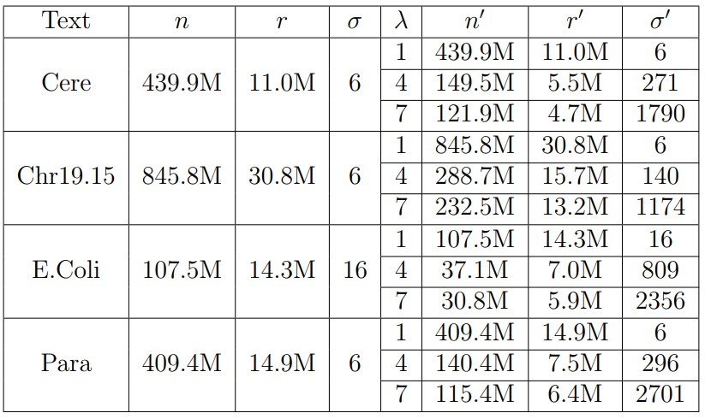
Experiments: dataset
Texts
Cere, E. Coli, and Para are from Pizza & Chili Repetitive Corpus
Chr19.15 is concatenation of 15 individual sequences of the human chromosome 19
n (n’): length of text (S*-λ-factorized text)
r (n’): number of maximal character runs in BWT of text (S*-λ-factorized text)
σ (σ’): size of alphabet (set of factors)

Slide 16
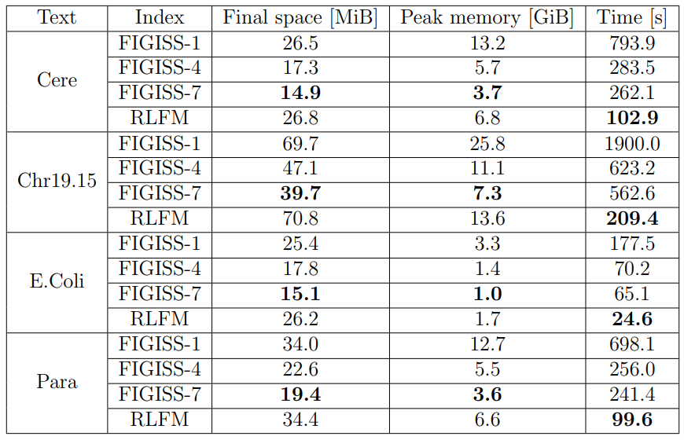
Experiments: construction
FIGISS-λ
λ = 1, 4, and 7
Pros
Space-efficient
Final space
Peak memory
Cons
Slow construction time

Slide 17
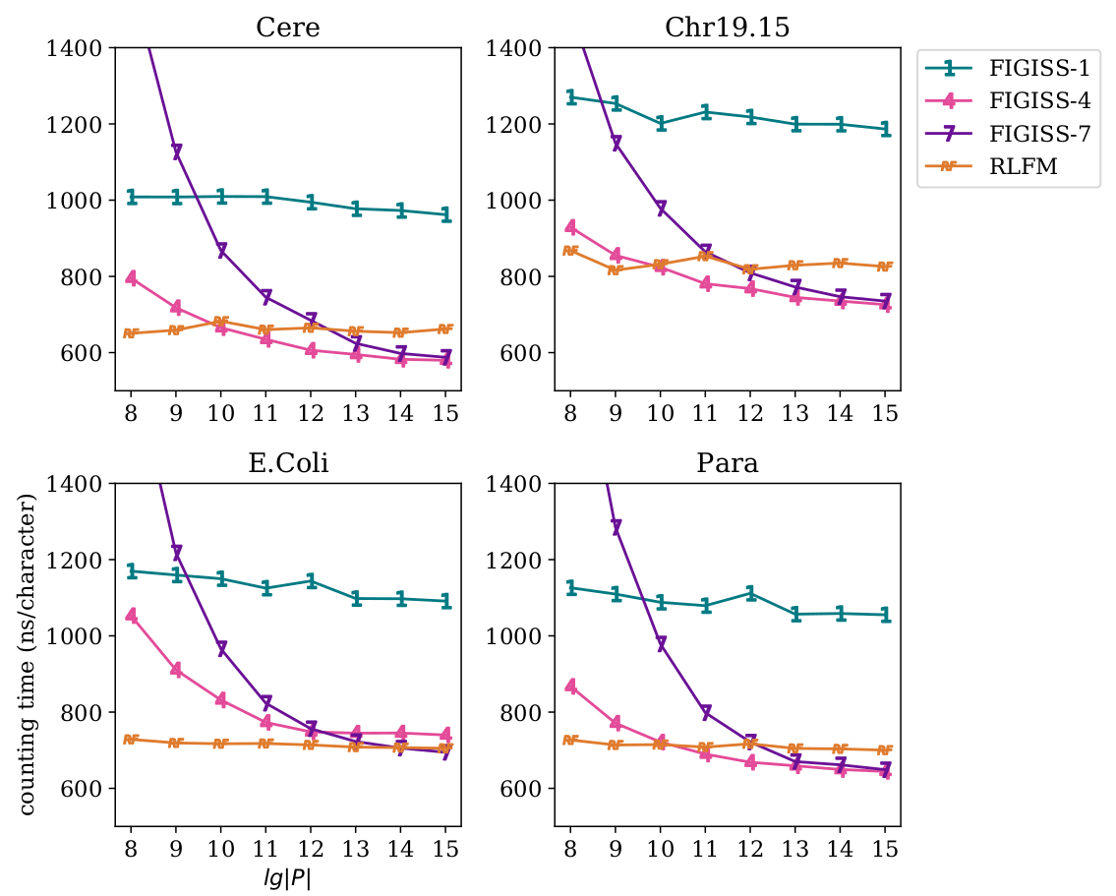
Experiments: counting time
Competitive with RLFM when counting long patterns
FIGISS-4 & FIGISS-7
Space-time trade-off
FIGISS-4 is relatively larger but faster
FIGISS-7 is relatively smaller but slower

Slide 18
Summary
FIGISS is a text index on text T supporting counting queries for a pattern P
Pros : S*-λ-factorization for compressing the text and skipping backward-searching steps
Cons : Additional costs for factorizing P and looking up grammar rules during counting
Experiments show that FIGISS is
space-efficient in terms of final index space and peak memory during construction
competitive for counting long patterns
Implementation is on github: https://github.com/jamie-jjd/figiss
Future Work
Supporting locating queries like r-index but on S*-λ-factorized T
Recursive application of the S*-factorization like [Akagi et al. ‘21] [Diaź et al. ‘21]
Alternative factorization using string synchronizing sets [Kempa & Kociumaka ‘19]

