Slide 1
Privacy-Assured and Multi-Prior Recovered Compressed
Sensing for Image Compression-Encryption Applications
Hui Huang* , Di Xiao*, Min Li*
* College of Computer Science
Chongqing University
Chongqing 400044, China
Email: dixiao@cqu.edu.com
Notes:
更多精品素材：http://shop248912786.taobao.com （下拉可隐藏）

Slide 2
Content
1
Introduction
2
Preliminaries
3
The Proposed Scheme
4
Simulation Results and Analyses
5
Conclusion

Slide 3
1
Introduction
Challenges

Slide 4
Challenges
Low-security: The compressive sensing (CS)-based cryptosystem cannot resist cryptographic attacks, including ciphertext-only attack (COA), known-plaintext attack (KPA) and chosen-plaintext attack (CPA). Additionaly, key space is small, which need to be improved.
Low-quality recovery: The existing reconstruction algorithms without consider more prior regularization term to improve the recovery performance, which cannot provide better service.

Slide 5
2
Premilinaries
The CS-based cryptosystem
Cryptographic attack models

Slide 6
The CS-based cryptosystem
A signal is called -sparse if there exists a sparse representation basis satisfying
Sparse signal
Measurements
Measurement
matrix
Nonzero
entries
The measurement matrix satisfies the restricted isometry property (RIP), which can preserve more signal information. Signal reconstruction can be achieved by using prior information of the original signal.
The measurement matrix
that is incoherent with the sparse representation basis is generated to produce the linear measurement by the random linear projection,
Notes:
CS is not just a compression technology, it is a cryptosystem. Compression techniques are reflected in the signal from N-dimensional to M-dimensional. The cryptosystem is that if the adversary does not know the measurement matrix, it cannot reconstruct the original signal. In addition to the measurement matrix, the prior information of the original signal helps to reconstruct the original signal.

Slide 7
Cryptographic attack models
COA: The adversary only knows the ciphertext and attempts to find the corresponding key and plaintext.
KPA: The adversary can access the plaintext/ciphertext pairs
dataset to infer the secret measurement matrix by using , where represents pseudoinverse operation.
CPA: The adversary can select the identity matrix as a plaintext to infer the measurement matrix.
Notes:
Cryptographic attack models should be considered in our reseach. The first type of attack is COA, which means that the adversary only knows the ciphertext and attempts to find the corresponding key and plaintext. The second attack is KPA, which refers to the adversary can access the plaintext/ciphertext pairs and infer the secret measurement matrix. The third kind of attack is CPA, which means that the adversary can select the identity matrix as a plaintext to infer the measurement matrix.

Slide 8
3
The Proposed Scheme
Image permutation-diffusion encryption
Diffused image compression
Multi-prior regularization image recovery
Notes:
The third part is our proposed solution, which consists of two parts: CS encoding and CS recovery.

Slide 9
Framework
Figure 1: The overall architecture of the proposed scheme.
Notes:
CS encoding includes Image permutation-diffusion encryption and diffused image compression, and CS recovery is mainly dedicated to multi-prior regularization image recovery. This is the overall architecture of the proposed scheme.

Slide 10
Image permutation-diffusion encryption
The Original image
The index matrix
The permuted image
1
Permutation
The chaotic matrix
The random binary interger matrix
2
Diffusion
The chaotic matrix
The diffused image

Slide 11
Diffused image compression
The measurement matrix
The diffused image
The measurement
It is obvious that the size of the measurement is far less than that of the diffused image .
Intuitively, it is infeasible to recover the diffused image if the receiver does not know the chaotic measurement matrix .
Since the measurement need to be transmitted, it is quantized by uniform quantization operation.
Notes:
The diffusion image Xd is compressed and encrypted simultaneously by Phi into Y. Obviously, the size of the measurement is far less than that of the diffused image Xd, and it is infeasible to recover the diffused image if the receiver does not know the chaotic measurement matrix Phi. Additionaly, since the measurement need to be transmitted, it is quantized by uniform quantization operation.

Slide 12
Multi-prior regularization image recovery
The estimated measurement
The encryption operation
Prior regularization term
The above optimization problem can be transformed into the gradient descent recursion of the unknown image
ensure that is the solution space of .
Solution: Strengthen the low-rank property Decrease the image TV Encourage the image sparsity Ensure the iteration solution on its solution space
is used to ensure the small norm in wavelet domain.
can decrease the image TV.
is used to strengthen the low-rank property.
Notes:
Image recovery exert an significant role in the CS-based cryptosystem. Therefore, the better recovery performance scheme is designed by using multi-prior regularization term. This is the model we build for image reconstruction，where we employ l1 norm, TV and low-rank prior regularization term. This model requires solving. So, The above optimization problem can be transformed into the gradient descent recursion of the unknown image X, where g1(Xn) ensure that Xn is the solution space, g2(Xn) is used to ensure the small l1 norm in wavelet domain, g3(Xn) can decrease the image TV, and g4(Xn) is used to strengthen the low-rank property. Therefore, The solution process is this.

Slide 13
Multi-prior regularization image recovery
1
Initialization:
The pseudoinverses of
The decryption operation
2
Rank minimization:
a combination of similar patch
Low-rank matrix optimization
The first-order Taylor expansion
The low-rank solution
Notes:
First of all, an initial value is given by addressing the minimin l2-norm solution, and the initial value of original image can be acquired by decryption operation.
Next, since a surrogate function is closer to the rank than the nuclear norm, we select the surrogate function to solve the rank minimization problem, where Xi denotes a combination of similar patch.
Then, the low-rank matrix optimization problem is contructed by this, and according to the first-order Taylor expansion of Rank(Xi) and ignoring the constants, the solution of low-rank matrix is acquired in the (k+1)-th iteration.
Based on the the weighted singular value thresholding method, it is used to reconstruct the low-rank matrix in the (k + 1)-th iteration.

Slide 14
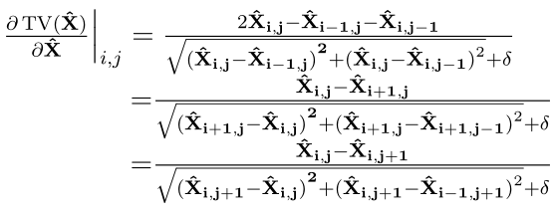
Multi-prior regularization image recovery
3
Gradient descent:
4
Bivariate shrinkage:
5
Projection onto the solution space:
Notes:
Gradient descent method is used to reduce image TV by this equation.
Bivariate shrinkage is widely used in removal of Gaussian noise.
Finally, we ensure that the solution is in the solution space.

Slide 15
4
Simulation results and analyses
Privacy-assured performance evalution
Compression performance evalution
Notes:
The fourth part is Simulation results and analyses.

Slide 16
Privacy-assured performance evaluation
Table 1: The key space and disadvantage of three schemes
Permutation-only encryption [10]: The random permutation matrices are used to encrypt the original image.
Diffusion-only encryption [5]: The original image is encrypted by using NINPT.
The proposed permutation-diffusion encryption.
[5] B. Zhang, D. Xiao, M. Wang, and J. Liang, “Privacy-preserving compressed sensing for image simultaneous compression-encryption applications,” in 2021 Data Compression Conference (DCC), 2021, pp. 283–292.
[10] M. Wang, D. Xiao, and Y. Xiang, “Low-cost and confidentiality-preserving multi-image compressed acquisition and separate reconstruction for internet of multimedia things,” IEEE Internet of Things Journal, vol. 8, no. 3, pp. 1662–1673, 2021.
Notes:
It is known that the privacy-assured performance is of great significance for image processing. We compare the key space to demonstrate the privacy-assured performance of the proposed scheme. From Table 1, we can see that the proposed scheme has an advantage over other schemes in terms of key space and it can overcome the disadvantage of other schemes.

Slide 17
Privacy-assured performance evaluation
COA
KPA
CPA
Notes:
Subsequently, we analyze the the resisting cryptographic attacks capability of the proposed scheme, including COA, KPA and CPA. We prove three theorem to demonstrate that the proposed scheme can resist the above cryptographic attacks. Theorem 1 demonstrates that the diffused image can not infer in the case of COA. It is known that the the measurement Y will leak the energy of the diffused image Xd. Since the diffused image is acquired by using the permutation-diffusion structure for the original image, the energy of original image can not be obtained. Therefore, it is impossible that the original image can be obtained without knowing keys.
Theorem 2 gives the fact that the proposed scheme can resit KPA.
And theorem 3 shows that the proposed scheme can resist CPA.

Slide 18
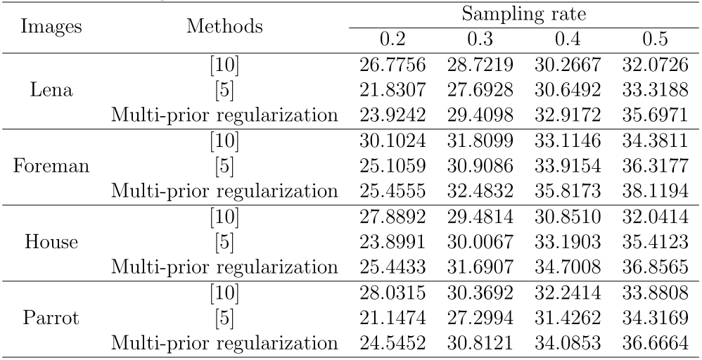
Compression performance evaluation
Table 2: PSNR (in dB) value of the recovered test gray images by using three configurations with different sampling rates.
Notes:
The relationship between the recovery performance and sampling rate with three configurations is presented in Table 2. From this table, it can be seen that the PSNR gain of the proposed scheme has an advantage over l1 norm regularization configurations, and it has remarkable benefit for block-based l0 norm regularization at higher sampling rate. Therefore, the proposed scheme not only improves security but also acquires better recovery performance in comparison with [5].

Slide 19
5
Conclusion

Slide 20
Conclusion
The permutation-diffusion structure is embedded to the CS encoding process, and it can resist cryptographic attacks and increase the key space while compressing.
The multi-prior regularization recovery algorithm is designed to recover the original image from the measurement effectively, and it can improve the recovery performance.
Notes:
we design a privacy-assured and multi-prior recovered CS strategy for image compression-encryption applications. The privacy-assured CS and multiprior regularization recovery can address the problems of low-security and low-quality recovery, respectively. For the low-security challenge, the permutation-diffusion structure is embedded to the CS encoding process, which can resist cryptographic attacks and increase key space. For the low-quality recovery challenge, we employ the multiprior regularization recovery to enhance the recovery performance. The simulation results and analyses show the effectiveness and feasibility of the proposed scheme.

Slide 21
Thanks

