Slide 1
Learning-based Point Cloud Geometry Coding Rate Control
Manuel Ruivo, André F. R. Guarda, and Fernando Pereira
Instituto Superior Técnico - Instituto de Telecomunicações Lisboa – PORTUGAL Data Compression Conference
Snowbird, Utah, USA, March 21-24, 2023
Notes:
My name is André Guarda, and I'm presenting the paper titled "Learning-based Point Cloud Geometry Coding Rate Control".
1

Slide 2
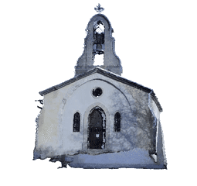
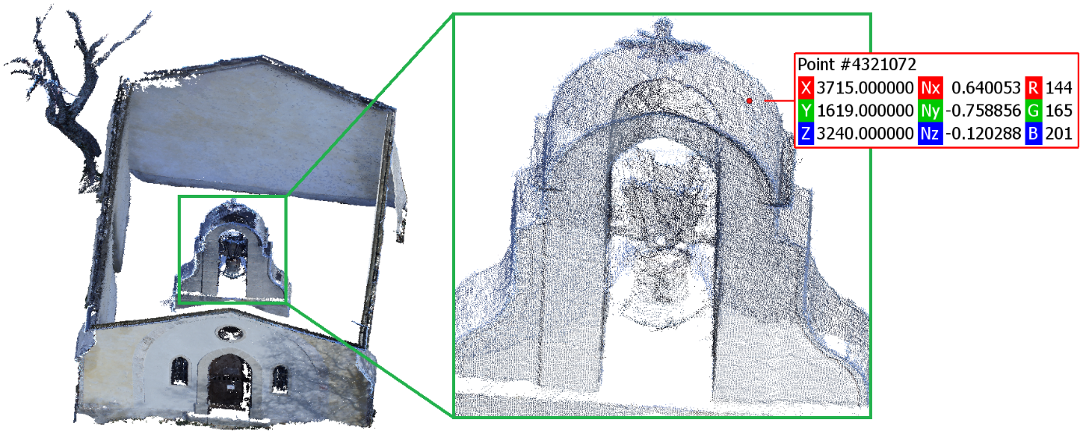
Point Cloud Coding
A point cloud (PC) is a 3D visual representation model consisting of an unordered set of 3D points, characterized by their coordinates (x, y, z).
PCs may have millions of points to offer realism and immersion, involving a large amount of data.
Efficient coding solutions are essential for the practical storage and transmission of PC data.
2
Notes:
To start with the basics, a Point Cloud is a 3D visual representation format, and it consists of a set of points in the 3D space, which define the geometry of an object, a person, or whatever scene we wish to capture.
Point clouds are ideal for immersive and interactive applications such as virtual and augmented reality. But in order to provide these realistic experiences, point clouds require millions of points and a huge amount of data, becoming expensive in terms of storage and transmission.
This makes the compression of point clouds extremely important.

Slide 3
Objective
JPEG is developing a deep learning (DL)-based PC coding standard, following a Call for Proposals in January 2022.
In the current JPEG Pleno PCC Verification Model (VM), the coding rate may be controlled through a set of coding parameters which depend on the specific PC (e.g., sparsity and homogeneity).
This requires manually coding the PC with different parameter configurations to reach the target rate.
The objective of this paper is to:
Design a learning-based rate control mechanism for the current JPEG Pleno PCC VM.
3
Notes:
JPEG is currently developing a learning-based standard for point cloud coding, and following a Call for Proposals in 2022, the first Verification Model was defined. In this Verification Model codec, we can control the coding rate by configuring some coding parameters, which typically depend on the characteristics of each point cloud, like its sparsity or homogeneity. However, this means that we have to manually encode and decode the point cloud with different parameter configurations in order to reach a specific target rate.
With this in mind, the objective of this paper is to design a learning-based rate control mechanism for the current JPEG Verification Model.

Slide 4
JPEG Pleno PCC Verification Model
A set of input parameters is available to provide flexibility during coding time.
The codec is equipped with three sampling tools: the basic down-/up-sampling modules and the DL Super Resolution (SR) model.
4
Notes:
The current Verification Model divides the point cloud into blocks, which are encoded separately. It contains sampling tools for down and up-sampling the point cloud data, in order to facilitate coding and reach lower rates, as well as super-resolution to restore some of the lost data. The codec uses 2 deep learning models: one used for encoding and decoding, and another for super-resolution.

Slide 5
Rate Control: A New Challenge
Achieving a specific target rate demands flexibility during coding time.
Choosing the optimal coding parameters is a rate control problem.
5
Notes:
As such, several coding parameters can be defined, which provide flexibility at coding time. For example, the block size for random access, the sampling factor for reducing the rate, or the coding model itself for a desired rate-distortion trade-off.

Slide 6
Rate Control: A Classification Approach
To simplify the problem, only the two coarser rate control parameters have been considered.
The discrete domain of these parameters allows to see it as a classification problem.
$$\text{Class} \text{ID}$$ | Sampling Factor | Coding Model ($λ$ value)
[0, 5] | 1 | [0.00025,0.0005,0.001,0.0025,0.005,0.01]
[6, 11] | 2 | [0.00025,0.0005,0.001,0.0025,0.005,0.01]
[12, 14] | 4 | [0.001,0.0025,0.005]
Classifier’s Goal: Predict the class holding the parameter pair that leads to the optimal RD Performance when coding a given PC and aiming for a certain target coding rate.
6
Notes:
In order to choose the coding parameters that achieve a desired target rate, we can adopt a classification approach. Considering the most relevant parameters like the sampling factor and the coding model, we have a finite set of combinations, in this case equal to 15. The goal is to train a classifier that can predict the combination of coding parameters that allows reaching the desired target rate, for a specific point cloud.

Slide 7
JPEG Pleno PCC VM with Automatic Rate Control
Extending JPEG Pleno PCC VM with an Automatic Rate Control (ARC) mechanism.
Original PC and target rate are used by ARC to select the optimal sampling factor and coding model (λ value).
7
Notes:
We extended the JPEG Verification Model with the proposed automatic rate control mechanism, which receives as input the point cloud we wish to code and the target rate, and provides the set of coding parameters for the codec.

Slide 8
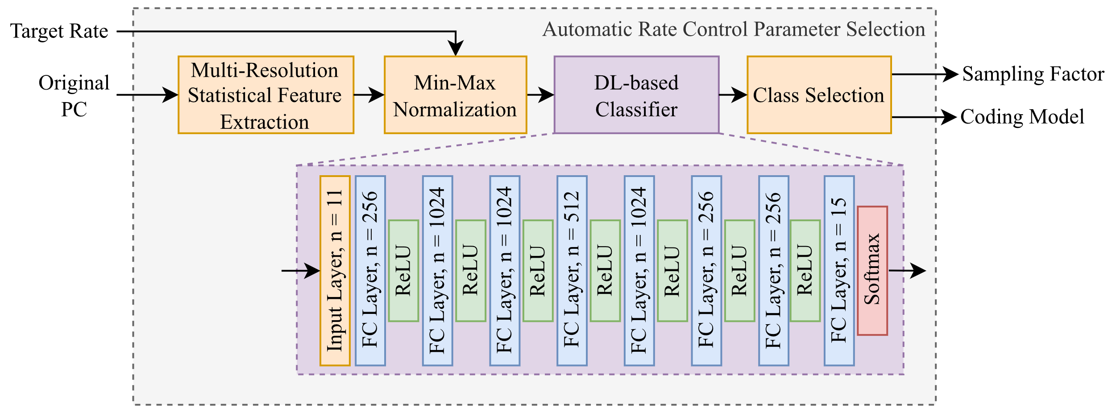
ARC: Detailed Architecture
Extracts multi-resolution features from the original PC regarding size, density, uniformity, among others.
Uses a Fully-Connected Neural Network as a Classifier to predict every classes’ probability.
8
Notes:
This ARC mechanism essentially extracts several statistic features of the point cloud at different resolutions, such as the number of points and distances between them. Then, these features are provided to a fully connected neural network trained as a classifier.

Slide 9
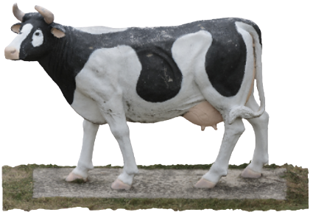
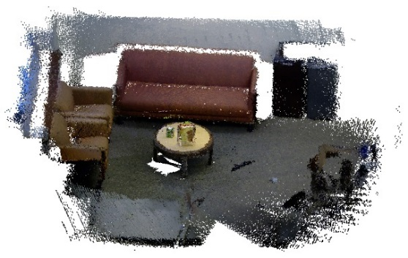
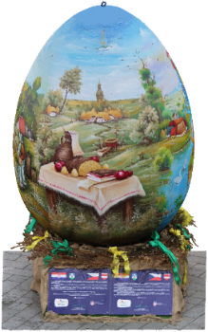
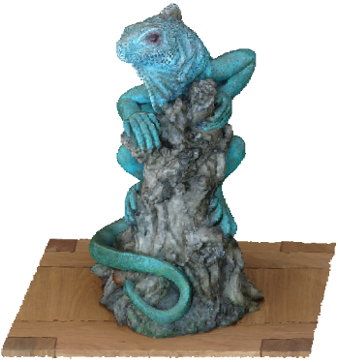
Testing Dataset and Conditions
For testing, 25 PCs were selected by JPEG.
The JPEG CTTC defined a set of target rates (in bpp) that must be achieved within a 10% error margin:
0.05 ± 0.005 ⇒ [0.045, 0.055]
0.15 ± 0.015 ⇒ [0.135, 0.165]
0.5 ± 0.05 ⇒ [0.45, 0.55]
1.5 ± 0.15 ⇒ [1.35, 1.65]
Achieving specific target rates without retraining the DL coding model is a challenge that requires flexibility during coding time.
9
Notes:
To evaluate the proposed ARC mechanism, we followed the testing conditions defined by JPEG, namely using the test dataset of 25 point clouds of varying characteristics, coded for a set of target rates (withing a 10% margin).

Slide 10
ARC: Evaluation Metrics
The Classifier’s performance evaluation was based on:
Classification Metric: Overall Accuracy
Rate Error Metrics:
Delta Target Rate (ΔTR)
Delta Optimal Rate (ΔOR)
Target Rate Infringement (TRI)
RD Performance Comparison Methods:
Bjontegaard-Delta (BD)-Rate
BD-PSNR
Combining these metrics allows to evaluate how much the Classifier predicts correctly and how much mispredicted labels penalize the codec’s RD performance.
10
Notes:
In terms of metrics, we measure the overall classification accuracy, but more importantly, we evaluate the performance in terms of the deviation of the actual coding rate regarding the target rate, as well as in terms of the rate-distortion.

Slide 11
ARC: Impact on RD Performance
For a good performance evaluation, testing was performed on two sets of target rates.
The ARC mechanism misses about 33% of the labels, however these mispredictions have a small impact on the final RD performance, namely with a 4% rate penalty when considering the training target rates (marked in blue).
When compared to the brute-force approach, the proposed ARC mechanism reduces in 93.3% the number coding operations necessary to optimize the coding parameters, thus drastically reducing its running time.
Target Rates (bpp) | Acc (%) | ΔTR (%) | ΔOR (%) | TRI (%) | BD-Rate (%) | BD-PSNR (dB)
1.5, 0.5, 0.15 | 66.67 | 26.116 | 12.284 | 20.115 | 4.32651 | -0.13477
1.0, 0.6, 0.25 | 65.33 | 18.809 | 13.975 | 5.813 | -0.38020 | -0.00673
11
Notes:
We evaluated the performance for two sets of target rates: first, the rates defined by JPEG, which were used when training the classifier, and second, a different intermediate set of rates which the classifier never saw during training, which allows us to see the generalization capabilities of the proposed solution. In both cases, the classification accuracy is around 66%. However, whenever it misses the optimal set of coding parameters, the error in rate is only around 13%. In addition, the impact in terms of rate-distortion performance is very small, showing only a 4% rate penalty.

Slide 12
Conclusions
This paper proposes a new learning-based automatic rate control mechanism for a DL-based PC geometry codec, which is the current JPEG Pleno PCC Verification Model.
The proposed automatic rate control mechanism is able to determine the coding parameters for a given PC and desired target rate, based on the PC’s characteristics.
Currently, in order to select the optimal coding configuration, a brute force approach is used which requires multiple encodings and decoding with different coding parameters.
The proposed approach is able to achieve similar results, with only a 4% rate penalty, with only a fraction of the cost in terms of complexity.
12
Notes:
To conclude, in addition to the relatively small impact in performance, the main advantage of the proposed automatic rate control mechanism is the fact that it reduces the number of encoding and decoding operations drastically, especially when compared to a brute-force approach, which is often necessary to optimize the coding parameters.

Slide 13
Thank you for your attention!
ACKNOWLEDGMENT
This work has been financially supported by the Fundação para a Ciência (FCT, Portugal) through the research project PTDC/EEI-COM/1125/2021, entitled “Deep Learning-based Point Cloud Representation”.
13
Notes:
Thank you for your attention.

