Slide 1
Introduction
Optimization Model
Unfolding Scheme
Experiment results
Conclusion
HMNet: Hierarchical Microscale-aware Network for Infrared Small Target Detection
Yueqian Quan, Honghui Xu, Yidong Yan, Hang Zheng, Jianwei Zheng*
Notes:
Hi，everyone, good afternoon, I am glad to have the opportunity to give a lecture. I come from Zhejiang University of Technology（tai 克闹乐gei）. The topic of the paper is titled "Hierarchical Microscale-aware Network for Infrared Small Target Detection." First, let me briefly introduce the concept of small targets in infrared images.

Slide 2
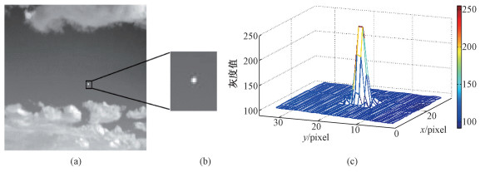
Introduction
Optimization Model
Unfolding Scheme
Experiment results
Conclusion
Infrared small target detection
Background and motivations
Infrared small target detection
Infrared images
Target region
3D distribution map
The weak target appears centrosymmetric and radial in shape, resembling a two-dimensional Gaussian function!
$$f_{T}(x,y)=A∙exp1\{−\frac{1}{2}[{(\frac{x−x_{c}}{θ_{x}})}^{2}+{(\frac{y−y_{c}}{θ_{y}})}^{2}]\}$$
Notes:
When an infrared target occupies an area no larger than 9 （pei 扣so）pixels × 9 pixels, it's termed as an infrared small target. As （一勒）illustrated in the figure, such weak targets typically appear （三true see卖脆克） centrosymmetric and radial in shape, resembling （re 赞mu 不灵） a two-dimensional （dai man） Gaussian（糕兴） function. Detecting small targets in infrared images presents unique challenges, despite their widespread（歪的丝be rua） applications in real-world （se nai reals）scenarios such as early warning（王ning） systems, （p瑞 塞巡 ）precision guidance, and （奥 掏nemous）autonomous driving.

Slide 3
Introduction
Optimization Model
Unfolding Scheme
Experiment results
Conclusion
Infrared small target detection
Background and motivations
Infrared small target detection
Small Size
Low contrast
Noisy environment
Detecting infrared small targets presents distinctive challenges!
Notes:
As shown in the figures, firstly, due to long imaging distances, infrared small targets appear extremely tiny within（喂zin） the overall scenes（things）. Secondly, infrared small targets easily blend（不蓝的） into cluttered（克拉特的）backgrounds due to low contrast. Additionally, atmospheric（@mer斯fear锐啊ke） scattering （斯该特ring）, refraction, and sensor misalignment contribute to low signal-to-noise ratios in infrared images. so these factors make infrared small targets detection an extremely challenging task.

Slide 4
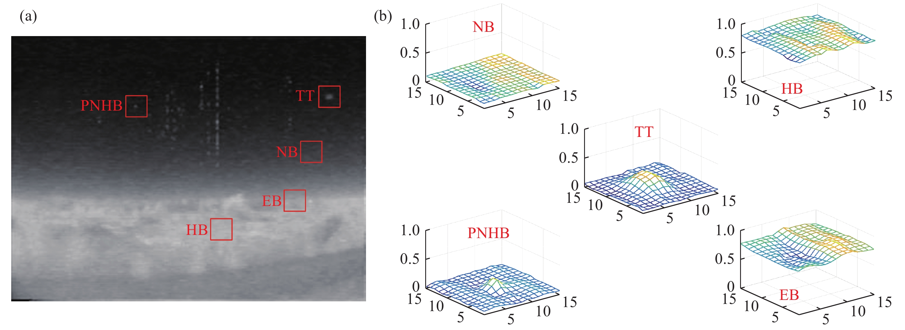
Introduction
Optimization Model
Unfolding Scheme
Experiment results
Conclusion
Infrared small target detection
Background and motivations
Infrared small target detection
TT: True Target; NB: Normal Background; HB: High-brightness Background;
EB:Edge of Background; PNHB: Pixel-sized Noise with High Brightness;
The real target typically appears as clustered, with varying gray levels, gradually fading from the center outward.
Notes:
Next, let's analyze the characteristics（carry 克特瑞斯tei克） of infrared small target images. As seen in this figure, compared to Normal Background, High-brightness Background, Edge of Background, and Pixel-sized Noise with High Brightness, the True Target typically appear clustered, with varying gray levels, gradually fading from the center outward.

Slide 5
Introduction
Optimization Model
Unfolding Scheme
Experiment results
Conclusion
Infrared small target detection
Background and motivations
Background and motivations
Traditional methods:
filtering-based
local contrast-based
low rank-based
suppress external disturbance and focus on target regions
utilize differential information to inhibit background
interferences
rely on visual properties of given inputs to collect target contour
Dependency on manual prior knowledge
Uncertain performance in cluttered, noisy images.
Notes:
Based on this characteristic, many traditional methods have been proposed, such as filtering-based, local contrast-based, and low rank-based approaches.（鹅pro去斯） However, these methods rely on manually（卖牛雷） setting prior knowledge and exhibiting unstable performance in cluttered （克拉特的）, noisy images.

Slide 6
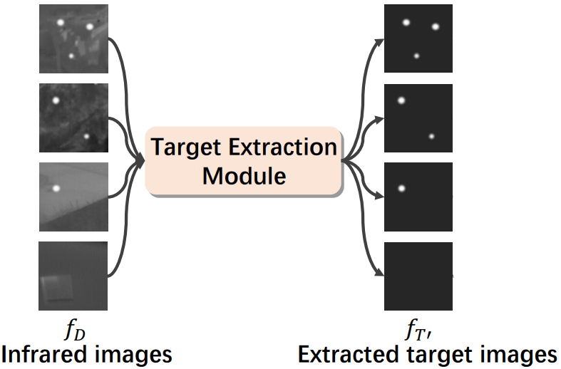
Introduction
Optimization Model
Unfolding Scheme
Experiment results
Conclusion
Infrared small target detection
Background and motivations
Background and motivations
CNN-based methods:
data-driven manner
deep network
Due to the small size of infrared small targets, multiple down-sampling operations can lead to target loss, which is irreversible
Limited by the local receptive field of the convolution operation, and lack the ability of global information perception
Unable to avoid target loss and background interference.
Notes:
Subsequently, CNN-based methods have also been introduced to this task. Due to the small size of infrared small targets, multiple down-sampling（三木pling） operations can result in irreversible（色波） target loss. Additionally, the limited receptive field of CNN methods prevents the establishment of global information perception, leading to weak recognition（rua 克个nei巡） capabilities for targets with scale variations. （very 诶巡si） These issues render CNNs unable to avoid target loss and background interference.

Slide 7
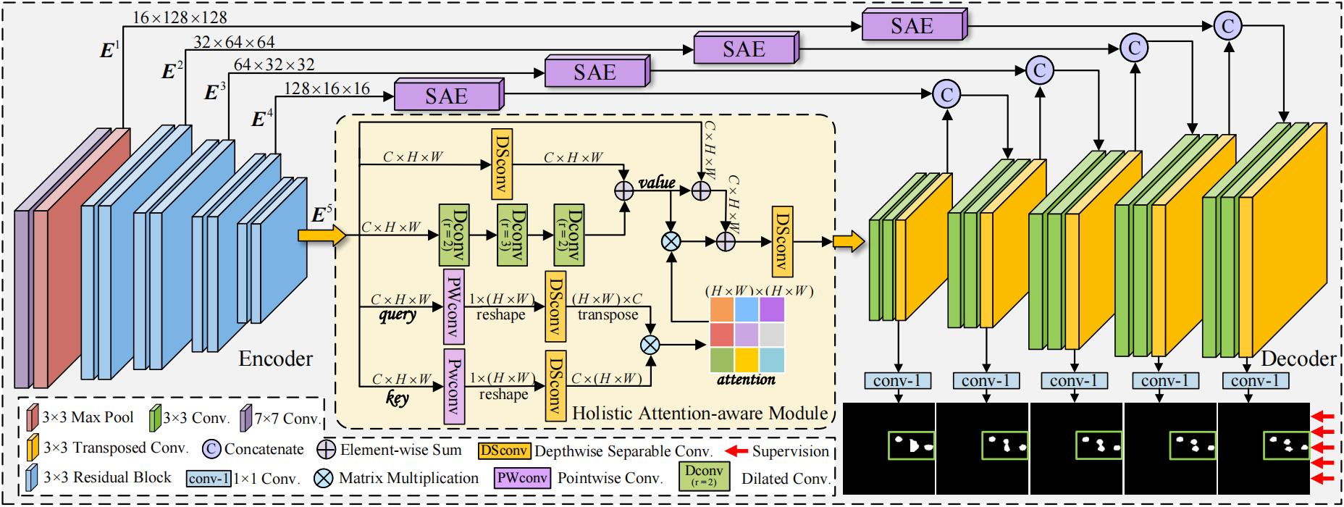
Introduction
Optimization Model
Unfolding Scheme
Experiment results
Conclusion
Framework
Framework
The Hierarchical Microscale-aware Network following an encoder-decoder framework.
The HAA module is utilized for global context modeling to enhance targeting precision.
Input
Notes:
Motivated by these considerations, we aim to design a network with global information perception capabilities while（挖药） possessing（pe zan sing） good adaptability(啊呆pei特北雷tei) to multi（莫特t）-scale targets. The diagram （代牙gram）illustrates（一乐street） the overall framework of our network. Following the encoder-decoder architecture, we introduce a holistic（hou） attention-aware (HAA) module（猫叫er）. It splits the encoder's output into five branches, （不蓝去斯），and conducts attention computations internally（硬，特呢雷）, and outputs them as input to the decoder. This effectively integrates（英特igreedc） global context from self-attention with local features extracted by convolutional operations.

Slide 8
Introduction
Optimization Model
Unfolding Scheme
Experiment results
Conclusion
Unfolding components
The SAE module s used to refine texture information.
To dynamically extract multi-scale features across various receptive field sizes, the input feature undergoes convolutional operations in layers with multiple kernel sizes.
Notes:
To address issues such as low signal（斯哥no）-to-noise ratio and insufficient texture details in the feature maps, we have incorporated（in 扣pei rue 忒的） an SAE module into the skip connections. The SAE module employs（英破佬s） multi-scale feature（飞true） adaptive fusion and attention mechanisms to enhance edge precision（Pre塞巡） and spatial details. To extract multi-scale（猫） features across different receptive field sizes, the input feature undergoes convolution in layers with different kernel sizes. Subsequently, the feature passes through channel and spatial attention units.

Slide 9
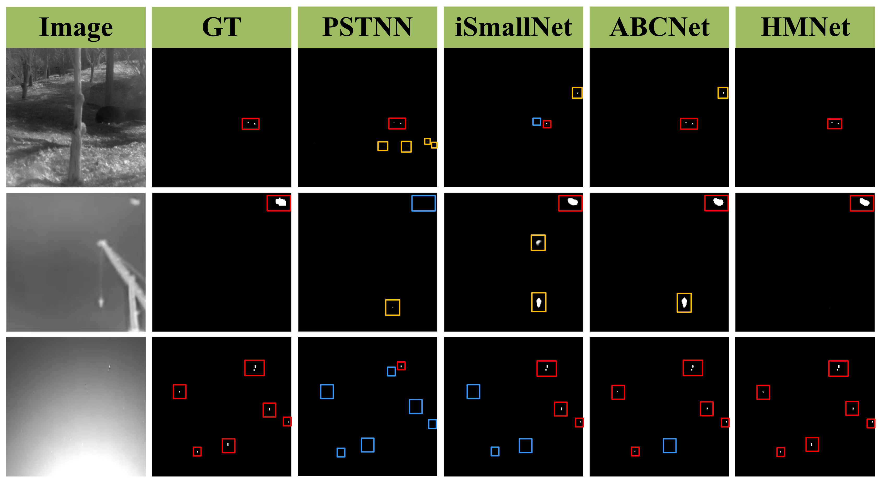
Introduction
Optimization Model
Unfolding Scheme
Experiment results
Conclusion
Experiment results
Red box: correct detection
Yellow box: false
detection
Blue box: missed detection
Notes:
We compared our method with some state-of-the-art algorithms, and here are our experimental results. In the results, the red box represents(rua pei) correct detection, the yellow box represents false（fools） detection, and the blue box represents missed detection. Our HMNet demonstrates（呆门stree此） the capability to detect extremely small and dim targets, achieving precise（破瑞赛） target localization（look 来贼巡） and shape segmentation. （赛个man忒巡）

Slide 10
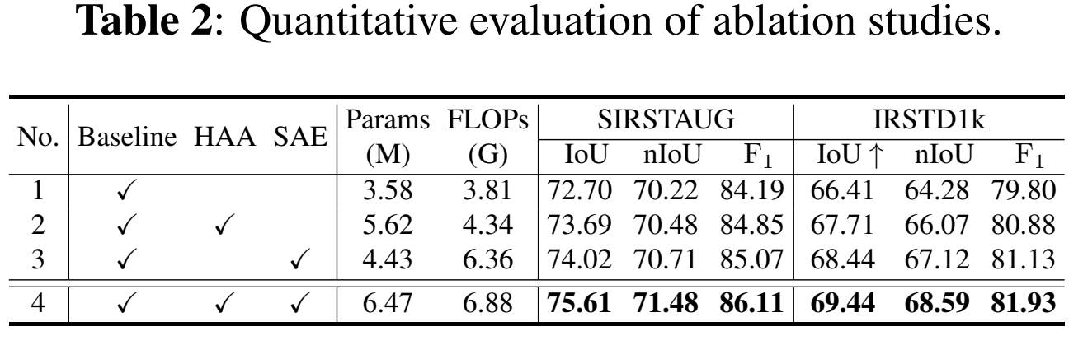
Introduction
Optimization Model
Unfolding Scheme
Experiment results
Conclusion
Experiment results
Notes:
Table 1 presents the experimental （ex白弱） results on three datasets, showing that our method leads in almost all metrics （卖true克斯）, except for the nIoU metric on the NUAA dataset, possibly（破zibei雷） due to the limited number of images in the NUAA dataset, leading to potentially unstable results. Tables 2 and 3 show some of our ablation（啊b雷巡） experiments, involving the usage of certain modules and hyperparameters（嗨 配p rai酶特斯）, which helped us determine the final network architecture. 啊 key

Slide 11
Thanks
Email: qyq@zjut.edu.cn
Notes:
That’s all for my presentation. Thanks for your attention.

