Slide 1
Variable-Length Quantization Strategy for Hashing
Yang Shi, Xiushan Nie*, Xin Zhou,
Xiaoming Xi, Yilong Yin*
Notes:
Hello everyone, my name is Shi Yang. I come from Shandong University, China. It's an honor for me to introduce our work here. The title of our paper is Variable-Length Quantization Strategy for Hashing.

Slide 2
Outline
Hashing
VLQ
Experiments
Summary
Notes:
This is the outline. At first, I will give a brief introduce on hashing used for retrieval. Next, I will introduce the proposed method VLQ. Then I will show the experimental results and summary of this work.

Slide 3
Outline
Hashing
VLQ
Experiments
Summary
Notes:
So, what is the hashing I mentioned in this paper?

Slide 4
Hashing
Hashing: a widely-studied solution to the approximate nearest neighbor search, aims to transform a data item to a low-dimensional representation, or equivalently a short code consisting of a sequence of bits, called hash code.
[Jingdong Wang, 2017]
Notes:
That's the definition of hashing, which is basically the process of representing data into hash codes

Slide 5
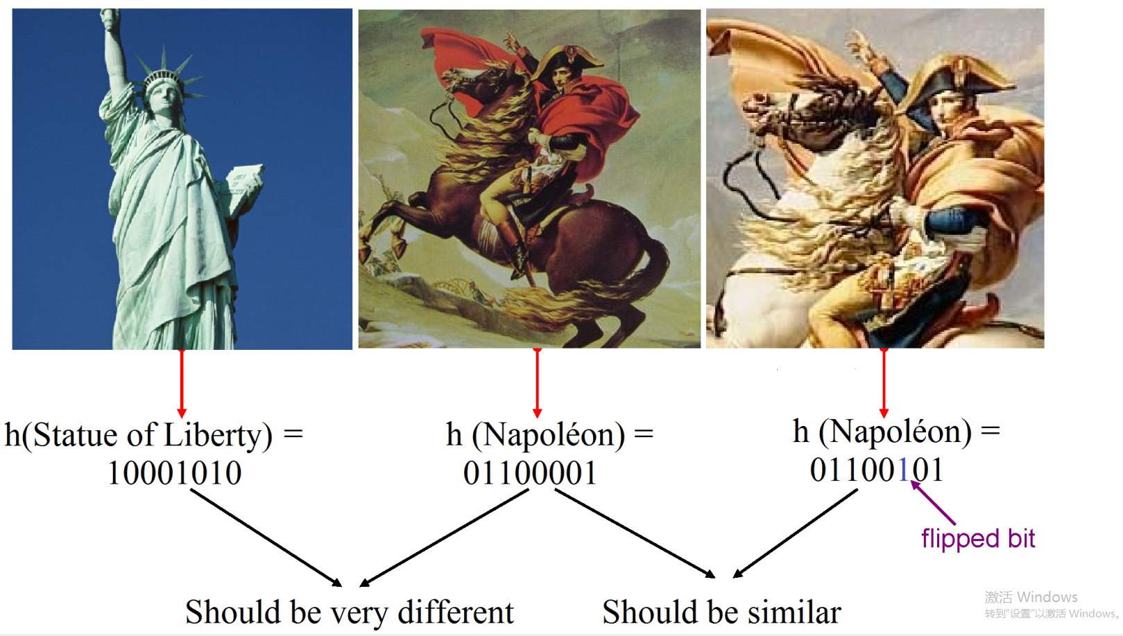
Similarity Preserving Hashing
[Wu-Jun Li , 2015]
Notes:
The hashing I mentioned above is similarity preserving hashing, which is used for information retrieval.
Look at these three pictures. The last two images are similar, while the first one is much different to the others. When these three images are represented by hash codes, the similarity should be preserved. The process that learn how to compresses data into compact binary codes with similarity preserving is called learn to hash.

Slide 6
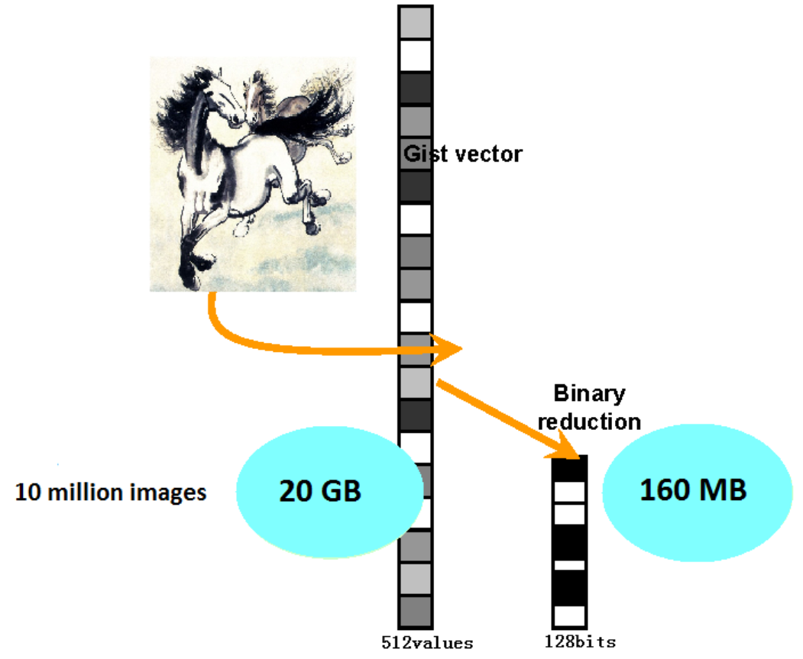
Advantages
Reduce Dimensionality and Storage Cost
Fast Query Speed
[Wu-Jun Li , 2015]
Notes:
Hashing can facilitate a highly efficient search process and reduce storage cost. Just as the figure shows, 10 million images use 20 GB memory represented by Gist 512, while stored by hash codes only use 160 MB. When we do retrieval, the distance calculations of binary codes (as known as Hamming distance) can be done on hardware, which is much faster than real-value.

Slide 7
Outline
Hashing
VLQ
Experiments
Summary
Notes:
Next, I will introduce the proposed method VLQ.

Slide 8
Variable-Length Quantization Strategy for Hashing
Motivation
Formulation
Optimization
Notes:
I will introduce VLQ from three aspects, that are motivation, formulation, and optimization.

Slide 9
Motivation
In general, most methods transform the image into binary code by projection step and quantization step. Therefore, the reduction of quantization loss is still an important issue that needs to be addressed.
Quantization step usually leads to unexpected poor performance due to the following:
1) Single Bit Quantization method leads to significant quantization loss;
2) Multi-bit quantization methods based on hamming distance don't take into account the idea of allocation;
3) Quantization methods based on non-hamming distance cause low retrieval speed.
Our method assigns different code lengths to different dimensions according to the dispersion degree.
Notes:
In hashing, in order to reduce losses,the quantization step is as important as the projection step.
Among many Quantization methods,
Single Bit Quantization method does not perform well,
Multi-bit quantization method based on hamming distance doesn't consider the idea of allocation,
and Quantization method based on non-hamming distance causes low retrieval speed

Slide 10
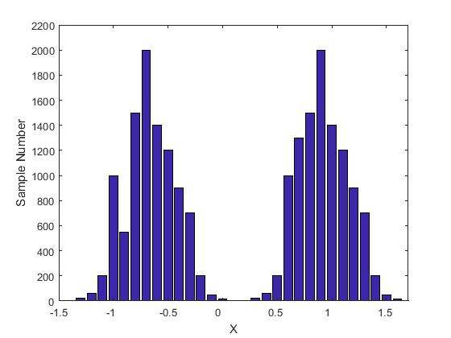
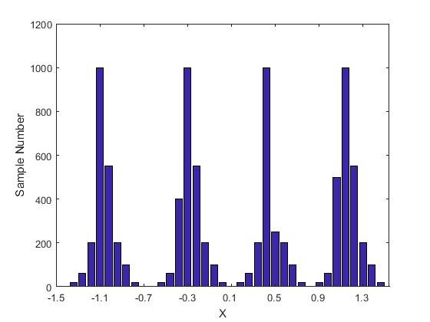
Motivation
A
B
0 |  | 1
01 | 00 | 10 | 11
0 |  | 1
01 | 00 | 10 | 11
Notes:
We can see that in this case A, allocate one bit hash code is appropriate, and two bits hash codes are not.
In the case of B, allocate two bits hash code is more appropriate.
From this, we can see that the data distribution of each dimension is different, so we should determine the hash code length allocated to the dimension according to the data distribution of each dimension.

Slide 11
Formulation
Notation | Description
 | Real-valued feature matrix generated from original data using a projection step
 | The ith dimension for all samples
 | The feature vector of jth sample
$$μ_{i}$$
$$Y_{i}$$
 |  | ……
$$μ_{i}^{1}$$
$$μ_{i}^{2}$$
$$μ_{i}^{m_{i}}$$
$$c_{i}^{1}$$
$$c_{i}^{2}$$
$$c_{i}^{m_{i}−1}$$
Notes:
In order to effectively utilize each dimension after projection, we define Yi as the ith dimension for all samples.
After sorting, divide Yi into mi regions Gi1 to Gimi.
furthermore, the boundary values between the different regions are denoted as ci1 to cimi-1.
And we can determine the mean values for every region, which are indicated as µi1to µimi.
And the mean of Yi is µi.

Slide 12
Formulation
$$Y_{i}$$
 |  | ……
$$μ_{i}^{1}$$
$$μ_{i}^{2}$$
$$μ_{i}^{m_{i}}$$
$$c_{i}^{1}$$
$$c_{i}^{2}$$
$$c_{i}^{m_{i}−1}$$
$$μ_{i}$$
Notes:
In order to effectively utilize each dimension after projection, we define Yi as the ith dimension for all samples.
After sorting, divide Yi into mi regions Gi1 to Gimi.
furthermore, the boundary values between the different regions are denoted as ci1 to cimi-1.
And we can determine the mean values for every region, which are indicated as µi1to µimi.
And the mean of Yi is µi.

Slide 13
Formulation
Notation | Description
 | The ith dimension for all samples
 | the number of bits in the ith dimension
The dispersion degree in the lth region:
$$V_{i}^{′}\left(Y,k_{i},l\right)=\sum_{y_{i}^{j}∈G_{i}^{l}}{{(y_{i}^{j}−μ_{i}^{l})}^{2}}$$
The total dispersion degree of the ith dimension:
$$V_{i}\left(Y,k_{i}\right)=\sum_{l=1}^{2^{k_{i}}}{\sum_{y_{i}^{j}∈G_{i}^{l}}{{(y_{i}^{j}−μ_{i}^{l})}^{2}}}$$
Notes:
we denote the dispersion degree in the lth region as follows, which represents the structure in the lth region.
Then, we can obtained the total dispersion degree of the ith dimension as follows

Slide 14
Formulation
We set $k_{i}$ = 0 to represent the dispersion degree of the original data space without partition:
$$V_{i}^{0}=V_{i}\left(Y,0\right)=\sum_{j}{{(y_{j}^{i}−μ_{i})}^{2}}$$
the $k_{i}$ -bit quantization difference:
$W_{i}\left(Y,k_{i}\right)=$ $V_{i}\left(Y,0\right)$- $V_{i}\left(Y,k_{i}\right)$
Notes:
we set 𝑘_𝑖 = 0 to represent the dispersion degree of the original data space without partition
we denote W(Y, ki) as the ki-bit quantization difference, which indicates the difference after assigning ki bits for the ith dimension.

Slide 15
VLQ
The objective function of VLQ is formulated as
$$arg\max_{k_{1},k_{2},…,k_{u}}{\sum_{i=1}^{u}{W_{i}\left(Y,k_{i}\right)}}$$
$s.t.∀i∈\left\{1:u\right\},k_{i}$ $∈$ $\left\{0,1,…,k_{max}\right\}$
$\sum_{i=1}^{u}{k_{i}=L}$
Notes:
Therefore, we propose an optimization problem to obtain the appropriate bit number 𝑘_𝑖
where kmax and L are the maximum quantization code length of each dimension and the total length of the hash code, respectively.

Slide 16
Optimization
Max$\sum_{i=1}^{u}{W_{i}\left(Y,k_{i}\right)}=\sum_{i=1}^{u}{\sum_{j}{{(y_{j}^{i}−μ_{i})}^{2}−}}$ $V_{i}\left(Y,k_{i}\right)$ (1)
Mi$n$ $V_{i}\left(Y,k_{i}\right)$ (2)
the mean of the quantization code length of each dimension:
$$k_{mean}=L/u$$
the minimization goal :
$M=$ $\sum_{i=1}^{u}{V_{i}\left(Y,k_{i}\right)}$
Notes:
Our optimization goal is to maximize the value of (1) thus, we can achieve this by minimizing the value of (2)
First, we set the quantization code length of all the projection dimensions to kmean, then we can obtain the sum of the dispersion degree of all the
dimensions under this condition.
where M is the minimization goal in our optimization approach

Slide 17
Optimization
we sort these dimensions in the following order:$(V_{1}^{0}\sim V_{u}^{0})$
$V_{a^{1}}^{0}≤V_{a^{2}}^{0}≤$ $…≤V_{a^{u−1}}^{0}≤V_{a^{u}}^{0}$
Then, we can determine the two dimensions that have the largest and smallest variances, denoting them as $a^{1}$ and $a^{u}$
$$k_{large}≔k_{large}+1,k_{small}≔k_{small}−1$$
Notes:
we adopt a greedy strategy.
we sort these dimensions in the following order
Then, we can determine the two dimensions that have the largest and smallest variances, denoting them as 𝑎^1 and 𝑎^𝑢
In this manner, we can change the quantization code length of these two dimensions (denoted as klarge and ksmall) without destroying the constraints in the total hash code length using the following operation

Slide 18
Optimization
After reassigning the quantization code length for some dimensions, we recalculate the value of $M$ by applying the reassigned quantization code length. If the recalculated $M$is smaller than the previous $M$, it indicates that our reallocating strategy reduced the dispersion degree of the projected data.
This approach is iterated until the updated $M$ is larger than the previous $M$, which indicates that reassigning the quantization bits cannot render the dimension partition or quantization more effective; this serves as the stopping condition for iteration, and consequently, the number $k_{i}$ at this point is the approximate optimal solution of the proposed optimization problem.
Notes:
After reassigning the quantization code length for some dimensions, we recalculate the value of M by applying the reassigned quantization code length. If the recalculated M is smaller than the previous M, it indicates that our reallocating strategy reduced the dispersion degree of the projected data.
This approach is iterated until the updated M is larger than the previous M, which indicates that reassigning the quantization bits cannot render the dimension partition or quantization more effective;
When we obtain the number ki for the ith dimension, we quantify the data accordingly and we use the Hamming distance metric to retrieve the data.

Slide 19
Outline
Hashing
VLQ
Experiments
Summary
Notes:
Next, I will show the experimental details.

Slide 20
Experiment setting
Dataset | Label | size | Training/Testing
MINIST | Single(10) | 60K | 5K/1K
CIFAR-10 | Single(10) | 60K | 5K/1K
CALTECH-256 | Single(256) | 30K | 25K/5K
quantization method | Property
SBQ | Single Bit
HQ(2011) | Multi-bit
DBQ(2012) | Multi-bit
HCQ(2015) | Multi-bit
MH(2012) | Multi-bit
projection method | Property
LSH(1998) | Data-independent
SH(2009) | Unsupervised
PCAH(2006) | Unsupervised
ITQ(2011) | Unsupervised
Notes:
Three extensively-used image datasets were utilized in the experiments, including MINIST, CIFAR and CALTECH.
We used four projection methods.LSH is a data-independent method.SH, PCAH and ITQ are unsupervised hashing methods.
We compared the proposed VLQ with the five methods. HQ DBQ HCQ and MH are Multi-bit quantization method

Slide 21
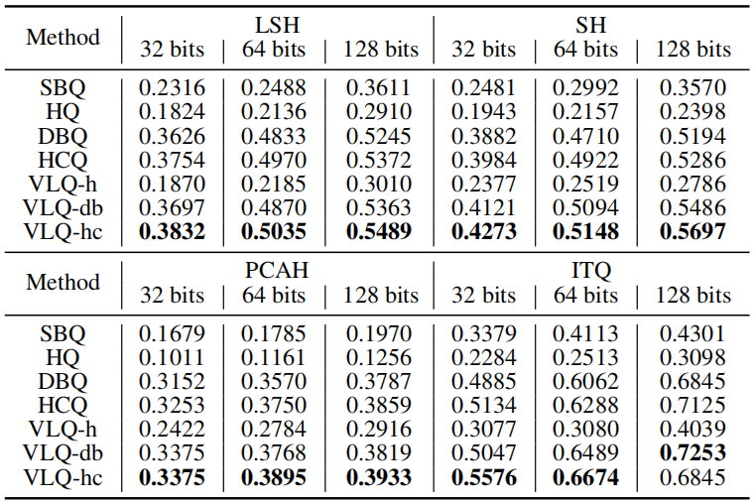
MAP score
Performance in terms of mAP score on CIFAR-10 datasets. The best results for mAP are shown in bold
Notes:
This is mAP score on CIFAR-10 datasets.

Slide 22
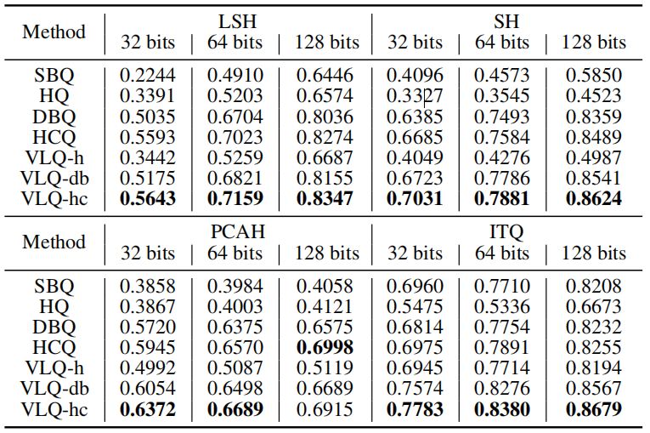
MAP score
Performance in terms of mAP score on MNIST datasets. The best results for mAP are shown in bold
Notes:
This is mAP score on MINIST datasets.

Slide 23
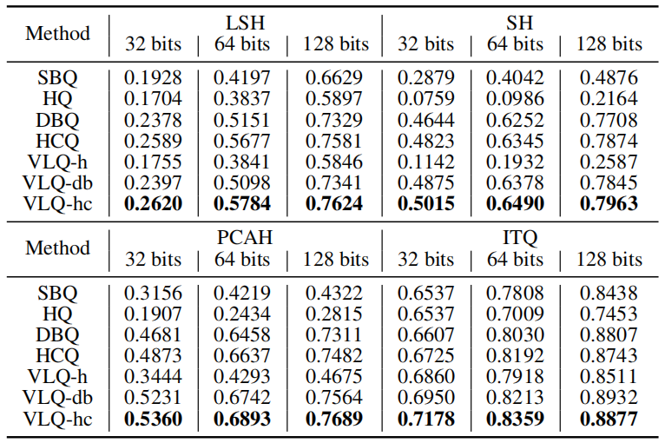
MAP score
Performance in terms of mAP score on Caltech-256 datasets. The best results for mAP are shown in bold
Notes:
This is mAP score on Caltech datasets.
We can see our Method VLQ perform well.

Slide 24
Time
Time consumption between the proposed VLQ and MH which uses the Manhattan distance as the similarity metric.
Notes:
This is Time consumption between VLQ and MH ,shows VLQ is much faster than MH which uses the Manhattan distance as the similarity metric.

Slide 25
PR curve
The results of PR curve on CIFAR-10 dataset.
Notes:
This is the results of PR curve on CIFAR-10 dataset.

Slide 26
PR curve
The results of PR curve on MNIST dataset.
Notes:
This is the results of PR curve on MINIST dataset.

Slide 27
PR curve
The results of PR curve on Caltech-256 dataset.
Notes:
This is the results of PR curve on Caltech-256 dataset.
It can be seen that our method works better than other methods

Slide 28
Outline
Hashing
VLQ
Experiments
Summary
Notes:
Ok, let me show the summary of this paper.

Slide 29
Summary
We proposed a new VLQ strategy based on the dispersion degrees of different dimensions. The proposed method assigns different hash bits to different dimensions, which not only preserves the structures among different dimensions of samples, but also achieve a fast retrieval speed owing to the use of the Hamming distance metric.
Experiments based on three large-scale datasets demonstrate the performance under various scenarios.
Notes:
We proposed a new VLQ strategy based on the dispersion degrees of different dimensions. The proposed method assigns different hash bits to different dimensions, which not only preserves the structures among different dimensions of samples, but also achieve a fast retrieval speed owing to the use of the Hamming distance metric.
And Experiments based on three datasets prove Our method has a good effect.

Slide 30
Thanks !
Questions？
Notes:
That’s all.
Thanks for your attention!

