Slide 1
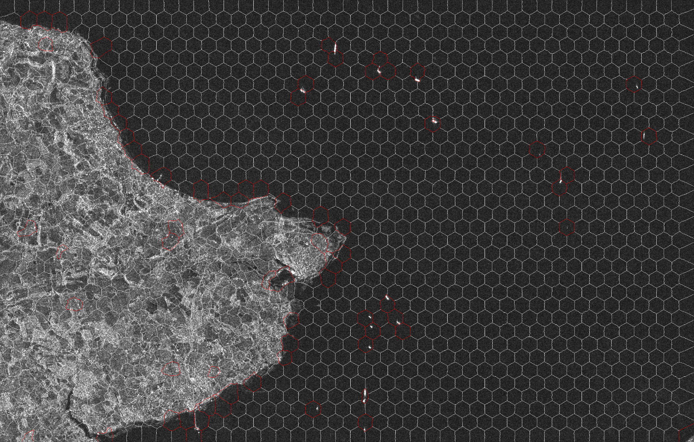
SUPERPIXEL-GUIDED CFAR DETECTION OF SHIPS AT SEA IN SAR IMAGERY
Odysseas A. Pappas, Alin M. Achim, David R. Bull
Visual Information Laboratory, University of Bristol, UK
Combining heavy-tailed CFAR and region-of-interest identification via superpixel statistical analysis for the detection of ships in SAR images.
The Superpixel Statistical Detector
Segment the image into superpixels whose size is larger than any expected target.
Most superpixels contain largely uniform pixels –a target, manifesting as a collection of pixels differing from their local background disturbs this expected homogeneity.
Results
Superpixel Segmentation
Over-segment an image into perceptually uniform, homogeneous “puzzle pieces”.
Tend to be of similar shape & size.
Respect image boundaries & object edges.
The SAR Ship Detection Problem
Synthetic Aperture Radar has proven very popular for maritime monitoring applications.
Ship Targets in SAR images appear as small, bright blob-like targets.
Small target size limits the availability of shape information.
SAR images often suffer from significant presence of speckle noise.
Sea clutter appears heterogeneous in high-resolution SAR, with ship wake, turbulence and waves being distinguishable.
Superpixels of interest can be selected using simple tests detecting a higher-than-average statistical dispersion as well as the presence of heavy tails.
Useful metrics include statistical moments such as statistical range, variance $σ^{2},$sample kurtosis $g_{2}$ and skewness $g_{1}$.
Hartigan’s Dip used to test for bimodality – can be used to distinguish land from sea segments.
SENTINEL-1 Image, detected superpixels and bound CFAR output.
Constant False Alarm Rate Detector
Image statistics modelled according to the Weibull distribution:
$$p\left(x\right)= \frac{C}{B}{\left(\frac{x}{B}\right)}^{C−1}exp\left\{−{\left(\frac{x}{B}\right)}^{C}\right\}$$
Adaptive threshold:
$$P_{FA}=\int_{T}^{∞}{p\left(x\right)dx=exp\left[{−\left(\frac{T}{B}\right)}^{C}\right]}$$
Dataset | Weibull CFAR | Proposed method | Ships Detected
Image 1 | 91445 | 1251 | 5/5
Image 2A | 133247 | 2495 | 17/17
Image 2B | 133247 | 1573 | 15/17
Image 3 | 121630 | 230 | 4/4
Image 4 | 103757 | 2385 | 4/4
Ship target contained within an anomalous superpixel
Total number of detected pixels for Weibull CFAR and proposed method, along with detected targets per image.
This project is supported by the Engineering and Physical Sciences Research Council (EP/I028153/1) via the Communications CDT and the University of Bristol.
Contact: o.pappas@bristol.ac.uk

