Slide 1
Analysis of Lossless Compressors Applied to Integer and Floating-Point Astronomical Data
Òscar Maireles-González Joan Bartrina-Rapesta
Miguel Hernández-Cabronero Joan Serra-Sagristà
Group on Interactive Coding of Images
Dept. of Information and Communications Engineering
Universitat Autònoma de Barcelona
oscar.maireles@uab.cat
Data Compression Conference 23-25 March 2022

Slide 2
Summary
Introduction to Astronomical Data
Dataset
Lossless Compression Techniques
Experimental Results

Slide 3
Astronomical Data Volume
Improvement of detectors and telescopes
Large Antenna Arrays (CTA, SKA)
FUTURE PROBLEM!
Data storage and transfer?
Data Compression

Slide 4
Astronomical Data Compression (?)
Data shared by FTP links (uncompressed)
Some data stored deleted for lack of storing space
Fpack and Funpack - currently used software:
Adapted to Flexible Image Transport System (FITS)

Slide 5
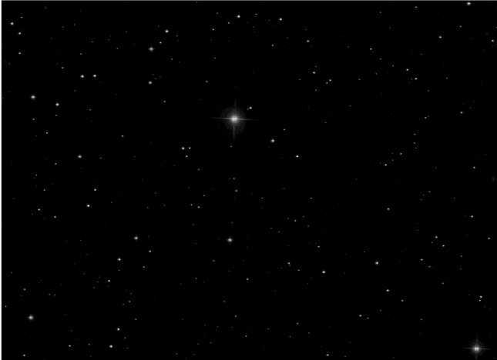
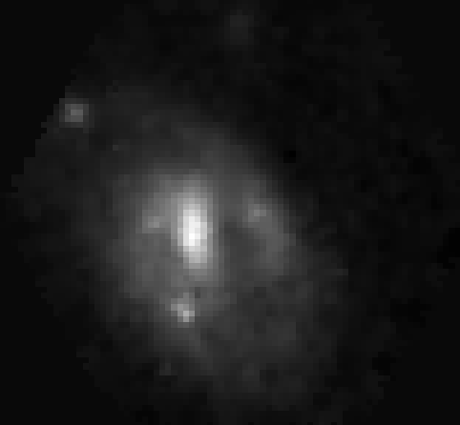
Image Distribution
Discrete configuration
Extensive object (Multispectral)
SDSS - BOSS
CALIFA IC0159

Slide 6
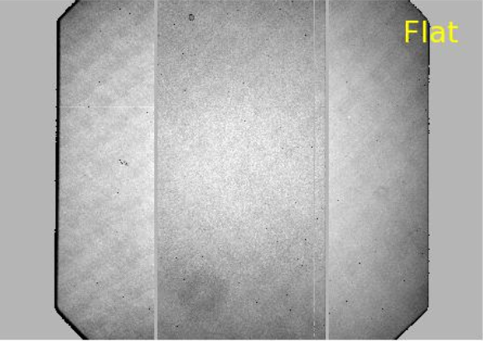
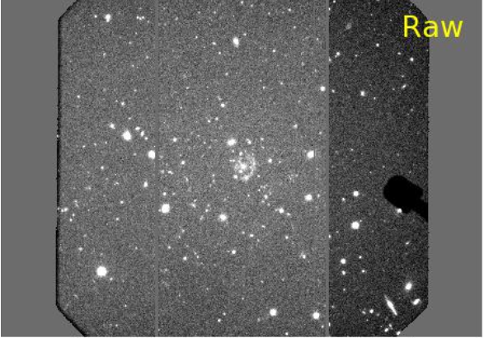
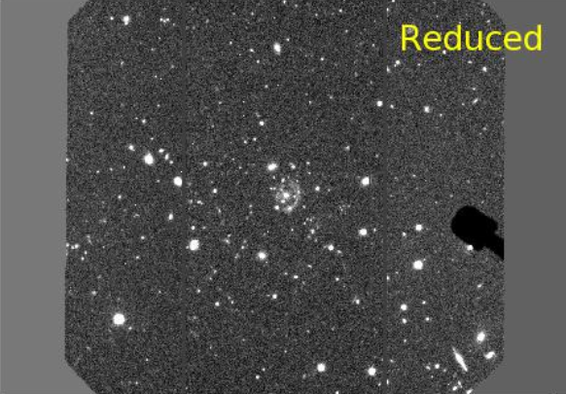
Image Data Types
Statistical noise suppression (IRAF)
Integer
Floating-Point

Slide 7
Summary
Introduction to Astronomical Data
Dataset
Lossless Compression Techniques
Experimental Results

Slide 8
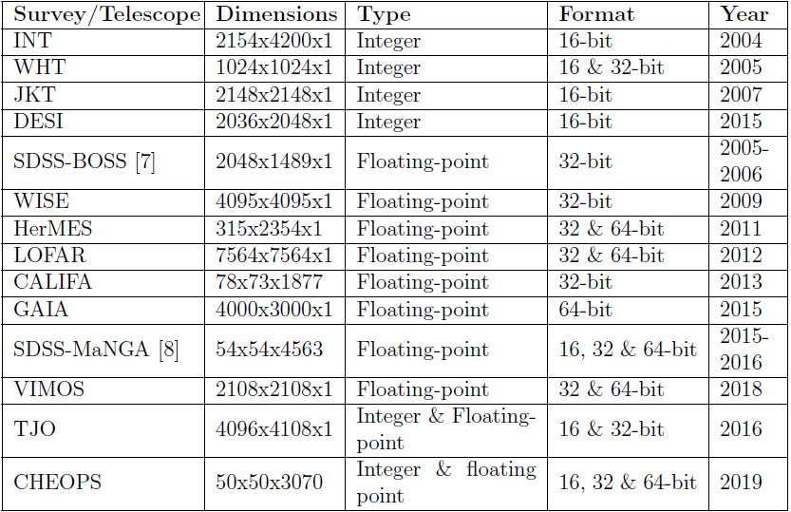
Dataset
The dataset consists of 103 images, with a combined uncompressed size of 16 GB.

Slide 9
Summary
Introduction to Astronomical Data
Dataset
Lossless Compression Techniques
Experimental Results

Slide 10
Lossless Coding Techniques
Integer
Floating-Point
Integer and Floating-Point
Fpack and Funpack :
RICE
HCOMPRESS
GZIP
JPEG2000
JPEG-LS
LZMA
ZSTANDARD
GZIP
LZ4
BZIP2
FAPEC
SPDP
SZIP
NDZIP
ZFP

Slide 11
Summary
Introduction to Astronomical Data
Dataset
Lossless Compression Techniques
Experimental Results

Slide 12
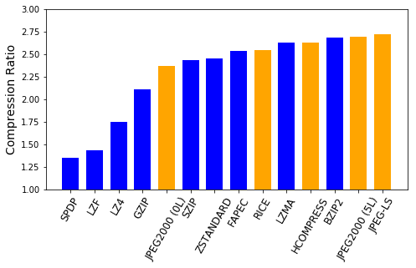
Results - 16-bit Integer Data
JPEG-LS predictor, JPEG2000 wavelet transform and Burrows-Wheeler have similar data decorrelation
Spatial information not properly exploited by JPEG2000 wavelet levels

Slide 13
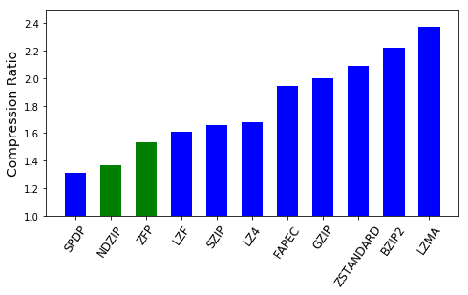
Results - Floating-point Data
The large dictionary of LZMA + range encoder can manage more efficiently all the codewords

Slide 14
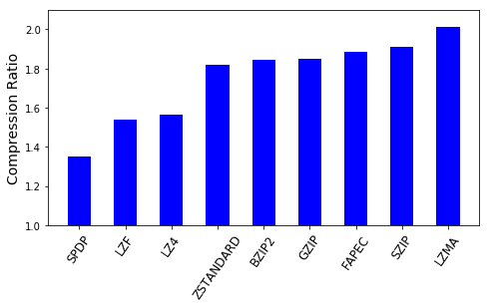
Results - Extensive Objects
Data radial distribution and similar probability values
LZMA:
Range encoder efficiency ↓
LZMA complex dictionary coding efficiency ↑
Radial distribution decreases FSE efficiency

Slide 15
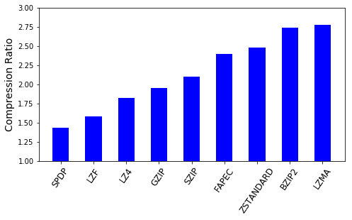
Results - Discrete Objects
Same result as Floating-Point data
CR values↑ due to integer data CR values

Slide 16
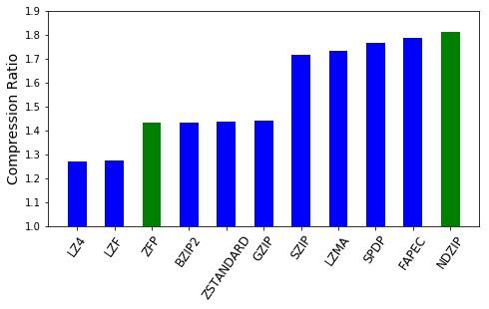
Results - Radio Data
Low data values ∼ 1e-6
NDZIP uses Integer Lorenzo Transform
FAPEC uses pre-processing stage
SPDP uses CRUSHER framework to adapt compression to input data

Slide 17
Results Summary

Slide 18
Conclusions
Unprecedented astronomical data lossless coding survey
Fpack and Funpack is not the most competitive technique
In light of our results, LZMA, JPEG-LS or NDZIP (for radio data) could be adapted to work directly on FITS data format, thus increasing the coding performance.

