Slide 1
Learning-Based Fast Depth Inter Coding
for 3D-HEVC via XGBoost
Zixiang Zhang, Li Yu*, Jian Qian, and Hongkui Wang
School of Electron. Inf. & Commun., Huazhong Univ. of Sci. & Tech.
DCC 2022
Notes:
本课题组主要的工作是传输经过采集、编码后的2D视频以及3D视频，一方面，通过设计流媒体应用层协议来提高用户观看视频的体验。另一方面，通过设计传输层协议以实现高链路利用率、低传输延时和多用户间公平性等数据传输性能。除此之外，通过设计网络层的队列管理机制配合传输层协议使用，提高传输层协议的综合传输性能。除了传输视频之外，本课题组还会进行2D视频分析，通过设计物理层性能优化方法，提高视频分析的精确度…等性能。

Slide 2
1
Introduction
Background and Motivation
Proposed Algorithm
Experimental Results
Conclusion
2
3
4
5
Notes:
本课题组主要的工作是传输经过采集、编码后的2D视频以及3D视频，一方面，通过设计流媒体应用层协议来提高用户观看视频的体验。另一方面，通过设计传输层协议以实现高链路利用率、低传输延时和多用户间公平性等数据传输性能。除此之外，通过设计网络层的队列管理机制配合传输层协议使用，提高传输层协议的综合传输性能。除了传输视频之外，本课题组还会进行2D视频分析，通过设计物理层性能优化方法，提高视频分析的精确度…等性能。

Slide 3
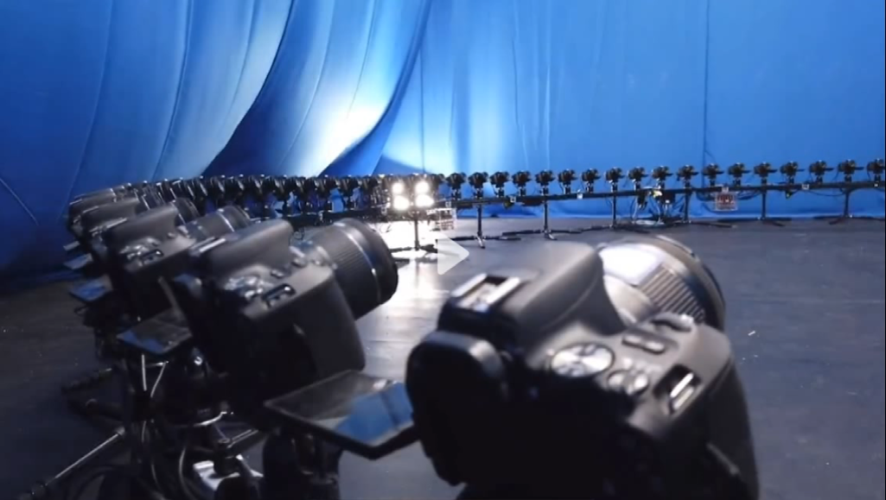
Introduction
Dense camera array system to achieve the “Bullet Time” visual special effect
Multi-view Video (MVV)
Immersive experience
massive data volume

Slide 4
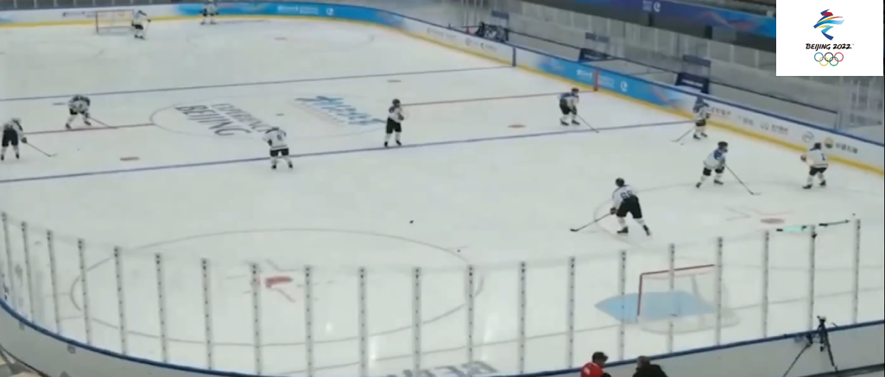
Introduction
Sparse camera array for free viewpoint watching in Beijing 2022 Winter Olympics
Multi-view plus Depth Video (MVD)
3D scene reconstruction using depth information
Relatively cheap cost for free viewing experience

Slide 5
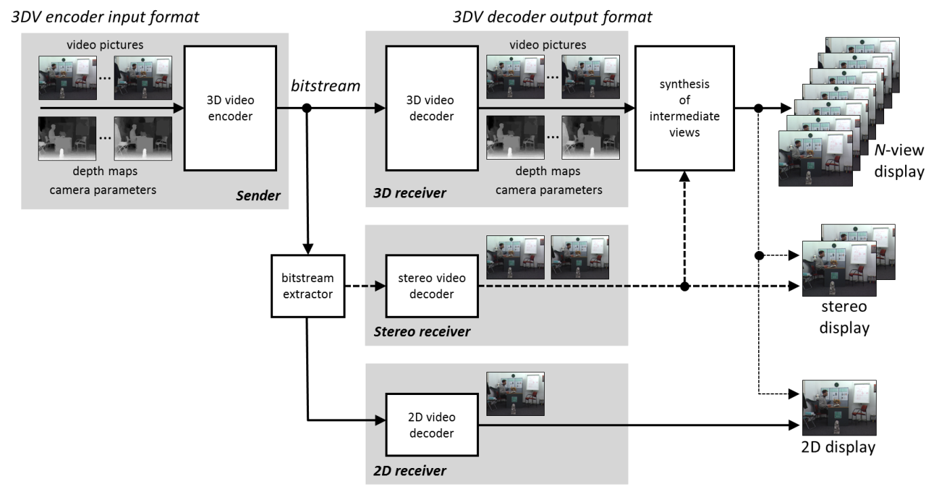
Introduction
3D-HEVC codec and transmission system architecture
High compression efficiency
Lots of new coding tools
Only transport sparse viewpoints together with their depth maps
High computational complexity
- More time-consuming than plain 2D video codec

Slide 6
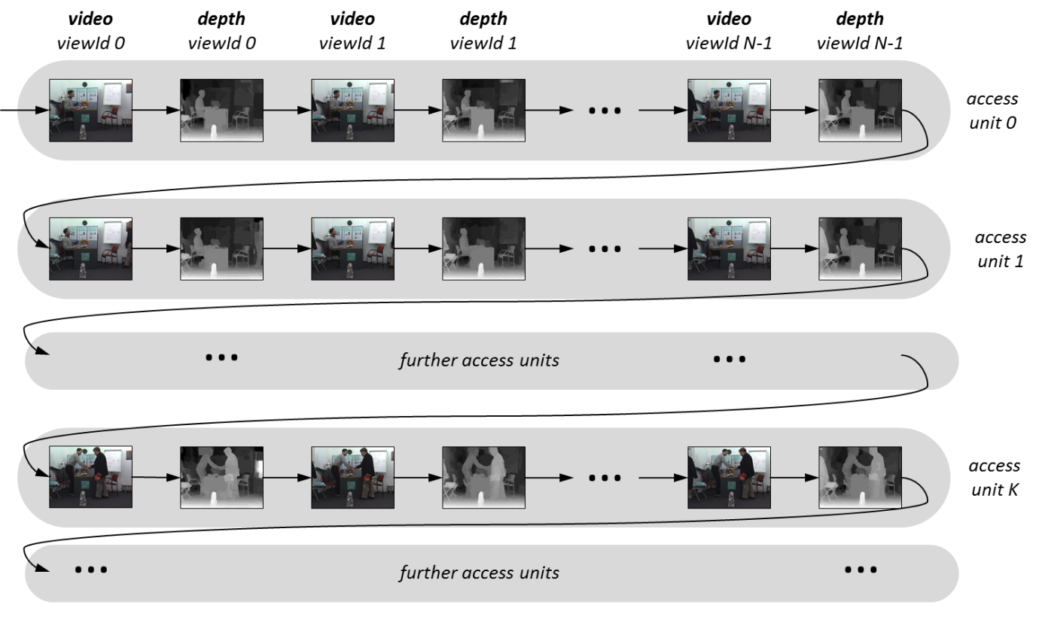
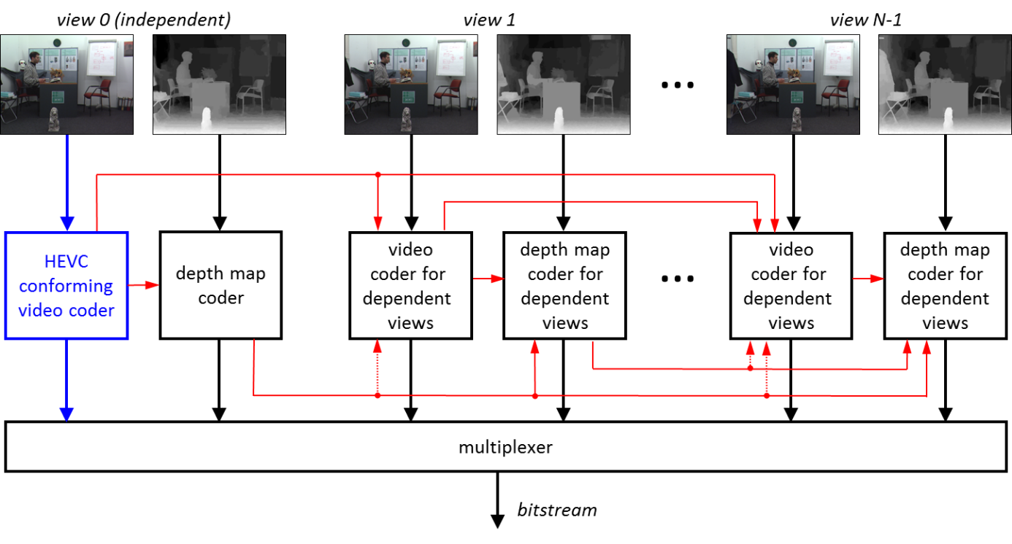
Background and Motivation
Coding Structure of 3D-HEVC
Access unit structure and the coding order
3D-HEVC codec structure with inter-component prediction

Slide 7
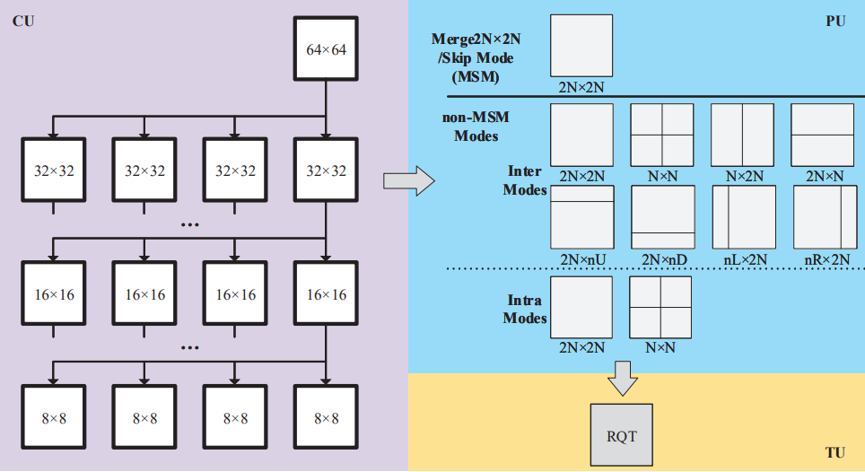
Background and Motivation
Coding process of each CTU in 3D-HEVC
CU Quadtree Partition
A 64×64 size CTU needs 85 attempts to determine the optimal partition by depth-first traversal
PU Mode Selection
Each CU needs to traverse 11 prediction modes to determine the optimal prediction mode

Slide 8
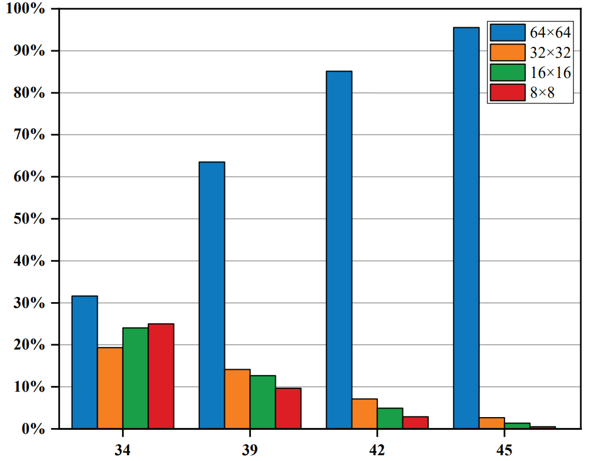
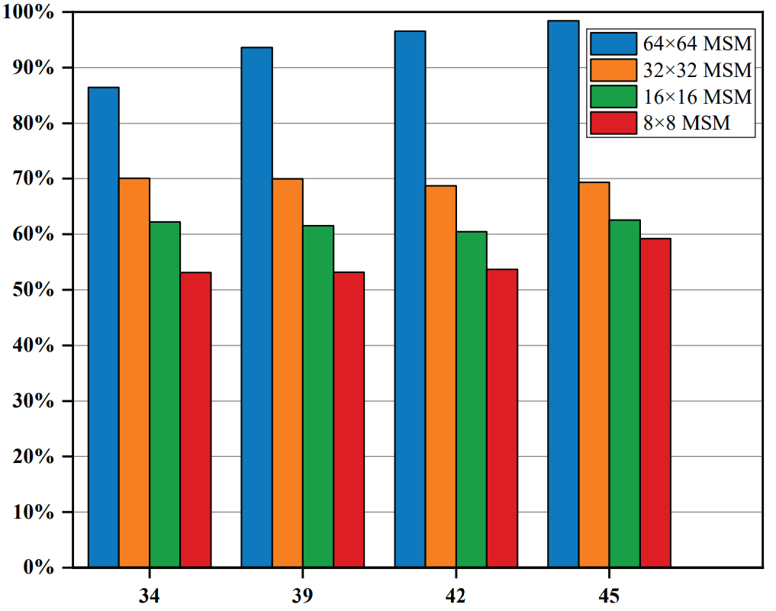
Background and Motivation
Statistical Analysis and Motivation
Unbalanced distribution of CU sizes and PU modes of the depth map
Distribution of CU sizes
Ratio of MSM for different CU sizes
A large number of CUs are encoded with 64×64 size and their proportion increases with the growth of QP
More than half of CUs choose the MSM as the optimal PU mode and their proportion increases with the CU size
Early determinate CU partition and PU mode can obtain generous coding time saving

Slide 9
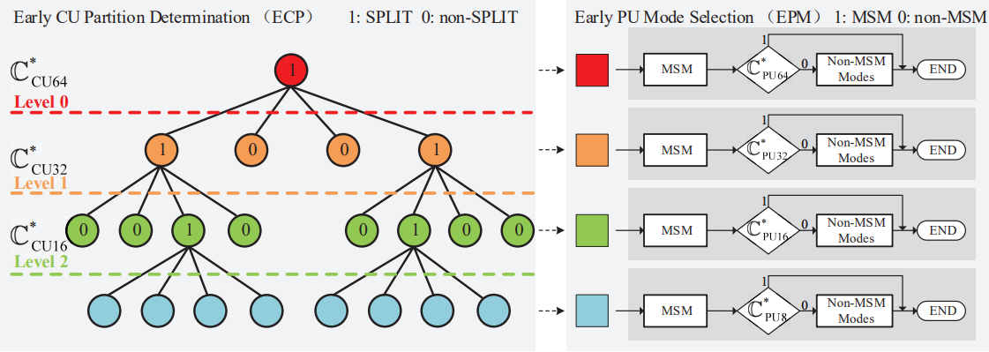
Proposed Algorithm
Hierarchical Classification Architecture of ECP and EPM
Early CU Partition and Early PU Mode Selection
In ECP, three binary classifiers respectively used for different sizes of CU to predict whether a CU needs to be split into sub-CUs
In EPM, different binary classifiers are inserted between the MSM and non-MSMs to predict whether MSM is the optimal mode for different PU sizes
Totally (3+4)×2=14 binary classifiers are used to achieve ECP and EPM

Slide 10
Proposed Algorithm
Gradient Tree Boosting Method — XGBoost
Combine multiple weak CART models to obtain an accurate overall result
Classification and Regression Tree
CART 1
F0 > th0
yes
no
feature
vector
CART 2
Prediction
result
F1 > th1
…
+
yes
no
…
CART n
base learner of XGBoost with simply structure and relatively weak accuracy
ensemble multiple weak CART models to build a strong prediction model and train the model in the gradient boosting way
Advantage:
high accuracy, convenient to be integrated into the encoder, and runs very fast

Slide 11
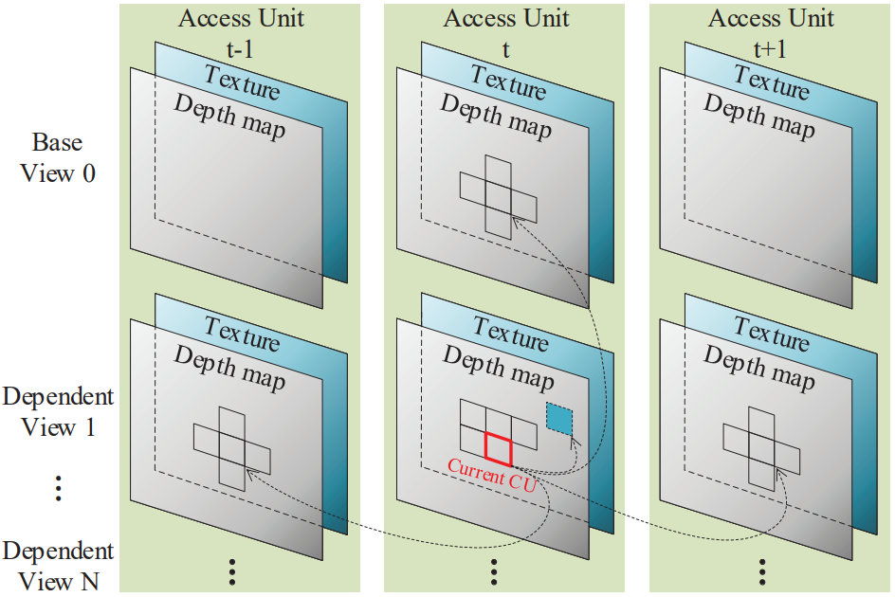
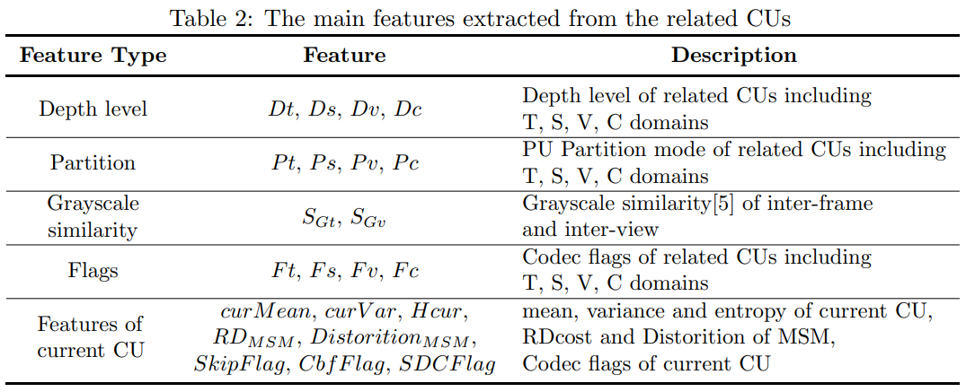
Proposed Algorithm
Feature Selection
The related CUs of the current coding CU
Multi-domain correlations
Spatio-temporal correlation
Inter-view correlation
Texture-depth correlation
Adequate number of features
The main features extracted from the related CUs
Using all the extracted features or part of them?
Acurracy vs Complexity Overhead
We choose all, because the complexity overhead
of feature extraction is small enough(<1%) to ignore

Slide 12
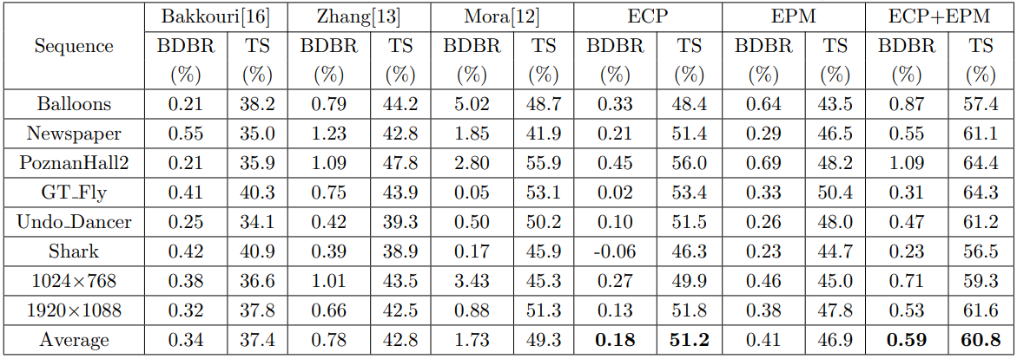
Experimental Results
XGBoost Models Accuracy
Only the false-negative (FN) samples for ECP and false- positive (FP) samples for EPM result in R-D performance degeneration
Coding Performance comparison
The proposed methods can speed up the depth inter coding process of 3D-HEVC to a large extent with negligible coding performance degeneration.

Slide 13
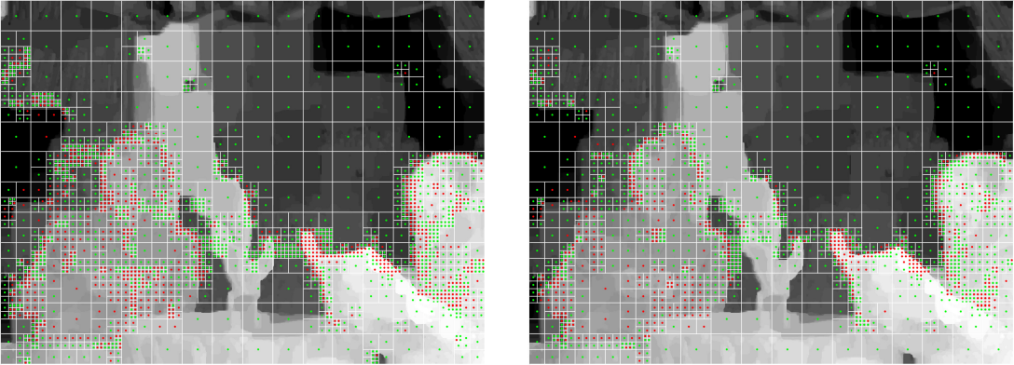
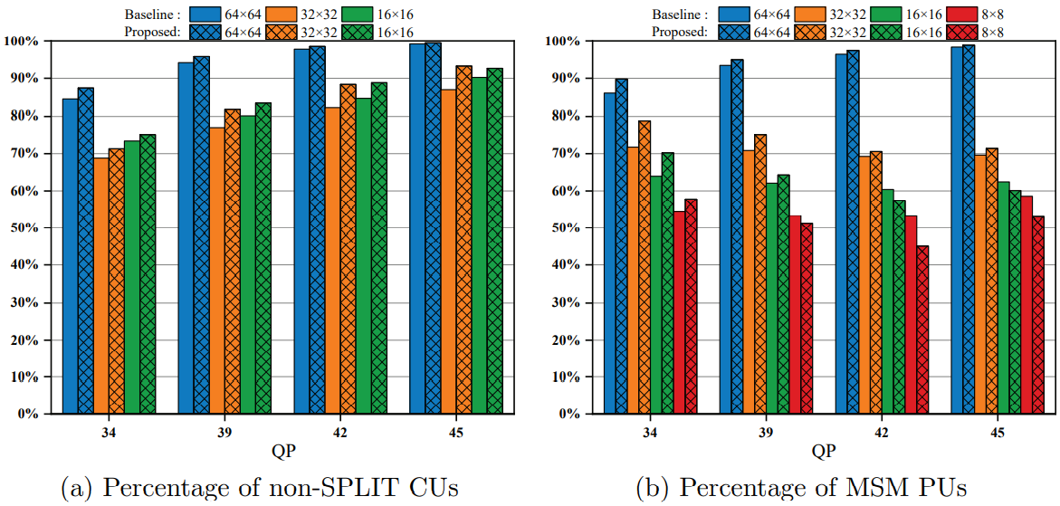
Experimental Results
origianl coding result
proposed coding result
Visualization Coding Results
the white line shows CU partition
the green dot donates the MSM
the red dot donates non-MSMs
Statistical Coding Results
The blocks with large sizes (64×64 and 32×32) in our method are inclined to choose non-SPLIT and select MSM as the optimal PU mode, which brings more coding time saving but results in BDBR performance degeneration.

Slide 14
Conclusion
This paper presented a learning-based fast algorithm for depth inter coding in 3D-HEVC.
The main contributions are as follows:
Firstly, both the CU partition and the PU mode selection are abstracted as binary classification problems and the hierarchical classification architecture of ECP+EPM was designed to accelerate the depth inter coding process.
Secondly, considerable features from multi-domain related CUs and the current coding CU were extracted to construct the database for model training. A total of 14 specialized XGBoost models targeted for different block types were constructed offline.
Finally, the XGBoost models were implemented into the HTM-16.0 and experimental results illustrate that the proposed ECP algorithm can achieve 51.2% total encoding time saving with a 0.18% BDBR increase. For the overall ECP+EPM algorithm, even 60.8% total encoding time saving can be obtained with a 0.59% BDBR increase, which greatly speeds up the depth inter coding process in 3D-HEVC.

Slide 15
Thanks for listening !

