Slide 1
Enabling Device Control Planning Capabilities of Small Language Model
Sudipta Paul, Lingyu Zhang, Yilin Shen, Hongxia Jin
Samsung Research America

Slide 2
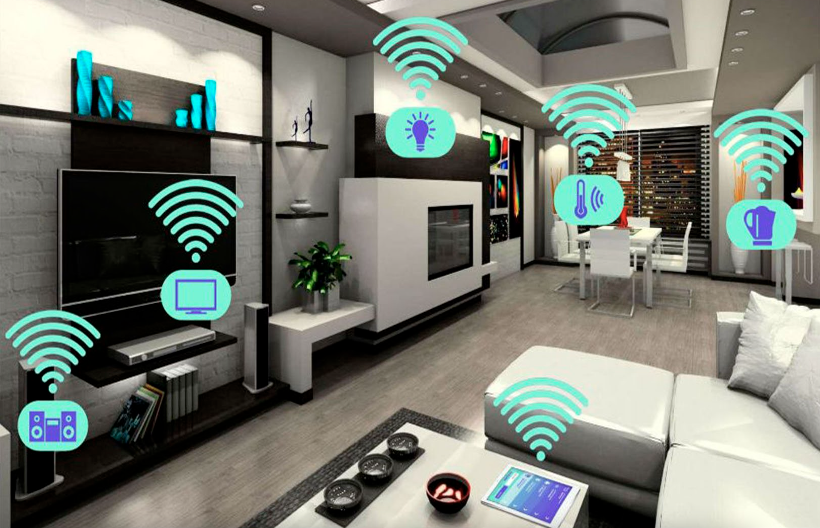
Introduction
Generate device control action plans based on user utterance.
The room is too bright
Step 1: Close the window,
Figure: Smart home with controllable devices
Step 2: Level down the lights.
Image Source: https://altusdigitalservices.com/wp-content/uploads/2020/02/resid3.jpg

Slide 3
Introduction
Large language models (GPT-3) can do device control planning,
Small language models-
Fail to understand the intent of utterance,
Fail to update plans based on the available devices.
Instruction
Activate the exercise mode (air conditioner and music player on high volume)
GPT-3
1. Turn on the air conditioner,
2. Turn on the music player.
Pretrained LlaMA-7B
1. Turn on the lights
2. Turn on the air conditioner
3. Turn on the music player
4. Turn on the diffuser
5. Turn on the air purifier
6. Turn on the window
7. Turn on the gym equipment
8. Turn on the thermostat
9. Turn on the projector
10. Turn on the fan
11. Turn off the lights
12. Turn off the air conditioner
13. Turn off the music player
14. Turn off the diffuser
15. Turn off the air purifier

Slide 4
Approach
Utilize LLM to generate instruction-plan data,
Use the generated instruction-plan data to finetune small LLM.
Large Language Model
Generate Data
finetune
Small Language Model
Generated Data
Two types of plan are generated:
Base plan: for intent understanding,
Contrastive plan: for home configuration adjustment.

Slide 5
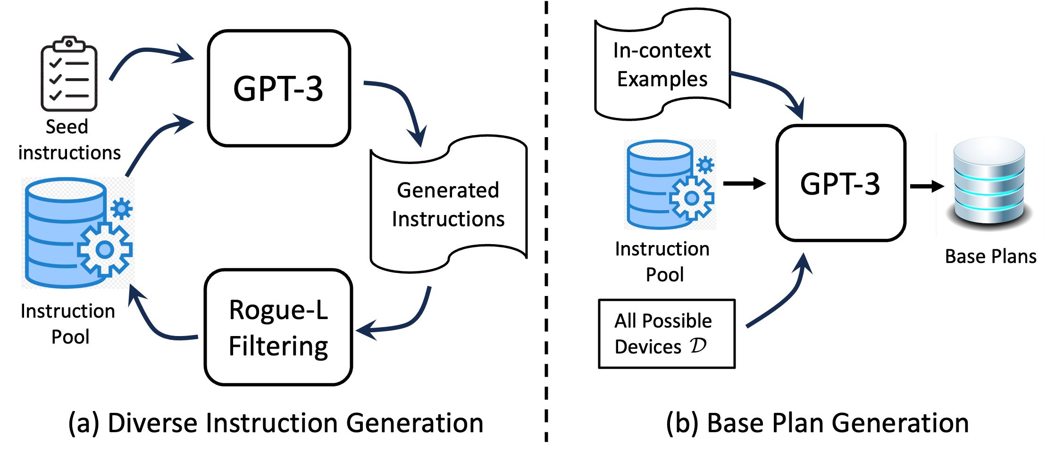
Approach
Steps
Generate instructions in a loop,
Generate base plans considering all devices are available.

Slide 6
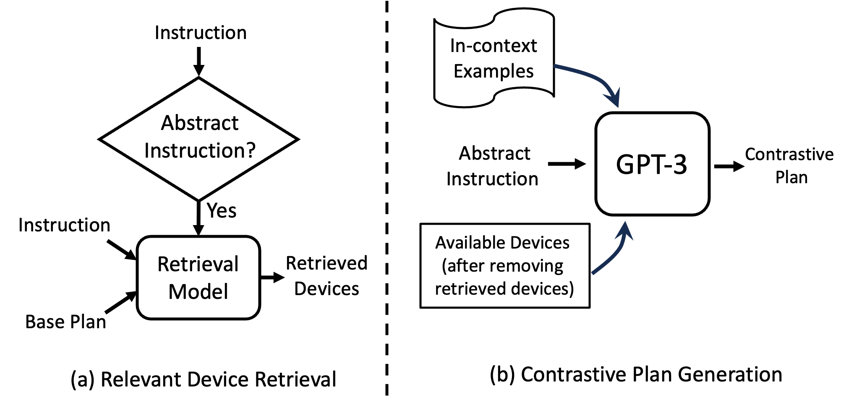
Approach
Steps
Retrieve relevant devices of base plans for abstract instructions,
Generate plans by removing relevant devices from the available device list.

Slide 7
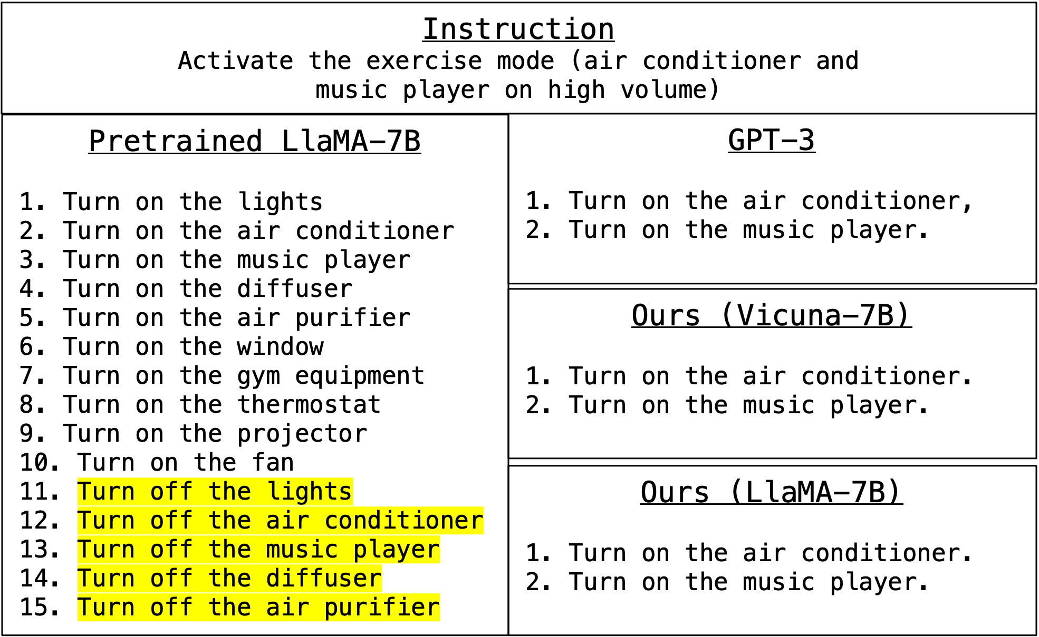
Experiment
Dataset
Introduced device control planning dataset with 28273 instruction-devices-plan triplets.
Is Pretrained Small Language Model a Good Device Control Planner?

Slide 8
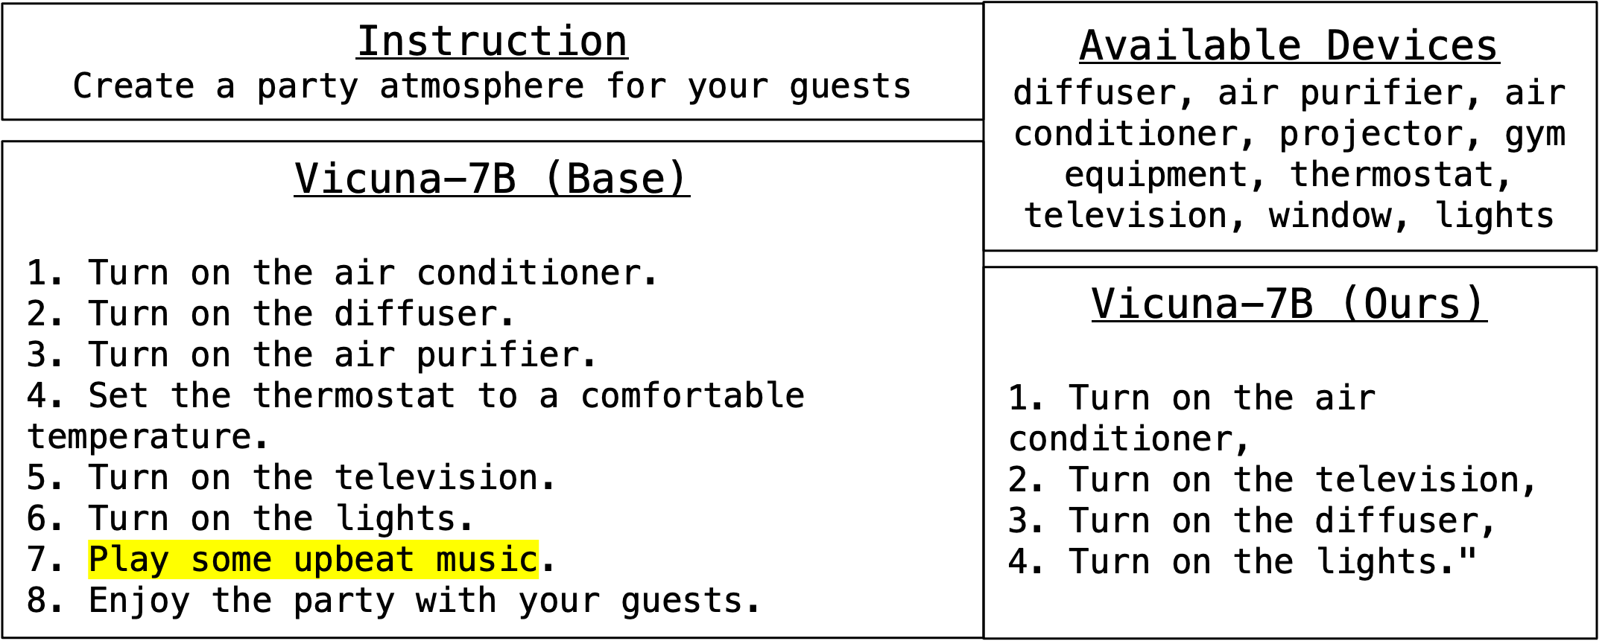
Experiment
Does Finetuning with Synthesized Triplets Help?
Are the Contrastive Plans Useful?

Slide 9
Thank You!

