Slide 1
Single image super-resolution with limited number of filters
Yusuke Nakahara, Takuro Yamaguchi, Masaaki Ikehara
from Keio Univ.

Slide 2
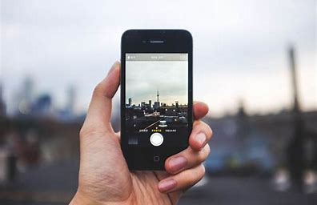
Introduction
The conversion of Low-Resolution(LR) images to High-Resolution(HR) images is needed in various fields.

Slide 3
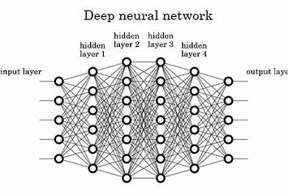
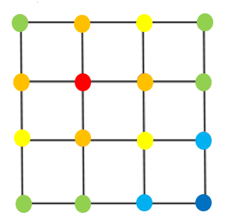
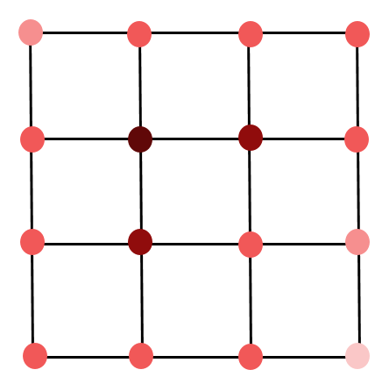
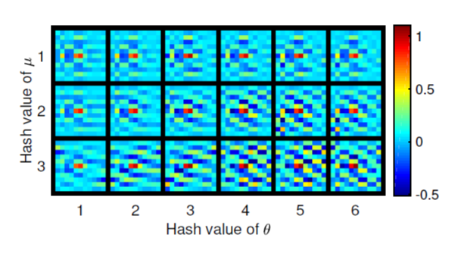
Introduction
Interpolation
Example based method
Linear filter
CNN
・Bicubic
・Bilinear
・RAISR
・ANR
・SRCNN
Short
Long
Processing
time
Bad
Great
Performance

Slide 4
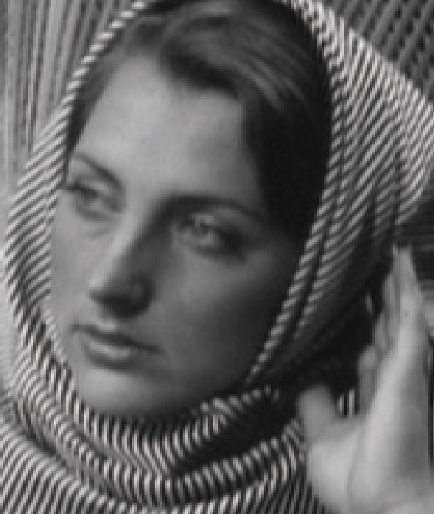
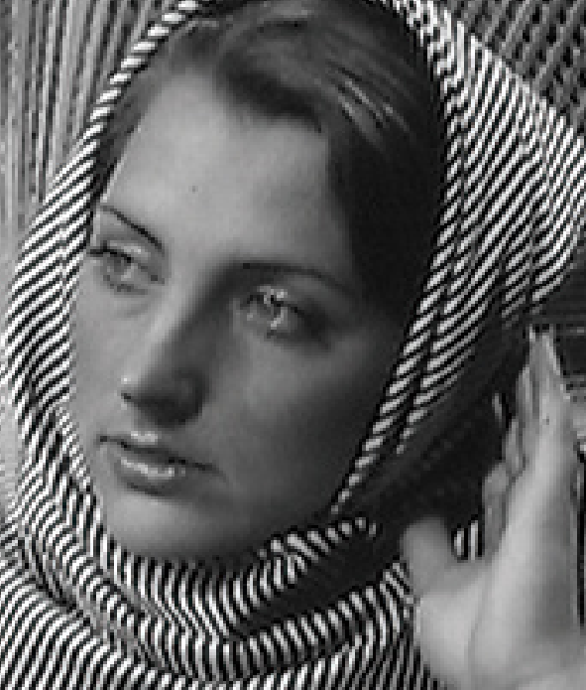
Algorithm of SR by learned linear filter
The performance and the runtime of the methods to utilize linear filters greatly depends on how input LR patches is divided into classes.
The pre-learned filter is learned in each class.
Classify
LR patches
Class20
Filter
Class48
Filter
LR image
Class3
Filter
HR image
Input LR patch
Output HR pixel

Slide 5
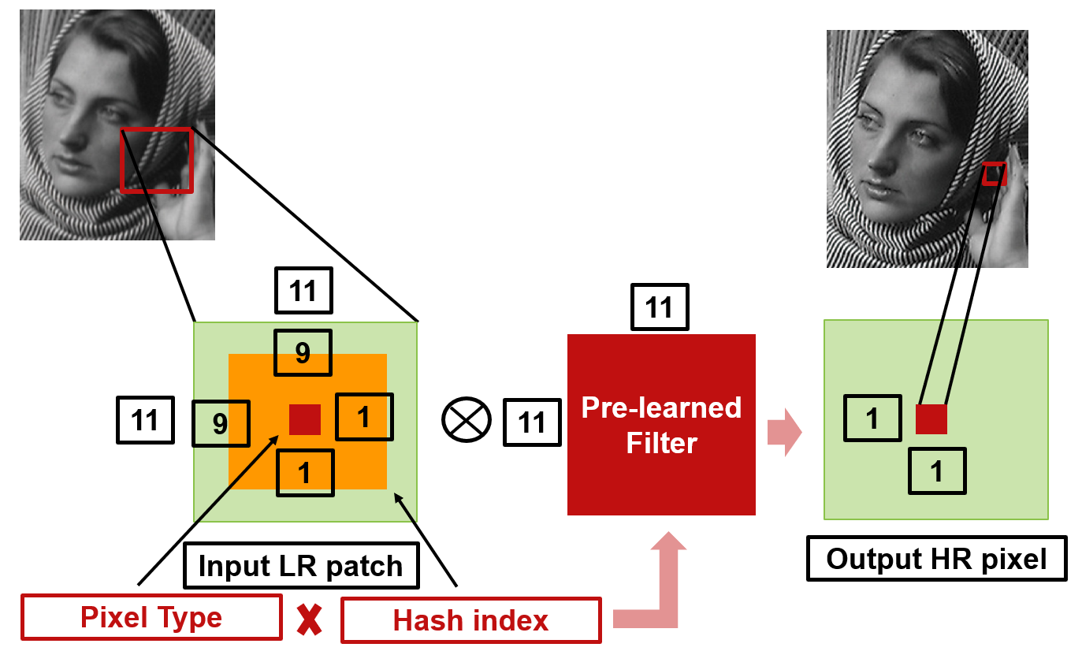
Outline of RAISR
RAISR is well known as rapid and accurate super-resolution method which utilizes 864 filters for upscaling.
RAISR classifies LR patches into 864 classes by hash index and pixel type index .

Slide 6
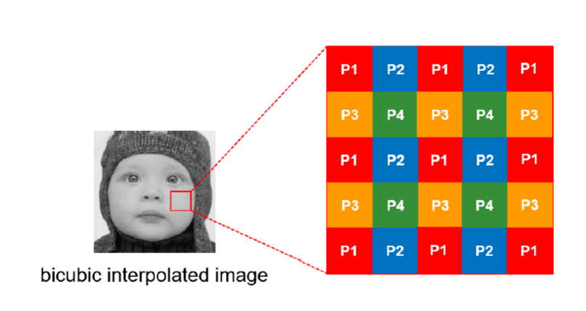
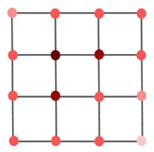
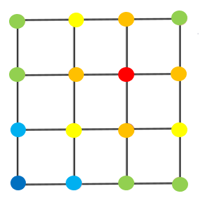
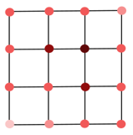
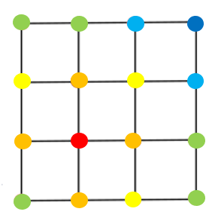
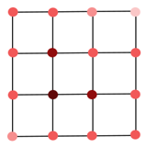
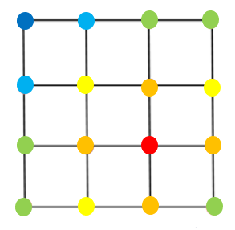
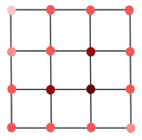
Classes for pixel Type
RAISR employs bicubic interpolation as cheap upscaling to up-scale LR images.
In RAISR, there are 4 classes for the type of pixel as upscaling input images by a factor of 2.
P1 type pixel is generated by
P2 type pixel is generated by
P3 type pixel is generated by
low
high
weight
P4 type pixel is generated by

Slide 7
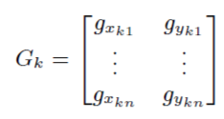
Classes for hash calculation
Hash index is calculated by the feature extraction of local gradient with Principal Component Analysis (PCA) algorithm.
To find local gradient of input $\sqrt{n}×\sqrt{n}$ patch, firstly $G_{k}$ is prepared.

Slide 8
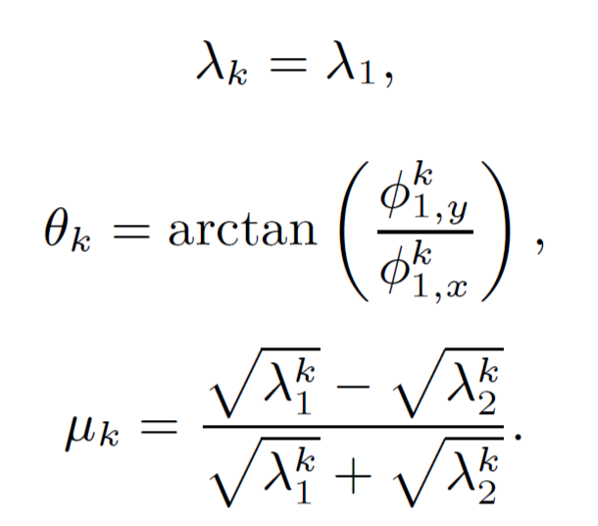
Classes for hash calculation
We calculate the eigenvalues of the covariance matrix $G_{k}^{T}W_{k}G_{k}$.
Largest eigenvalue $λ_{1}^{k}$ and the smaller eigenvalue $λ_{2}^{k}$ and two eigenvectors $Φ_{1}^{k}$ corresponding to $λ_{1}^{k}$ and $Φ_{2}^{k}$ corresponding to $λ_{2}^{k}$ are found.

Slide 9
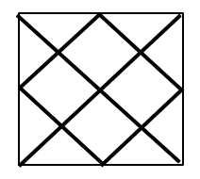
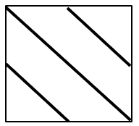
Classes for hash calculation
low
high
low
high

Slide 10
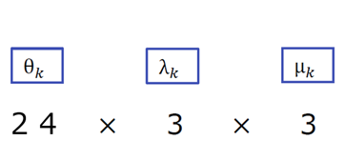
Classes for hash calculation
Strength $λ_{k}$, angle $θ_{k}$and coherence $µ_{k}$ function as the hash key.
In RAISR, by quantizing these parameters, $λ_{k}$ is divided into 3 classes, $θ_{k}$ is divided into 24 classes, $µ_{k}$ is divided into 3 classes.
= 216 classes

Slide 11
The problem of RAISR
too much
It is hard to process RAISR with mobile devices such as the smartphone.
To reduce the number of filters in RAISR test phase, there are three improvements in our proposed method.

Slide 12
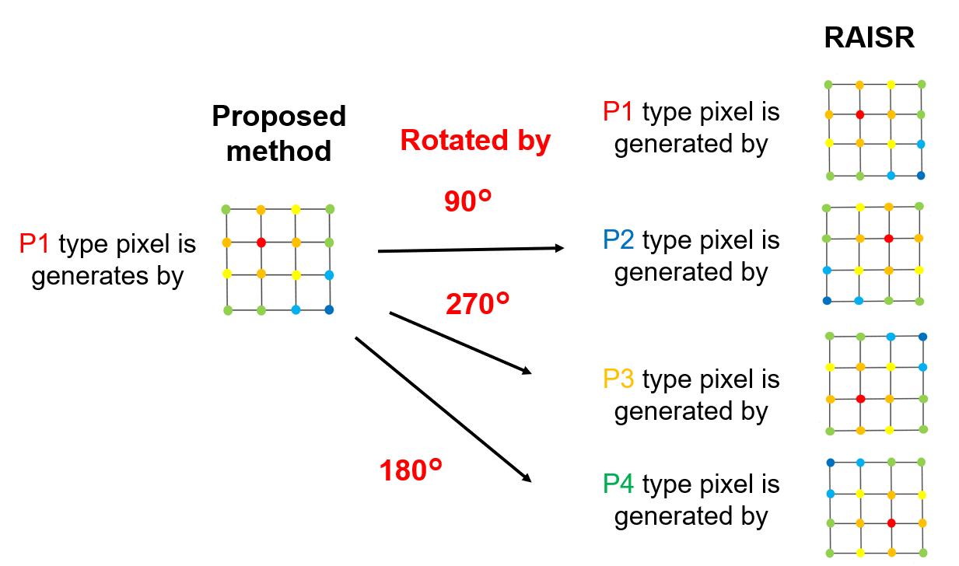
①：Rotation conversion based on pixel type
RAISR
The filter is learned in each P1 to P4 pixel type of Bicubic interpolated image.
Proposed method
Only filter for P1 type pixels needs to be learned
owing to rotation conversion.

Slide 13
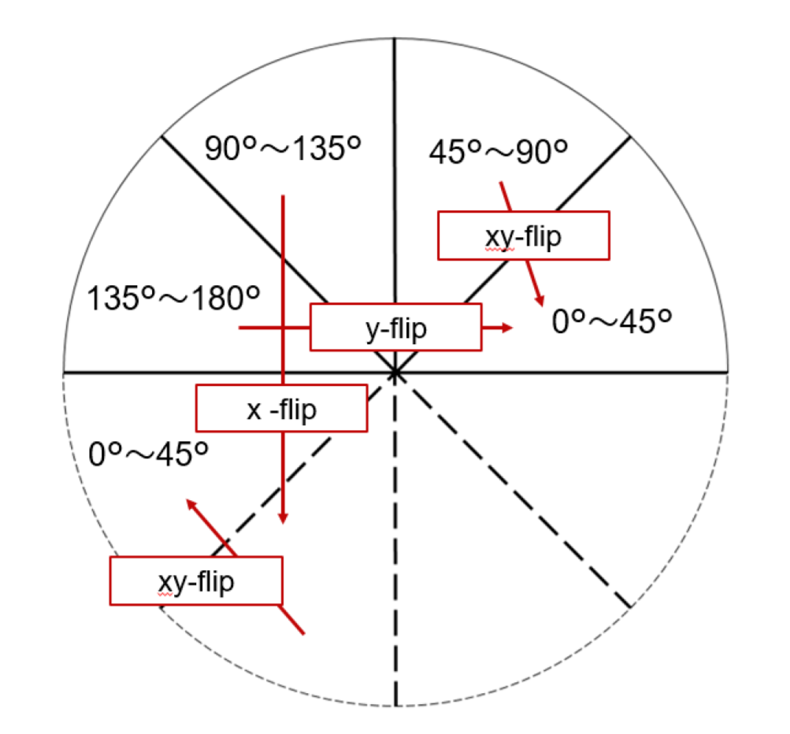
②：Geometric conversion based on gradient angle
RAISR
$θ_{k}$ is divided into 24 classes corresponding to the range from 0° to 180°.
$θ_{k}$ is divided into only 6 angle classes corresponding to the range from 0° to 45°
owing to geometric conversion
Proposed method
xy-flip

Slide 14
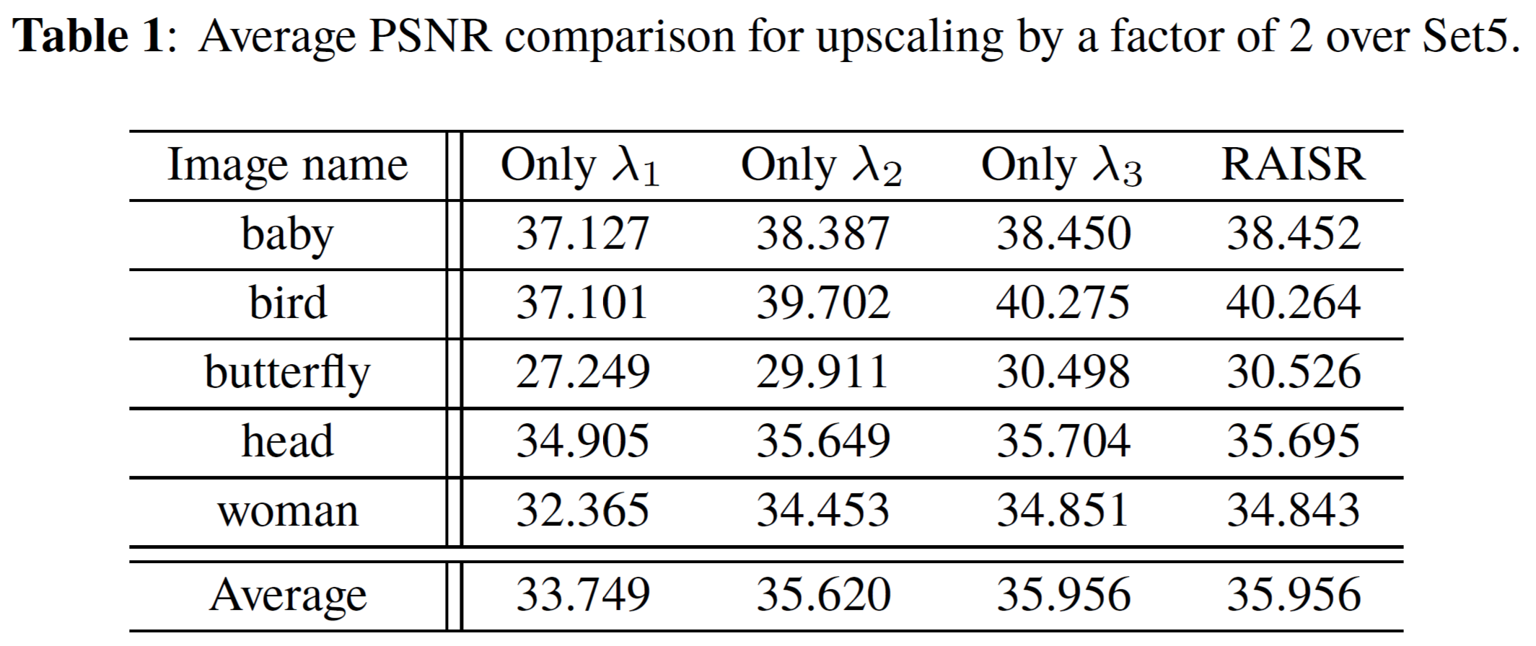
③：Reduction of the classes for $λ_{k}$
We empirically find the filter learned with high-frequency patches can generate even HR patches with low-frequency component.
RAISR
$λ_{k}$ is divided into 3 classes.
Proposed method
In training phase, we learn the filter with only LR patches in class${ λ}_{3}$.
In testing phase, we doesn’t need hash classes for $λ_{k}$.
3 classes for $λ_{k}$
$$λ_{1}$$
$$λ_{2}$$
$$λ_{3}$$
low
high

Slide 15
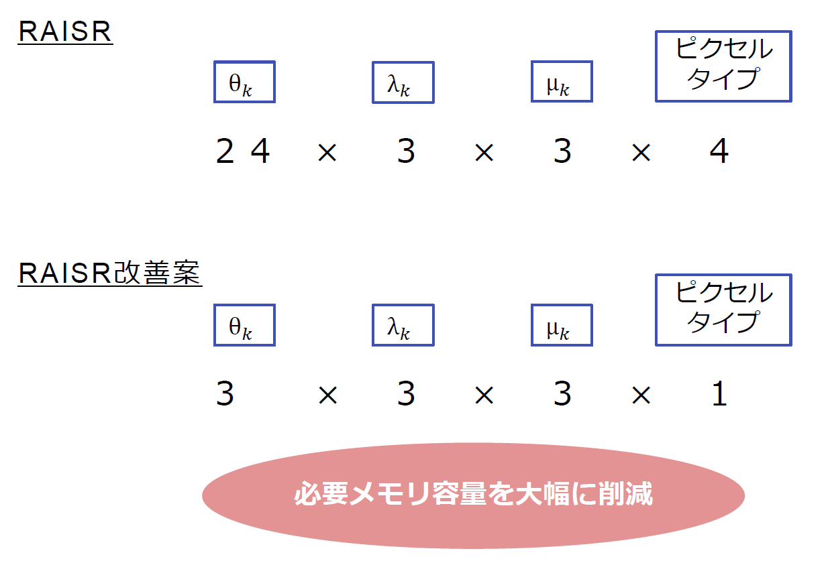
The comparison of the number of filters (1/2)
There are three improvements in our proposed method.
Pixel
type
２４
=864
２４
②
③
①
Proposed method
Pixel
type
６
1
=18
Proposed method can reduce significantly the number of filters in RAISR test phase.

Slide 16
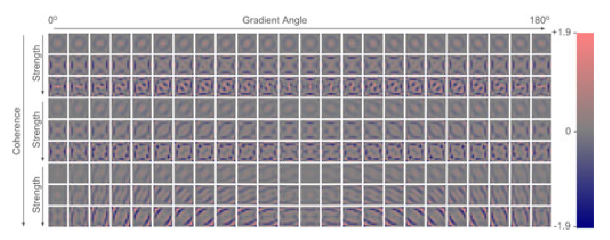
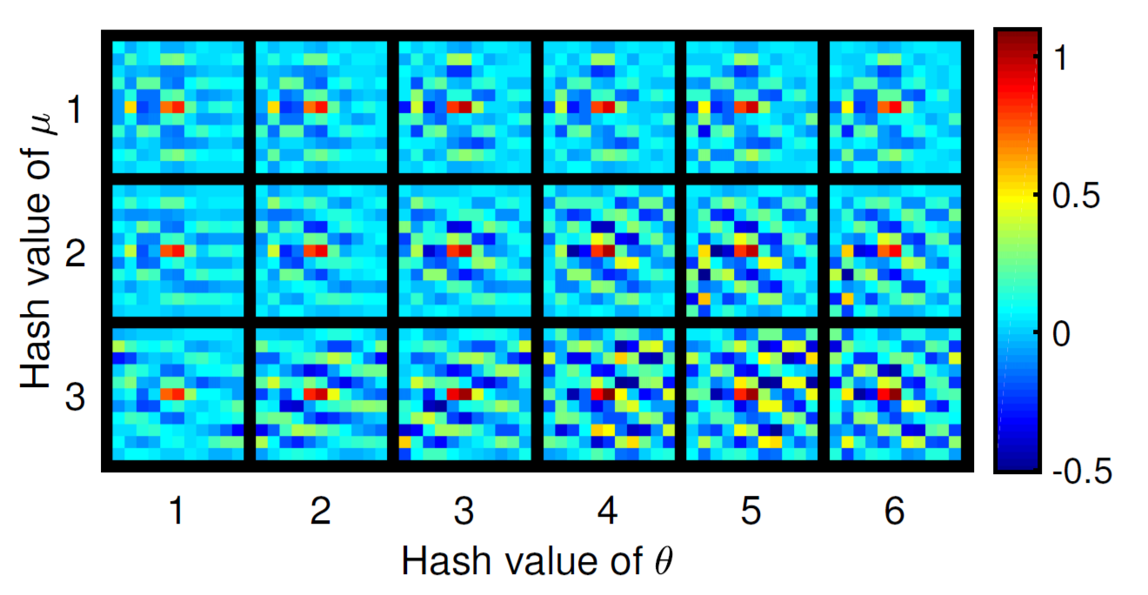
The comparison of the number of filters(2/2)
[1]Y. Romano, J. Isidoro, and P. Milanfar, “Raisr: Rapid and accurate image super resolution,” IEEE Transactions on Computational Imaging, vol. 3, no. 1, pp. 110–125, March 2017.
Hash class in each pixel type
Pixel Type
4
RAISR
cited from [1]
Proposed method

Slide 17
Compared methods
Interpolation
・Bicubic
Example based method
・Zeyde et al.
・ANR ・A+
・RAISR ・SRCNN
[2] Hsieh Hou and H. Andrews, “Cubic splines for image interpolation and digital filtering,” IEEE Transactions on Acoustics,Speech, and Signal Processing, vol. 26, no. 6, pp. 508–517,Dec 1978. [3]Roman Zeyde, Michael Elad, and Matan Protter, “On single image scale-up using sparse-representations,” in Curves and Surfaces, Jean-Daniel Boissonnat, Patrick Chenin, Albert Cohen, Christian Gout, Tom Lyche, Marie-Laurence Mazure, and Larry Schumaker, Eds., Berlin, Heidelberg, 2012, pp. 711–730, Springer Berlin Heidelberg. [4]R. Timofte, V. De, and L. V. Gool, “Anchored neighborhoodregression for fast example-based super-resolution,” in 2013IEEE International Conference on Computer Vision, Dec 2013,pp. 1920–1927. [5]Radu Timofte, Vincent De Smet, and Luc Van Gool, “A+:Adjusted anchored neighborhood regression for fast super-resolution,” in Computer Vision – ACCV 2014, Daniel Cremers, Ian Reid, Hideo Saito, and Ming-Hsuan Yang, Eds., Cham,2015, pp. 111–126, Springer International Publishing. [6]Chao Dong, Chen Change Loy, Kaiming He, and Xiaoou Tang, “Learning a deep convolutional network for image super-resolution,” in Computer Vision – ECCV 2014, David Fleet, Tomas Pajdla, Bernt Schiele, and Tinne Tuytelaars, Eds., Cham, 2014, pp. 184–199, Springer International Publishing.
cited from [2]
cited from [3]
cited from [4]
cited from [5]
cited from [1]
cited from [6]

Slide 18
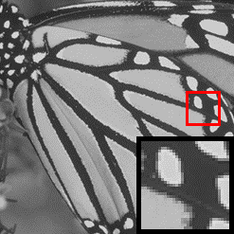
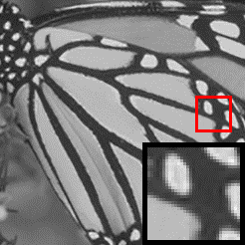
The result of experiments
original
Bicubic
27.4
Zeyde et al.
30.6
ANR
30.5
A+
32.0
SRCNN
32.7
RAISR
30.5
Proposed 30.5

Slide 19
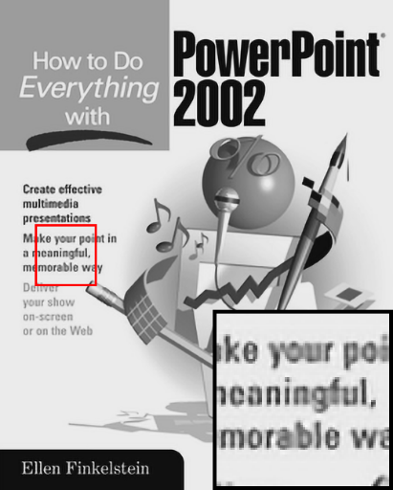
The result of experiments
original
Bicubic
26.9
Zeyde et al.
29.3
ANR
29.0
A+
30.1
SRCNN
32.8
RAISR
28.7
Proposed
28.7

Slide 20
The result of experiments
 | Bicubic | Zeyde et al. | ANR | A+ | SRCNN | RAISR | proposed
PSNR | 33.66 | 35.78 | 35.83 | 36.54 | 36.66 | 35.96 | 35.96
Time | 0.002 | 4.325 | 0.656 | 0.705 | 2.913 | 0.020 | 0.028
The number of filters | - | - | - | - | - | 864 | 18

Slide 21
Conclusion
・We proposed a rapid and accurate learning-based method for single image super-resolution with the significantly small number of filters.
・Our method needs only simple conversion including geometric flip and rotation addition for hash calculation and CT-blending used in RAISR.
・The important advantage of our method is that only 18 filters can make the same accurate image in the same runtime as RAISR while RAISR needs 864 filters to do that.

