Slide 1
DYNIMP: DYNAMIC IMPUTATION FOR WEARABLE SENSING DATA THROUGH SENSORY AND TEMPORAL RELATEDNESS
Zepeng Huo*, Taowei Ji*, Yifei Liang*, Shuai Huang^, Zhangyang Wang`, Xiaoning Qian*, Bobak Mortazavi*
*Texas A&M University,
^University of Washington,
`University of Texas at Austin

Slide 2
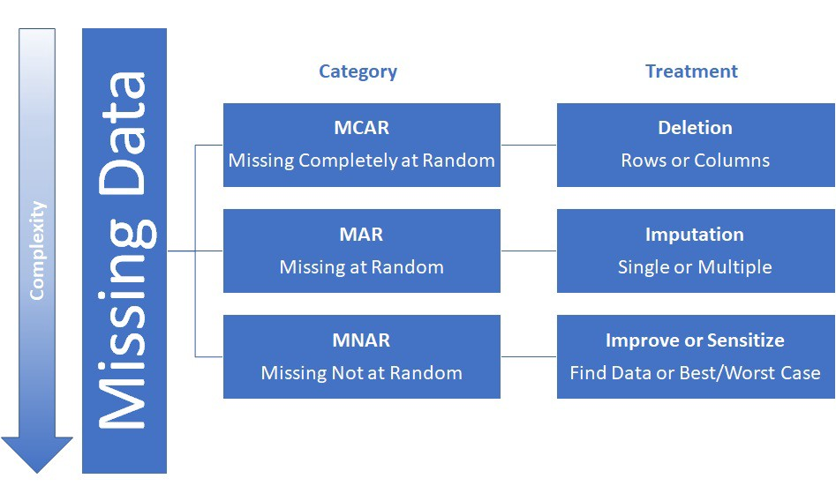
Missingness issue in wearable data
This is inevitable:
Different user would have different phone types, and each phone manufacturers would have different built-in sensor
Different user would turn on/off some functions of the phone (e.g. WiFi)
Other random reasons, e.g. malfunction, communication issue
There are some static solutions
Interpolation
Filling mean
Algorithmic-based imputation:
Missforest
Feature masking
We are proposing: a trainable autoencoder to learn the missing dynamics
Combining both time series dynamic and feature relatedness
Highly versatile to any downstream application

Slide 3
A dynamic imputation framework
For most of the motion sensor time-series data, the imputation to deal with missingness is still not ideal
The missingness dynamics might change from time to time but a static (e.g. mean imputation) is not able to capture this fluctuations
A learnable framework is much needed to learn the unique information for each user/each feature
We are proposing a dynamic imputation algorithm
LSTM-based Autoencoder
KNN-based padding
We tested different missingness levels (10% - 60%) to see how does the model perform
Robustness is important especially when missingness is high

Slide 4
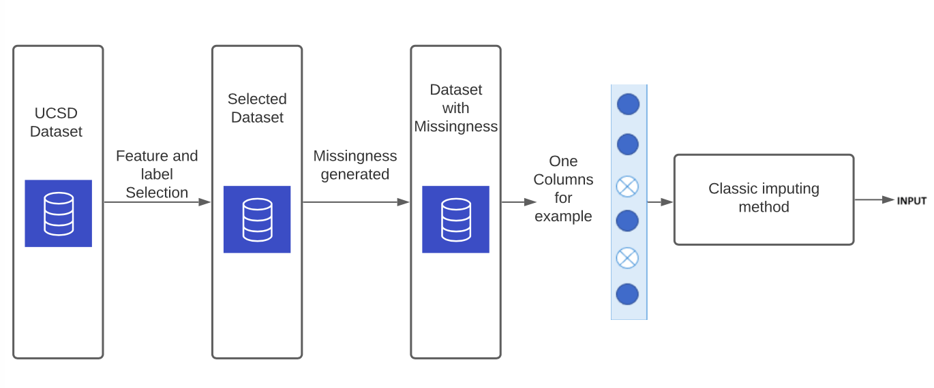
Framework setup
Feature extraction + label selection
Generating missingness from complete dataset

Slide 5
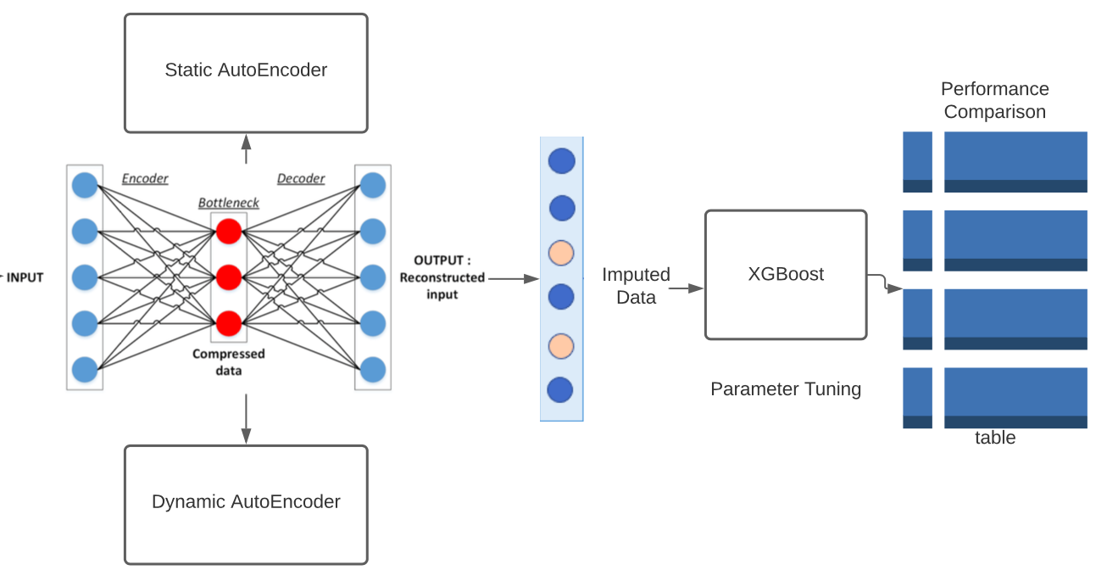
Framework setup
We used different variations to test the performance of missingness reconstruction
We give the imputed data for a downstream classifier

Slide 6
Results
Result comparison with Baselines:
Ablation study

Slide 7
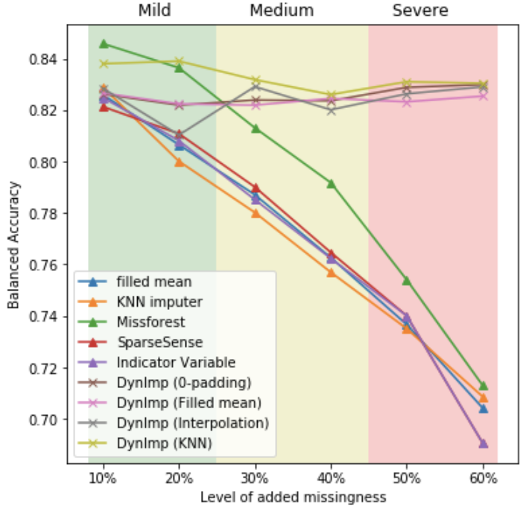
Conclusion
We proposed a dynamic imputation technique for remote sensing data
The method is through a trainable mechanism by the use of deep learning model to learn the missing dynamics along the time axis to impute the missing data.
The model shows strong performance compared to baselines

