Slide 1
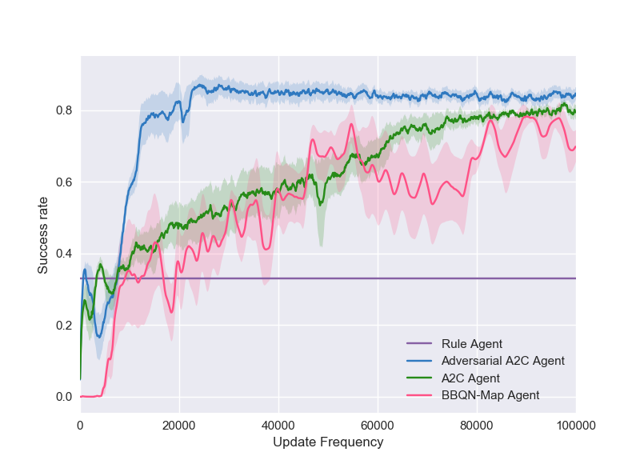
Adversarial Advantage Actor-Critic Model for Task-Completion Dialogue Policy Learning
Baolin Peng, Xiujun Li, Jianfeng Gao, Jingjing Liu, Yun-Nung (Vivian) Chen, Kam-Fai Wong
Adversarial Advantage Actor-Critic Model for Task-Completion Dialogue Policy Learning
Baolin Peng¹, Xiujun Li², Jianfeng Gao², Jingjing Liu², Yun-Nung Chen³ , Kam-Fai Wong¹
¹The Chinese University of Hong Kong, ²Microsoft AI & Research, ³National Taiwan University
Summary
2. Methodology
Motivation
Exploiting reinforcement learning for dialogue policy learning
Exploration in the large state-action space is challenging
Reward is delayed and sparse with a long trajectory
Approach
Propose an Adversarial Advantage Actor-Critic algorithm
Leverage expert-generated dialogues as priors
Use a discriminator to differentiate responses from an agent or human experts
The output of discriminator as intrinsic reward to explore state-action regions similar to what human experts do
Results
Significant improvement of efficiency and performance on a movie-ticket booking domain
Advantage Actor-Critic for Dialogue Policy Learning
Find a policy $π$ that maximizes the expected reward
$π$ is a parameterized probabilistic mapping function:
Update $θ$ with following gradients
Baseline function for reducing variance
TD error as an unbiased estimation
Adversarial Training
Actor $π_{θ}$ as a generator G
A discriminator D identifies state-action pair (s, a) from experts or G
D can be viewed as a reward function extracted from experts’ trajectories
D is to maximize the probability of classifying each pair correctly
Actor $π_{θ}$ (G) can be improved with $−log\left(1−D\left(s,a\right)\right)$ as the reward function
Discriminator Training
Expert
Demonstration
Sample (s,a) pair
Expert
vs
Simulation
Discriminator
Simulation
Sample (s,a) pair
TD error
Actor
TD error
State
$$s$$
Critic
Discriminator
Action
$$a$$
Hi, how can I help you?
Reward
I would like to book a ticket for deadpool.
User Simulator
What theater would you like?
AMC pacific place.
Combine A2C with a reward function learned from experts’ demonstrations with adversarial training.
The discriminator D guides actor to explore state action regions where human experts will explore.
Adversarial Advantage Actor-Critic
Agent
Which time do you prefer?
Tomorrow evening.
User
Sure, here it is one ticket for deadpool 8 PM at AMC pacific place is available for you.
3. Experiments & Results
Evaluation
Success rate
10 run averaged learning curve
2000 dialogues for testing
1. Task Definition
Dataset: human-human conversations in the movie-ticket booking scenario
collected via AMT and annotated by human experts
280 labeled dialogue with 11 average turns
11 dialogue acts, 29 slots
Informable (narrow down search), requestable (ask info from agent)
Use a publicly available user simulator
Baselines
Rule Agent: handcrafted rule-based policy that in- forms and requests a hand-picked subset of necessary slots.
A2C: trained with a pre-defined reward function and a standard advantage actor-critic algorithm
BBQN-Map Agent (AAAI’18): the best agent among a set of BBQN variants that has great efficiency for policy exploration in dialogue systems
Natural Language Understanding (NLU) turns natural language into intents and slot-values
Natural Language Generation (NLG) turns system actions into natural language
Dialogue Manager (DM)
tracks dialogue states and updates state accordingly
interacts with the database
takes state as input to output system action → Dialogue Policy Learning
User Goal
Dialogue Manager
Dialogue Observations
(History Utterances, Belief State, KB Results)
Semantic Frame
Dialogue State Tracker
Adversarial A2C learns faster and more stable with better exploration.
NLU
$$o_{1}$$
$$o_{2}$$
$$o_{t}$$
$$s_{t}$$
Model
Agent | Succ. | Turn | Reward
Rule | 41.34 | 16.00 | 0.26
A2C | 81.24 | 15.43 | 5.08
BBQN-MAP | 81.56 | 18.75 | 5.00
Adversarial A2C | 87.52 | 13.52 | 5.93
4. Conclusion
State Representation
We propose an adversarial advantage actor-critic model with efficient exploration.
The discriminator severs as an additional critic to guide policy exploration towards human-like one. It also has connection with inverse reinforcement learning that learns reward function.
Our experiments in a movie-ticket booking domain show its superiority.
System Action
(Policy)
Dialogue Policy Learning
NLG
$$s_{1}$$
$$s_{2}$$
……
$$s_{n}$$
$$a^{∗}=\max_{a}{π\left(a|s\right)}$$
…
System Action
e.g. inform(ticket=?)
$$π_{1}$$
$$π_{2}$$
$$π_{k}$$

