Slide 1
Generating Persona-aware Empathetic Responses With Retrieval-augmented Prompt Learning
Zhengjie Huang Pingsheng Liu Gerard de Melo Liang He Linlin Wang
East China Normal University
Hasso Plattner Institute, University of Potsdam
Shanghai Artificial Intelligence Laboratory
Notes:
Hello everyone. I’m Linlin Wang. Today I'm honored to be here to present our paper titled "Generating Persona-aware Empathetic Responses With Retrieval-augmented Prompt Learning".

Slide 2
Empathetic Response Generation
Notes:
Considering the following dialogue generation scenario where the user informs the dialogue agent that he has managed to lose 5 pounds in the last half month. He hopes that the dialogue agent can perceive and understand his emotion as proud, and thereby generate an Empathetic Response. In practice, despite encountering identical conversational contexts, dialogue agents with different personas may deliver disparate empathetic responses. For instance,

Slide 3
Empathetic Response Generation
Notes:
If the agent is a food enthusiast who like eating very much, he may express his admiration by saying I want to lose weight too, but I m a carnivore.
But if the agent is a doctor, he may express his joy but also suggest to the user not to forget to maintain adequate nutrition.

Slide 4
Empathetic Response Generation
Persona-aware Empathetic Response Generation
To generate informative, personalized, and empathetic dialogue responses
Notes:
However, traditional approaches often overlook the role of persona when generating empathetic responses.
Our paper addresses this gap by studying the task of generating Persona-aware Empathetic Responses, delivering informative, personalized, and empathetic interactions for dialogue systems.

Slide 5
Related Work and Challenges
Existing work (e.g., EmpTransfo, COMAE) focuses solely on Emotion and Dialogue Act, ignoring the impact of persona characteristics on emotion.
Integrate persona with semantic context
No distinct emotional expressions
Notes:
Most existing work focuses solely on Emotion and Dialogue Act and ignores the impact of personality characteristics when generating empathetic dialogue responses. Even ChatGPT tends to primarily integrate its character persona with semantic context rather than displaying distinct emotional expressions.

Slide 6
Related Work and Challenges
Existing work (e.g., EmpTransfo, COMAE) focuses solely on Emotion and Dialogue Act, ignoring the impact of persona characteristics on emotion.
Integrate persona with semantic
No distinct emotional expressions
Persona
I do not like to talk
real personality traits (“introverted”)
▇ Subjective and vague expressions
▇ Short and superficial descriptions
Notes:
This is because personas expressions are sometime subjective, short and vague. For instance, it is hard for models to recognize the real personality trait “introverted” from the superficial description “I do not like to talk”.

Slide 7
Related Work and Challenges
Existing work (e.g., EmpTransfo, COMAE) focuses solely on Emotion and Dialogue Act, ignoring the impact of persona characteristics on emotion.
Integrate persona with semantic
No distinct emotional expressions
Persona
Challenge 1
I do not like to talk
real personality traits (“introverted”)
Lack adequate cues to model implicit traits of persona
Lack the ability to respond in a persona-specific way.
▇ Subjective and vague expressions
▇ Short and superficial descriptions
Notes:
Since there are insufficient cues to model implicit traits of persona, existing models Lack the ability to respond in a persona-specific way.

Slide 8
Related Work and Challenges
Challenge 2
Intricate interaction among persona, context, and emotion, forming complex dialogue.
Difficult to capture the real impact of persona on empathetic responses
Notes:
Besides, there exists intricate interaction among persona, context, and emotion, forming complex dialogue, which brings difficulty for models to capture the real impact of persona on empathetic responses.

Slide 9
Persona-aware Empathetic Responses
Challenge 1
Exemplar Retrieval
— Dense Passage Retrieval (DPR)
Lack the ability to respond in a persona-specific way.
Challenge 2
Difficult to capture the real impact of persona on empathetic responses
Exemplars serve as guiding signals.
Notes:
To address the first challenge of lacking the ability to respond in a persona-specific way, we propose using Dense Passage Retrieval to extract exemplars from the training set to enhance our model. An ‘exemplar’ refers to a specific example that serves as a guiding signal or reference response generated in similar situations. For instance, by providing an exemplar such as ‘the loss of a beloved person may hit you hard,’ our model can learn appropriate empathetic expressions. These extracted exemplars can serve as guiding signals for Persona-aware Empathetic Responses.

Slide 10
Persona-aware Empathetic Responses
Challenge 1
Exemplar Retrieval
— Dense Passage Retrieval (DPR)
Lack the ability to respond in a persona-specific way.
Challenge 2
Difficult to capture the real impact of persona on empathetic responses
Exemplars serve as guiding examples
Retrieval-augmented Prompting
& Empathetic Response Decoding
Construct prompts based on Exemplars to
Elicit richer persona information from LLMs
Capture interactions between persona and emotions, and their impact on responses with disentangled-attention
Notes:
To address the second challenge, we propose leveraging Retrieval-augmented Prompting, which constructs prompts based on exemplars to extract richer persona information from LLMs, along with empathetic response decoding to better capture the genuine impact of persona on empathetic responses.

Slide 11
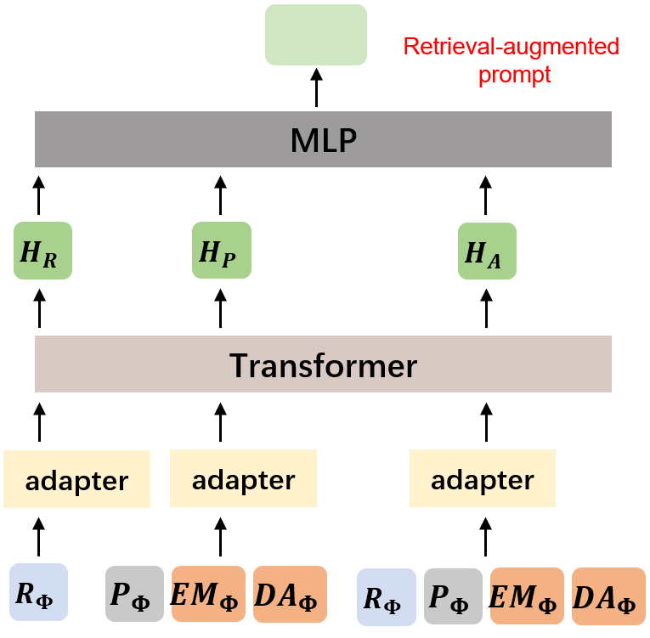
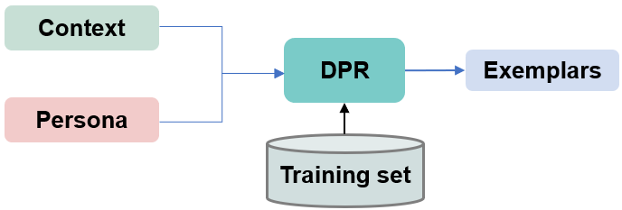
Proposed Model
A Disentangled Transformer with Retrieval-augmented Prompt Learning
Embed
I would be devastated if I lost my beloved family. I’m so sorry.
Persona
Context
Exemplars
$$E_{P}^{1}$$
$$E_{P}^{2}$$
$$E_{P}^{3}$$
$$E_{C}^{1}$$
$$E_{C}^{2}$$
$$E_{c}^{3}$$
$$E_{Φ}^{1}$$
$$E_{Φ}^{2}$$
$$E_{Φ}^{3}$$
output
LM loss
Transformer
$$H_{x}^{1}$$
$$H_{x}^{2}$$
$$A_{x}^{1}$$
$$A_{x}^{2}$$
…
$$A_{x}^{l}$$
response
$${EM}_{y}^{ }$$
Empathetic loss
$${DA}_{y}^{ }$$
Retrieval-augmented prompt
Embedded persona
Embedded context
Embedded retrieved-exemplars
Output hidden states
Key and values in the attention blocks
Embedding of emotion or dialog Act
Notes:
Finally, we propose a disentangled attention-based Transformer architecture with Retrieval-augmented Prompt Learning for the persona-aware empathetic response generation task.

Slide 12
Proposed Model
Embed
I would be devastated if I lost my beloved family. I’m so sorry.
Persona
Context
Exemplars
$$E_{P}^{1}$$
$$E_{P}^{2}$$
$$E_{P}^{3}$$
$$E_{C}^{1}$$
$$E_{C}^{2}$$
$$E_{c}^{3}$$
$$E_{Φ}^{1}$$
$$E_{Φ}^{2}$$
$$E_{Φ}^{3}$$
output
LM loss
Transformer
$$H_{x}^{1}$$
$$H_{x}^{2}$$
$$A_{x}^{1}$$
$$A_{x}^{2}$$
…
$$A_{x}^{l}$$
response
$${EM}_{y}^{ }$$
Empathetic loss
$${DA}_{y}^{ }$$
Retrieval-augmented prompt
Embedded persona
Embedded context
Embedded retrieved-exemplars
Output hidden states
Key and values in the attention blocks
Embedding of emotion or dialog Act
Notes:
Specifically, we will first introduce the retrieval component that takes input context and persona, and outputs relevant exemplars.

Slide 13
DPR-based Exemplar Retrieval
Score
Sim
Training with contrastive learning
Query Encoder
Candidate Encoder
Persona
Context
Candidate
Notes:
We leverage dense passage retrieval(DPR) to gather relevant exemplars, employing the agent's persona and dialogue as the query. Subsequently, we utilize two Bert models to encode both the query and candidate responses from the training set, and learn the probability distribution based on similarity shown in this slide. The DPR training process comprises four steps, including assigning positive response labels, creating negative labels, calculating similarity, and computing the contrastive loss. As for inference, we calculate similarity scores, sort the scores in descending order, and select q sentences as exemplar response information.

Slide 14
Proposed Model
Embed
I would be devastated if I lost my beloved family. I’m so sorry.
Persona
Context
Exemplars
$$E_{P}^{1}$$
$$E_{P}^{2}$$
$$E_{P}^{3}$$
$$E_{C}^{1}$$
$$E_{C}^{2}$$
$$E_{c}^{3}$$
$$E_{Φ}^{1}$$
$$E_{Φ}^{2}$$
$$E_{Φ}^{3}$$
output
LM loss
Transformer
$$H_{x}^{1}$$
$$H_{x}^{2}$$
$$A_{x}^{1}$$
$$A_{x}^{2}$$
…
$$A_{x}^{l}$$
response
$${EM}_{y}^{ }$$
Empathetic loss
$${DA}_{y}^{ }$$
Retrieval-augmented prompt
Embedded persona
Embedded context
Embedded retrieved-exemplars
Output hidden states
Key and values in the attention blocks
Embedding of emotion or dialog Act
Notes:
Secondly, we introduce the retrieval-augmented prompt learning part. Given the retrieved exemplars, persona, emotion and reference responses, we set up three independent parameter attention adapters to focus on the interplay between personality and emotions, and model how they influence responses.

Slide 15
Retrieval-augmented Prompt Learning
Semantic Adapter
Emotion
$${EM}_{Φ}$$
Persona
Dialog Act
$${DA}_{Φ}$$
Capture the impact of semantic context
Persona
Transformer
Context
$$P_{Φ}$$
Exemplars
$$R_{Φ}$$
adapter
$$H_{R}$$
Notes:
The first adapter captures the impact of semantic context to get H_R.

Slide 16
Retrieval-augmented Prompt Learning
Persona-Emotion Adapter
Emotion
$${EM}_{Φ}$$
Capture the effect of personality-emotion interaction
Persona
Dialog Act
$${DA}_{Φ}$$
adapter
$$H_{P}$$
Persona
Transformer
Context
$$P_{Φ}$$
Exemplars
$$R_{Φ}$$
Notes:
The second one capture the effect of personality-emotion interaction like this.

Slide 17
Retrieval-augmented Prompt Learning
Global Adapter
adapter
$$H_{A}$$
Emotion
$${EM}_{Φ}$$
Explore how the above factors influence responses
Persona
Dialog Act
$${DA}_{Φ}$$
Persona
Transformer
Context
$$P_{Φ}$$
Exemplars
$$R_{Φ}$$
Notes:
The third one explores how the above factors influence responses.

Slide 18
Retrieval-augmented Prompt Learning
Prompt Generation
Integrate the results from three adapters to generate prompts
adapter
$$H_{A}$$
Emotion
$${EM}_{Φ}$$
Persona
Dialog Act
$${DA}_{Φ}$$
adapter
$$H_{P}$$
Retrieval-augmented
prompt
Persona
Transformer
MLP
Context
$$P_{Φ}$$
Exemplars
$$R_{Φ}$$
adapter
$$H_{R}$$
Notes:
Finally, we set up an MLP to integrate all outputs from three adapters to generate prompts, that can not only elicit personality information from LLMs but also capture the interaction between persona, emotion, and exemplars, etc.

Slide 19
Proposed Model
Embed
I would be devastated if I lost my beloved family. I’m so sorry.
Persona
Context
Exemplars
$$E_{P}^{1}$$
$$E_{P}^{2}$$
$$E_{P}^{3}$$
$$E_{C}^{1}$$
$$E_{C}^{2}$$
$$E_{c}^{3}$$
$$E_{Φ}^{1}$$
$$E_{Φ}^{2}$$
$$E_{Φ}^{3}$$
output
LM loss
Transformer
$$H_{x}^{1}$$
$$H_{x}^{2}$$
$$A_{x}^{1}$$
$$A_{x}^{2}$$
…
$$A_{x}^{l}$$
response
$${EM}_{y}^{ }$$
Empathetic loss
$${DA}_{y}^{ }$$
Retrieval-augmented prompt
Embedded persona
Embedded context
Embedded retrieved-exemplars
Output hidden states
Key and values in the attention blocks
Embedding of emotion or dialog Act
Notes:
Here comes the Empathetic Response Decoding part.

Slide 20
Empathetic Response Decoding
Embed
Persona
Context
Exemplars
$$E_{P}^{1}$$
$$E_{P}^{2}$$
$$E_{P}^{3}$$
$$E_{C}^{1}$$
$$E_{C}^{2}$$
$$E_{c}^{3}$$
$$E_{Φ}^{1}$$
$$E_{Φ}^{2}$$
$$E_{Φ}^{3}$$
using the last two digits of the hidden layer for EM and DA to prediction
Transformer
hidden state
$${EM}_{y}^{ }$$
$${DA}_{y}^{ }$$
Empathetic loss
Retrieval-augmented prompt
Embedded persona
Embedded context
Embedded retrieved-exemplars
Output hidden states
Key and values in the attention blocks
Embedding of emotion or dialog Act
Notes:
We input persona, dialogue context, retrieved exemplars, and the constructed prompt into the transformer-based decoder, which is based on an autoregressive GPT-2. This process yields the output hidden states, keys, and values in the attention blocks. Next, we utilize the last position of the hidden state to predict the emotion, and the penultimate position to predict the dialogue act in the target response.

Slide 21
Empathetic Response Decoding
Embed
I would be devastated if I lost my beloved family. I’m so sorry.
Persona
Context
Exemplars
$$E_{P}^{1}$$
$$E_{P}^{2}$$
$$E_{P}^{3}$$
$$E_{C}^{1}$$
$$E_{C}^{2}$$
$$E_{c}^{3}$$
$$E_{Φ}^{1}$$
$$E_{Φ}^{2}$$
$$E_{Φ}^{3}$$
output
Control the empathy expression of the response
Transformer
key
value
response
$${EM}_{y}^{ }$$
$${DA}_{y}^{ }$$
Retrieval-augmented prompt
Embedded persona
Embedded context
Embedded retrieved-exemplars
Output hidden states
Key and values in the attention blocks
Embedding of emotion or dialog Act
Notes:
Then we add the Emotion embedding and Dialogue act embedding to acquire the fused embedding to control the empathy expression of the response, and thus get the embedding of each token in the response.

Slide 22
Empathetic Response Decoding
Embed
I would be devastated if I lost my beloved family. I’m so sorry.
Persona
Context
Exemplars
$$E_{P}^{1}$$
$$E_{P}^{2}$$
$$E_{P}^{3}$$
$$E_{C}^{1}$$
$$E_{C}^{2}$$
$$E_{c}^{3}$$
$$E_{Φ}^{1}$$
$$E_{Φ}^{2}$$
$$E_{Φ}^{3}$$
output
Predict the next token in response
Transformer
key
value
response
$${EM}_{y}^{ }$$
$${DA}_{y}^{ }$$
Retrieval-augmented prompt
Embedded persona
Embedded context
Embedded retrieved-exemplars
Output hidden states
Key and values in the attention blocks
Embedding of emotion or dialog Act
Notes:
Finally, we can predict the next token yt+1 in the response as the equation shown in the slide.

Slide 23
Training Objective
Notes:
The final training objective is the sum of NLL loss, EM loss and DA loss, where L_NLL is the negative log likelihood loss of the target response, L_EM and L_DA are Emotion and Dialog Act prediction losses, respectively.

Slide 24
Experiments
Dataset
PEC-AE, a large-scale persona-grounded empathetic conversation dataset crawled from Reddit with Dialogue Act (DA) and Emotion (EM) labels added.
Baseline
GPT(GPT-2): a basic model that generates responses solely based on the dialogue context.
EmpTransfo: a transfer learning-based scheme that incorporates a multi-task objective for generating empathetic responses.
CoMAE: a framework that hierarchically models empathy factors for empathetic response generation.
ChatGPT: a representative model specifically trained to interact with users in a truly conversational manner.
Notes:
For experiments, we use PEC for experiment which is a large-scaled persona-grounded empathetic conversation collected from reddit, and compare our model with four representative baselines that include GPT, EmpaTransfo, CoMAE and ChatGPT.

Slide 25
Experiments
Metrics:
Human Evaluation
(1) Empathy: How empathetic is the response to the user?
(2) Relevance: How coherent is the response with the persona and context?
(3) Fluency: How fluent and human-like is the response?
Automatic evaluation
(1) ROUGE-L: measure the similarity between the generated and reference responses.
(2) Distinct-2 (Dist-2): which refers to the ratio of distinct bi-grams in responses, is used to measure diversity.
(3) Emotion prediction accuracy (EA) for the generated responses.
Notes:
To evaluate the quality of generated responses, we ask human evaluators to assess the Empathy, Relevance, and Fluency of the generated responses. Additionally, we utilize widely-used automatic metrics, including ROUGE-L, Distinct-2, and Emotion prediction accuracy.

Slide 26
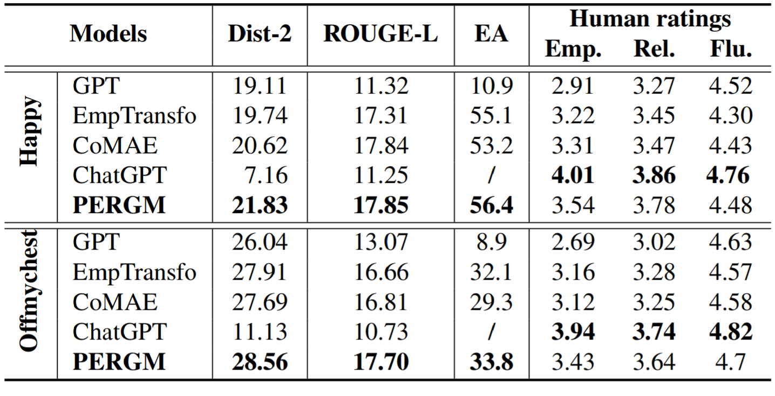
Experiments
Main Results:
The generated responses are more informative and have better fidelity. Our model can generate high-quality empathetic response.
Based on human ratings, our model exhibits comparable performance.
Notes:
As observed, PERGM yields the best performance on almost all the automatic metrics, which indicates our model can generate high-quality empathetic response. And the generated responses are more informative and have better fidelity. Besides, our model exhibits comparable performance compared with ChatGPT based on human ratings.

Slide 27
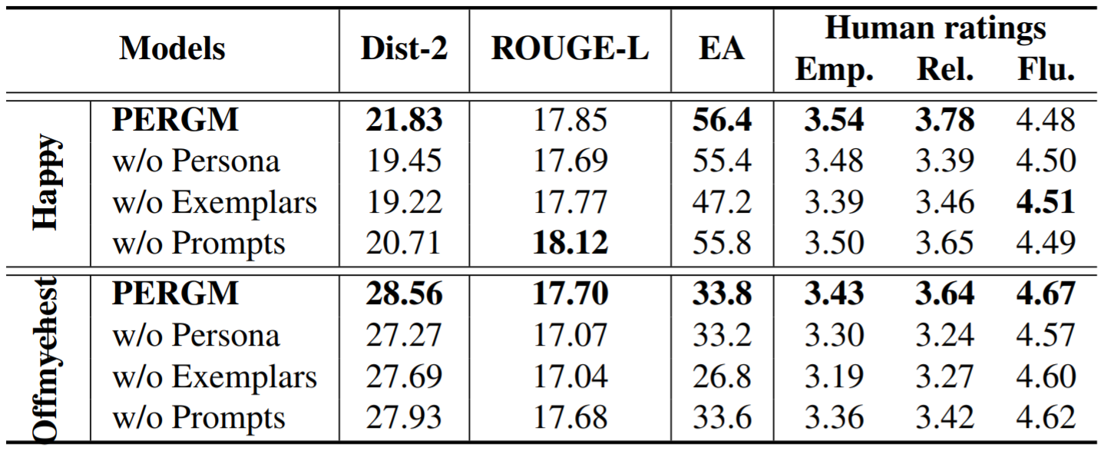
Experiments
Ablation Stuty:
The removal of retrieved exemplars
causes a 7% accuracy drop in EA,
a relative 3.8% ROUGE-L drop
and 3.1% in Dist-2 on Offmychest,
indicating that retrieved exemplars greatly facilitate emotional understanding.
When removing the prompts, almost all the metrics also deteriorate slightly.
Notes:
We also disentangled the contributions of each part of our model, and find all the metrics become worse after we eliminate the persona, demonstrating the effectiveness of persona in model generation quality. The removal of the retrieved exemplars causes a 7% accuracy drop in EA, a relative 3.8% ROUGE-L drop and 3.1% in Dist-2 on Test-Offmychest, indicating that the retrieved exemplars can greatly facilitate emotional understanding. When removing the prompts, almost all the metrics also deteriorate slightly. This demonstrates that the necessary prompts are beneficial to empathetic response generation.

Slide 28
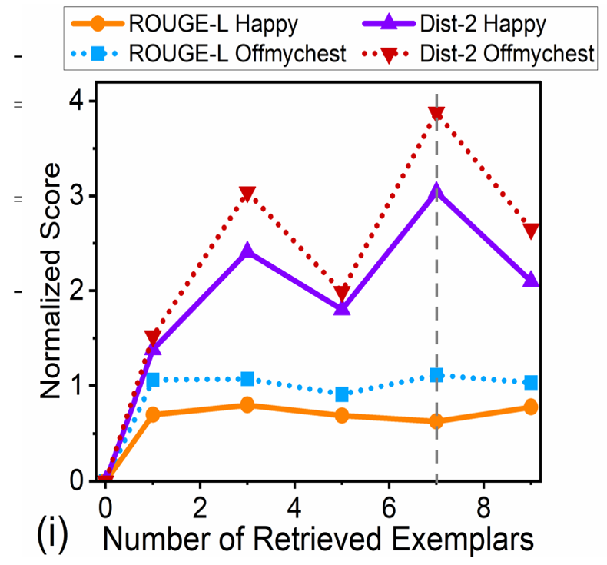
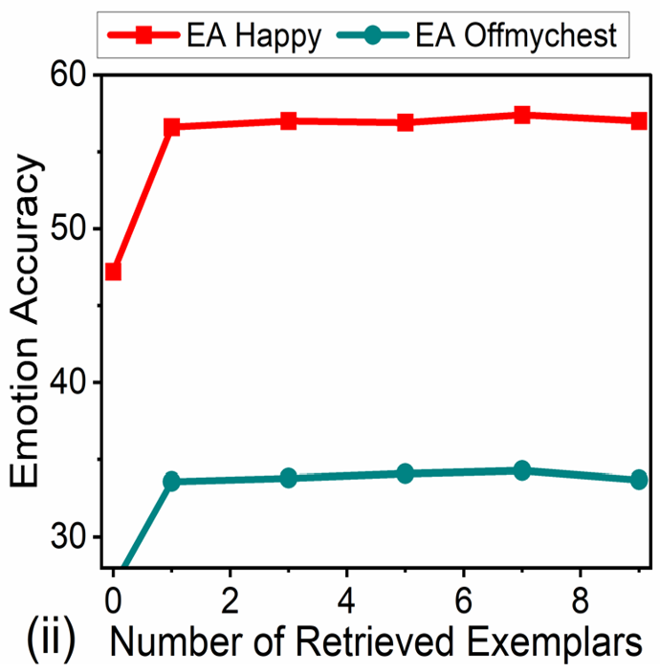
Experiments
Quantitative Analysis:
Notes:
We also show the impact of number of retrieved exemplars in this slide as Quantitative Analysis, where we can observed performance changes with different number of retrieved exemplars.

Slide 29
Experiments
Case Stuty:
Exemplars can guide the emotional and semantic expression of responses.
As a character who likes cute animals, one should exhibit a stronger feeling of happiness.
Notes:
In case study, we further analyzed the influence of exemplars and find retrieved exemplars are highly semantically similar to the references, corresponding to dialogue context and the responder’s persona, which indicates that the exemplars can assist the decoder in generating relevant words in the response. Specifically, the generated response is semantically close to the retrieved exemplar, and both express joy at finding the lost kitten. On the contrary, the generation from w/o Exemplar is generic and does not exhibit the persona character of “I like cute animals”.

Slide 30
Conclusions
In summary
Propose a novel Transformer-based architecture for Persona-aware Empathetic Responses
Retrieve exemplars to extract more relevant characteristics, guiding the model to better understand and generate empathetic responses
Leverage three adapters to perceive the relationships among persona, emotion, and response, and utilize retrieval-augmented prompt learning to guide the generation
llwang@cs.ecnu.edu.cn
Notes:
In summary, we Propose a novel Transformer-based architecture for Persona-aware Empathetic Responses. This model retrieves exemplars to extract more relevant characteristics, guiding the model to better understand and generate empathetic responses. It leverages three adapters to perceive the relationships among persona, emotion, and response, and utilize retrieval-augmented prompt learning to guide the generation.

