Slide 1
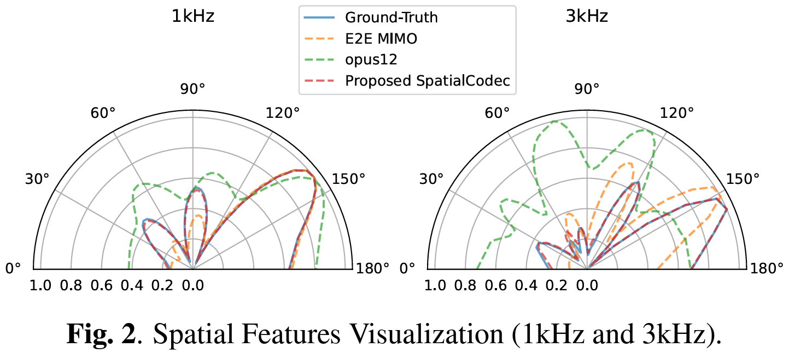
SpatialCodec: Neural Spatial Speech Coding
[PDF] [DEMO] [CODE]
Zhongweiyang Xu*, , YongXu†, Vinay Kothapally†, Heming Wang#, Muqiao Yang‡, Dong Yu† †Tencent AI Lab, *University of Illinois Urbana-Champaign, #The Ohio State University, ‡Carnegie Mellon University (This work was done while Z. Xu, H. Wang, and M. Yang were interns at Tencent AI Lab, Bellevue, USA.)
INTRODUCTION
Background
Current neural speech codecs mostly consider compressing monaural or stereo speech signals while preserving the perceptual spectral quality. This work completes these codecs by preserving spatial information for multi-channel speech.
Motivation
Given a multi-microphone recorded speech, coding the signal while preserving the spatial cues allows:
Efficient signal transmission and storage
Allows beamforming or spatial sound replay after decoding
Problem Formulation
Given an M-channel reverberant speech signal recorded by a microphone array the goal is to:
Encode or compress the M-channel speech to low-bit rate codes
Reconstruct the M-channel speech while preserving both speech spectral and spatial cues.
Evaluation Metrics
RTF Error
Error on relative transfer function, $a$and$\tilde{ a}$ are groundtruth and
decoded relative transfer functions:
MUSIC DoA Error
MUSIC DoA error is the DoA estimation error corresponding to
the ground-truth DoA. This is a very intuitive metric to roughly
measure the ability of the algorithm to capture the direct path
component.
Spatial Similarity
We propose spatial similarity as the correlation similarity between
groundtruth and estimated signals’ spatial features. The spatial
features are defined as different angle’s beamforming results, as
shown in Fig.2 below.
The the Spatial Similarity is:
$S$and$\tilde{ S}$ denotes groundtruth and decoded signals’ spatial features.
Beamforming Performance
We also evaluate the beamforming result between the groundtruth
signals and the decoded signals. We use PESQ as the metric after
super-directive beamforming using the groudtruth direction of
arrival.
Method
The overall architecture of the proposed SpatialCodec is depicted in Fig.1 which comprises two main branches:
A single-channel sub-band codec pre-trained to code the reference channel of the microphone array
A SpatialCodec that codes spatial information to reconstruct multi-channel audio signals.
The motivation comes from that spectral and spatial information are independent.
Single-Channel Sub-band Codec (First Branch)
We propose a novel single-channel frequency domain sub-band codec. The encoder and decoder are all 2D residual convolution on time frequency domain. When the frequency are compressed to several sub-bands, each band is residual vector quantized to form the codes. The the decoder decodes the reference-channel reverberant speech in a symmetric way.
SpatialCodec (Second Branch)
This branch codes the spatial information needed for multi-channel reconstruction. The inputs of the models are:
Reference-channel speech (same input as first branch)
Spatial covariance matrix of multi-channel speech
The encoder, quantization, and decoder are all similar to the first branch. Then the decoded output is:
(M-1) channel complex ratio filter (CRF)
Synthesis
Then the CRF could be used to filter the first branch’s reference-channel output, to reconstruct the rest (m-1) channel speech.
Loss
First branch is trained with HiFi-Codec loss function, with MEL and Adversarial Loss
Second branch is trained with SNR loss (after CRF filtering)
Table 1. Evaluation results for 8-channel reverberant audio reconstruction on the test set. CI denotes Channel Independent. SS denotes spatial similarity. SB-CODEC denotes our sub-band codec. DoA Error is in degrees while RTF Error is in radians. PESQ (WB) is for the beamforming performance.
RESULTS
The result is shown in Table 1 above, we have the following baseline and proposed models below:
OPUS12: OPUS[1] codec with 12kbps
OPUS6: OPUS[1] codec with 6kbps
ENCODEC[2]: neural speech codec (retrained)
HIFI-CODEC[3]: neural speech codec (retrained)
SB-CODEC: proposed sub-band codec
SB-CODEC+SpatialCodec (proposed)
Bit Rate
From Table 1 we can see that all baselines need at least 48 kbps, while our SBCODEC+SpatialCodec only need 12 Kbps. Note that the first five baselines are all channel-independent coding, which mean they all code each channel independently using single channel codecs.
Performance
Table shows although SB-CODEC+SpatialCodec only needs 12 Kbps, it achieves the best performance in all metrics.
References
[1] Jean-Marc Valin, Gregory Maxwell, Timothy B. Terriberry, and Koen Vos, “High-quality, low-delay music coding in the opus codec,” 2016.
[2] Alexandre D´ efossez, Jade Copet, Gabriel Synnaeve, and Yossi Adi, “High fidelity neural audio compression,” 2022.
[3] Dongchao Yang, Songxiang Liu, Rongjie Huang, Jinchuan Tian, Chao Weng, and Yuexian Zou, “HiFi-Codec: Groupresidual vector quantization for high fidelity audio codec,” 2023.
CONCLUSIONS
This project proposes a novel double branch method for multi-channel speech coding. Results show that our method is able to achieve superior coding quality with only 12 Kbps.

