Slide 1
A Lightweight Hybrid Multi-channel Speech Extraction System with Directional Voice Activity Detection
Tianchi Sun^{1,2}, Tong Lei^{1,2}, Xu Zhang³, Yuxiang Hu², Changbao Zhu², Jing Lu^{1,2}
¹ Key Laboratory of Modern Acoustics, Nanjing University, Nanjing 210093, China ² NJU-Horizon Intelligent Audio Lab, Horizon Robotics, Beijing 100094, China ³Jiangsu Thingstar Information Technology Co., Ltd., Nanjing 210046, China
Presenter: Tianchi Sun
17 April, 2024
Notes:
Hello everyone, my name is tianchi sun. Today I will talk about our work called a lightweight hybrid multi-channel speech extraction system with directional voice activity detection. This paper is the result of collaboration among Nanjing university, Horizon robotics and Thingstar.

Slide 2
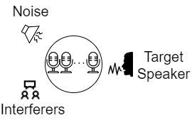
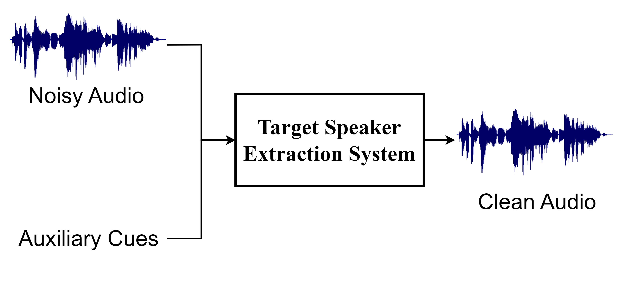
Target Speaker Extraction
Target speaker extraction (TSE) aims to extract desired speech by utilizing auxiliary cues.
Auxiliary cues:
Speaker embeddings
Direction of arrival (DOA)
Many applications (e.g. conference calls and hearing aids)
Notes:
Target speaker extraction, typically referred to as TSE, aims to extract the speech of the target speaker from a noisy environment characterized by competing speakers and background noise.
A TSE system receives noisy audio along with auxiliary cues related to the target speaker as input and attempts to suppress the interfering components.
In terms of auxiliary cues, speaker embeddings serve as an effective feature to discriminate speakers. However, an enrollment utterance from the target speaker might be inaccessible in many cases. In this work, we focus on the problem of extracting the speaker from a specific direction. In other words, the direction of arrival of the target speech is approximately known.
In practice, target speaker extraction systems can be useful in a variety of applications, such as conference calls and hearing aids.

Slide 3
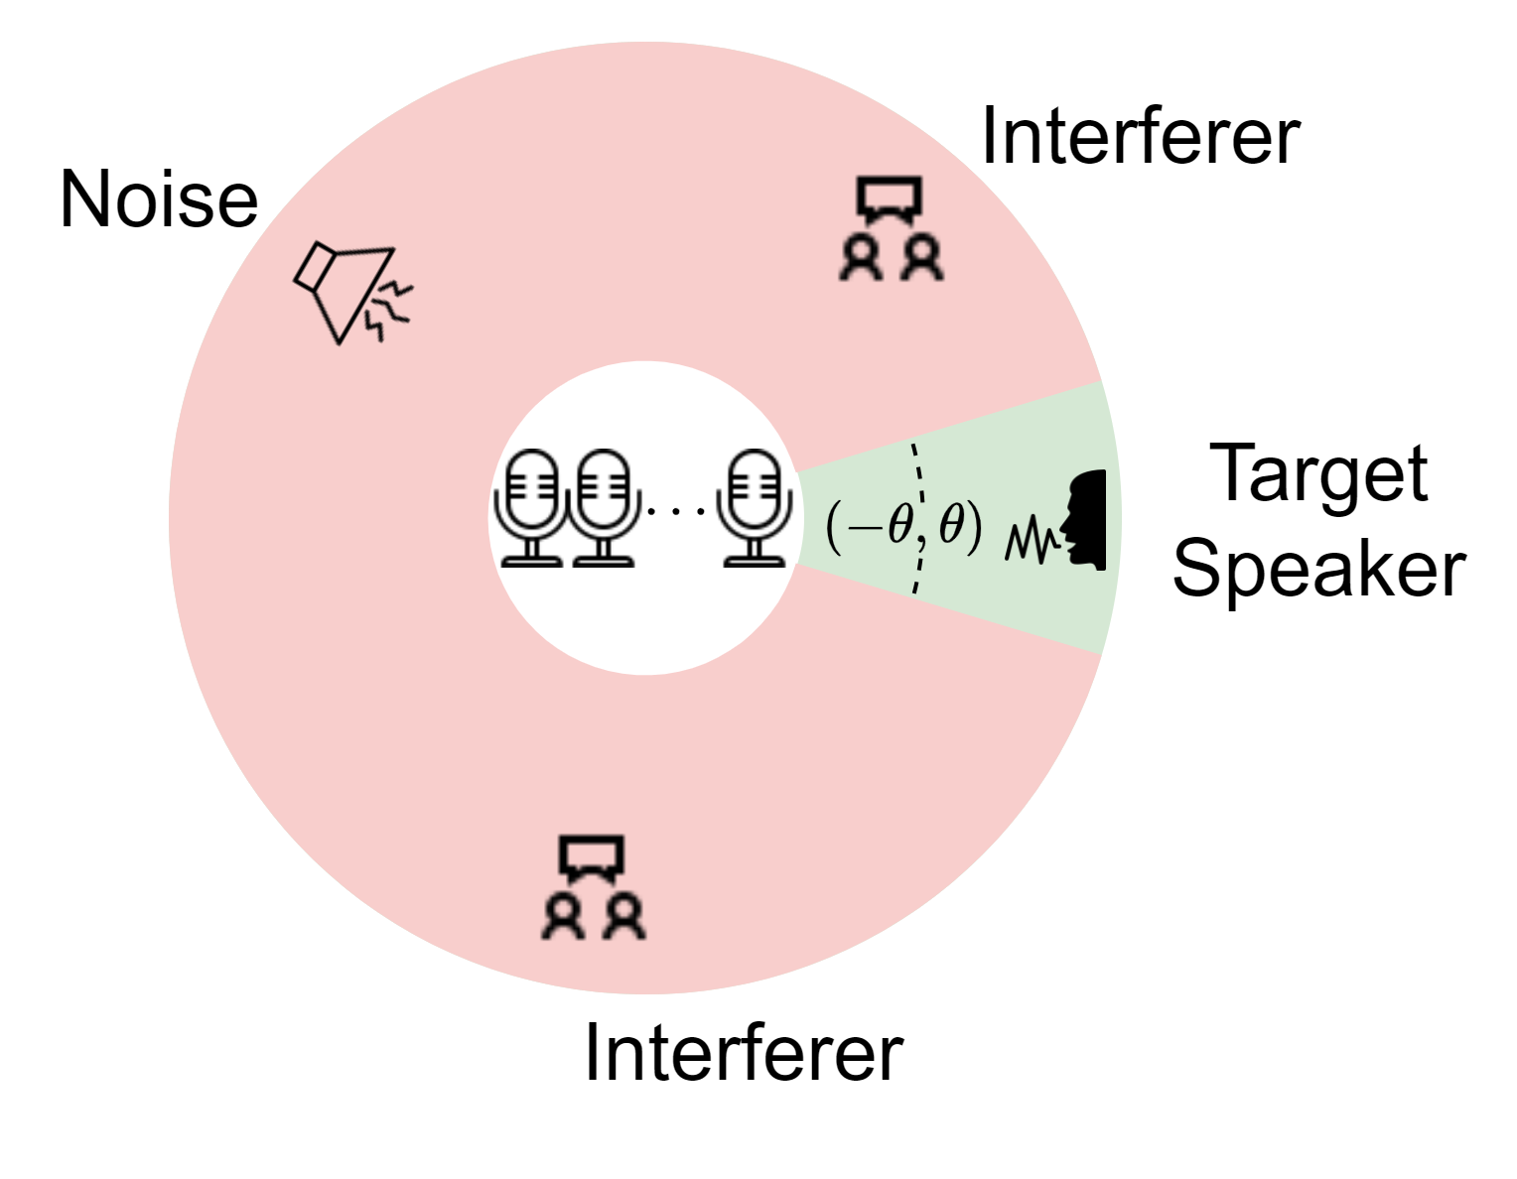
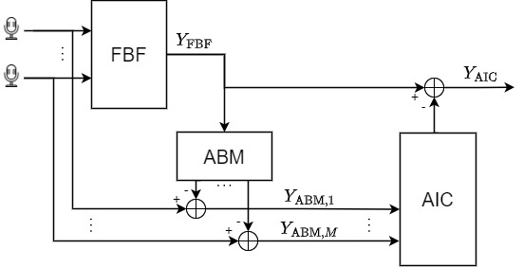
Conventional GSC
Structure of conventional GSC
Structure of conventional GSC
Notes:
In today’s world, most devices are equipped with several microphones which allow spatial filtering to attenuate signals from unwanted directions. For a given array, we can derive a beamformer that preserves signals from certain frontal angles while suppressing those from elsewhere. This is followed by a post-filter that works to further reduce interference.
The generalized sidelobe canceller is a well-known signal processing-based strategy to realize the structure. As illustrated, a conventional GSC consists of three main modules: a fixed beamformer to focus on sound from a particular direction, an adaptive blocking matrix to gather signal from other directions and an adaptive interference canceller to remove remaining noise from the beamformed signal. However, there inevitably exists speech distortion in the output due to the leakage of the desired signal in the blocking matrix.

Slide 4
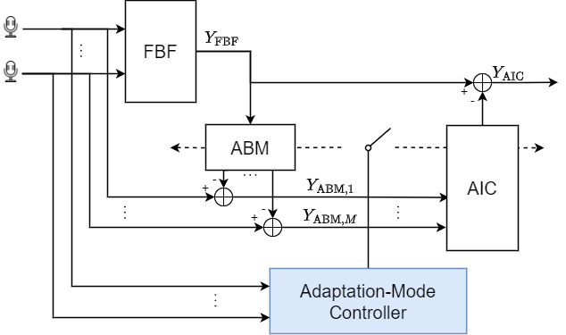
Robust GSC
Structure of Robust GSC
Update rules:
target speaker’s speech, update ABM
target speaker’s silence, update AIC
Notes:
To address this issue, a module called adaptation-mode controller is introduced to determine the optimal occasion to update parameters of the respective modules. To put it simply, the update of the ABM is expected to occur exclusively during the target speaker's speech frames, while the AIC update is conducted during the target speaker's silent frames. Although traditional voice activity detection algorithms, which often rely on energy levels, can support this module, they tend to suffer from a high number of false alarms caused by competing speakers in multi-talker environments . Moreover, signal processing techniques typically see their performance degradation in scenarios with low signal-to-noise ratios.

Slide 5
Approaches to TSE
Problems with robust GSC
Performance degradation in low SNR.
False alarms of VAD in multi-talker scenarios.
Problems with end-to-end
High computational complexity.
Poor robustness in unseen environments.
Our approach
Combination of signal processing and NN.
Competitive performance with lower complexity.
Better generalization on real-world data.
[1] Yang Y, Shih S F, Erdogan H, et al. Guided Speech Enhancement Network[C]//ICASSP 2023-2023 IEEE International Conference on Acoustics, Speech and Signal Processing (ICASSP).
Notes:
Another class of solutions to TSE relies on deep learning, where the model takes in raw microphone array signals as input and outputs clean target speech. Unlike traditional methods with explicit spatial filtering and post-filtering steps, most neural networks are trained in an end-to-end manner. Although end-to-end approaches have made significant progress in speech separation and speech enhancement, they face two major limitations. Firstly, their high computational loads will pose challenges for the application in real-time audio processing. Additionally, neural networks are fully trainable and trained using totally simulated datasets. The robustness is not guaranteed in unseen environments.
Considering the factors mentioned above, we propose a hybrid TSE system, that combines signal processing and neural networks. The system integrates the robust GSC with two neural network-based modules. The first module, termed directional voice activity detection, is designed to identify whether there are active speakers in specific directions. And the second one, a neural post-filter aims to minimize the residual interference in the GSC output. We are going to explain the data flow of the system in detail on the next slide. Our experimental results demonstrate that, despite its significantly lower complexity, our system can achieve performance comparable to the current end-to-end method on synthetic data and generalize better when tested on real-world data.

Slide 6
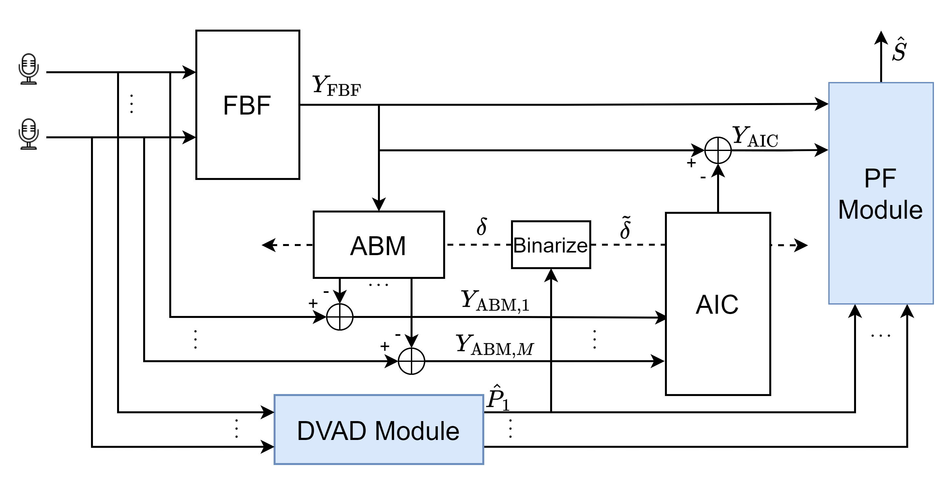
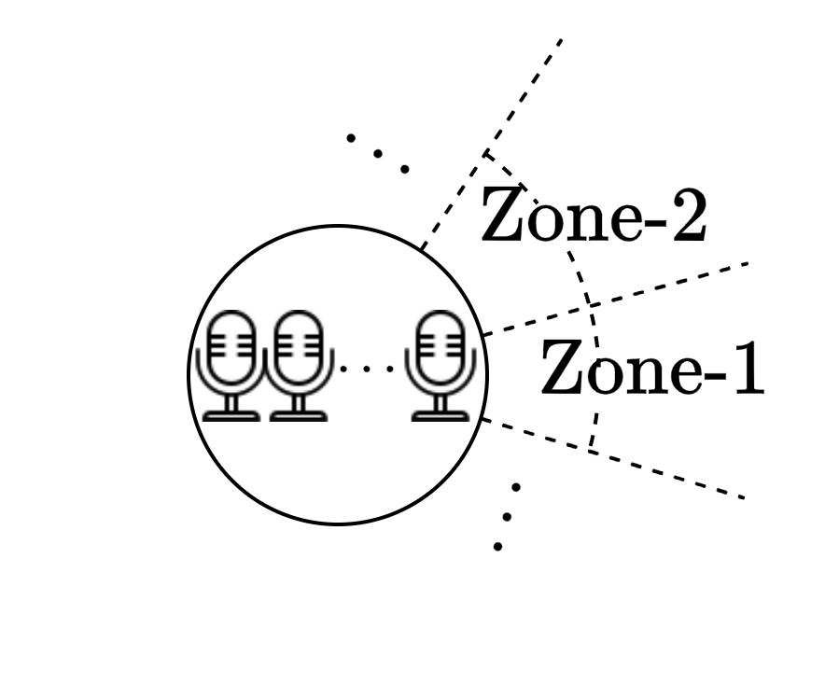
Proposed DVAD-GSC-PF System
N zones:
Structure of DVAD-GSC-PF
Notes:
For a commonly utilized planar array, the DOA of a sound source is usually defined by the azimuth with respect to the array. As illustrated in the top-left diagram, the azimuth plane can be divided into N disjointed zones. Without loss of generality, the target speaker is assumed to be known in zone-1 and competing speakers are in the other zones.
It‘s worthwhile to note that all the modules in our system process the complex spectrum of audio frame by frame, thus ensuring causality.
The directional voice activity detection module takes multichannel noisy audio as input and produces an N-dimensional estimation vector as output, denoted by P hat in the diagram. Each node in the vector represents the estimation of speaker activity in the corresponding zone.

Slide 7
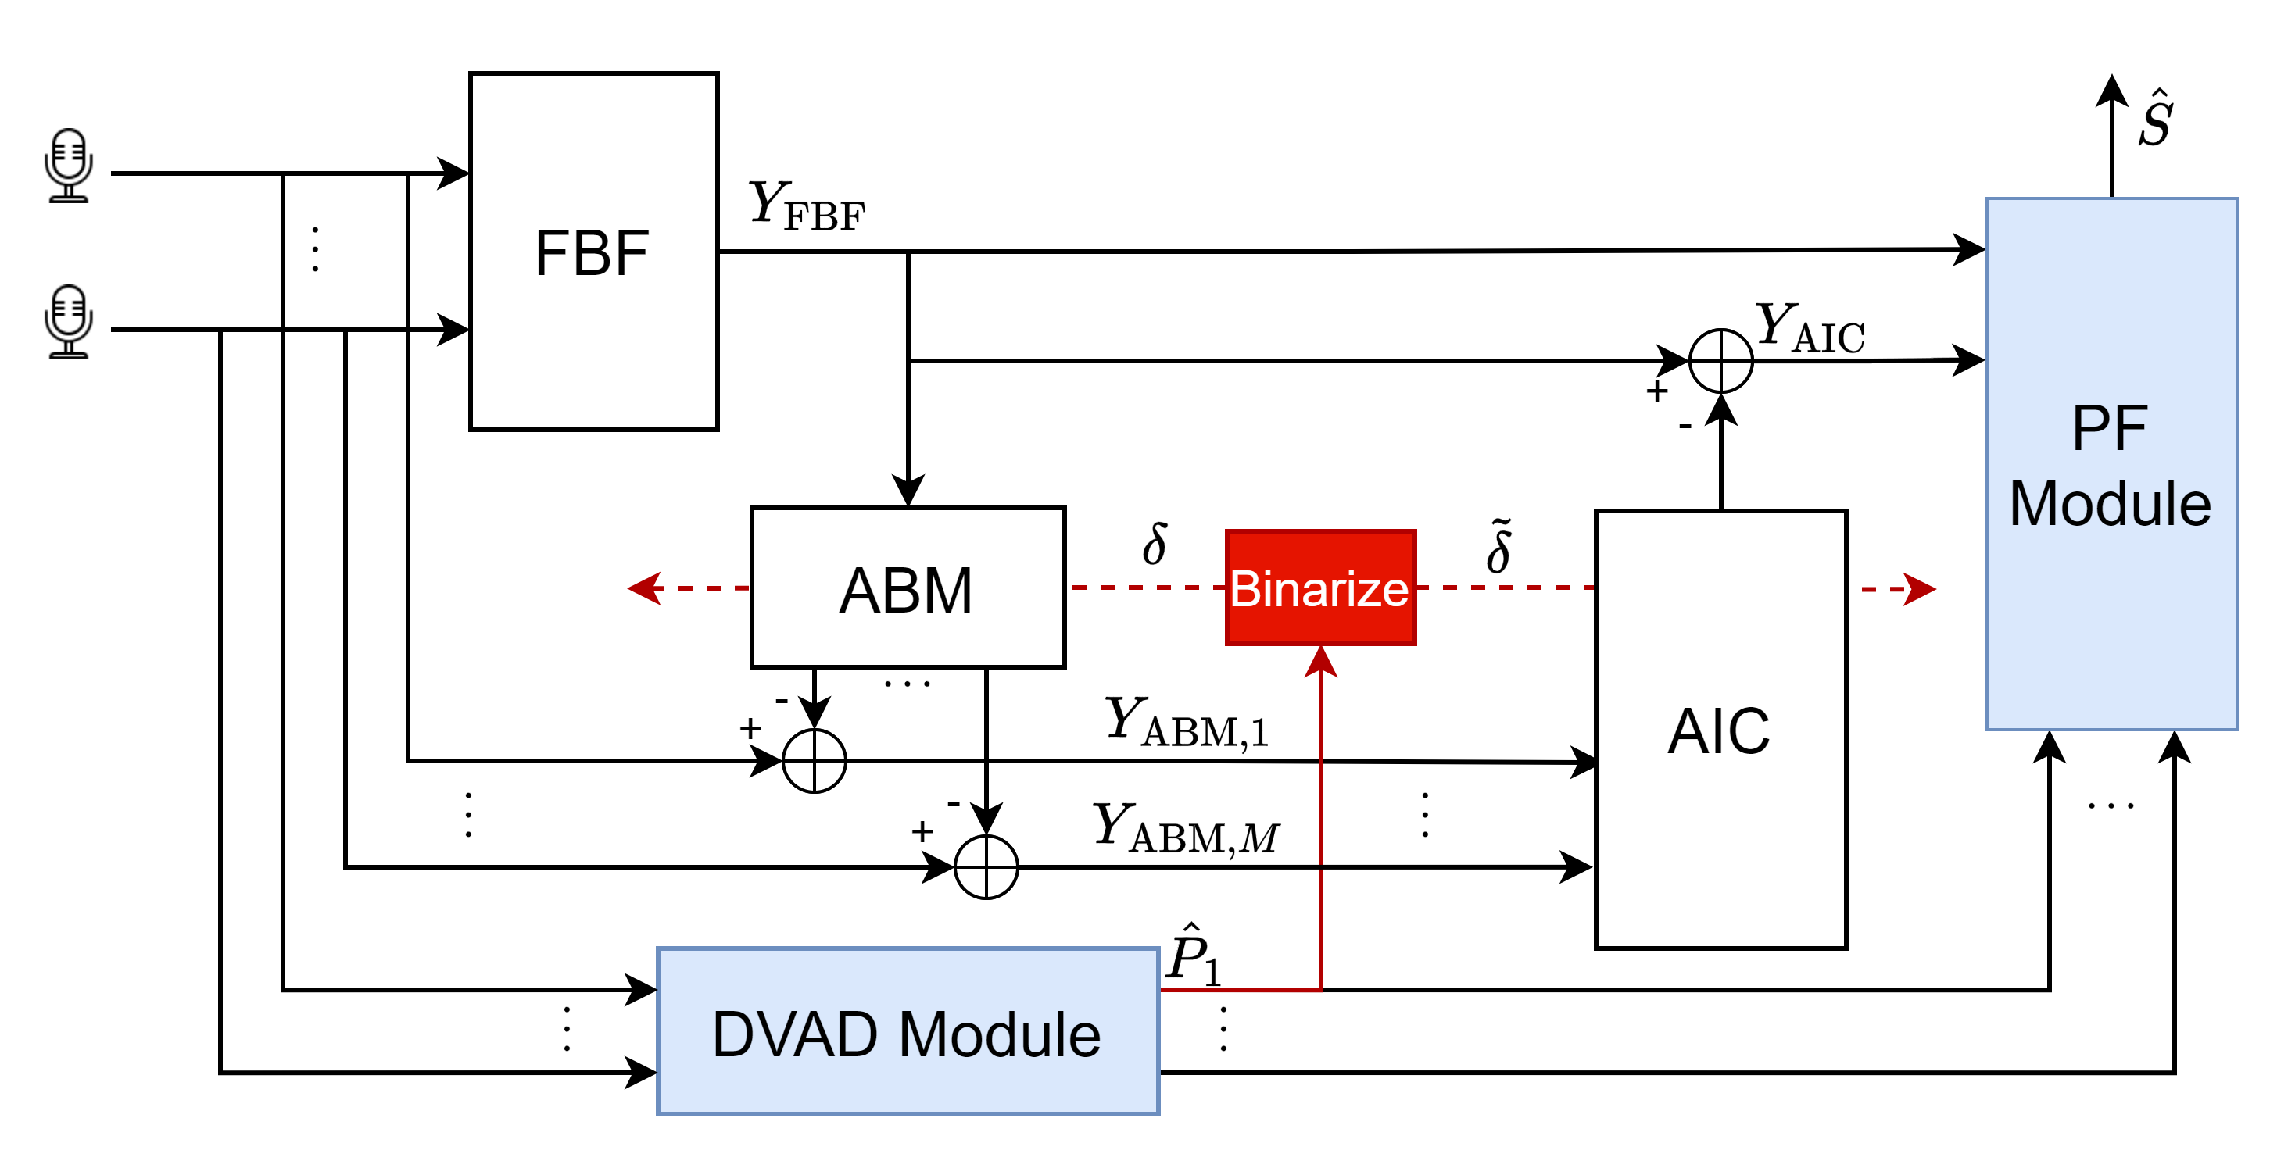
Proposed DVAD-GSC-PF System
N zones:
Binarize:
Structure of DVAD-GSC-PF
Notes:
Subsequently, P hat sub one, which corresponds to the speech activity estimated in target speaker's zone, gets binarized to yield a hard VAD label, delta, as depicted by the lower-left equation. When delta or tilde delta equals one, it means that the parameters of the ABM or AIC module should be updated.

Slide 8
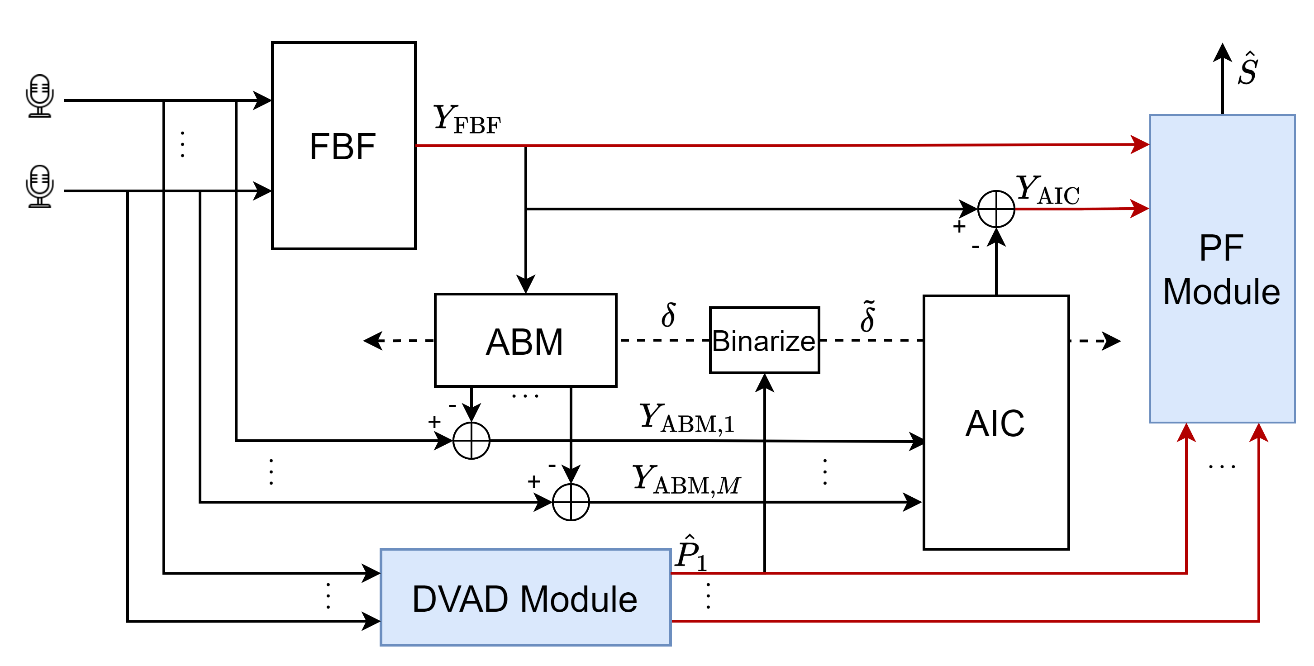
Proposed DVAD-GSC-PF System
N zones:
Binarize:
Structure of DVAD-GSC-PF
Notes:
Finally, the output of FBF and the output of the AIC are combined into a dual-channel signal, as input to the post-filter. This combination is based on the recognition that these two signals complement each other. Besides, the DVAD vector is introduced in an intermediate module to assist the post-filter identify the target speaker in overlapping speech segments.

Slide 9
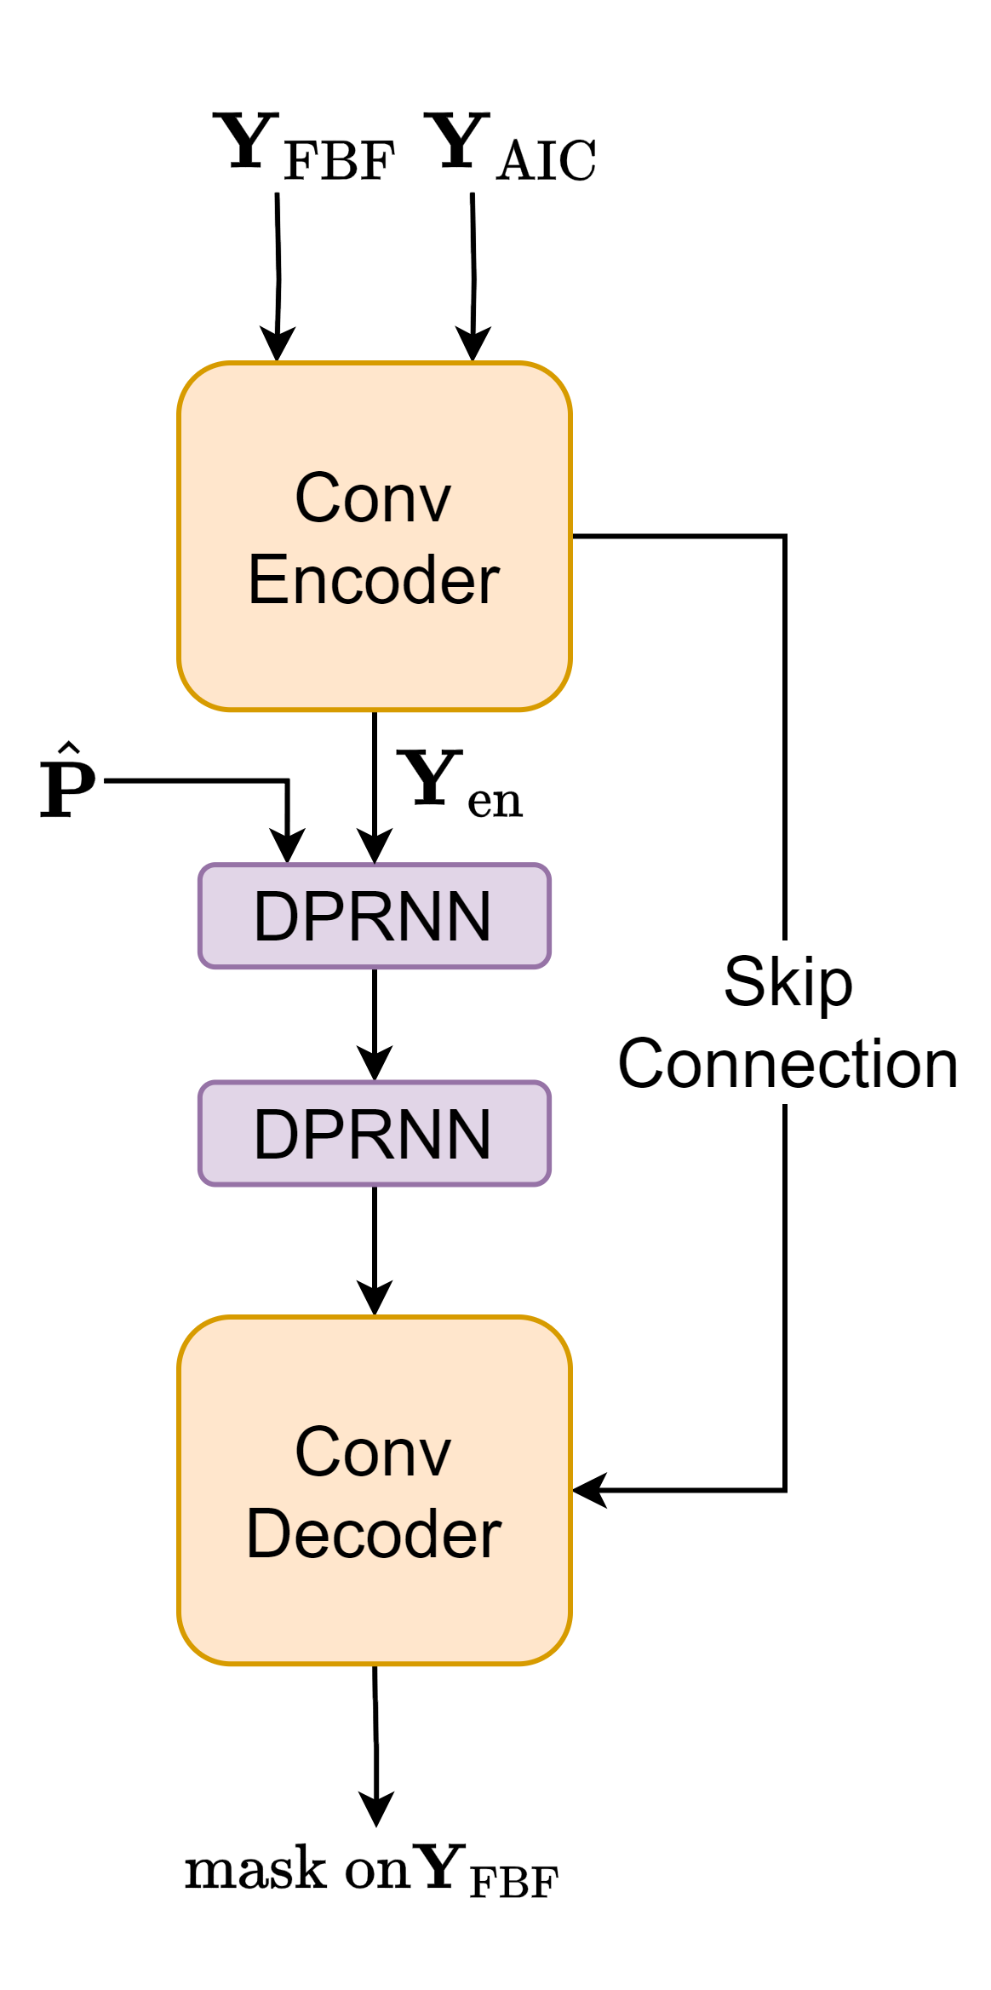
Network Architectures
DPCRN [2]
Structure of DVAD Module
Structure of PF Module
[2] Le, X., Chen, H., Chen, K., Lu, J. (2021) DPCRN: Dual-Path Convolution Recurrent Network for Single Channel Speech Enhancement. Proc. Interspeech 2021.
Notes:
Inspired by the research on sound event detection and sound source localization, we have modified the classic convolutional recurrent neural network which is referred to as CRN, to perform DVAD estimation. The feature extractor plays a crucial role in this task as it needs to exploit both frequency and spatial information. Among numerous variants of features, we have discovered through experiments that, combining linear-frequency log-power spectrograms with sin inter-channel phase differences leads to best performance in DVAD estimation.
As for the post-filter module, it's constructed upon the previous work of our research group, dual-path CRN, which is a lightweight neural network with outstanding performance on monaural speech enhancement. Different from the original setup, the DPCRN we used operates on dual-channel input, and the soft DVAD estimation vector is concatenated with the encoder output along the channel axis. The decoder generates the complex ratio mask, to be multiplied with the fixed beamformer output.

Slide 10
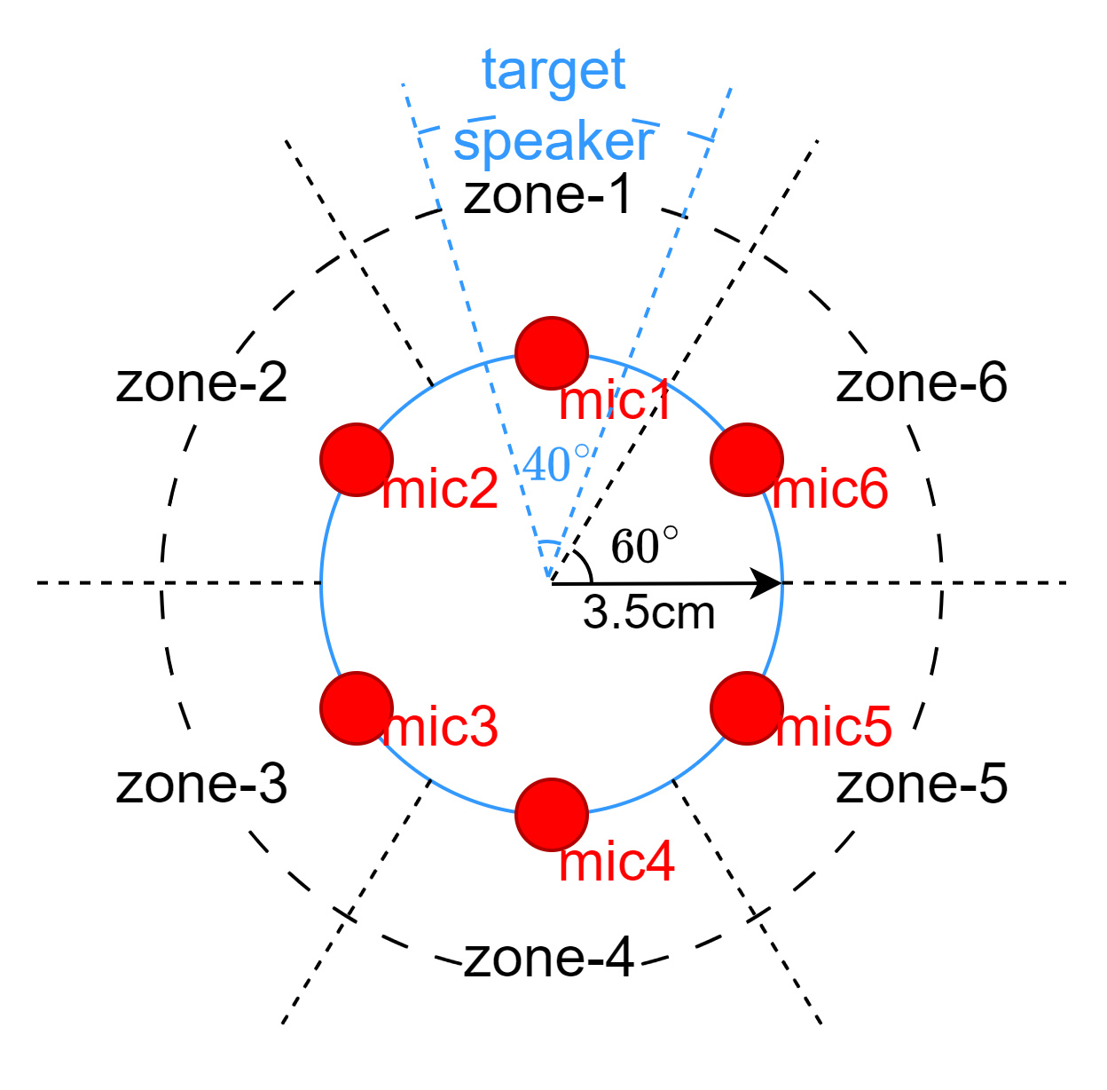
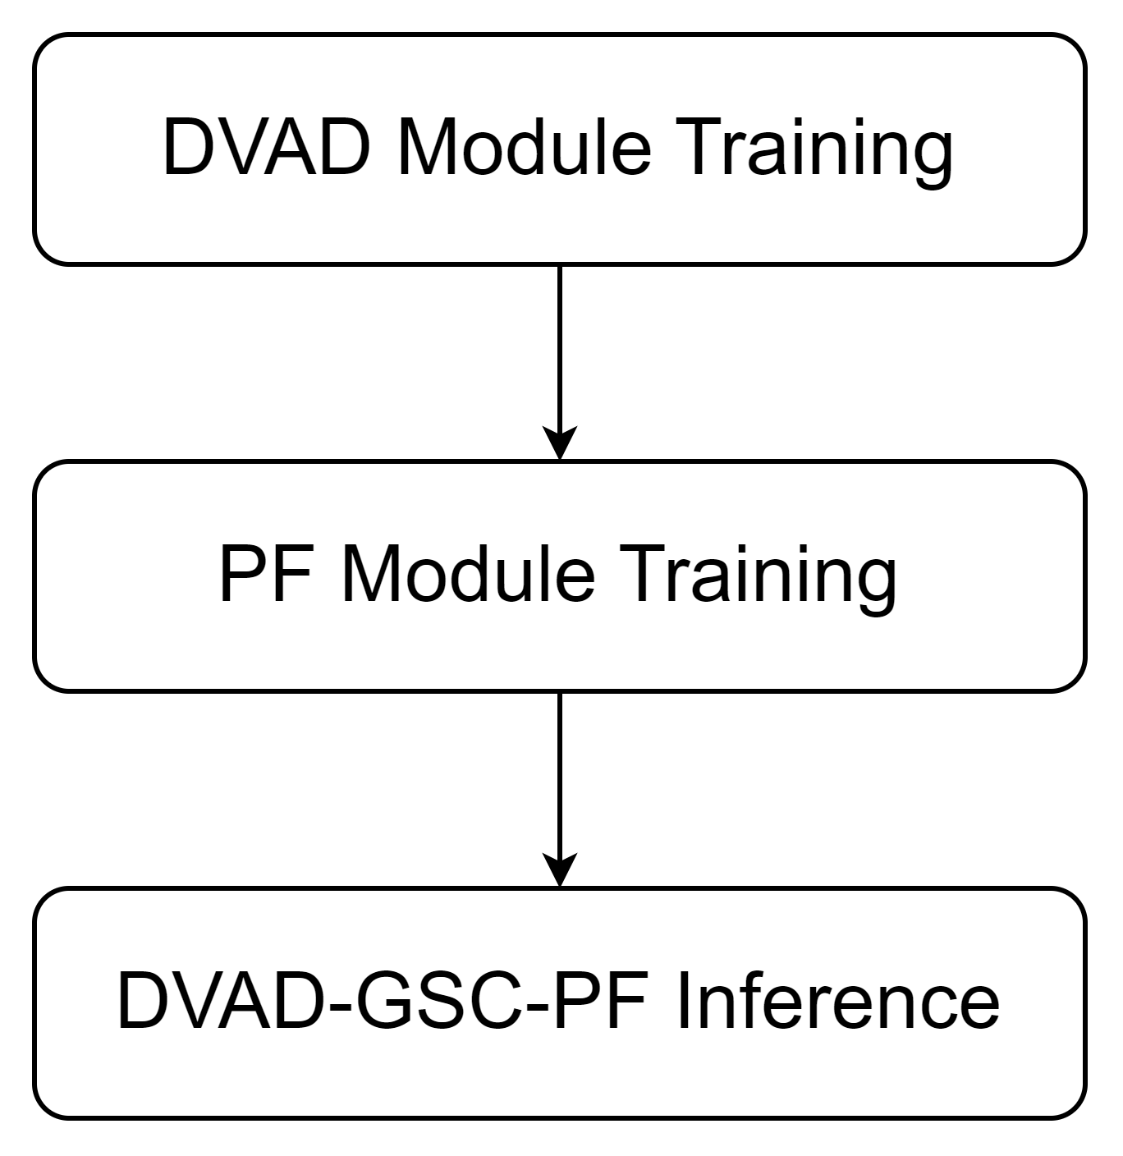
Experimental Setup
Training and inference procedures:
Array and Zone Configuration
Notes:
In our experimental setup, we utilize a uniform six-microphone circular array with a radius of three point five centimeters. As depicted in the illustration, the horizontal plane is evenly divided into six zones. Each zone covers a sixty-degree-span area. As mentioned above, zone-1 is designated as the target zone, encompassing an azimuthal range from minus thirty to thirty degrees relative to the first channel. Considering real-world scenarios, the target speaker is positioned within the range of minus twenty to twenty degrees, to ensure the absence of interfering speakers within a specified range. As indicated by the blue dashed line, here we set the range to ten degrees.
Regarding the training datasets, clean speech from multi speakers is mixed together with noise to generate multichannel noisy audio received by the microphone array. Due to the non-differentiability of the generalized sidelobe canceller, the DVAD module and the PF module are trained separately. Two training datasets are created using the same source speech and noise data.

Slide 11
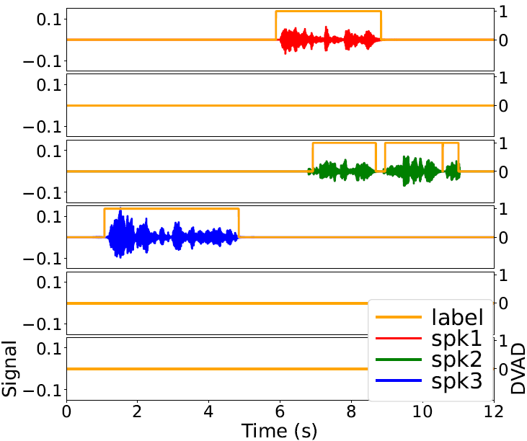
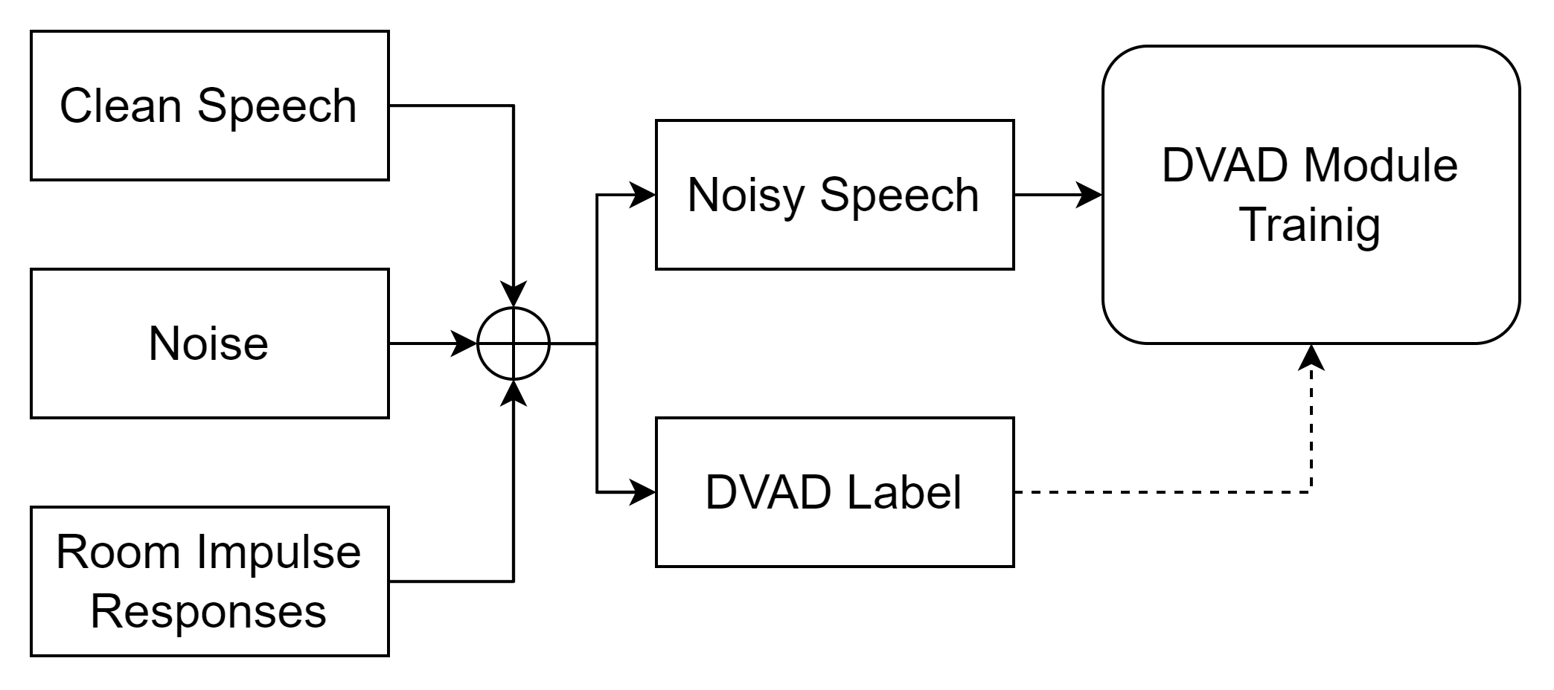
DVAD Module Training
One to three speakers.
Uniformly sampled DOAs.
DVAD label with 3 speakers at
Notes:
In the training samples for the DVAD module, the azimuths of speakers are uniformly sampled. The ground-truth VAD labels for multiple speakers are obtained by applying a signal processing-based VAD algorithm called robust VAD, to reverberant speech from each speaker before mixing. Subsequently, the VAD labels are converted into directional ones. An example of the DVAD label is shown in the figure on the right.

Slide 12
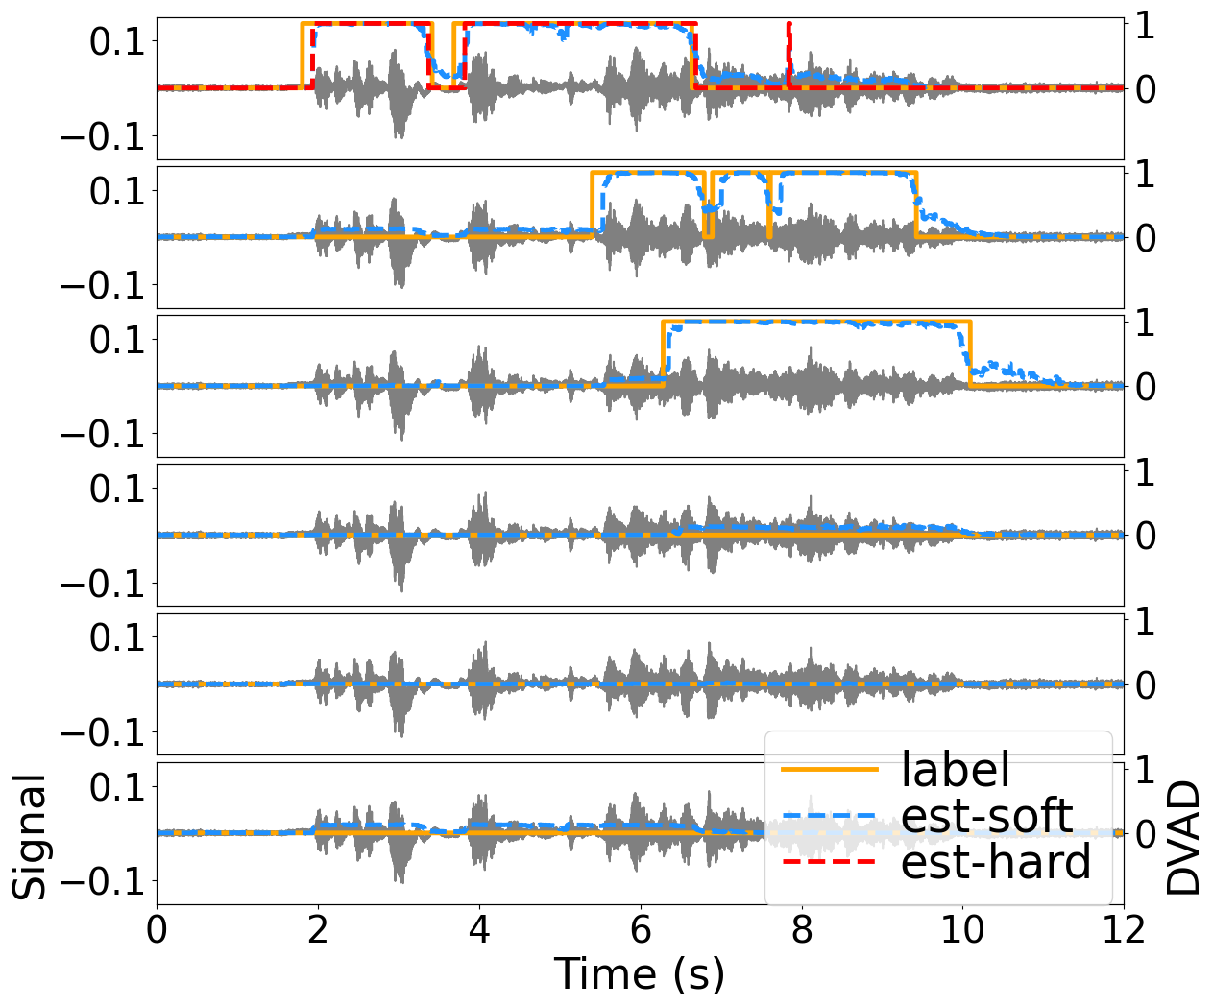
DVAD Module Training
Evaluation results:
Prec | Recall
0.94 | 0.95
DVAD estimation with one target speaker and two interferers
Notes:
When evaluated on the test set, the DVAD module achieves performance with a precision of ninety-four percent and a recall rate of ninety-five percent. An example from the test set is provided here.

Slide 13
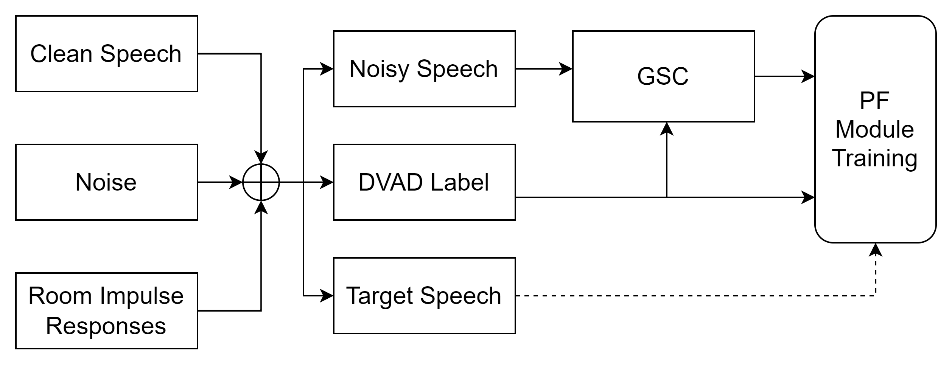
PF Module Training
One target speaker in zone-1.
Zero to two competing speakers outside zone-1.
Notes:
In contrast to the DVAD training dataset, the samples for the PF module must include a target speaker set in zone-1, with competing speakers restricted outside zone-1. During training, the output signals from the generalized sidelobe canceller are guided by the ground-truth DVAD labels. And in the inference stage, the estimated signals and DVAD vectors will be used.

Slide 14
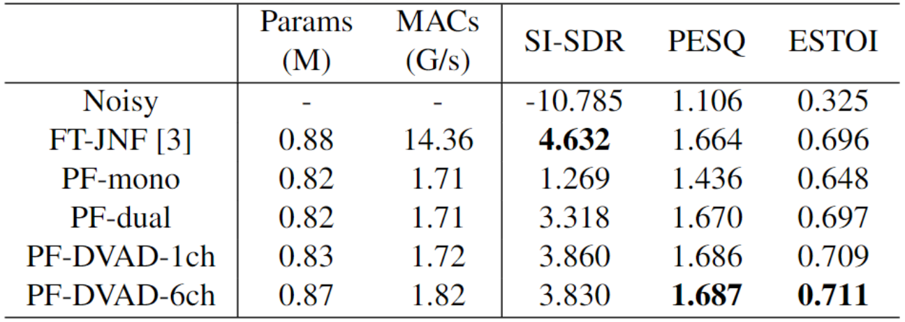
Evaluation Results on Simulated Data
Objective Results on the Simulated Test Set
[3] Tesch K, Gerkmann T. Insights into deep non-linear filters for improved multi-channel speech enhancement[J]. IEEE/ACM Transactions on Audio, Speech, and Language Processing, 2022.
Notes:
At last, I'll present the evaluation results. The table displays the objective scores on the simulated test set. We assess four types of post-filters with different input features to validate the design of the proposed system. The meanings of the four types have been listed.
From the table, it is evident that the introduction of FBF output and DVAD information progressively enhances the post-filter’s performance. With the inclusion of FBF output, speech distortion caused by the GSC can be effectively compensated for, which leads to significant improvements across all objective metrics.
We also compare our system with an end-to-end approach called FT-JNF. This paper comprehensively summarized multi-channel nonlinear speech enhancement paradigms and proposed a SOTA model. On simulated data, PF-dual outperforms FT-JNF in terms of PESQ and ESTOI scores. With the assistance of DVAD, better performance can be achieved by PF-DVAD-1ch and PF-DVAD-6ch. As a consequence, our method achieves similar objective scores while reducing computational cost by nearly ninety percent. The parameters and computational load counted here encompass all the modules in our system.

Slide 15
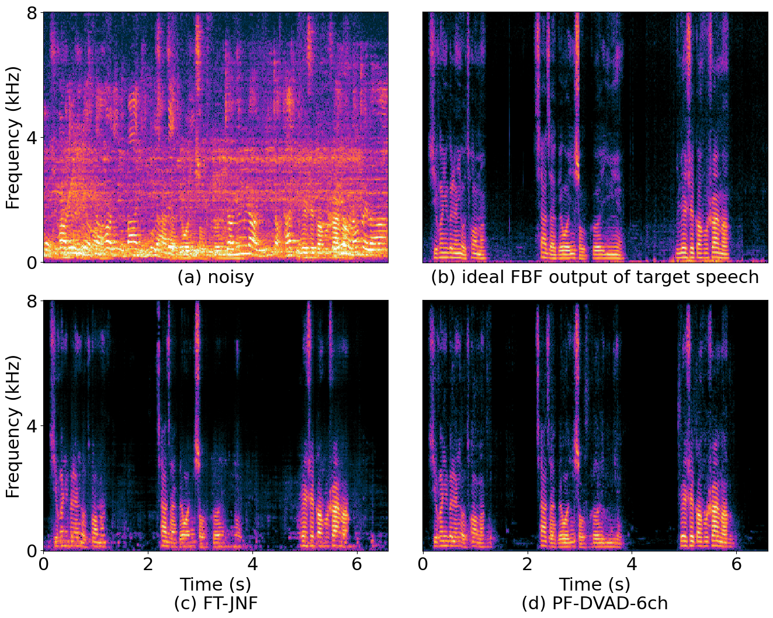
Evaluation Results on Real-world Data
Subjective Results on the Simulated/Real-world Test Set
[2]
[3] Tesch K, Gerkmann T. Insights into deep non-linear filters for improved multi-channel speech enhancement[J]. IEEE/ACM Transactions on Audio, Speech, and Language Processing, 2022.
Notes:
Additionally, we recorded real-world noisy test data in a small conference room using a microphone array identical to the simulated setup. This was done to evaluate the performance of models in unseen environments.
The table displays the subjective scores, DNSMOS, obtained on both the simulated and real-world test set. It should be noted that the DNSMOS tool is not suitable for evaluating the quality of target speech in an unprocessed multi-speaker recording. Therefore, the metrics of noisy speech are not included.
The three models achieve similar scores on the simulated test set, with FT-JNF slightly leading in SIG and OVRL scores. However, the impact of introducing complete DVAD is evident when evaluating DNSMOS on real-world data. PF-DVAD-6ch significantly outperforms FT-JNF and PF-DVAD-1ch, especially in terms of the SIG score. It suggests that, the comprehensive DVAD, which provides activity distribution of all speakers, results in less spatial information loss during post-filtering. As a result, extraction of the target speech becomes more robust.
An audio sample is provided. (play audio) The four subplots are labeled as follows: noisy speech, ideal fixed beamformer output of target speech, output of FT-JNF, and output of PF-DVAD-6ch. We can see that, in the enhanced result by PF-DVAD-6ch, noise is more effectively suppressed in non-speech segments, while significantly more speech components are preserved.

Slide 16
Q & A
Thanks for your attention
Notes:
Thanks for your attention. If you have any questions, please feel free to reach out.

