Slide 1
AUDIO-VISUAL ACTIVE SPEAKER EXTRACTION FOR SPARSELY OVERLAPPED MULTI-TALKER SPEECH
Junjie Li, Ruijie Tao, Zexu Pan, Meng Ge, Shuai Wang, Haizhou Li
Apr 2024

Slide 2
Introduction
Audio-visual Target Speaker Extraction
Sparsely-overlapped Speech
Previous TSE works primarily focus on highly overlapped speech, which has an overlapping ratio of nearly 100%.
However, in real-world situations, the overlapping ratio can be less than 20% in meetings^{[1]}.
[1] Analysis of overlaps in meetings by ¨ dialog factors, hot spots, speakers, and collection site: Insights for automatic speech recognition

Slide 3
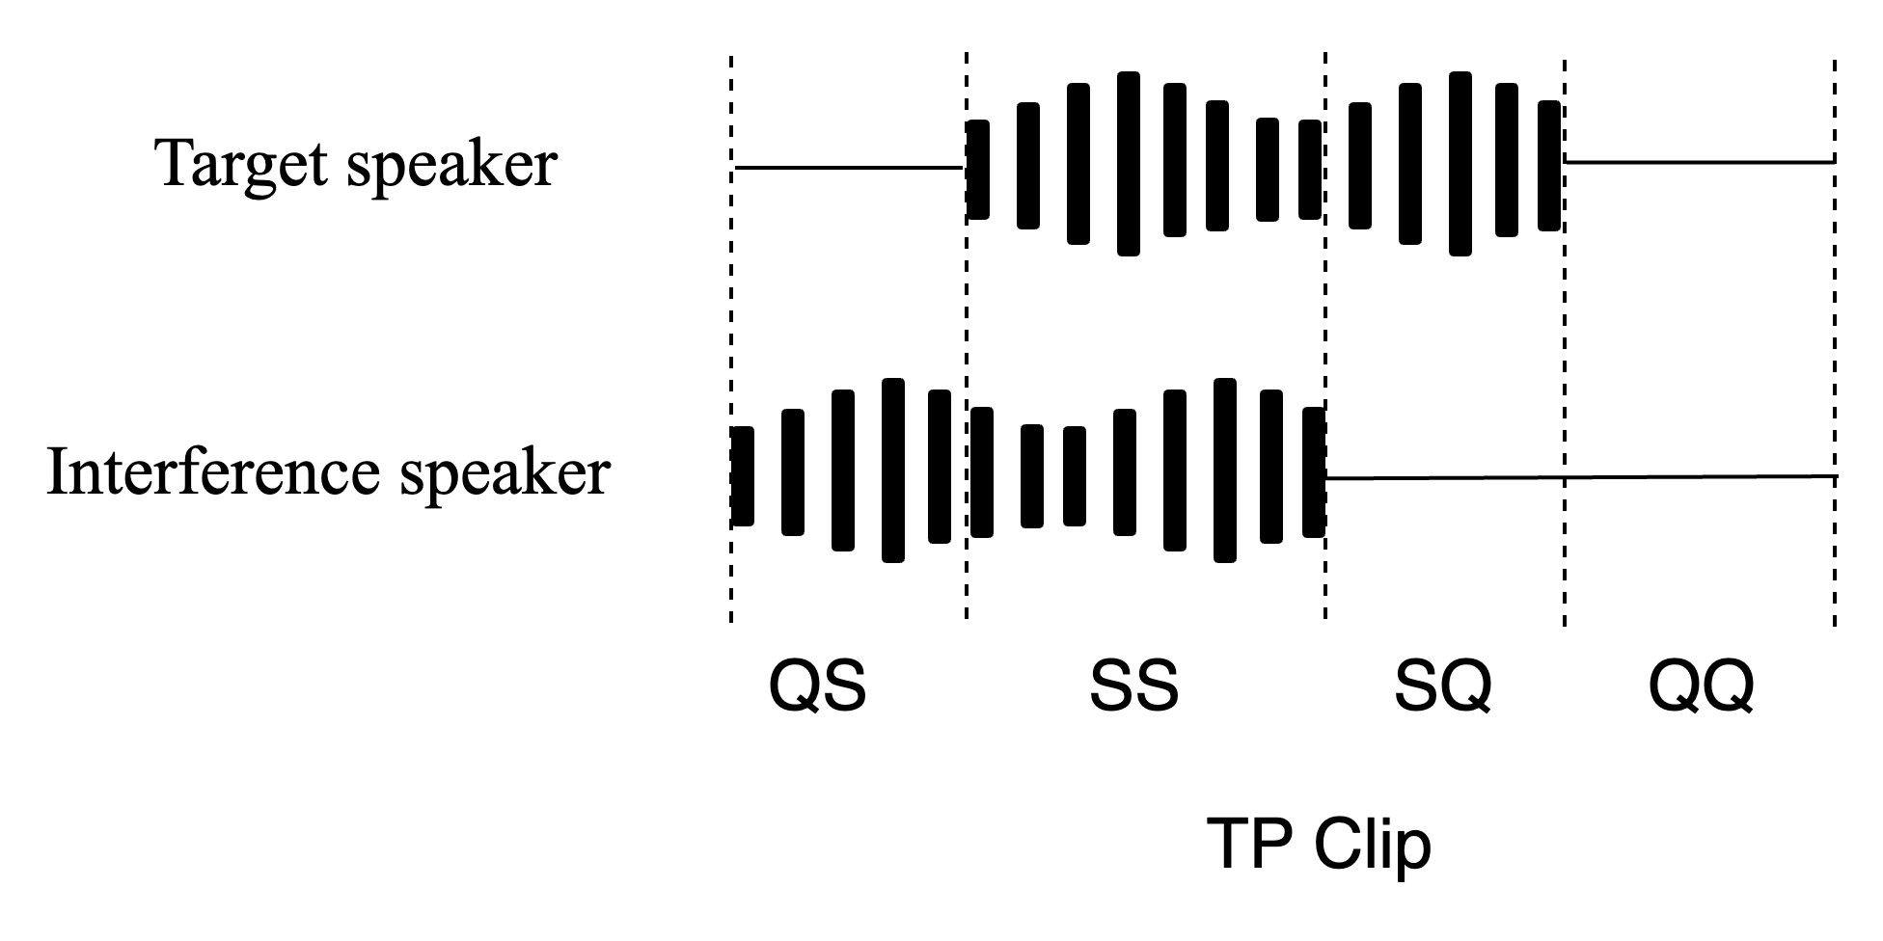
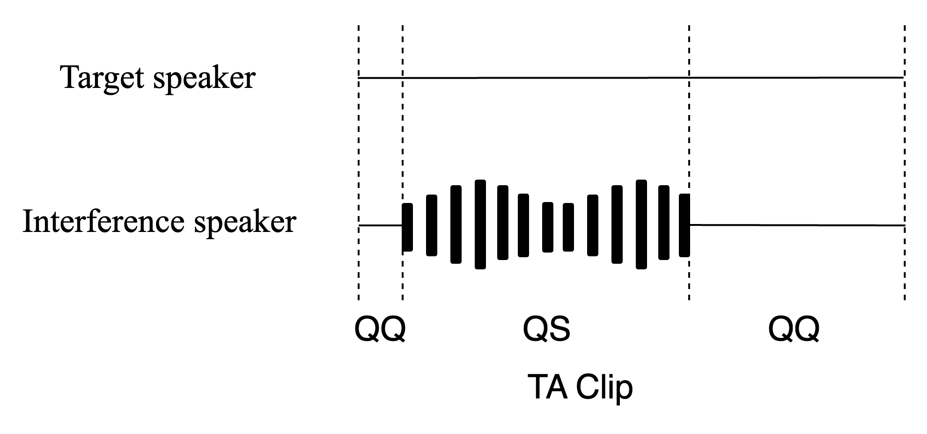
Sparsely overlapped speech
Target Absent (TA) refers to a scenario where the target speaker keeps quiet throughout the conversation.
Target Present (TP) indicates that the target speech is present in the mixture.
QQ : a scenario where both target and interference speakers are Quiet.
SQ : a scenario of Speaking target speaker and Quiet interference speaker.
QS : denotes Quiet target speaker and Speaking interference speaker.
SS: denotes both target and interference speakers are Speaking.

Slide 4
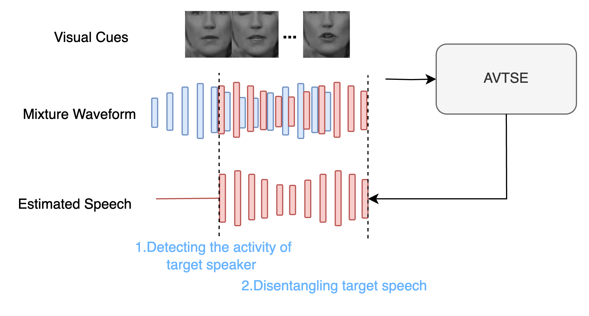
The role of visual cues in Sparsely overlapped scenarios
Detect whether the target speaker is activity.
1. If the target speaker is inactive, the AVTSE model outputs silent signal.
2. If the target speaker is active, the AVTSE model should disentangle target speech from mixture.

Slide 5
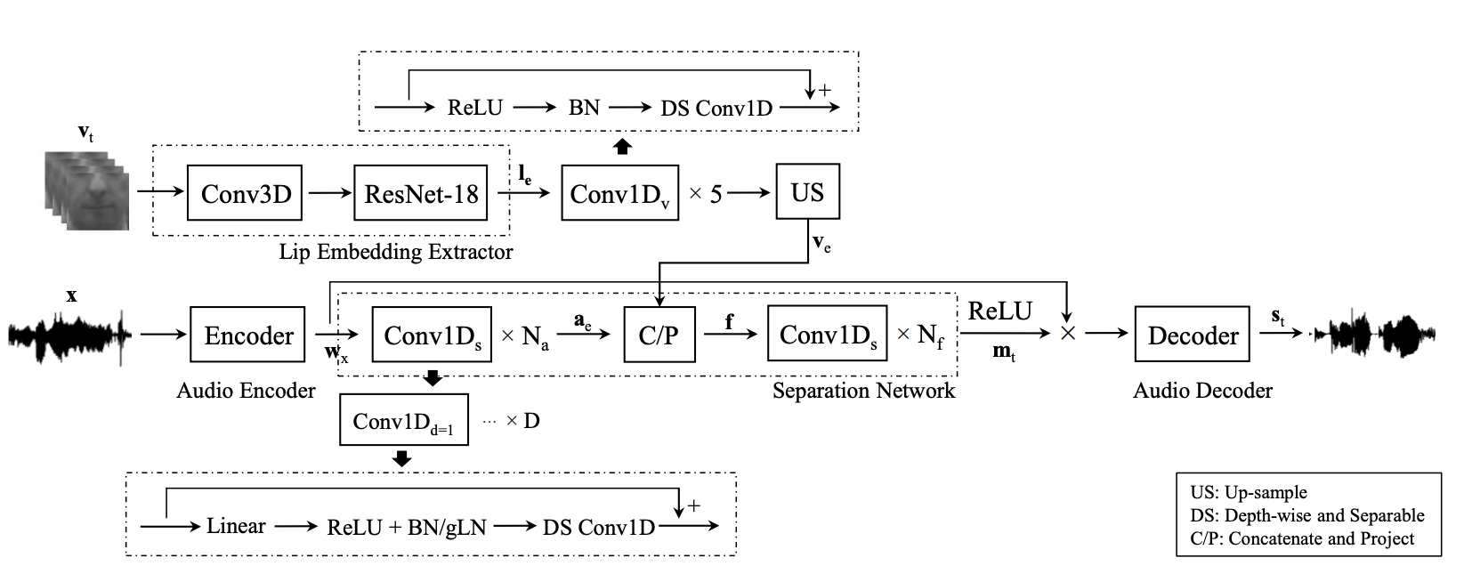
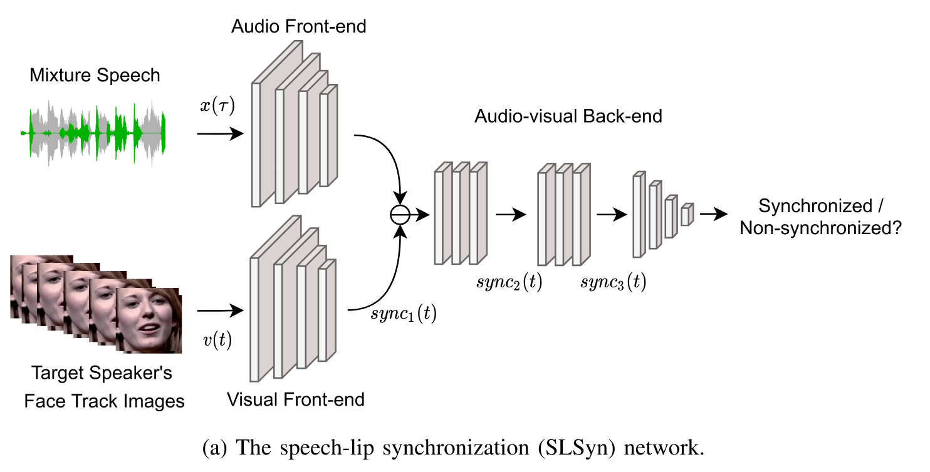
Related works
1. Pretrained from lipreading^{[1]}
2. Pretrained from speech-lip synchronization^{[2]}
Drawbacks:
Previous pretrained visual encoders only consider active speaker case.
If the target speaker is silent, they are not able to distinguish speech and non-speech segment.
[2] Wu, Jian, et al. "Time domain audio visual speech separation." 2019 IEEE automatic speech recognition and understanding workshop (ASRU). IEEE, 2019.
[3] Pan, Zexu, et al. "Selective listening by synchronizing speech with lips." IEEE/ACM Transactions on Audio, Speech, and Language Processing 30 (2022): 1650-1664.

Slide 6
Method
We propose to use ASD^{[4]} (Activate Speaker Detection) model as visual frontend.
ASD is used to determine whether that target speaker is speaking.
Assisted by this speaking activity information^{[5]}, AVTSE is able to extract the target speech.
[4] R. Tao, Z. Pan, R. K. Das, X. Qian, M. Z. Shou, and H. Li, “Is Someone Speaking? Exploring Long-term Temporal Features for Audio-visual Active Speaker Detection,” in Proc. ACM Multimedia, 2021.
[5] M. Delcroix, K. Zmolikova, T. Ochiai, K. Kinoshita, and T. Nakatani, “Speaker activity driven neural speech extraction,” in Proc. ICASSP. IEEE, 2021.

Slide 7
Experiments
Dataset
Highly overlapped speech dataset: Voxceleb-2Mix
Sparsely overlapped speech dataset: IEMOCAP-2Mix
Training procedure
Train ASD module
Train separation module on Voxceleb-2Mix
Finetune separation module on IEMOCAP-2Mix

Slide 8
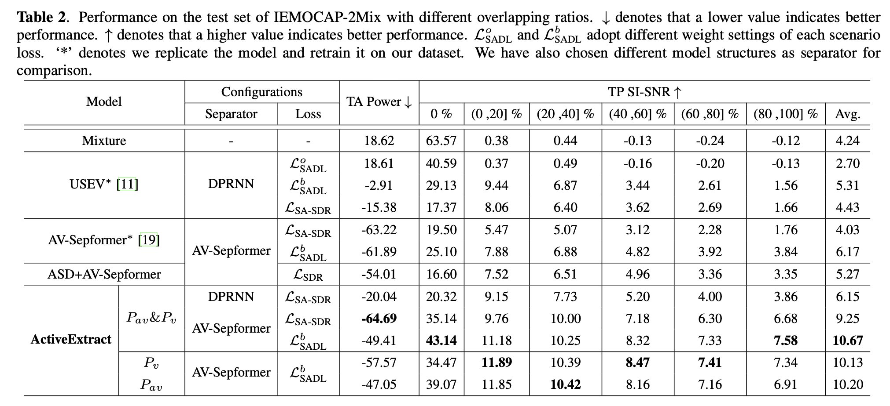
Results

Slide 9
Demo
Fully-overlapped

Slide 10
Demo
Conversation
(Sparsely overlapped)

Slide 11
Demo
Single Speaker Speaking

Slide 12
Thank you
If you are interested, you could find more from the link below.

