Slide 1
AUDIO-VISUAL PERSON RECOGNITION IN MULTIMEDIA DATA FROM THE IARPA JANUS PROGRAM
Gregory Sell, Kevin Duh, David Snyder, Dave Etter, Daniel Garcia-Romero
Human Language Technology Center of Excellence
The Johns Hopkins University, Baltimore, MD, USA

Slide 2
Active research in video
Area of interest in face recognition for years
YouTube Celebrities
YouTube Trailers
TV/Movies (Buffy, GoT, Hannah and Her Sisters)
IARPA Janus
Recent speaker recognition corpora from videos
Speakers in the Wild (SITW)
VoxCeleb
Multimodal data is hard to find

Slide 3
Possible multimedia corpora
YouTube Trailers, Buffy, GoT, Hannah and Her Sisters, …
Pro: Labeled with audio and visual
Con: Not many people
Con: Professional production (multiple cameras, dubbing, …)
VoxCeleb
Pro: Many people with many videos
Con: Videos selected based on face recognition (Biased)
Google public speakers
Pro: 1,111 labeled videos of public speakers
Con: Only 74 speakers with multiple videos

Slide 4
IARPA Janus ijb-b
Face recognition in challenging conditions
Diverse environments and wide range of orientations
Still images and videos
Typically use key frames, but distributed with full videos
7,011 videos for 1,845 IDs
Distributed by NIST
Could be good as multimodal, but needs voice labels

Slide 5
Trimming ijb-b to multimedia
7,012 videos for 1,845 IDs
HAS AUDIO
2,312 videos for 674 IDs
But, still don’t know if person is speaking

Slide 6
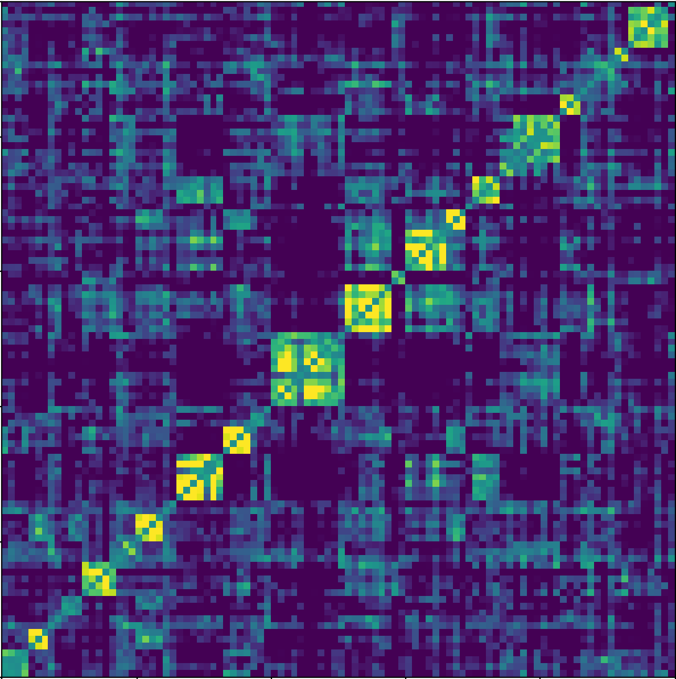
is labeled face the speaker?
Check manually
Compute full set of speaker scores
Sort by face label
Find videos with anomalous scores
Manually check label
Select enrollment data
List all speakers with multiple videos
Select video to use for model (manual)
Label 5 seconds with correct voice
Already have frames with face
Similar to Assist in SITW

Slide 7
Trimming ijb-b to multimedia
7,012 videos for 1,845 IDs
HAS AUDIO
2,312 videos for 674 IDs
Janus Multimedia FULL
ASSISTED SCREENING
1,593 videos for 597 IDs
Janus Multimedia CORE

Slide 8
Janus multimedia statistics
CORE has both face and voice
FULL has face and might have voice
Differ only in test data (same enroll)
CORE is subset of FULL
No overlap between dev and eval

Slide 9
Multimodal person recognition
Speaker Recognition Systems
I-vectors learned on Fisher (8kHz, MFCCs)
X-vectors learned on SRE + Mixer-6 (+ augmentations)
PLDA learned on SRE + Mixer-6 (+ augmentations)
Face Recognition System
Detection with Multi-task Cascaded Convolutional Net
FaceNet trained on subset of MS-Celeb-1M
One frame per second, use max score in video
Fusion
Scores calibrated on held-out set
Fused with simple summation

Slide 10
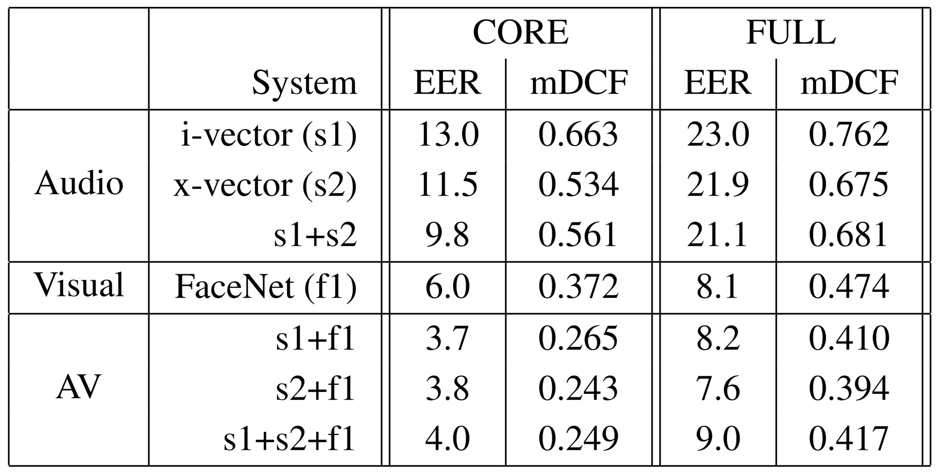
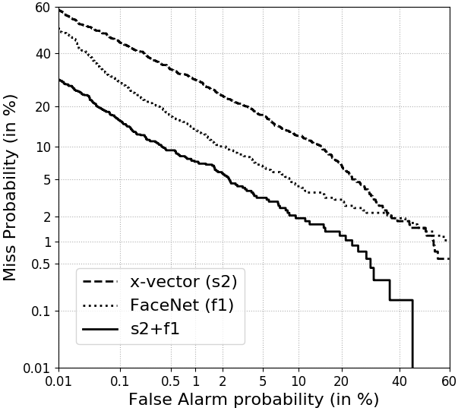
Multimodal person recognition

Slide 11
Multimodal person recognition
1. Face more effective than speaker here

Slide 12
Multimodal person recognition
2. Major improvements from multimodality

Slide 13
Multimodal person recognition
3. Big gap between sets (and no fusion gain)

Slide 14
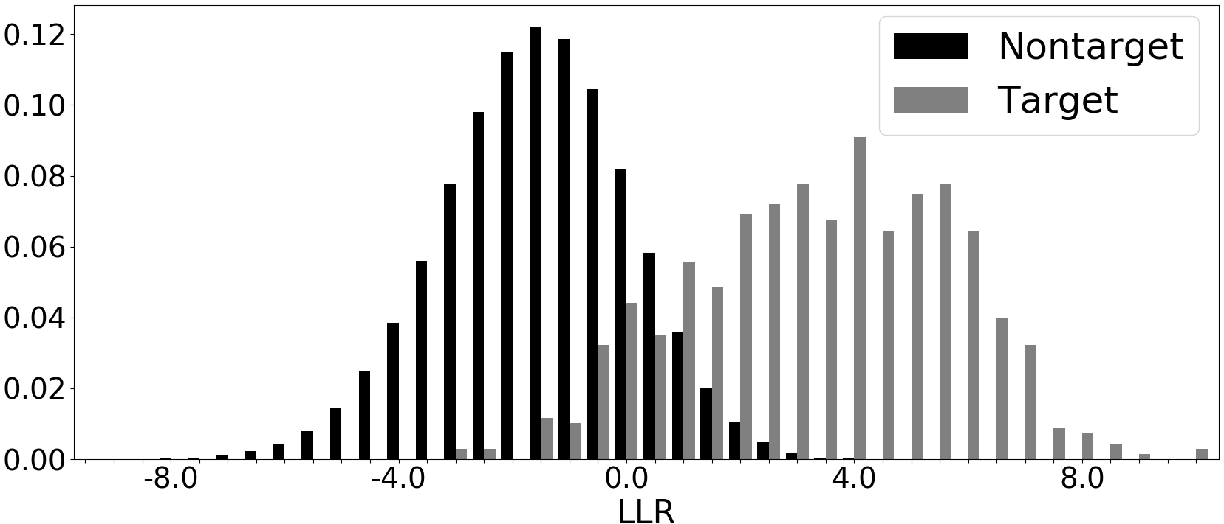
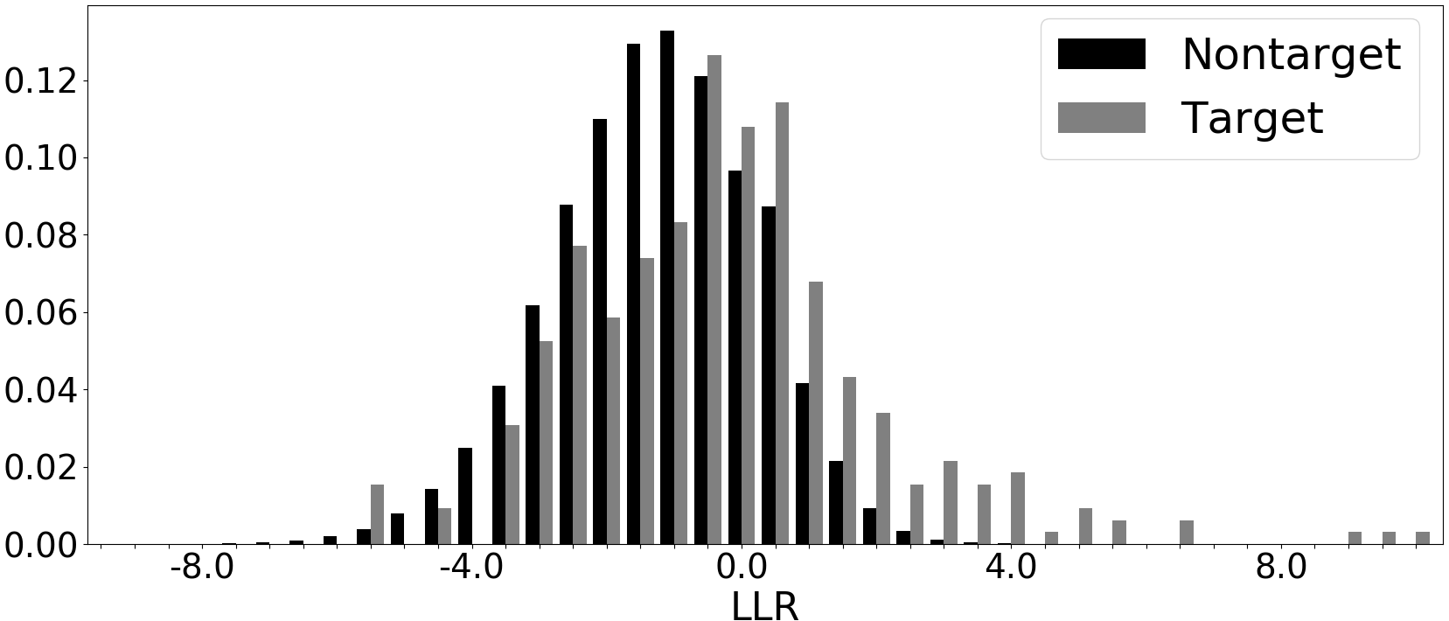
full set fusion
Fusion strategy assumes both modes drawn from same label
CORE speaker scores
FULL\CORE speaker scores
Voice often not present, so scores are misleading
FULL set a good platform for future A/V fusion research

Slide 15
conclusions
Added speaker labels to subset of Janus videos
Called Janus Multimedia
Distributed through NIST (URL in paper)
Demonstrated value of multimodal recognition
Big improvements over face or speaker alone
Showed need for smarter fusion if face/voice disagree
Plenty of other remaining opportunities
Multimodal diarization
OCR of text in video

