Slide 1
SSPP-DAN: Deep Domain Adaptation Network for Face Recognition with Single Sample Per Person
2017 IEEE International Conference on Image Processing
Sungeun Hong, Woobin Im, Jongbin Ryu, Hyun S. Yang
AIM Lab, , South Korea

Slide 2
Contents
Motivation & Problem Definition
Single sample per person (SSPP)
Challenges in real-world face recognition
Proposed method
Domain adaptation
Face synthesis
Experiments
New heterogeneous dataset
LFW for SSPP

Slide 3
Motivation & Problem Definition

Slide 4
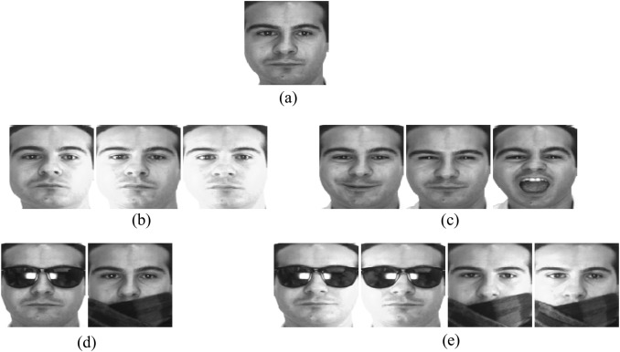
SSPP face recognition
Face recognition using Single Sample Per Person (SSPP)
Identify or verify identities using only one single gallery image
Related to the recently attracted one-shot learning
Train (on single gallery)
Test (on probe images)
Illumination
Expression
Disguise
Multiple
Sample images of the AR database

Slide 5
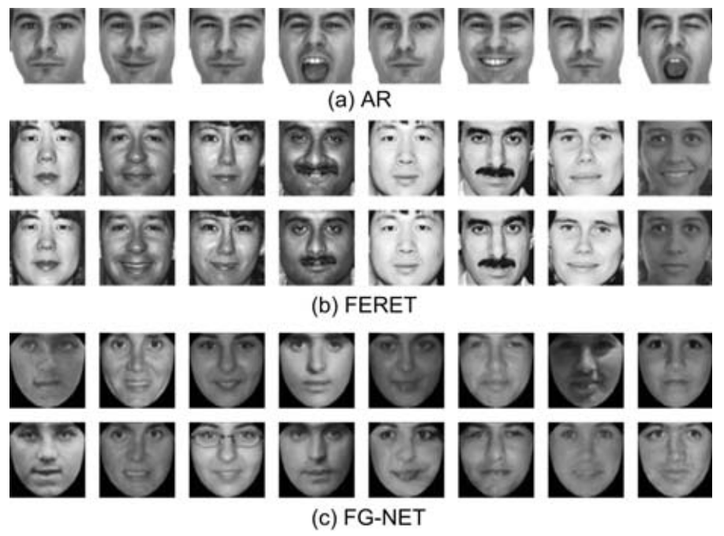
SSPP face recognition
Limitations of existing SSPP datasets
Lab controlled environment
Consistent shooting environment
Gallery (train)
Probe (test)
Lu, Jiwen, Yap-Peng Tan, and Gang Wang. "Discriminative multimanifold analysis for face recognition from a single training sample per person." IEEE transactions on pattern analysis and machine intelligence 35.1 (2013): 39-51.

Slide 6
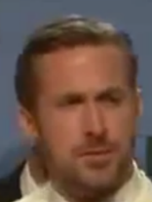
Real-world SSPP Face recognition
Identification (Probe)
Registration (Gallery)
Gallery
A stable image like clear frontal mugshot
e.g., ID card or e-passport
Probe
Unstable images including non-trivial variations
e.g., surveillance camera, web images
Variations:
camera sensor, blur, noise, pose, illumination

Slide 7
Real-world SSPP Face recognition
Registration (Gallery)
Identification (Probe)
Challenges
Heterogeneity of the shooting environments
Gallery: stable environment
Probe: highly unstable environment
Shortage of training samples
Only one training sample per person is available

Slide 8
Proposed method

Slide 9
Real-world SSPP Face recognition
Registration (Gallery)
Identification (Probe)
Gap
Challenges
Heterogeneity of the shooting environments
Gallery: stable environment
Probe: highly unstable environment

Slide 10
Real-world SSPP Face recognition
Registration (Gallery)
Identification (Probe)
Domain
Adaptation
Challenges
Heterogeneity of the shooting environments
Gallery: stable environment
Probe: highly unstable environment

Slide 11
Domain Adaptation (DA)
Adjust a model to a different target domain distribution starting from the source domain knowledge
Source domain
Target domain
With labels
Without labels
Notes:
I’ll briefly explain about domain adaptation.
In domain adaptation, we need two domains: so-called source and target domain.
The reason we do domain adaptation is that target domain has no ground-truth labels, but shares context with source domain.

Slide 12
Domain Adaptation (DA)
Adjust a model to a different target domain distribution starting from the source domain knowledge
Source domain w/ label
Notes:
Here we have a source domain with labels.

Slide 13
Domain Adaptation (DA)
Adjust a model to a different target domain distribution starting from the source domain knowledge
Source domain w/ label
Model

Slide 14
Domain Adaptation (DA)
Adjust a model to a different target domain distribution starting from the source domain knowledge
Source domain w/ label
Model
Fine
classification
Notes:
Then we can train a model to produce fine classification result.

Slide 15
Domain Adaptation (DA)
Adjust a model to a different target domain distribution starting from the source domain knowledge
Target
domain
w/o label
Model
Worse result
fine
classification
Notes:
But, if we directly feed target data to this model, it would produce worse result, because model haven’t learned such kind of data.

Slide 16
Domain Adaptation (DA)
Adjust a model to a different target domain distribution starting from the source domain knowledge
Source domain w/ label
Model
Fine
classification

Slide 17
Domain Adaptation (DA)
Adjust a model to a different target domain distribution starting from the source domain knowledge
Source domain w/ label
Model
Domain Adaptation
Model
Fine
classification
Distribution matching happens
Notes:
Here domain adaptation happens with some distribution matching process…

Slide 18
Domain Adaptation (DA)
Adjust a model to a different target domain distribution starting from the source domain knowledge
Source domain w/ label
Target
domain
w/o label
Model
Domain Adaptation
Model
Fine
classification
Better
result
Notes:
Then it would produce better result on target domain, even the model was only supervised with source domain data.

Slide 19
Domain Adaptation (DA)
Purpose | Train |  | Test
Domain | Source | Target | Target
Image condition | Stable | Unstable | Unstable
Label | O | X | -
Source domain w/ label
Target
domain
w/o label
Model
Domain Adaptation
Model
Fine
classification
Better
result
Notes:
In our case. We wanted to use this technique like this.
Our source domain is frontal, clear face images, and target is unconstrained, low-quality face images.
Let’s check if it works.

Slide 20
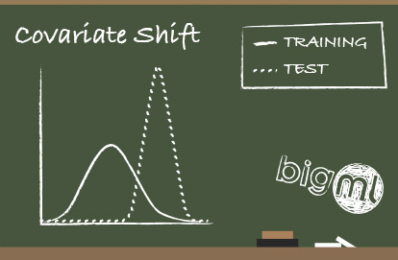
Domain Adaptation (DA)
Basic assumptions of DA
samples are abundant in each domain
sample distribution of each domain is related but different
Lack of samples
Registration (Gallery)
Identification (Probe)
Domain
Adaptation
Notes:
But there was a problem.
(click)
Since domain adaptation is a kind of distribution-matching, lack of samples was very critical issue.
That’s because only one sample per person cannot represent a source distribution.

Slide 21
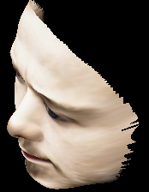
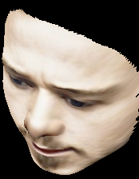
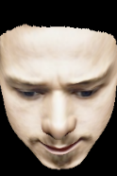
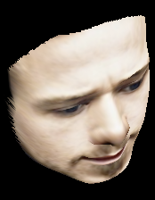
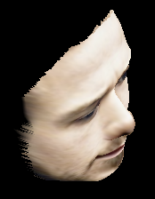
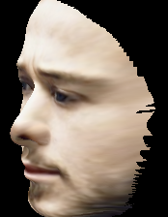
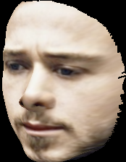
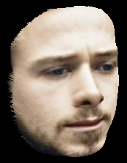
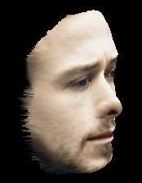
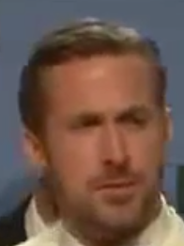
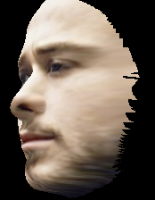
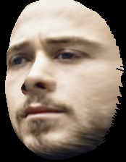
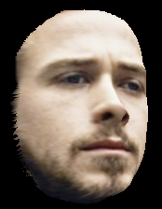
Face synthesis
Generate virtual samples for lack of samples.
Registration (Gallery)
Synthesized (from Gallery)
Identification (Probe)
Notes:
So we tried to augment samples.
Because simple augmentation methods like cropping, color jittering, flipping did not really helpful,
We synthesized face images with pose variations.

Slide 22
SSPP-DAN
Image synthesis
Without Synthesis
Notes:
This process will roughly mimic original distribution of the source domain,
And that will lead to a successful domain adaptation result.
We’ll show this later in experiment part.

Slide 23
SSPP-DAN
Image synthesis >> distribution of samples
Without Synthesis
With Synthesis
Notes:
This process will roughly mimic original distribution of the source domain,
And that will lead to a successful domain adaptation result.
We’ll show this later in experiment part.

Slide 24
SSPP-DAN
Image synthesis >> distribution of samples >> Success of DA
Without Synthesis
DA
fails
With Synthesis
DA
succeeds
Notes:
This process will roughly mimic original distribution of the source domain,
And that will lead to a successful domain adaptation result.
We’ll show this later in experiment part.

Slide 25
Real-world SSPP Face recognition
Registration (Gallery)
Identification (Probe)
Challenges
Heterogeneity of the shooting environments
Gallery: stable environment
Probe: highly unstable environment
Shortage of training samples
Only one training sample per person is available

Slide 26
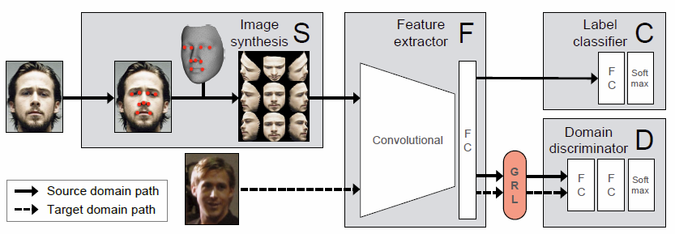
SSPP-DAN:
Domain Adaptation Network for Single Sample Per Person
Domain adaptation network
From stable face domain (source) to unstable face domain (target)
Face synthesis
Generate virtual samples

Slide 27
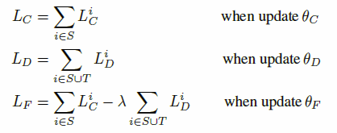
SSPP-DAN
Domain adaptation network with domain-adversarial training
Feature learning
Domain adaptation
Classifier learning
Jointly
Ganin, Yaroslav, and Victor Lempitsky. "Unsupervised domain adaptation by backpropagation." International Conference on Machine Learning. 2015.

Slide 28
SSPP-DAN
Domain adaptation network
From stable face domain (source) to unstable face domain (target)
Face synthesis
Generate virtual samples
Landmark detection
Supervised descent method
2D → 3D mapping
Pose estimation
Image synthesis
(yaw: -80°~+80°, pitch: -10°~40°)

Slide 29
Domain Adaptation
Data Feed
Source (with label): frontal images + synthesized images
Target (without label): surveillance camera images

Slide 30
Experiments

Slide 31
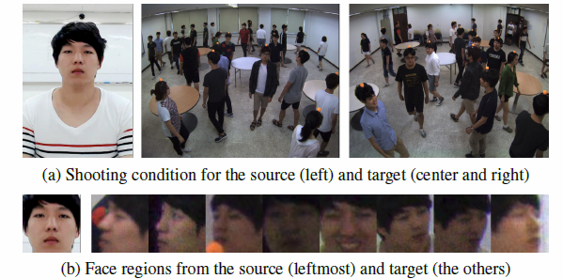
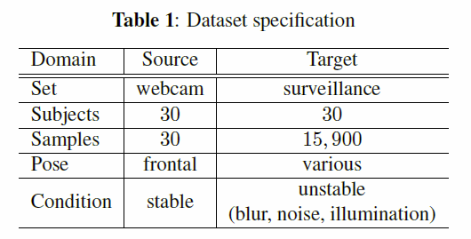
Heterogeneous dataset
Source
Target

Slide 32
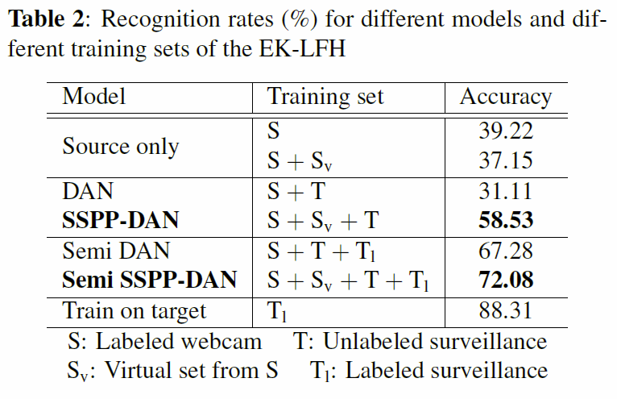
Heterogeneous dataset
only using face synthesis
Lower bound
only using domain adaptation
Upper bound

Slide 33
Heterogeneous dataset
Semi: 3 samples per person from target domain are revealed

Slide 34
Labeled Faces in the Wild (LFW)
Source
Target
Dataset summary
Rearranged LFW-A for SSPP face recognition
Gallery: 50 images for 50 people
Generic set: 108 subjects

Slide 35
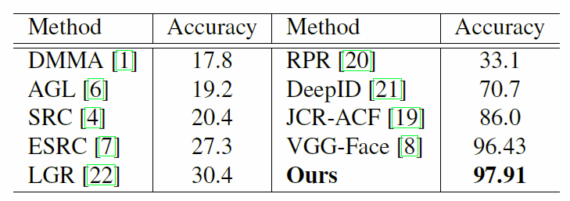
Labeled Faces in the Wild (LFW)
Source
Target
LFW for SSPP protocol
Gallery: 50 images for 50 people
Generic set: 108 subjects
Deep learning

Slide 36
Summary
Identification (Probe)
Registration (Gallery)
Gap
Heterogeneity of the shooting environments
Domain adaptation network
Shortage of training samples
Face synthesis

Slide 37
Summary
Identification (Probe)
Registration (Gallery)
Heterogeneity of the shooting environments
Domain adaptation network
Shortage of training samples
Face synthesis

Slide 38
Questions?

Slide 39
Appendix

Slide 40
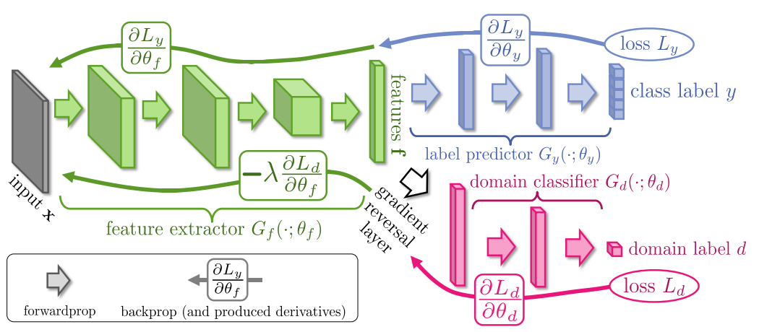
Domain Adaptation (DA)
Domain Adversarial Network (Ganin, Yaroslav, and Victor Lempitsky. "Unsupervised domain adaptation by backpropagation." ICML 2015.)
Unified framework using adversarial training
Feature extractor
Label classifier
Domain classifier

Slide 41
Domain Adaptation (DA)
Domain Adversarial Network (Ganin, Yaroslav, and Victor Lempitsky. "Unsupervised domain adaptation by backpropagation." ICML 2015.)
Unified framework using adversarial training
Feature extractor
Label classifier
Domain classifier

Slide 42
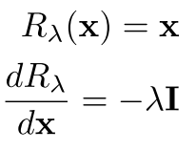
Domain Adaptation
Adversarial Training
$F$ is trained to fool $D$ so that $D$ cannot determine domain of data.
Gradient Reversal Layer (GRL)
forward: identity operation
backward: multiply by $−λ$
Loss for training
$L_{C}^{i}$and $L_{D}^{i}$: loss of $C$ and $D$, and $θ_{D},θ_{F},θ_{C}$ : parameters of $D, F, C$

