Slide 2
SEISMIC FAULT IDENTIFICATION USING GRAPH HIGH-FREQUENCY COMPONENTS AS INPUT TO GRAPH CONVOLUTIONAL NETWORK
by Patitapaban Palo,
Department of Electrical Engineering,
IIT Kharagpur, Kharagpur, India-721302

Slide 3
Contents
Introduction
Motivation
Proposed Methodology
Related Theory
Description of data
Extraction of Patches
Graph High-Frequency Components
Application of GCN
Results and Discussion
Conclusion

Slide 4
Introduction
Images, graphs, analysis tools, and several other methods can be used to present and visualize data.
When data are irregular and complex in structure, they are more challenging to represent and analyze.
In such cases, a graph helps as an essential tool.
Signal processing techniques such as Fourier transform, filters, and frequency response are applied to data residing on graphs in graph signal processing (GSP).

Slide 5
Introduction
A fault in seismic data is one kind of fracture or discontinuity in the volume of rocks.
Fault can appear due to various reasons such as earthquakes, the movement of tectonic plates, or the pressure built up over many years due to friction and rigidity of constituent rocks.
The structure of seismic data is highly nonlinear and nonuniform, because of which often, an expert's interpretation is needed to identify the faults.
Faults constitute the critical components of subsurface hydrocarbon traps.
Faults may seal porous reservoir rocks and form the hydrocarbon reservoirs.

Slide 6
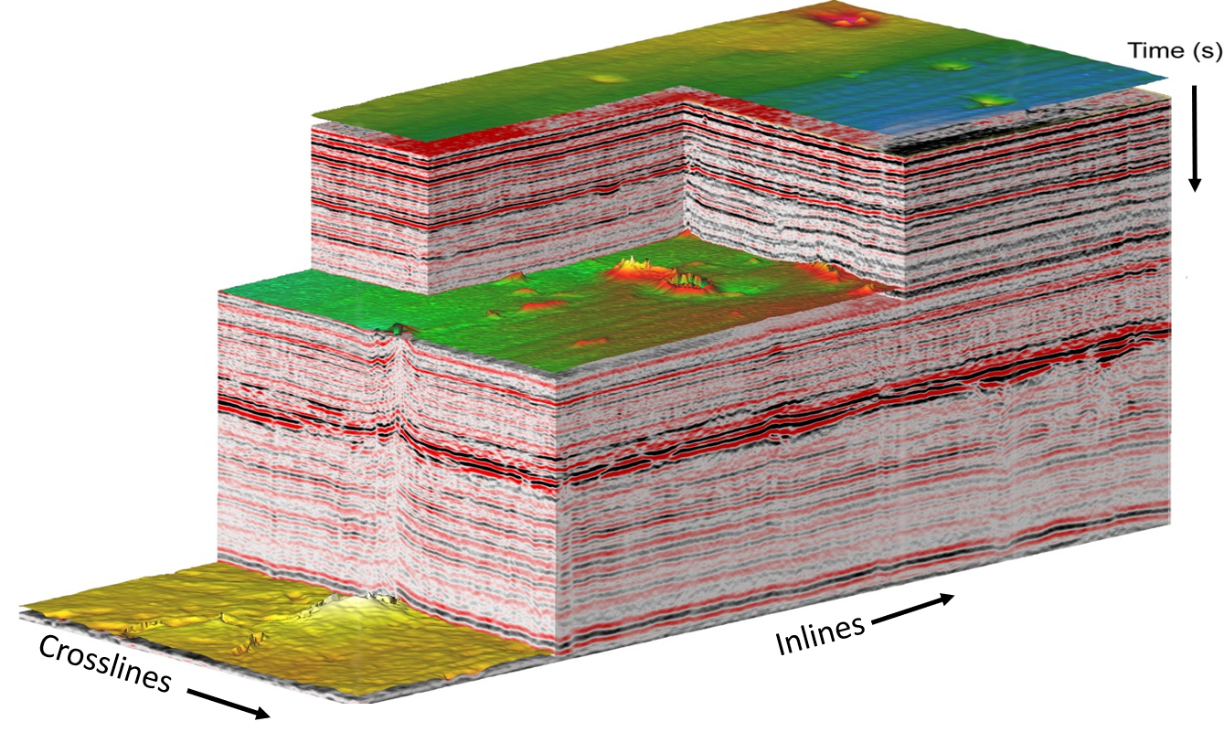
Introduction

Slide 7
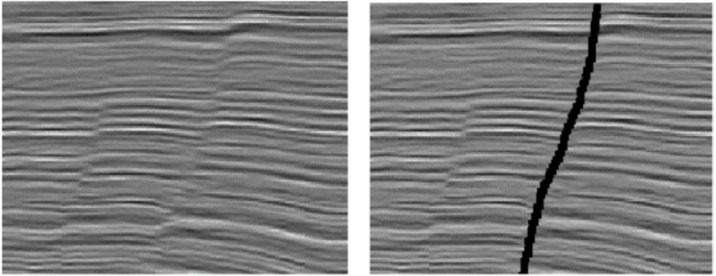
Introduction

Slide 8
Motivation
Following normalization, we extract 2D patches centered around a single seismic data point (pixel).
Then, the patches are represented in the graph domain by viewing each data point as a node and the seismic amplitudes as graph signals.
A seismic fault will create a significant difference in signal variation, causing graph high-frequency components.
The graph high-frequency components are obtained using a graph high-pass filter and graph Fourier transform (GFT).
We train the GCN using these high-frequency components, and identify the fault by classifying the extracted patches.

Slide 9
Block Diagram of the Proposed Work

Slide 10
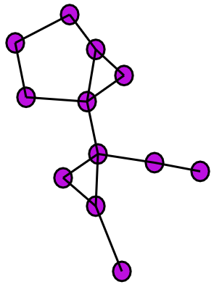
Related Theory
$$v_{0}$$
$$A_{0,1}$$
Graph can be expressed as $G=\left(V,A\right)$, where $V=\{v_{0},…,v_{N−1}\}$ is a set of $N$ nodes, and $A$ is the $N×N$ adjacency matrix.
Each weight $A_{i,j}∈ℂ$, where $ℂ$ is the set of complex numbers.
The neighbourhood of a vertex $v_{i}$ is defined as $M_{i}=\left\{j\right| A_{i,j} ≠0\}$
The graph signal is defined as $s: V→ℂ$, and its vector form as $s={[s_{0},…,s_{N−1}]}^{T}∈ℂ^{N}$
$$v_{1}$$
$$v_{N−2}$$
$$A_{N−2,N−1}$$
$$v_{N−1}$$
Example of a
nearest neighbour graph

Slide 11
Related Theory
The graph filter system $H(∙)$ produces the filtered output $H(s)$by taking the graph signal $s$as input.
The graph shift operator is defined as ${\tilde{s}}_{n}=\sum_{m∈H_{n}}{A_{n,m}s_{m}}$ and the vector form $\tilde{s}={[{\tilde{s}}_{0}, …,{\tilde{s}}_{N−1}]}^{T}=As$.

Slide 12
Related Theory
A linear, shift-invariant graph filter is a polynomial in the adjacency matrix of the form $h\left(A\right)=h_{0}I+h_{1}A+…+h_{L}A^{L} \& H\left(s\right)=h\left(A\right)s$
Additionally, a graph's spectrum is defined by its distinct eigenvalues $λ_{0},λ_{1},…,λ_{P−1}$ of the graph adjacency matrix $A$, called its graph frequencies, and its Jordan eigenvectors correspond to its frequency components.
The Jordan decomposition of $A$ can be expressed as $A=VJV^{−1}$
Hence, the GFT is defined as $\hat{s}=Fs$ where $F=V^{−1}$ is the GFT matrix.
The total variation refers to the similarity of a graph signal and its shifted version ${TV}_{G}\left(s\right)={||s−A^{norm}s||}_{1}$

Slide 13
Related Theory
According to the definition of the total variation, if two eigenvalues are ordered as $λ_{i}<λ_{j}$, the TVs will be ordered as ${TV}_{i}>{TV}_{j}$.
So for a graph having real spectrum, the frequencies will be reverse ordered as that of eigenvalues. The maximum eigenvalue represents the lowest frequency, and the minimum eigenvalue represents the highest frequency.
The high pass filter $h\left(A\right)$ is defined as (we take $λ_{cut}=0.8λ_{max}$) $h_{l}=\left\{\begin{aligned}1, λ_{l}≤λ_{cut} \\ 0, λ_{l}>λ_{cut}\end{aligned}\right.$

Slide 14
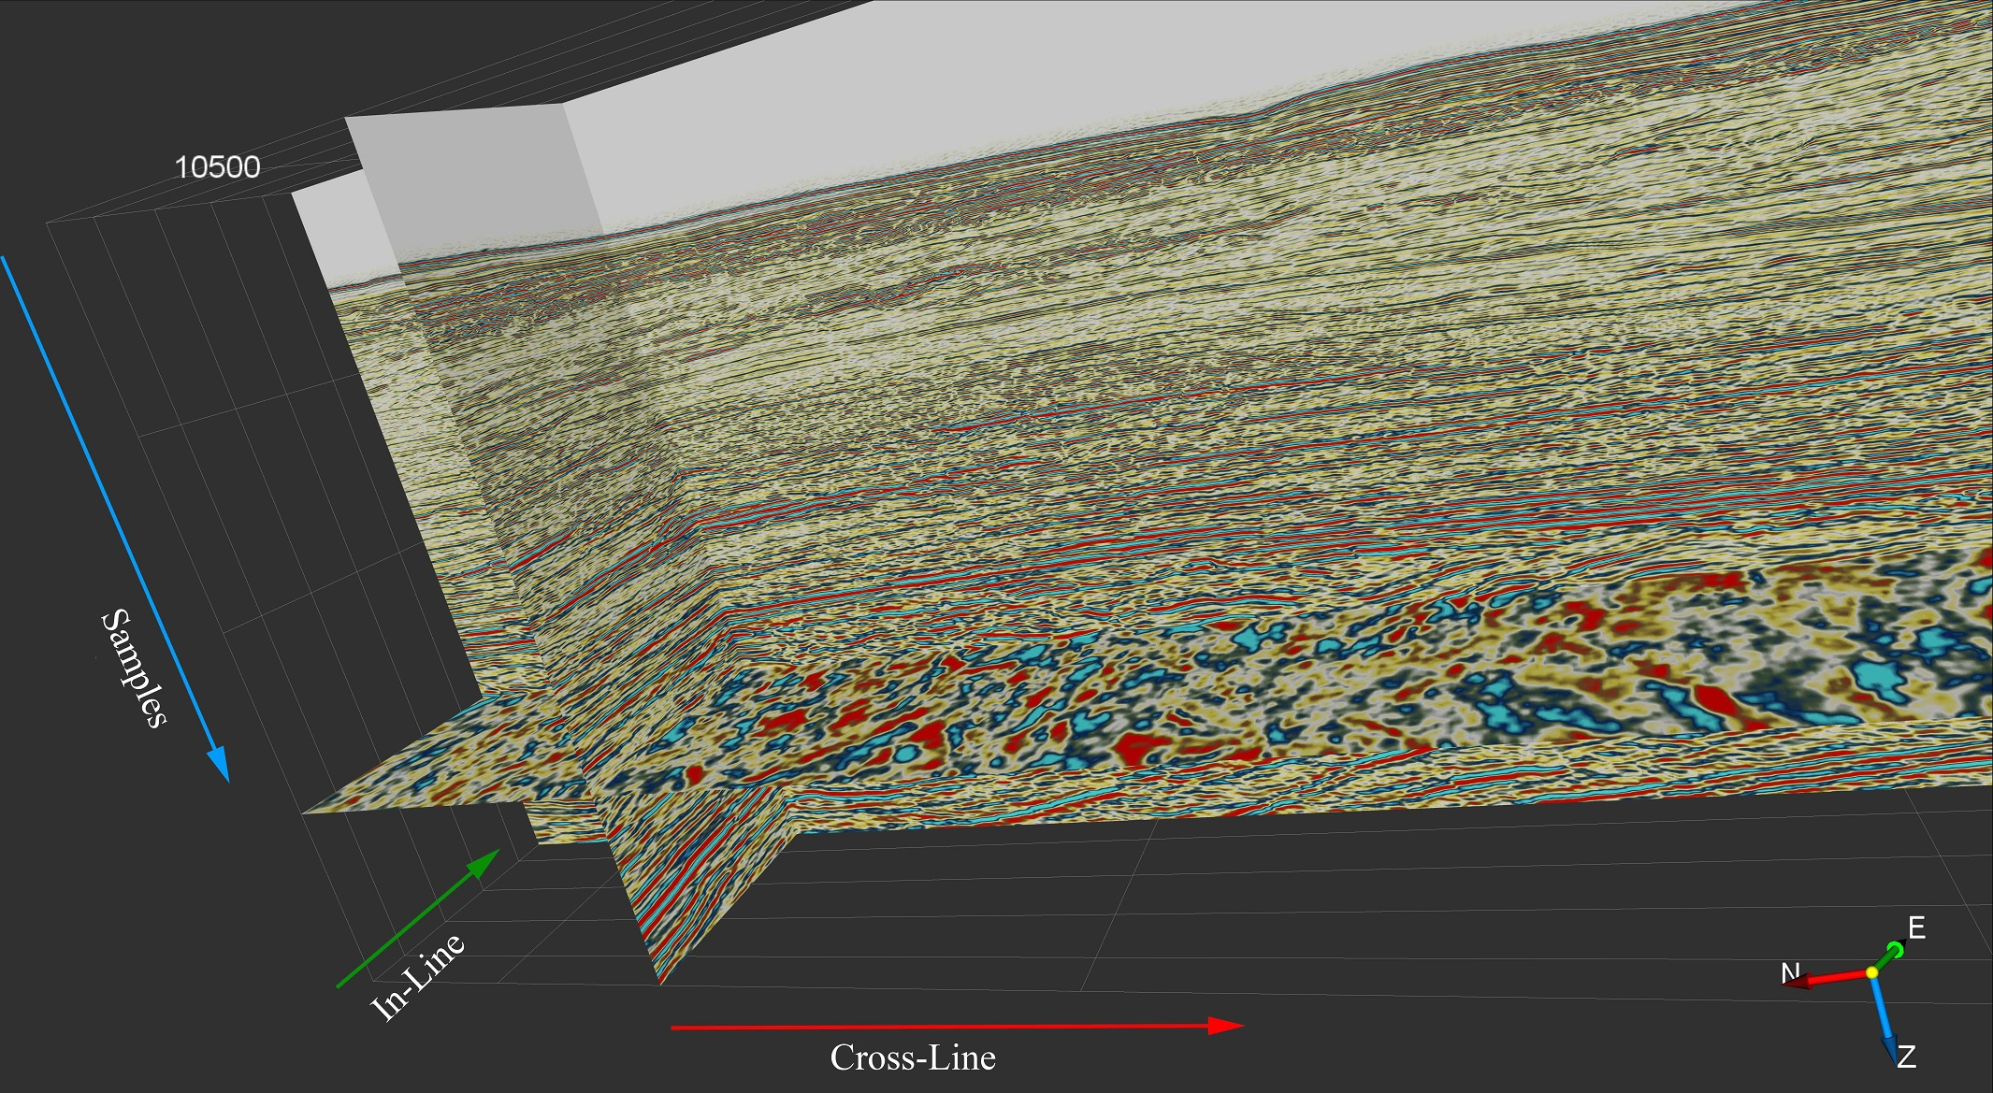
Description of Data
The seismic data contain seismic amplitude values.
The seismic amplitude value measures the contrast between two distinct seismic layers.
Depending on the relative hardness change from one layer to another, the seismic amplitude can take positive, negative or zero values.
The data used for analysis is marine data collected from KG (Krishna-Godavari) Basin area from the Bay of Bengal, India.
3D view of a small section
of KG Basin Data

Slide 15
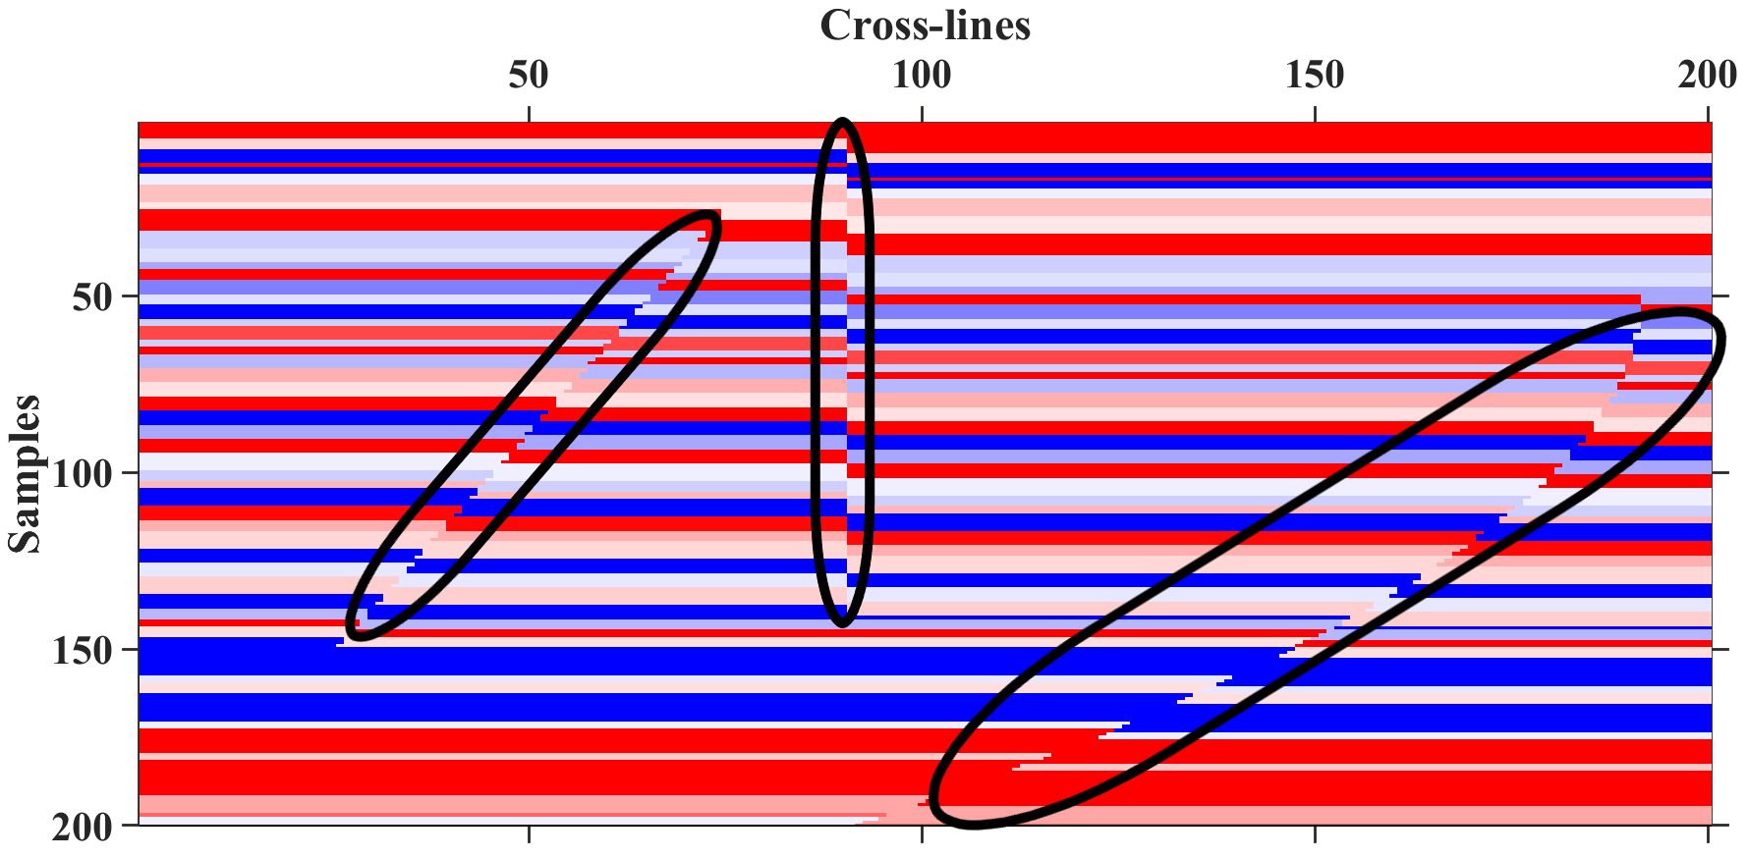
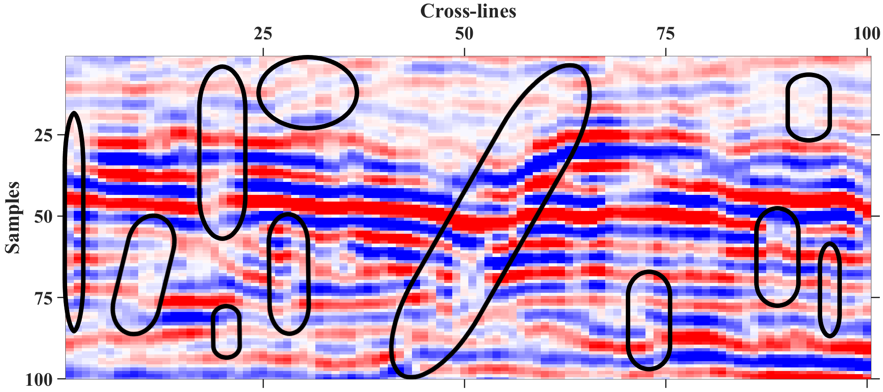
Description of Data
The synthetic data can be generated using a simple convolution $s\left(t\right)=w\left(t\right)∗r\left(t\right)+n(t)$ where $s\left(t\right)$ is the seismic trace, $w\left(t\right)$ is a wavelet and $r\left(t\right)$ is the reflectivity series, and we assume noise $n\left(t\right)$ to be zero.
Example of a 2D
synthetic fault data
Example of a 2D
real fault data

Slide 16
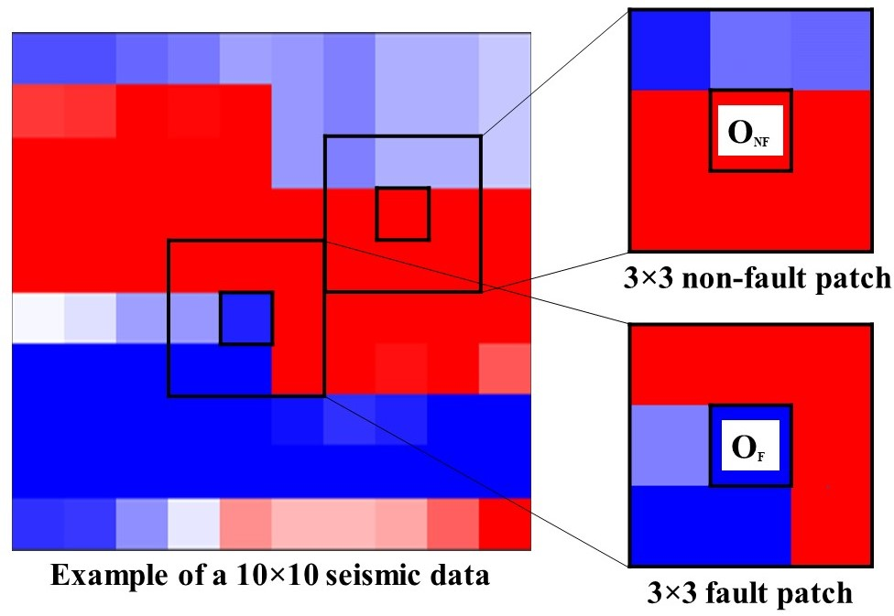
Extraction of Patches
Take a patch whose central point is the point of our concern.
Analyzing the patch; interpret if the point is a fault point or not.
Before extracting patches, we normalize the data

Slide 17
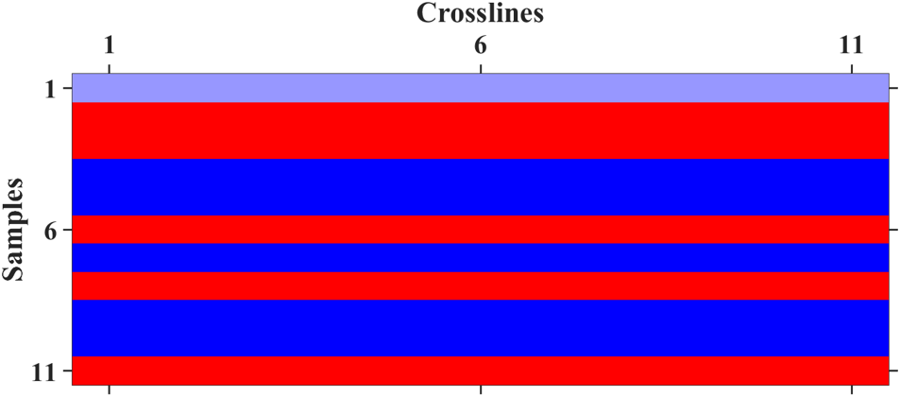
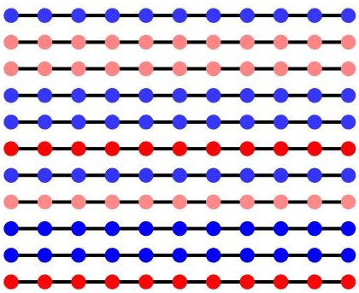
Graph High-Frequency Component
For the representation of patches in the graph domain, we consider a 2D-grid graph without vertical connections.
Fault in seismic data is a kind of discontinuity among the seismic layers in a horizontal direction. In order to capture the variation in the horizontal direction, we consider unweighted and undirected lateral edges in a graph.

Slide 18
Graph High-Frequency Component
The signal's most energy will be concentrated in low frequencies, which gets eliminated by a graph high pass filter.
Fault points will have a large variation in seismic signal values along the lateral direction, and high-frequency components will result.
The range of frequency coefficients is the distinguishing factor.
Moreover, in the case of fault data, there are a lot more frequency coefficients in a higher range than that of non-fault.

Slide 19
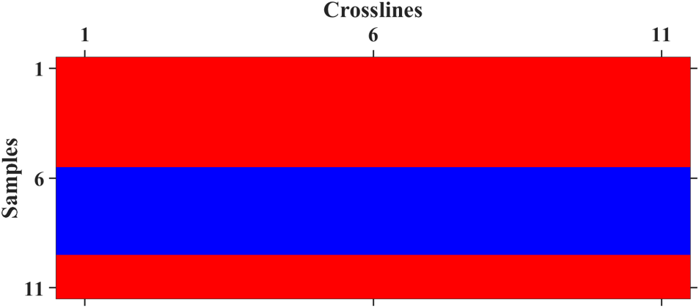
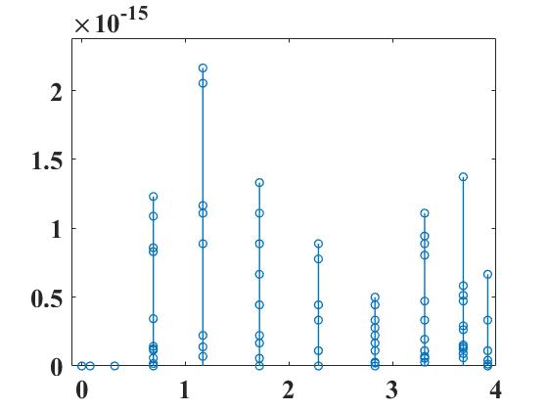
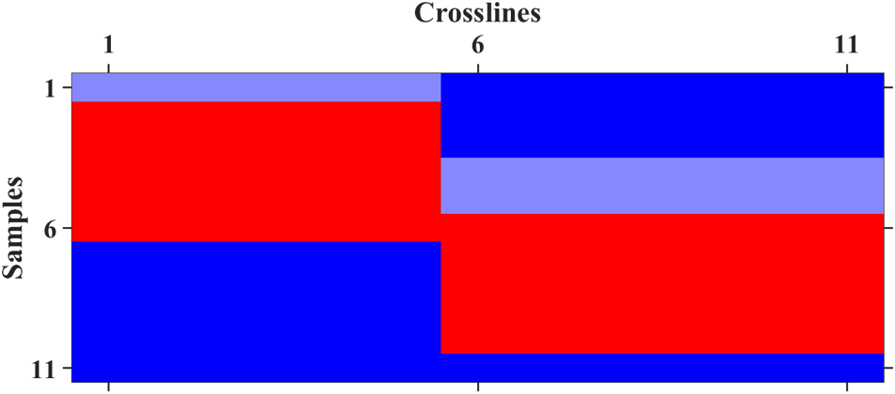
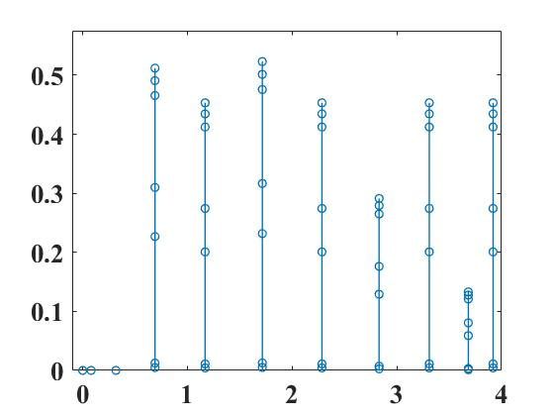
Graph High-Frequency Component

Slide 20
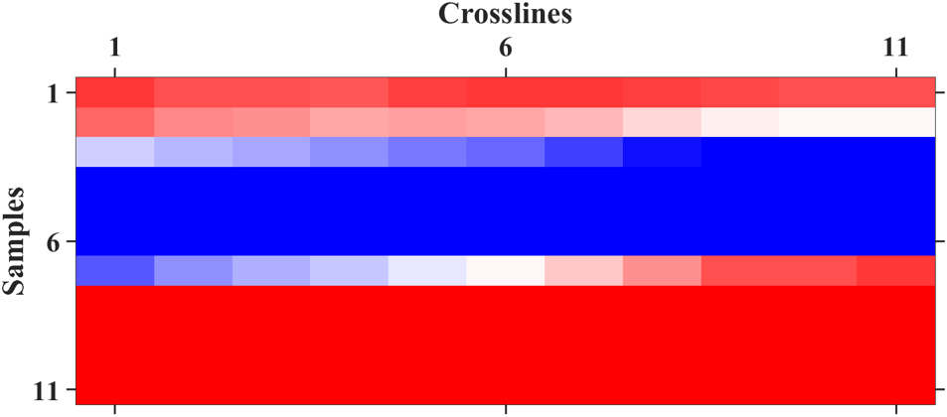
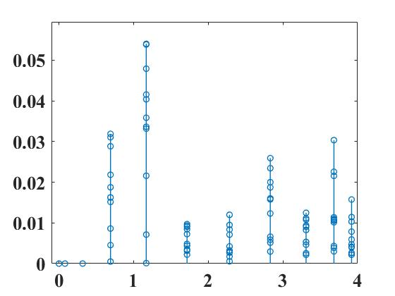
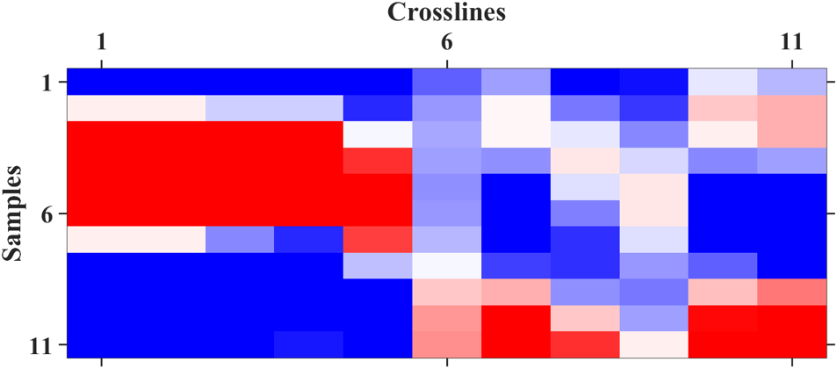
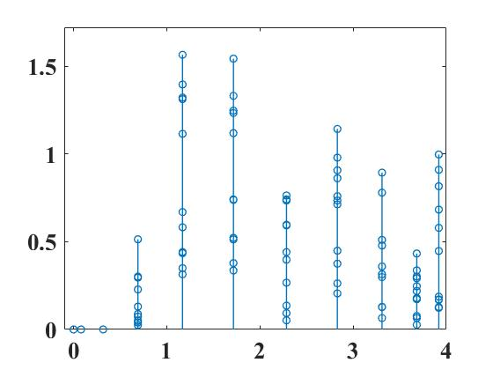
Graph High-Frequency Component

Slide 21
Application of GCN
We use GCN for node classification, representing the $m×m$ graph high-frequency components from $m×m$ patch as a single node of $m^{2}$-dimensional vector in a single k-nearest neighbor (kNN) graph.
In the kNN graph, each node is connected to its six nearest neighbors using undirected edges with weight $A_{i,j}=exp⁡(−{d_{i,j}}^{2})$, where $d_{i,j}$ is the distance between the high-frequency components of $i$th and $j$th node.
The kNN graph is the input to GCN.

Slide 22
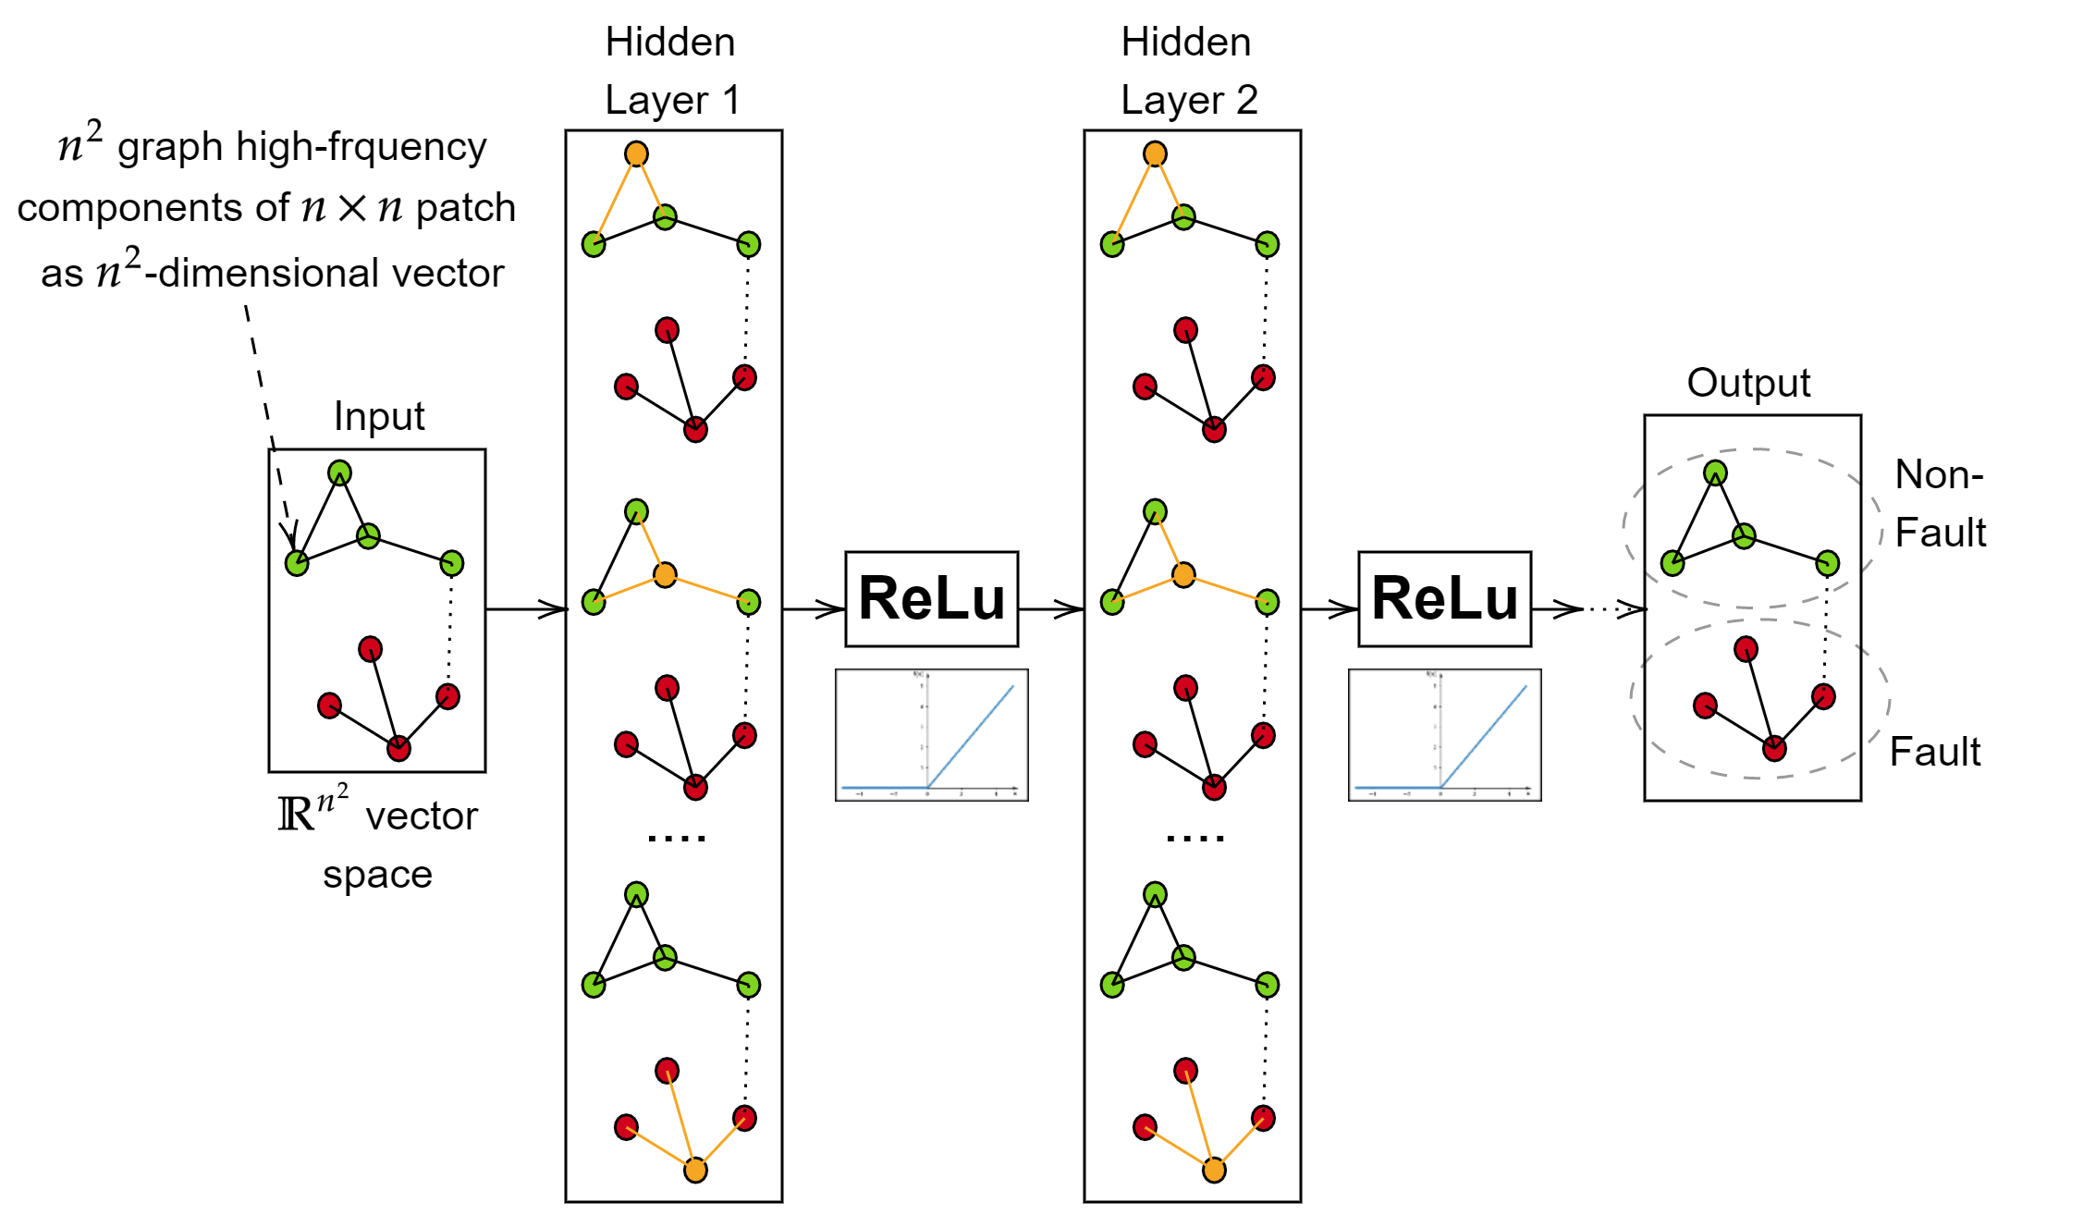
Application of GCN

Slide 23
Results and Discussion
For the GCN model we use batch gradient descent, cross entropy loss, and we train the GCN model with 16 hidden layers having ReLU activation for hidden layers and softmax for output, initial learning rate of 0.01, and a drop out of 0.5.
The training data contain equal parts synthetic and real data.
We take 10000 for each fault and non-fault data for the training dataset and validation 2000 for each fault and non-fault data.
Using these 24000 data, we test 100×100 real field data. So when we extract patches from each point, there will be 10000 testing data patches.

Slide 24
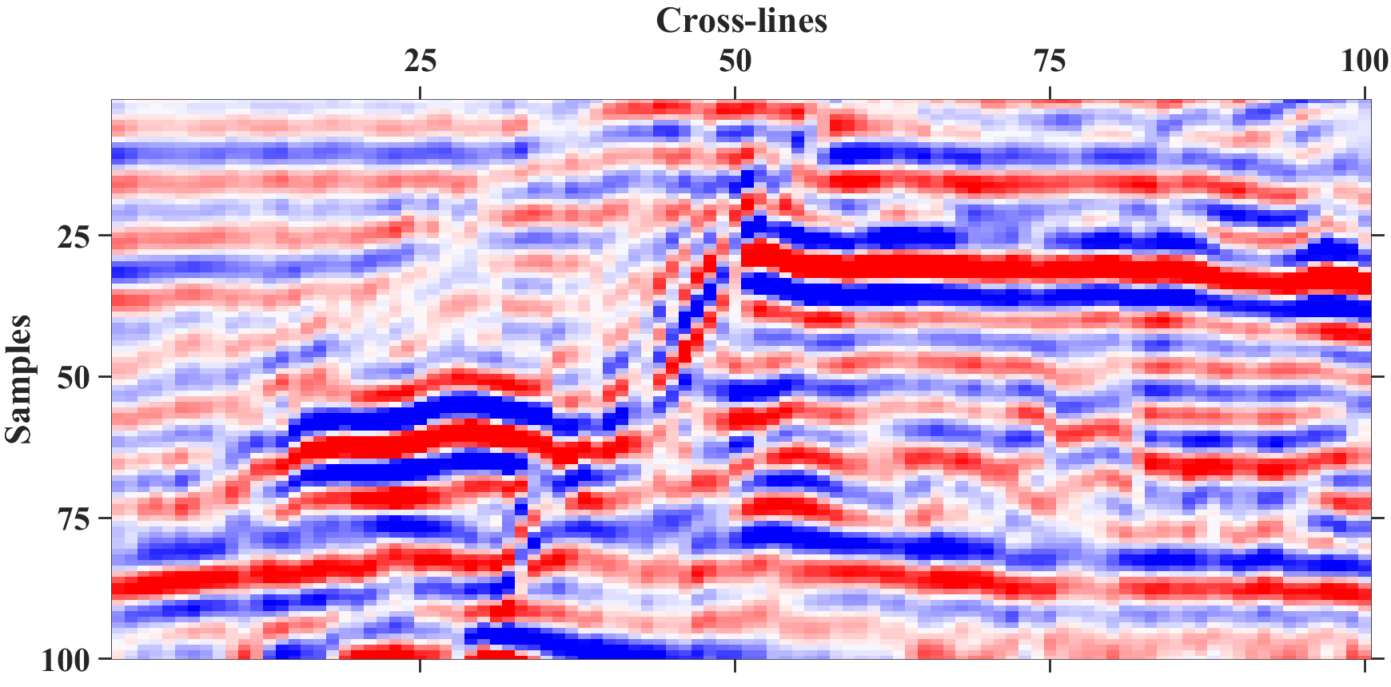
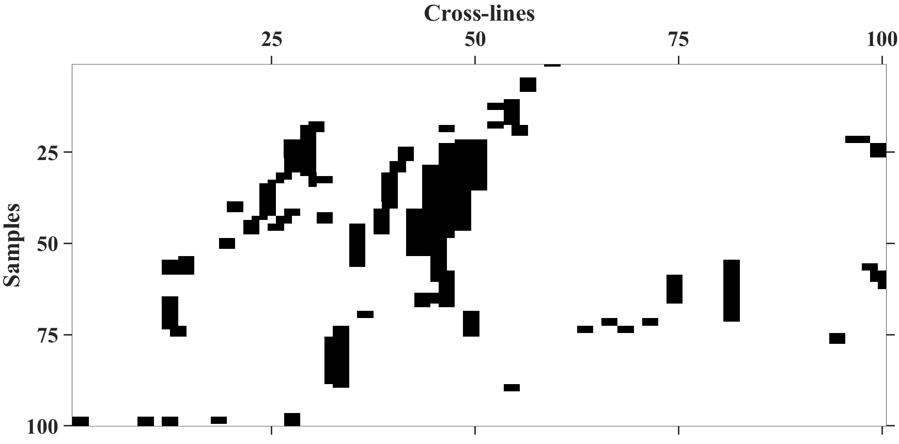
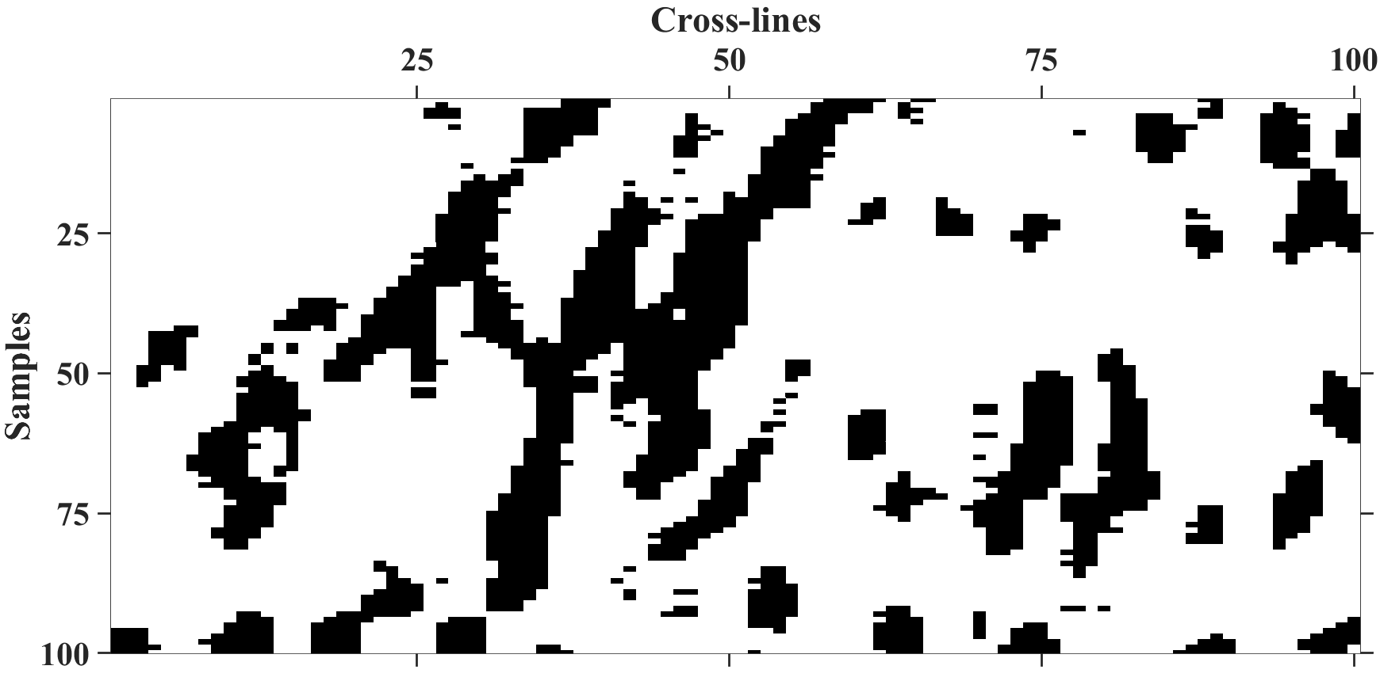
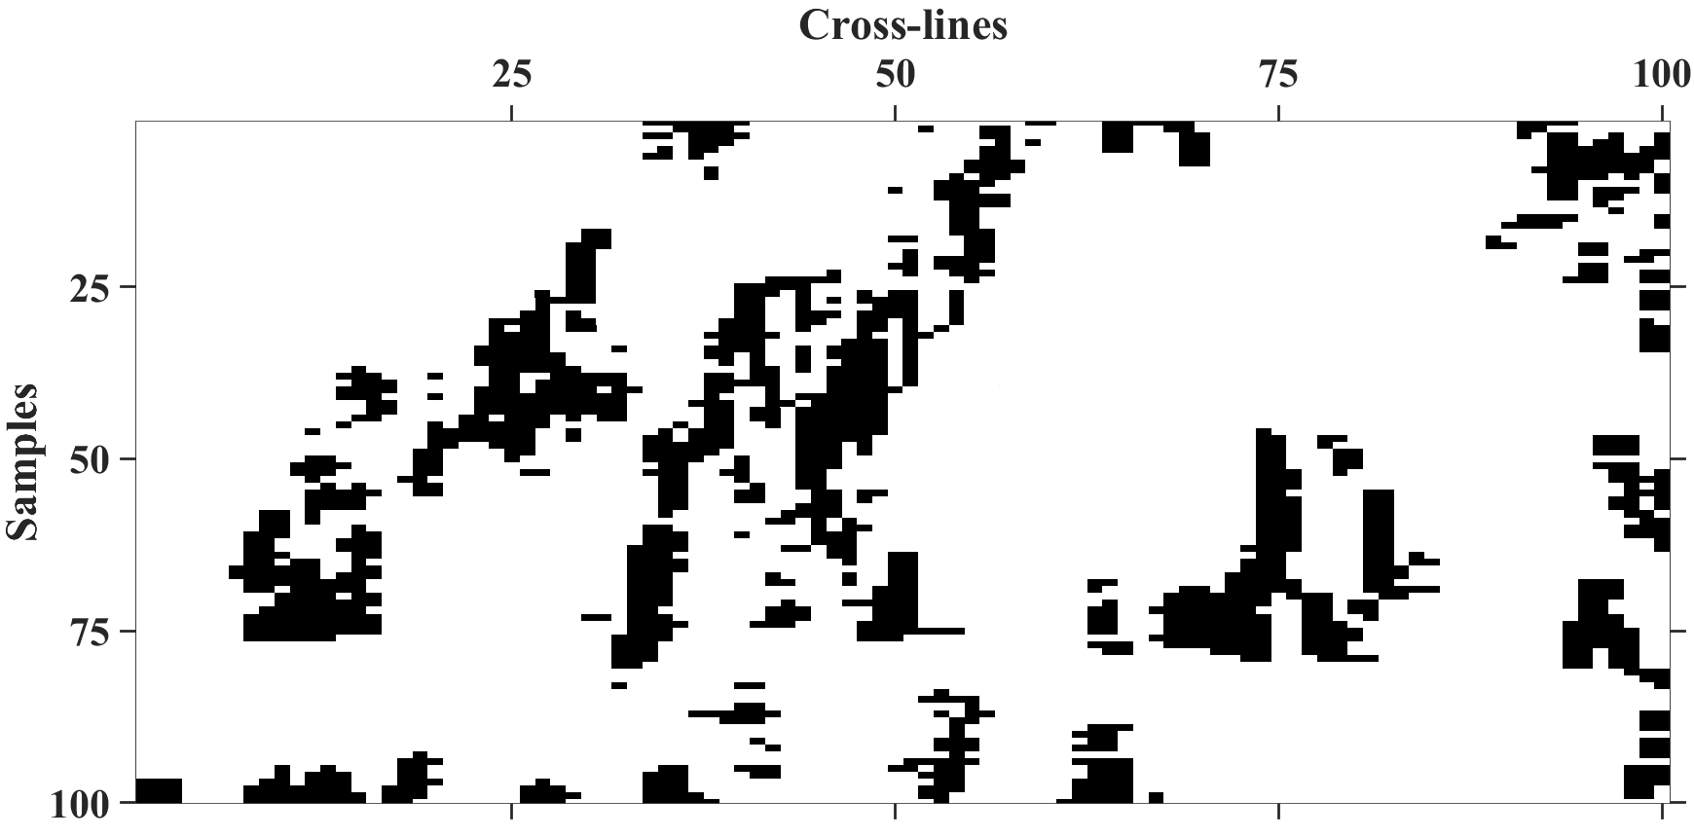
Results and Discussion
100×100 seismic data
Target Label
Label using CNN (Accuracy: 82.89%)
Label using GSP & GCN (Accuracy: 90.67%)

Slide 25
Results and Discussion
We compare the performance of our method by implementing a CNN-based method. We apply CNN to extracted 2D patches and identify the fault.
False fault point detection happens because the points located close to faults are detected as fault points, which affects the accuracy (82.89%) in the case of CNN.
For the results obtained using GSP high-frequency components as input to GCN, when we vary the dimension of patches, the accuracy (90.67%) is the highest for 11×11 patches.

Slide 26
Results and Discussion
Patch Dimension | Accuracy | Patch Dimension | Accuracy
3×3 | 83.19% | 11×11 | 90.67%
5×5 | 88.35% | 13×13 | 90.11%
7×7 | 89.02% | 15×15 | 89.44%
9×9 | 89.44% | 17×17 | 88.65%

Slide 27
Conclusion
We present a method to identify faults in seismic data by using graph high-frequency components as inputs to a graph convolutional network.
We first extract the patches and then present the patches using a laterally connected graph.
Next, we obtain the graph high-frequency components by implementing a graph high-pass filter and graph Fourier transform.
Then we identify the fault by classifying the patches using GCN, and it shows good accuracy when applied to real field data.

Slide 28
References
[1] F. R. K. Chung, Spectral Graph Theory, Providence, RI, USA: American Mathematical Society, 1997.
[2] J. F. Tenenbaum, V. Silva, and J. C. Langford, “A global geometric framework for nonlinear dimensionality reduction,” Science, vol. 290, pp. 2319–2323, 2000.
[3] A. Sandryhaila and J. M. F. Moura, “Discrete signal processing on graphs: Graph filters,” in IEEE International Conference on Acoustics, Speech and Signal Processing, 2013, pp. 6163–6166.
[4] X. Zhu and M. Rabbat, “Approximating signals supported on graphs,” in IEEE International Conference on Acoustics, Speech and Signal Processing, 2012, pp. 3921–3924.
[5] A. Sandryhaila and J. M. F. Moura, “Discrete signal processing on graphs: Frequency analysis,” IEEE Transactions on Signal Processing, vol. 62, no. 12, pp. 3042– 3054, June 2014.
[6] David I Shuman et. al., “The emerging field of signal processing on graphs: Extending high-dimensional data analysis to networks and other irregular domains,” IEEE Signal Processing Magazine, vol. 30, no. 3, pp. 83–98, 2013.
[7] Zonghan Wu et. al., “A comprehensive survey on graph neural networks,” IEEE Transactions on Neural Networks and Learning Systems, vol. 32, no. 1, pp. 4–24, 2021.
[8] Michael Defferrard, Xavier Bresson, and Pierre Van- ¨ dergheynst, “Convolutional neural networks on graphs with fast localized spectral filtering,” in Proceedings of the 30th International Conference on Neural Information Processing Systems. 2016, NIPS’16, p. 3844–3852, Curran Associates Inc.

Slide 29
References
[9] Thomas N. Kipf and Max Welling, “Semi-supervised classification with graph convolutional networks,” CoRR, vol. arXiv:abs/1609.02907, 2016.
[10] David K Duvenaud et. al., “Convolutional networks on graphs for learning molecular fingerprints,” in Advances in Neural Information Processing Systems. 2015, vol. 28, pp. 2224–2232, Curran Associates, Inc.
[11] Liang Yao, Chengsheng Mao, and Yuan Luo, “Graph convolutional networks for text classification,” Proceedings of the AAAI Conference on Artificial Intelligence, vol. 33, no. 01, pp. 7370–7377, Jul. 2019.
[12] Sami Abu-El-Haija, Amol Kapoor, Bryan Perozzi, and Joonseok Lee, “N-GCN: multi-scale graph convolution for semi-supervised node classification,” CoRR, vol. arXiv:abs/1802.08888, 2018.
[13] Nasher M. AlBinHassan and Kurt Marfurt, “Fault detection using hough transforms,” in SEG Technical Program Expanded Abstracts, 2005, pp. 1719–1721.
[14] Zhen Wang and Ghassan AlRegib, “Fault detection in seismic datasets using hough transform,” in IEEE International Conference on Acoustic, Speech and Signal Processing, May 2014, pp. 2372–2376.
[15] Rahul Mahadik and Aurobinda Routray, “Fault detection and optimization in seismic dataset using multiscale fusion of a geometric attribute,” in IECON 2019-45th Annual Conference of the IEEE Industrial Electronics Society, 2019, vol. 1, pp. 107–112.

Slide 30
References
[16] X. Wu et. al., “Faultnet3d: Predicting fault probabilities, strikes, and dips with a single convolutional neural network,” IEEE Transactions on Geoscience and Remote Sensing, vol. 57, no. 11, pp. 9138–9155, Nov 2019.
[17] Augusto Cunha, Axelle Pochet, Helio Lopes, and ´ Marcelo Gattass, “Seismic fault detection in real data using transfer learning from a convolutional neural network pre-trained with synthetic seismic data,” Computers and Geosciences, vol. 135, pp. 104344, 2020.
[18] Wei Xiong et. al., “Seismic fault detection with convolutional neural network,” GEOPHYSICS, vol. 83, no. 5, pp. O97–O103, 2018.
[19] Haibin Di, Amir Shafiq, and Ghassan Alregib, “Seismic-fault detection based on multiattribute support vector machine analysis,” in SEG Technical Program Expanded Abstracts, 08 2017, pp. 2039–2044.
[20] Lei Huang, Xishuang Dong, and T. Edward Clee, “A scalable deep learning platform for identifying geologic features from seismic attributes,” The Leading Edge, vol. 36, no. 3, pp. 249–256, 2017.
[21] A. Sandryhaila and J. M. F. Moura, “Discrete signal processing on graphs,” IEEE Transactions on Signal Processing, vol. 61, no. 7, pp. 1644–1656, 2013.
[22] Ming Chen et. al., “Simple and deep graph convolutional networks,” in Proceedings of the 37th International Conference on Machine Learning. Jul 2020, vol. 119, pp. 1725–1735, PMLR.
[23] Nathanael Perraudin, Johan Paratte, David Shuman, Li- ¨ onel Martin, Vassilis Kalofolias, Pierre Vandergheynst, and David K. Hammond, “GSPBOX: A toolbox for signal processing on graphs,” ArXiv e-prints, August 2014.

