Slide 1
SLFC: Scalable Light Field Coding
Hadi Amirpour, Christian Timmerer, and Mohammad Ghanbari
All rights reserved. ©2020

Slide 2
Introduction
Light field compression
SLFC
Experimental results
Conclusion
All rights reserved. ©2020
Notes:
I will

Slide 3
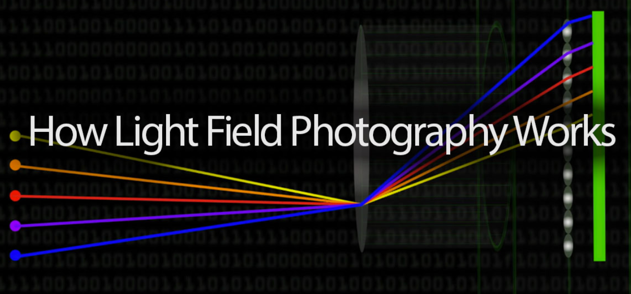
Introduction

Slide 4
Light field photography
conventional camera can only record 2D light intensity on an imaging sensor
light field camera will capture a 4D light field; that is, the intensity of light in a scene, and also the direction that the light rays are traveling in space

Slide 5
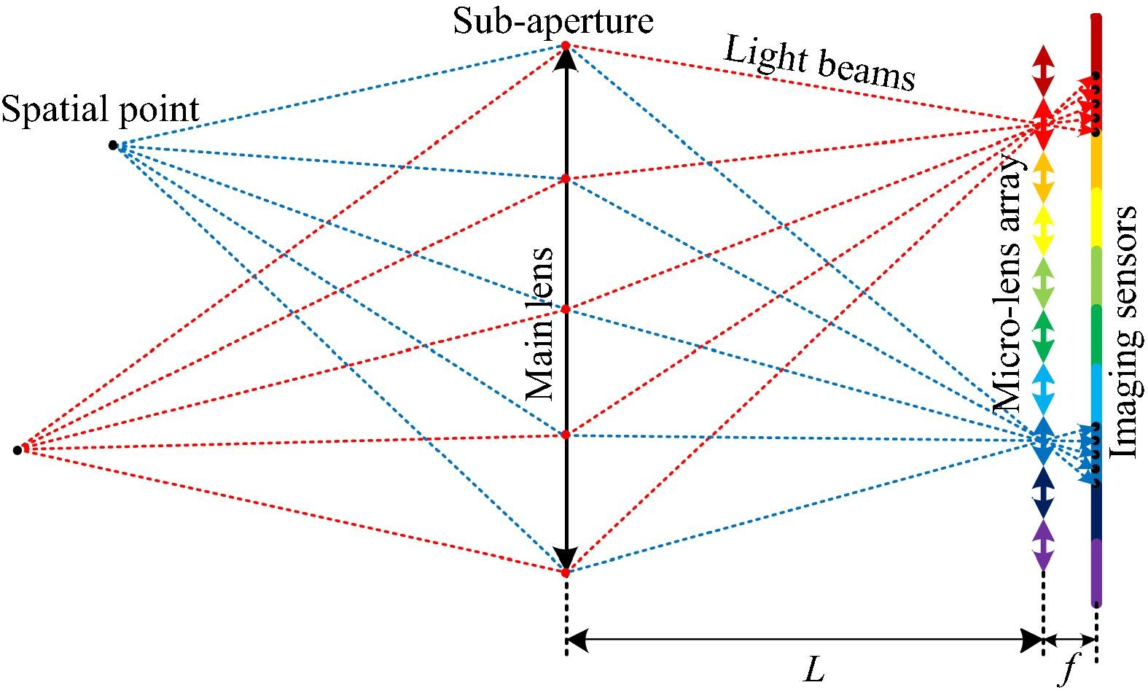
Light field photography

Slide 6
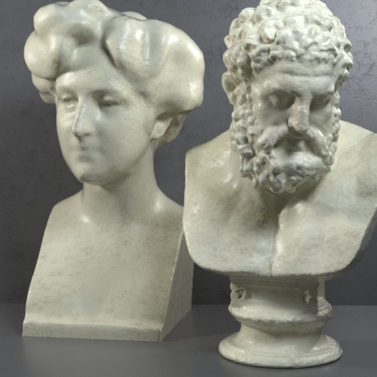
Light field photography
v
y
u
x

Slide 7
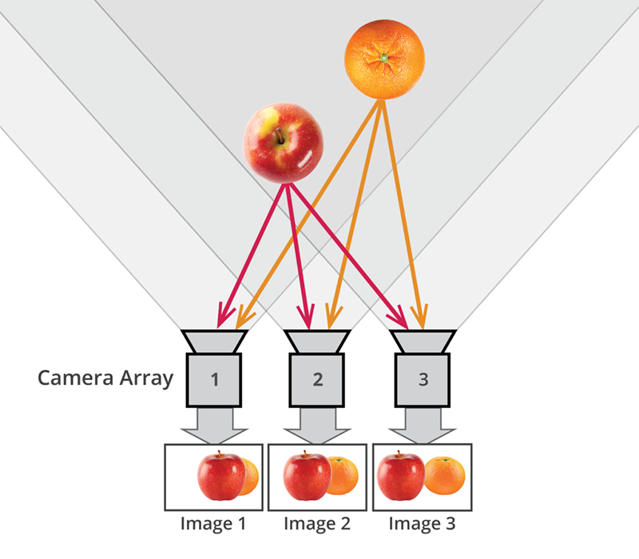
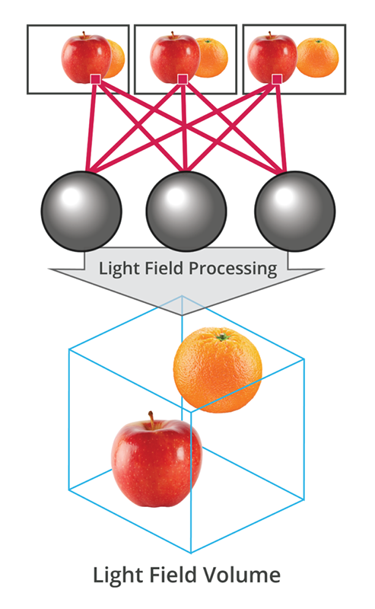
Introduction
http://lightfield-forum.com/what-is-the-lightfield/

Slide 8
Introduction
Post-processing task
refocusing
changing viewport
depth estimation
3D modeling
synthesizing new views

Slide 9
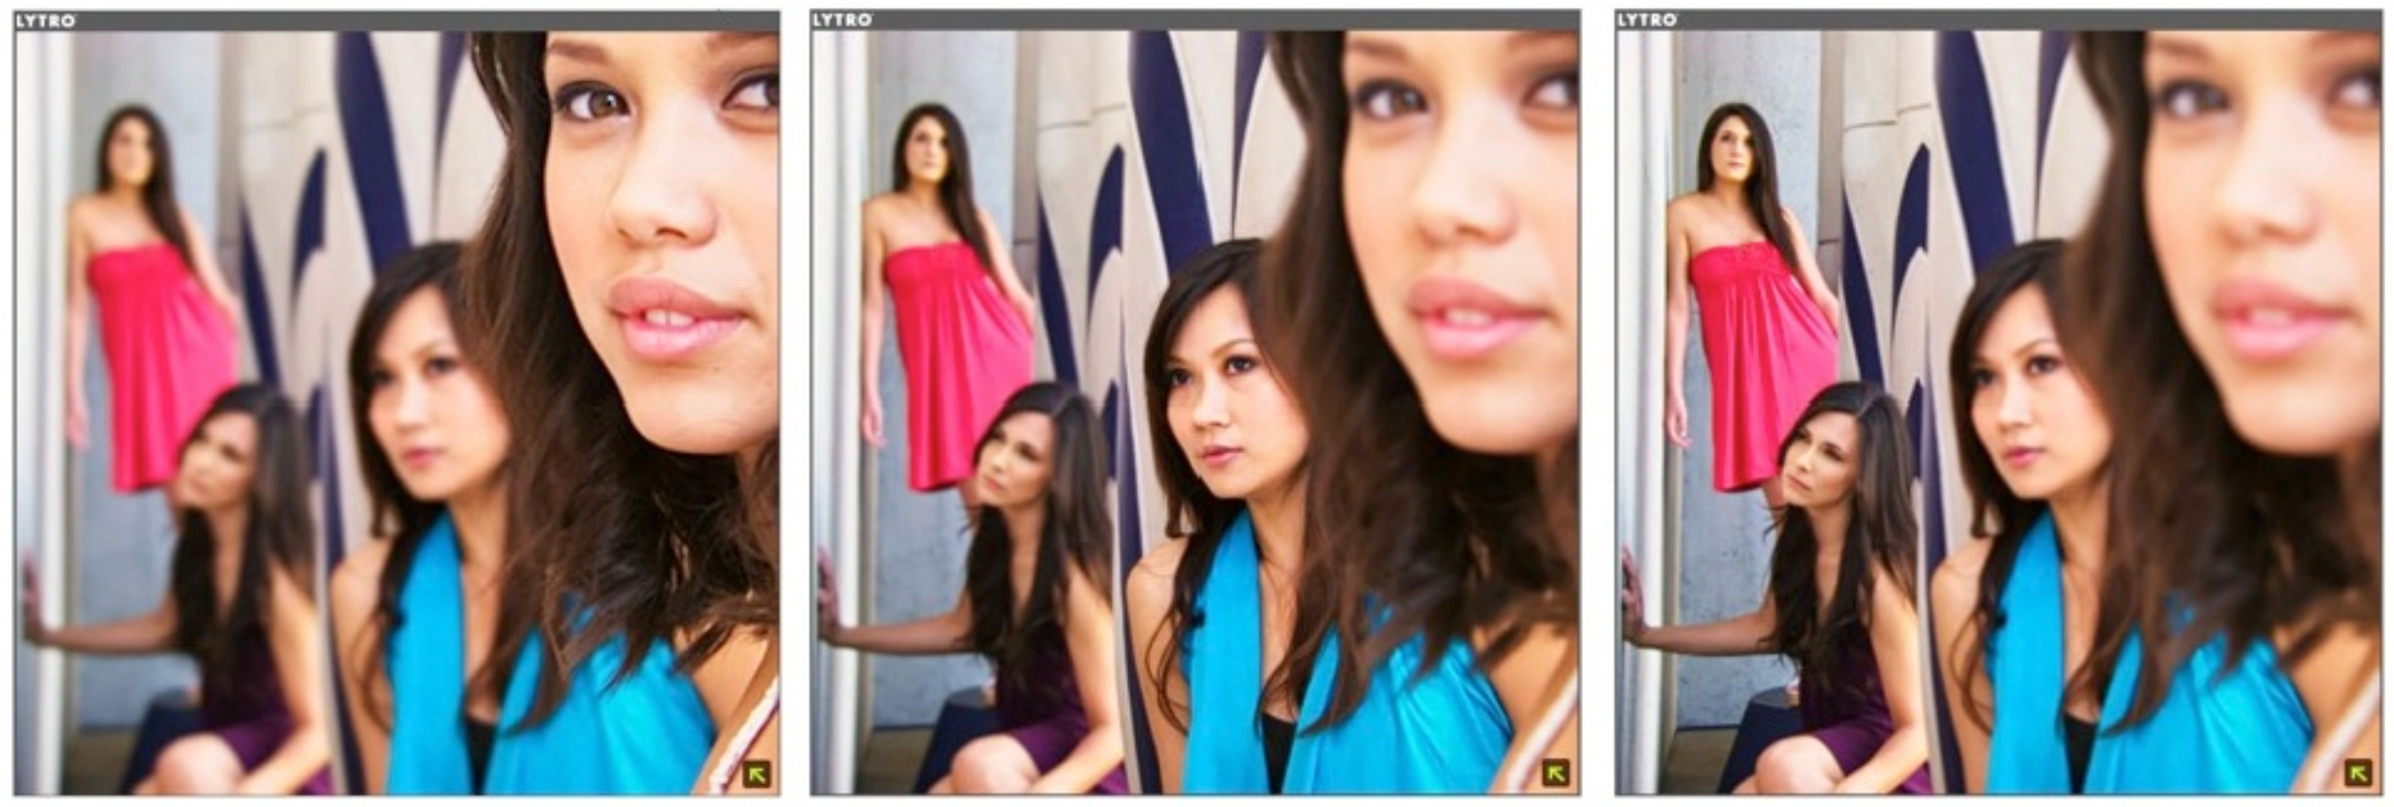
Introduction
Refocusing
Lytro Light Field Camera: from scientific research to a $50-million business

Slide 10
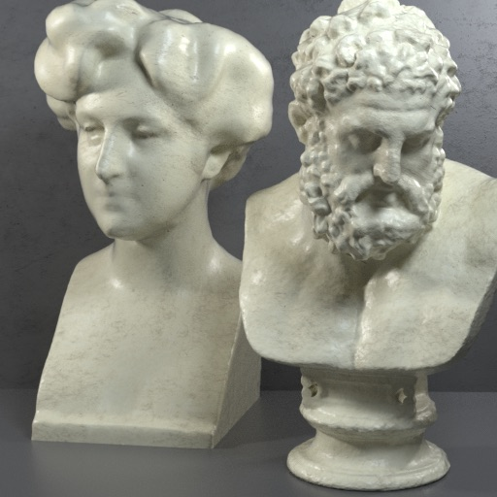
Introduction
Changing viewport

Slide 11
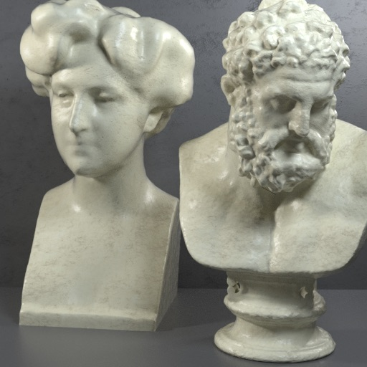
Introduction
Changing viewport

Slide 12
Light field compression and its challenges
All rights reserved. ©2020

Slide 13
Light field compression

Slide 14
Light field compression

Slide 15
Light field compression

Slide 16
Light field compression

Slide 17
Light field compression
Encoder
Bitstream
Decoder

Slide 18
Light field compression
Encoder
Bitstream
Dependency between views
Decoder

Slide 19
Light field compression challenges
encoding efficiency
viewport scalability
quality scalability
random access
uniform quality distribution

Slide 20
Viewport scalability
To increase compatibility with:
display
capturing device
network condition
processing power
storage capacity

Slide 21
Viewport scalability
To increase compatibility with:
display
capturing device
network condition
processing power
storage capacity

Slide 22
Quality scalability
To increase compatibility with:
network condition
processing power
storage capacity

Slide 23
Random access
Navigating between views can increase:
decoding delay
bandwidth requirement
processing power

Slide 24
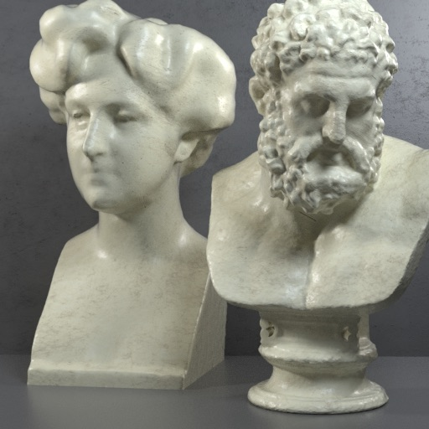
Random access
Navigating between views can increase:
decoding delay
bandwidth requirement
processing power

Slide 25
Quality distribution
It is undesirable to face different quality levels when navigating between viewports

Slide 26
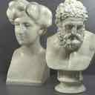
Quality distribution
It is undesirable to face different quality levels when navigating between viewports

Slide 27
SLFC: Scalable Light Field Coding
All rights reserved. ©2020

Slide 28
SLFC
light field image views are divided into seven layers
red view belong to that layer
gray views belong to the previous layers
black views belong to the next layers
L1
L2
L3
L4
L5
L6
L7

Slide 29
SLFC
The central view is intra-coded and can be accessed independently.
Views in the second layer, are encoded independent of each other but using the central view as their reference image.
We see encoding of the remaining views as view/frame interpolation problem.
L1
L2
L3
L4
L5
L6
L7

Slide 30
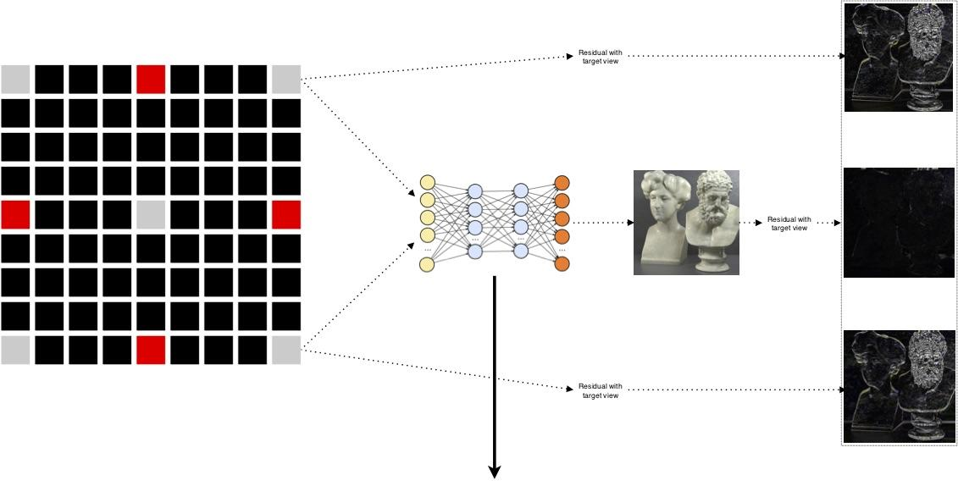
SLFC
Residual with target view
Residual with target view
Residual with target view

Slide 31
SLFC
SepConv: Video Frame Interpolation via Adaptive Separable Convolution

Slide 32
SLFC
In each layer (3 to 7), two views from the previously encoded layers are used to synthesize their intermediate view.
When the intermediate view is synthesized, it is added as a virtual reference frame to the reference list in the video encoder.
To encode each intermediate view four references are used for inter-coding: (i) the most central view, (ii, iii) two views that are used for interpolation, (v) the synthesized view.

Slide 33
SLFC

Slide 34
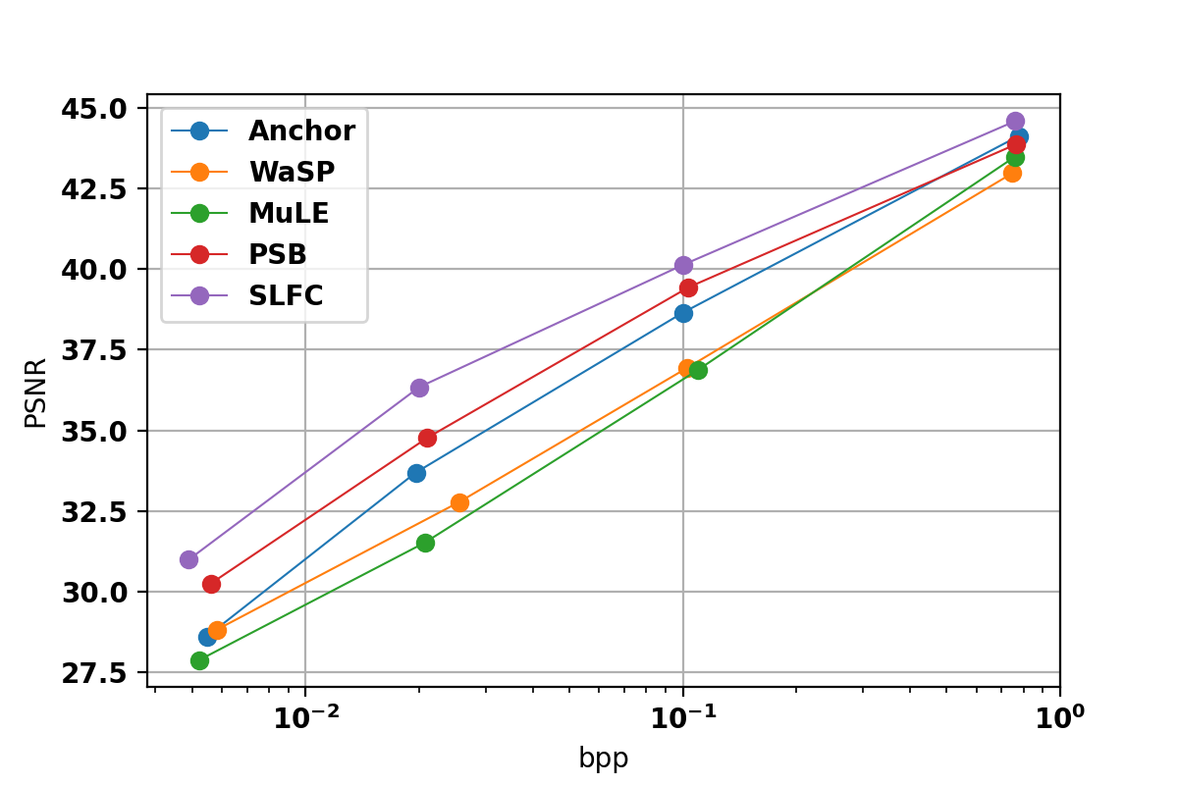
Encoding efficiency
Rate distortion curves for Table light field images.
Anchor: JPEG Pleno anchor
WaSP: Hierarchical warping, merging, and sparse prediction for light field image compression
MuLE: A 4D DCT-Based lenslet light field codec
PSB: Pseudo sequence based 2-D hierarchical coding structure for light-field image compression

Slide 35
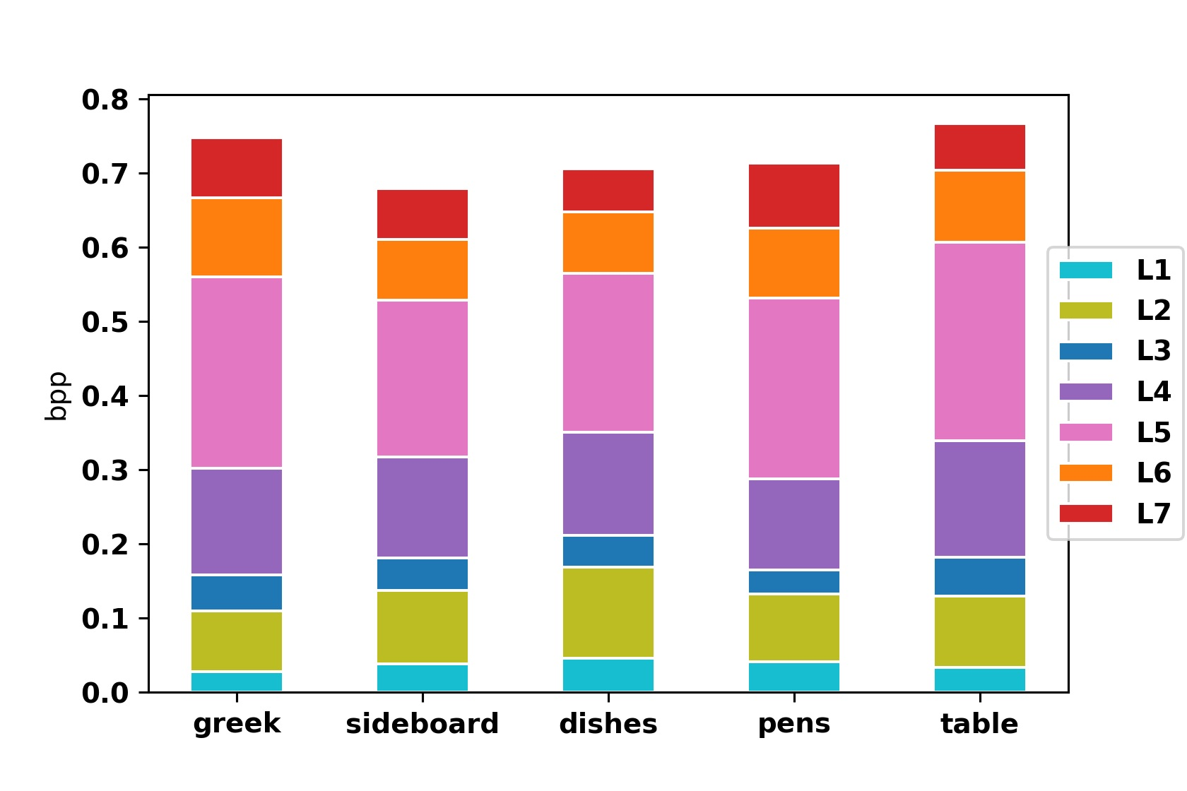
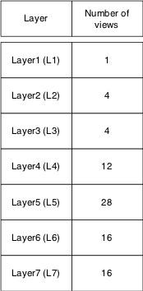
Viewport scalability
The number of views in each layer
Bitrate allocated to each layer at bpp4 = 0.75

Slide 36
Quality scalability
SLFC provides two quality levels :
quality 1: When the most central view and corner views are available, SLFC can synthesize all remaining views by utilizing SepConv.
quality 2: SLFC first synthesize a target view, then utilize the synthesized view for inter-coding at the cost of additional bitrate.

Slide 37
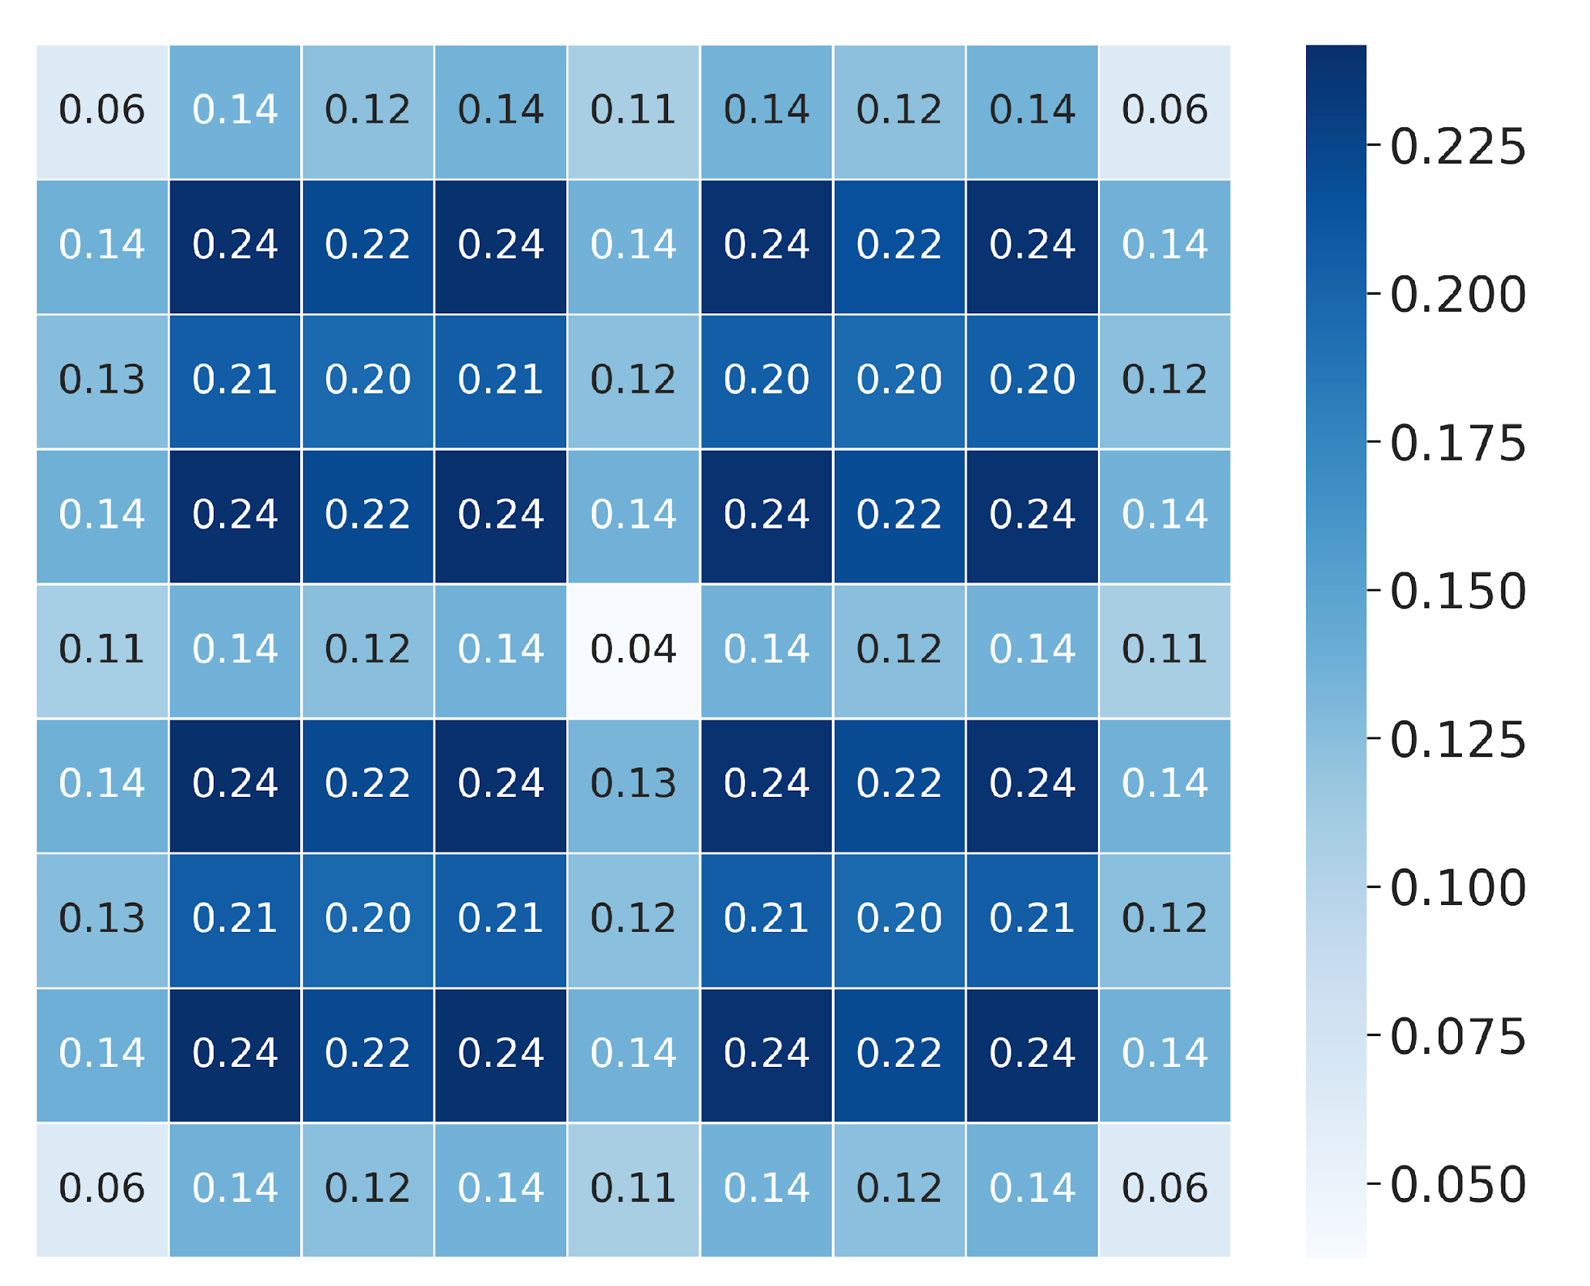
Random access
RA_{p} for all views of greek light field images at bpp4 = 0.75

Slide 38
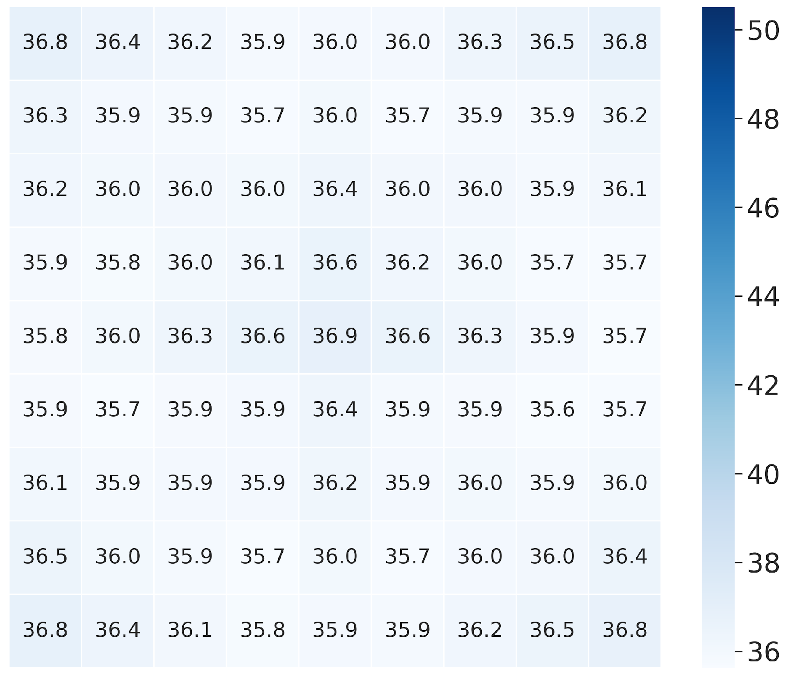
Uniform quality distribution
PSNR heatmap plot for greek light field image

Slide 39
Conclusion
SLFC utilizes a DNN to synthesize intermediate views.
Synthesized views are used as virtual references for inter-coding.
SLFC provides:
High encoding efficiency
Viewport scalability
Quality scalability
Random access
Uniform quality distribution

Slide 40
Thanks for your attention
www.athena.itec.aau.at

