Slide 1
Notes:
Hello, everyone, I am every glad to give my representation in icassp 2024. my paper’s title is ‘Synthesizing Black-box Anti-forensics DeepFakes with High Visual Quality’

Slide 2
Introduction
The process of generating DeepFakes
Notes:
(1) First, extracting frames from the input videos and locating the faces. (2) Then, converting the facial images into the individual masks of targets with facial expressions. (3) Afterward, applying necessary alignment, trimming, and enhancement to reduce the information loss during training. (4) Eventually, putting the generated masks on victims’ faces by Poisson fusion and edge fusion to improve the visual quality of products.

Slide 3
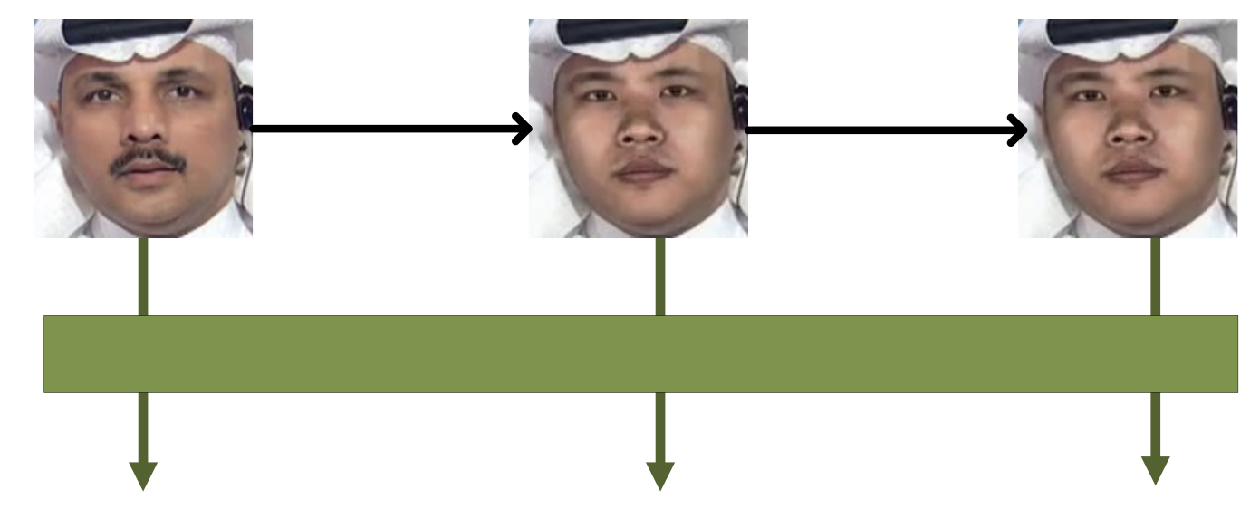
Deepfake Anti-forensics
Original face
DeepFake
Anti-forensics
Forensics detectors
real
fake
real
Notes:
Pre-trian forensics detectors are used to distinguish deepfake face from original face. The goal of anti-forensics is to add noise to deepfake face. as a result, the anti-forensics face should have the same face appearance with deepfake face but be detected to original face

Slide 4
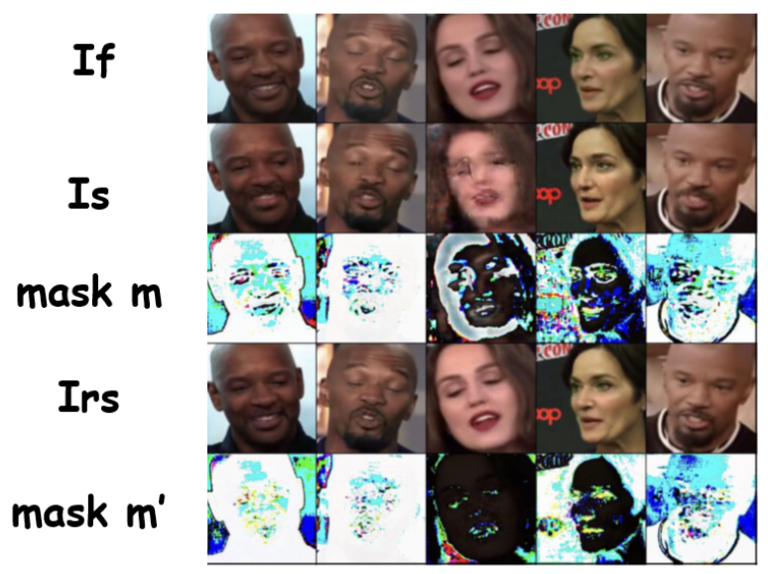
contribution
Introducing generate adversarial sharpening masks.
Adoption of a parameter-frozen training strategy.
state-of-the-art DeepFake anti-forensics methods
Adversarial sharpening masks
Notes:
1. Introduction of a method to generate adversarial sharpening masks, resulting in DeepFake images that are highly undetectable and visually appealing.
2. Adoption of a parameter-frozen training strategy into the VEN to produce higher-quality anti-forensics images.
3. Evaluation of the propose approach through comparisons with state-of-the-art DeepFake anti-forensics methods on various benchmark datasets.

Slide 5
Motivation
Inject adversarial noise in sharpen appearance -> good in visualization & anti-forensics
Notes:
Striking a balance between undetectability and visual quality is now a challenge in DeepFake antiforensics.
In this paper, we propose a method as our solution to the above challenge. Unlike existing methods, we cannot mitigate the effect of adversarial noise. Comparatively, we utilize more noise and limit them to disguise DeepFake images as slightly sharpened original images. The images processed by our proposed method can enhance the visual quality. In general, such images are more convincing to the human eye.

Slide 6
Framework
FDN-> highly undetectable, but worse appearance
VEN->good appearance
Notes:
The first module is the Forensics Disruption Network (FDN), where our primary goal is to ensure that the synthesized anti-forensics images can mislead DeepFake detectors through the injection of adversarial noise and achieve high undetectability. At this stage, we can tolerate lower visual quality in the images. After training FDN, the FDN network can generate highly undetectable synthesizing images
furthermore, in the second stage, we introduce the Visual Enhancement Network (VEN), to fine-tune and compensate for the visual quality loss caused by the injection of adversarial noise in the FDN network.
Specifically, we set the parameters of VEN G1 with the parameters of G1 trained in the first step of FDN and freeze it. Then, we fine-tune the parameters of G2 by training the VEN network. Finally, the trained VEN network is capable of restoring visually synthesized image with a sharpening effect and high undetectability

Slide 7
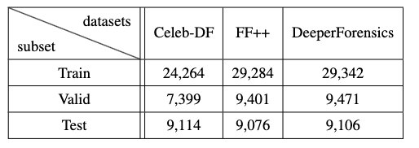
forensics detectors
Pre-train forensics detectors
-> All with highly accuracy
Notes:
All the models are trained independently on individual datasets. The number of images for training, validation, and testing on each model are 25k, 9k, and 9k, respectively. All with highly accuracy.

Slide 8
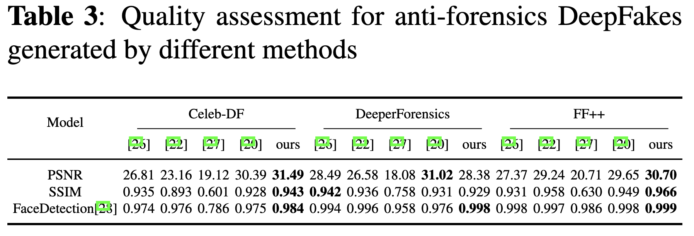
Visual compare
original
Our results have sharpen appearance and vivid
ours
Notes:
In the picture, we can see that Our results have sharpen appearance and vivid
And in the table, our method has the best performance in Celeb-DF and FF++

Slide 9
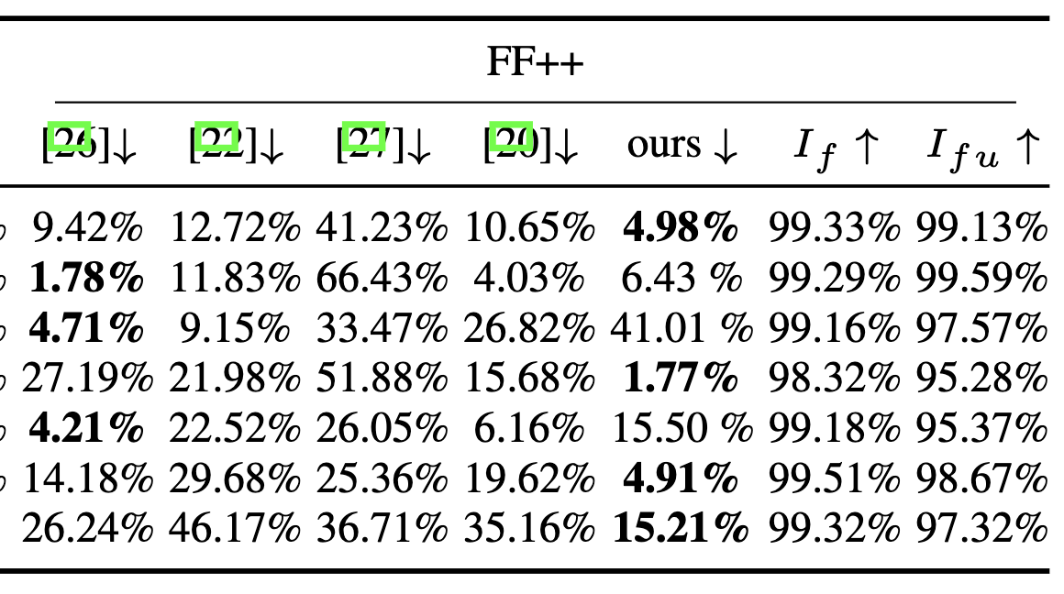
Anti-forensics compare
Sharpen deepfake
deepfake
Notes:
In anti-forensics compare, our method performance better than others in all three datasets. And we detect the deepfake and sharpen deepfake faces, which prove that the traditional USM sharpen method can’t fool detectors.

Slide 10
Thank you!

