Slide 1
Towards Ultra Low Bit-Rate Digital Human Character Communication via Compact 3D Face Descriptors
Binzhe Li¹, Bolin Chen¹, Zhao Wang², Shiqi Wang¹, and Yan Ye²
¹Department of Computer Science, City University of Hong Kong, Hong Kong
²Alibaba Group

Slide 2
Outline
Background
Related Works
The Proposed Method
Experimental Results

Slide 3
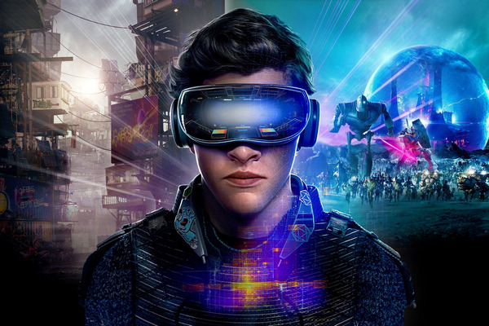
Background
Recently, there has been a tremendous demand for high-efficiency face video communications in numerous online chatting or meeting applications.
The digital human character and the virtual-real world are attractive for people.
The video compression, which has been long recognized as an essential component to warrant the video services, is usually designed with the general purpose without the specific consideration of the face videos.

Slide 4
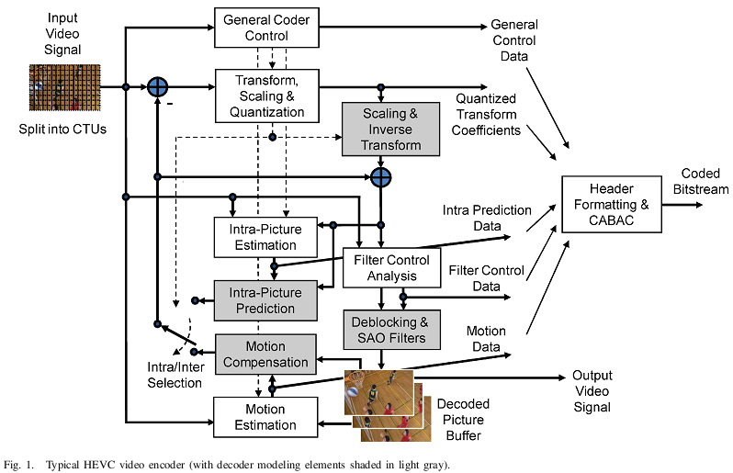
Related Works
Numerous hybrid video coding standards, as well as the end-to-end compression framework based on deep learning, have been developed [1,2].
The first-order motion model (FOMM) [3], which possesses many favorable properties for compactly representing the motion of faces, has readily been applied [4] for low bandwidth video chat.
Notes:
VVC
FOMM
3DMM

Slide 5
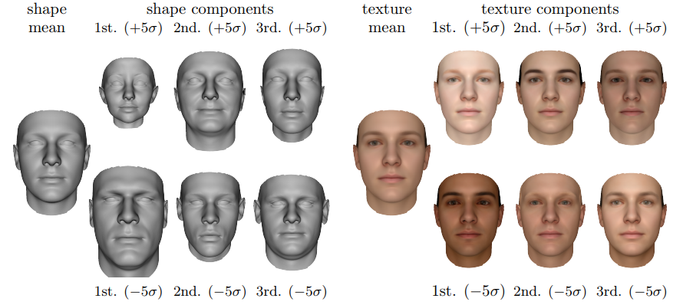
Related Works
The 3D Morphable Models (3DMM) plays an important role in 3D face reconstruction [5,6]. This model enables the reconstruction of the face with shape $𝒮$ and texture $𝒯$.
where $\overline{𝒮}$ and $\overline{𝒯}$ denote average identity and texture, and the basis vectors of the identity, expression and texture space are represented with $B_{id}$ , $B_{exp}$, $B_{t}$. The face identity, expression and texture are represented with the $α$, $β$, $δ$, which are corresponding feature vectors to control the reconstructed face.
$$𝒮=𝒮(α,β)=\overline{𝒮}+B_{id}α+B_{exp}β$$
$$𝒯=𝒯\left(δ\right)=\overline{𝒯}+B_{t}δ$$
Notes:
VVC
FOMM
3DMM

Slide 6
The Proposed Method
Fig 2. Illustration of the proposed framework.
Motivation:
No existing specific methods for 3D face communication
Virtual-physical interaction with ultra-low bit-rate in metaverse
High flexibility and enhanced robustness of 3D face communication
Contributions:
Propose a framework that facilitates the reconstruction of 3D faces with ultra low bit-rate conveyed and the 3D face template stored at the receiver side.
Introduce how the features that manipulate the 3D face template are compactly represented based on the end-to-end compression network.
Notes:
The paradigm is grounded on the mild assumption of the consistency and persistence of human appearance, such that only the compact features that determine the pose and expression of the 3D character need to be transmitted.
3D scheme enjoys the advantages of high flexibility and enhanced robustness due to the digital character level representation and 3D face template-based rendering. As such, the performance of the proposed approach is not governed by the first frame, and more importantly, the transmission of compact features instead of textures could further guarantee the privacy.

Slide 7
The Proposed Method
Fig 2. End to End Ultra Low Bit-Rate Digital Human Character Communication Framework via Compact 3D Face Descriptors
Purpose: Communicate by compressing 3D face driving descriptors with a low bit rate.
Function: Take the personal 3D face template and face video as input, output the reconstructed the 3D face.
Main Components of Framework:
Personal 3D Face Template: The offline generated face template stored on both sender and receiver sides.
Feature Extractor: Extract 3D face descriptors (including expression translation and angle) from frames.
3D Morphable Models (3DMM): Reconstruct accurate 3D face based on the 3D face template and face descriptors.
Encoder and Decoder: Compress and transmit face descriptors to receiver, and reconstructed descriptors for 3DMM.

Slide 8
The Proposed Method
Encode the difference between descriptors of the current frame $ω_{t}$ and quantized descriptors of the reference frame $ω_{r}^{′}$.
Fig 2. End to End Ultra Low Bit-Rate Digital Human Character Communication Framework via Compact 3D Face Descriptors
Purpose: Communicate by compressing 3D face driving descriptors with a low bit rate.
Function: Take the personal 3D face template and face video as input, output the reconstructed the 3D face.
Main Components of Framework:
Personal 3D Face Template: The offline generated face template stored on both sender and receiver sides.
Feature Extractor: Extract 3D face descriptors (including expression translation and angle) from frames.
3D Morphable Models (3DMM): Reconstruct accurate 3D face based on the 3D face template and face descriptors.
Encoder and Decoder: Compress and transmit face descriptors to receiver, and reconstructed descriptors for 3DMM.

Slide 9
The Proposed Method
Regarding the testing, make the secondary prediction between latent code $η_{t}^{′}$ and $η_{t−1}^{′}$. (dashed line part)
Fig 2. End to End Ultra Low Bit-Rate Digital Human Character Communication Framework via Compact 3D Face Descriptors
Purpose: Communicate by compressing 3D face driving descriptors with a low bit rate.
Function: Take the personal 3D face template and face video as input, output the reconstructed the 3D face.
Main Components of Framework:
Personal 3D Face Template: The offline generated face template stored on both sender and receiver sides.
Feature Extractor: Extract 3D face descriptors (including expression translation and angle) from frames.
3D Morphable Models (3DMM): Reconstruct accurate 3D face based on the 3D face template and face descriptors.
Encoder and Decoder: Compress and transmit face descriptors to receiver, and reconstructed descriptors for 3DMM.

Slide 10
Experimental Results
Table 1. Coding bits and quality of the proposed method and baseline (VVC)
* For some videos in VVC the face cannot be detected, corresponding to / in the table.
Metrics: 1) HyperIQA method for image quality assessment.
2) MSE of embedding vector of FaceNet to evaluate the reconstructed face consistency.
3) Coding Bits.
The quality evaluation results show that the proposed method has better visual quality with a lower bit rate.

Slide 11
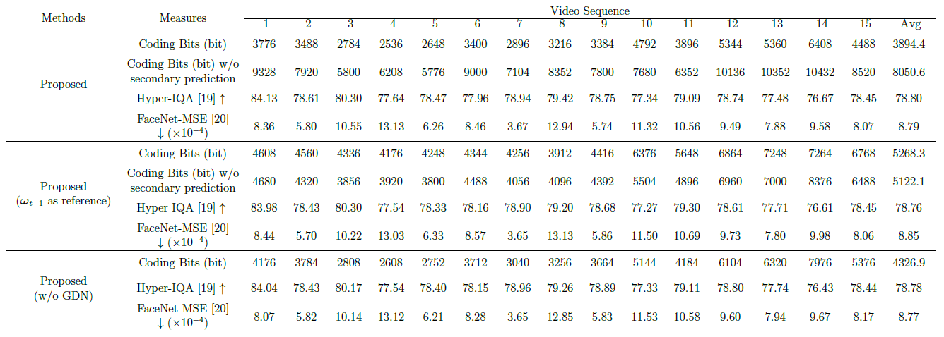
Experimental Results
Table 2. Performance comparisons in the ablation studies
Ablation Study 1: Take the reconstructed descriptors of the previous frame $ω_{t−1}$as reference, instead of $ω_{0}$ reference.
Ablation Study 2: Remove the Generalized Divisive Normalization (GDN) step.
Ablation Study 3: Remove the secondary prediction between latent code $η_{t}^{′}$ and frame $η_{t−1}^{′}$.
Secondary prediction, GDN step and $ω_{0}$ reference provide Coding Bits saving with almost same quality.

Slide 12
Reference
[1] Benjamin Bross, Ye-Kui Wang, Yan Ye, Shan Liu, Jianle Chen, Gary J Sullivan, and Jens-Rainer Ohm, Overview of the versatile video coding (VVC) standard and its applications," IEEE Transactions on Circuits and Systems for Video Technology, 2021.
[2] Guo Lu, Wanli Ouyang, Dong Xu, Xiaoyun Zhang, Chunlei Cai, and Zhiyong Gao, DVC: An end-to-end deep video compression framework," in Proceedings of the IEEE/CVF Conference on Computer Vision and Pattern Recognition, 2019, pp. 11006-11015.
[3] Aliaksandr Siarohin, Stephane Lathuiliere, Sergey Tulyakov, Elisa Ricci, and Nicu Sebe, First order motion model for image animation," Advances in Neural Information Processing Systems, vol. 32, pp. 7137-7147, 2019.
[4] Maxime Oquab, Pierre Stock, Daniel Haziza, Tao Xu, Peizhao Zhang, Onur Celebi, Yana Hasson, Patrick Labatut, Bobo Bose-Kolanu, Thibault Peyronel, and Camille Couprie, Low bandwidth video-chat compression using deep generative models," in Proceedings of the IEEE/CVF Conference on Computer Vision and Pattern Recognition (CVPR) Workshops, June 2021, pp. 2388-2397.
[5] Volker Blanz and Thomas Vetter, A morphable model for the synthesis of 3D faces,“ in Proceedings of the 26th annual conference on Computer graphics and interactive techniques, 1999, pp. 187-194.
[6] Yu Deng, Jiaolong Yang, Sicheng Xu, Dong Chen, Yunde Jia, and Xin Tong, Accurate 3D face reconstruction with weakly-supervised learning: From single image to image set," in Proceedings of the IEEE/CVF Conference on Computer Vision and Pattern Recognition Workshops, 2019.

Slide 13
Thank you!

