Slide 1
ELECTROENCEPHALOGRAM (EEG) SENSOR DATA COMPRESSION USING AN ASYMMETRICAL AUTOENCODER WITH A DISCRETE COSINE TRANSFORM LAYER
Xin Zhu¹ Hongyi Pan² Shuaiang Rong¹ A. Enis Cetin¹
¹Department of Electrical and Computer Engineering, University of Illinois Chicago, USA
²Machine & Hybrid Intelligence Lab, Northwestern University, USA

Slide 2
Introduction: EEG Data Compression
Autoencoder type neural network with a DCT layer
Classical and neural network approach
Experimental Results in BCI2 and Bonn EEG datasets
Conclusion
Overview

Slide 3
Electroencephalogram (EEG) plays a crucial role in neurological diagnosis.
Advanced feature extraction and recognition/classification algorithms have been designed for EEG analysis.
EEG Data compression has not received as much attention as other applications.
Section ONE
Introduction

Slide 4
The current methods for compressing EEG signals
Previous Work:
Traditional signal transform methods
Neural network-based methods
Transform-based learning techniques
The discrete wavelet transform/DCT+ adaptive arithmetic encoding
Limitation: Relatively Low reconstruction accuracy
Convolutional autoencoder
A near-lossless compression algorithm is developed based on discrete cosine transform (DCT) and multilayer perceptron (MLP)
A. E. Cetin and H. Koymen, `Compression of Digital Biomedical
Signals, Biomedical Engineering Handbook, Ed.
by J. D. Bronzino, pp. 853-865, IEEE Press and CRC Press, 1995.
Cetin, A.E., Koymen, H. and Aydin, M.C., 1993. Multichannel ECG data compression by
multirate signal processing and transform domain coding techniques. IEEE Trans. on Biomedical Eng.

Slide 5
Asymmetrical sparsifying autoencoder with a DCT layer for EEG sensor data compression.
Trainable thresholding units remove the noise and improve the data compression efficiency.
Fully connected layer before the DCT makes thresholds trainable
Combination of the fully connected and DCT layers learn the data compression capability of the structure
Scaling parameters approximately perform filtering in the transform domain and the
One-by-one convolution layer reduces the dimension and produces the latent space.
Section two
Contribution

Slide 6
Classical autoencoders are designed in a symmetric architecture.
In the proposed model, the encoder side has low complexity, which is suitable for implementation at the edge in sensors.
The decoder side has more linear layers than the encoder side to enhance the data reconstruction ability.
Section three
Asymmetrical Network Model

Slide 7
Encoder
Linear layer allows the training of thresholds and
scaling parameters
Linear layer functions similar to the MP3 wavelet transform
Block by block data processing: N=64

Slide 8
DCT layer is similar to a convolutional layer
Convolution y=h*x. → Elementwise multiplication: Y[k]=H[k]X[k] in the
Fourier transform domain
But Fourier transform requires complex arithmetic
DCT has its own convolution theorem, but we ignore it and use
Y[k]=H[k]X[k]
H[k]’s provide scaling & emphasizing in the DCT domain
Similar to JPEG/MPEG/MP3 …
Hard-thresholding instead of RELU
Training using backpropagation-type methods is possible

Slide 9
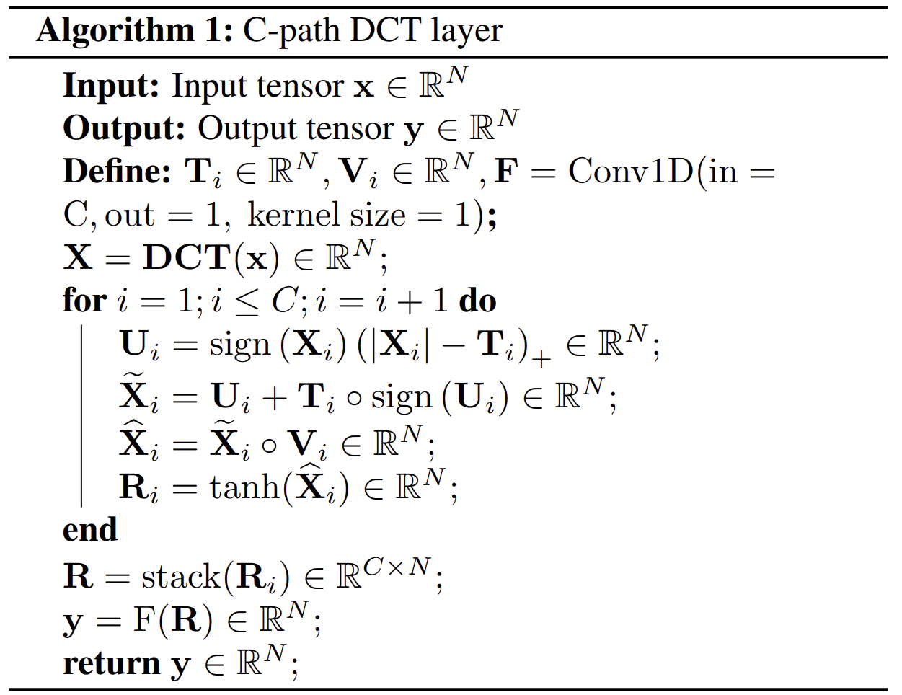
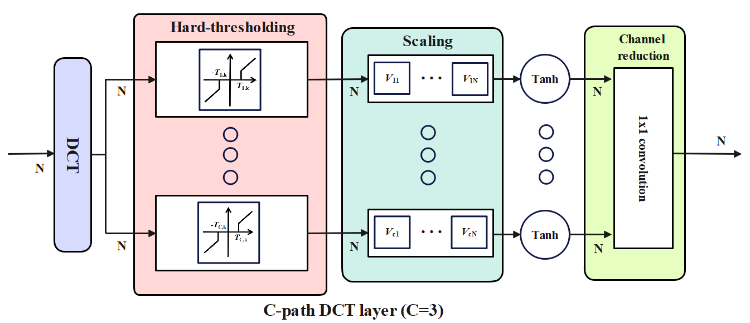
DCT layer
DCT-III:
Hard-thresholding function:

Slide 10
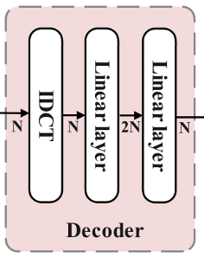
Decoder
Decoder has more fully connected (linear) layers than encoder to improve reconstruction
It decodes the quantized encoder data (quantization details are in the paper).

Slide 11
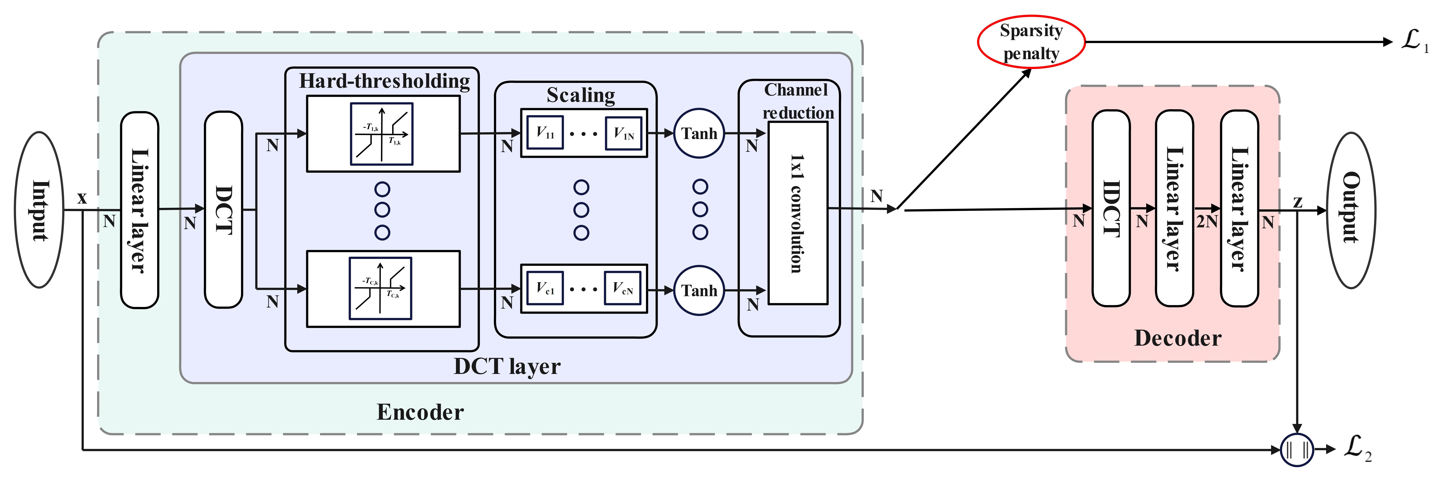
Proposed Model-Training stage
Overall loss function: Mean squared error + Sparsity penalty loss function based on Kullback–Leibler divergence

Slide 12
Asymmetrical Model-Transmission stage
Hybrid coding algorithm: A combination of Run-Length Encoding (RLE) and Lempel–Ziv–Markov chain algorithm (LZMA)

Slide 13
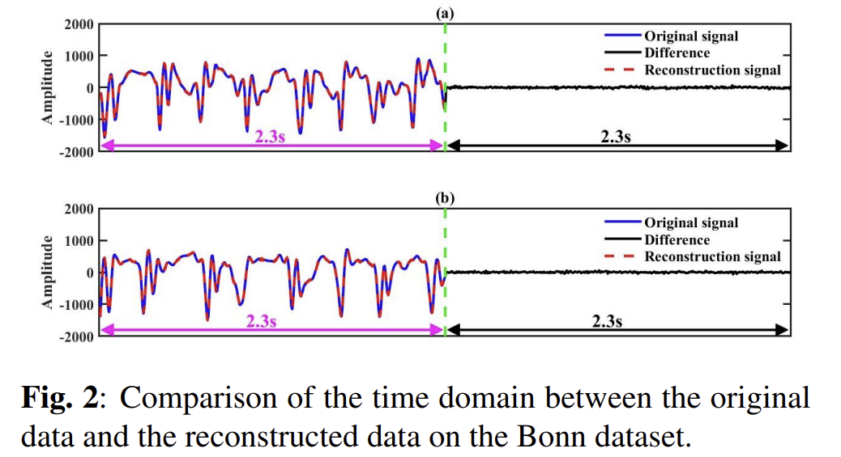
Section four
Experimental Results

Slide 14
Dataset:
(1). BCI2 dataset (316 training sets and 100 testing sets).
(2). Bonn University dataset.
Performance metric:
(1). Compression ratio (CR);
CR = Size of original data/ Size of reconstruction data
(2). Percent root-mean-square difference (PRD).
(3). Quality score (QS)
QS = CR/ PRD
Section four
Experimental Results

Slide 15
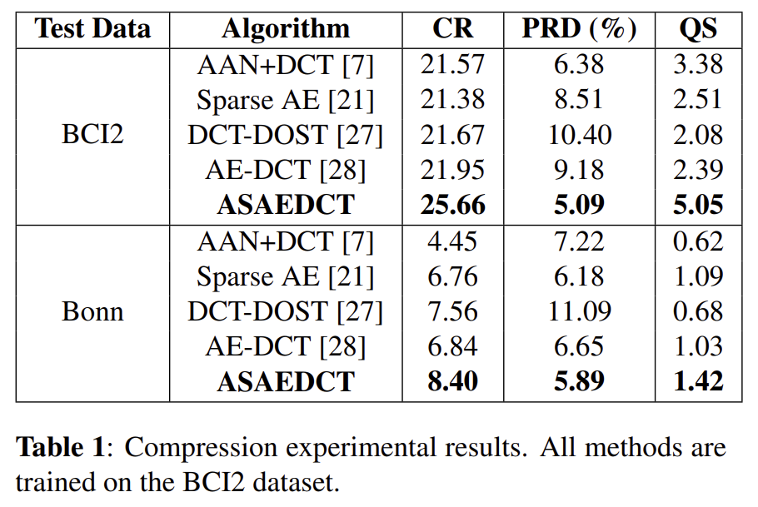
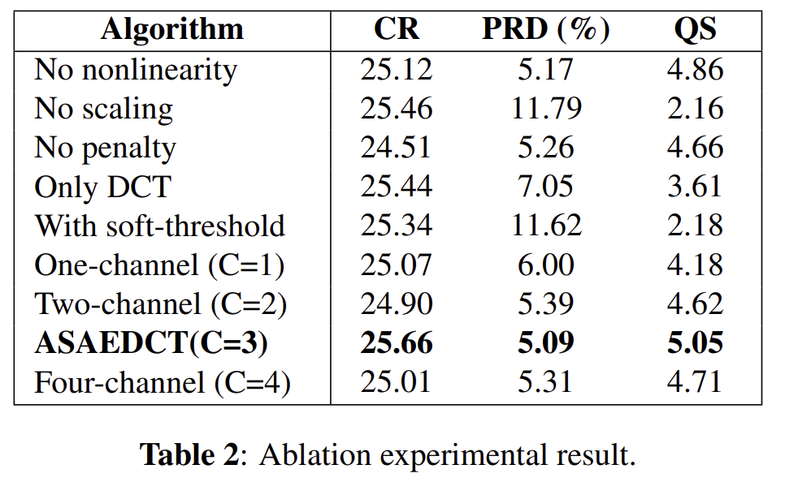
Experimental Results
(ASAEDCT is our algorithm)
Performance metric: Compression ratio (CR), Percent root-mean-square difference (PRD) and Quality score (QS)

Slide 16
Computational Cost
Analysis of the computational cost:
For an input with a duration of 6.4s, the compression time of the ASAEDCT network is only around 0.016s.
Although it is executed on the Intel Core i7-12700H CPU, the fast compression time indicates that the proposed method can be used in real-time compression of the EEG signals.

Slide 17
Asymmetrical autoencoder with a DCT layer with trainable hard-thresholding nonlinearity for EEG sensor data compression.
The hard-thresholding nonlinearity and scaling layers not only enhance the data compaction capability of the structure but also denoise the EEG signal.
The proposed model achieves the best compression efficiency and reconstruction accuracy compared to other methods in BCI2 and Bonn EEG datasets.
The computational load of the compression part of the ASAEDCT network is low, therefore, it can be implemented in the sensor for EEG data compression.
Section four
Conclusion

