Slide 1
Feature-Constrained and Attention-Conditioned Distillation Learning for Visual Anomaly Detection
Shuo Zhang, Jing Liu
Notes:
my name is shuozhang, i come from china, i am sorry because i am late, it is my first time to go abroad, so i make something wrong, and lose my PPT, this PPT is just i writed on the airplane, so it is very poor. i am sorry, but i glad to make presentation here, thanks icassp give me the chance , thank you

Slide 2
Background
Anomaly detection with localization
The difficulty of obtaining anomalous examples
Feature-based methods
Generative adversarial networks
Normalizing flows based methods
Reconstruction based approaches
Notes:
Visual anomaly detection in computer vision is an essential one-class classification and segmentation problem. The student-teacher (S-T) approach has proven effective in addressing this challenge. However, previous studies based on S-T underutilize the feature representations learned by the teacher network, which restricts anomaly detection performance. In this study, we propose a novel feature-constrained and attention-conditioned distillation learning method for visual anomaly detection with localization, which fully uses the features of the teacher model and the local semantics of the critical structure to instruct the student model to detect anomalies efficiently. Specifically, we introduce the Vision Transformer (ViT) as the backbone for anomaly detection tasks, and the central feature strategy and self-attention masking strategy are proposed to constrain the output features and impose agreement between multi-image views. It improves the ability of the student network to describe normal data features and widens the feature difference between the student and teacher networks for abnormal data. Experiments on the benchmark datasets demonstrate that the proposed method significantly improves the performance of visual anomaly detection compared with the competing methods.

Slide 3
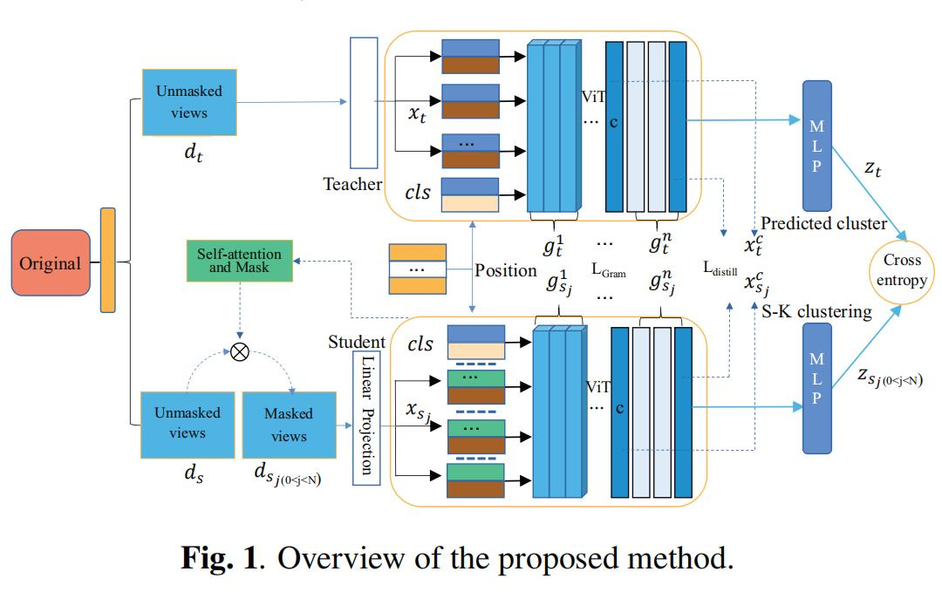
Methodology
Notes:
对不起

Slide 4
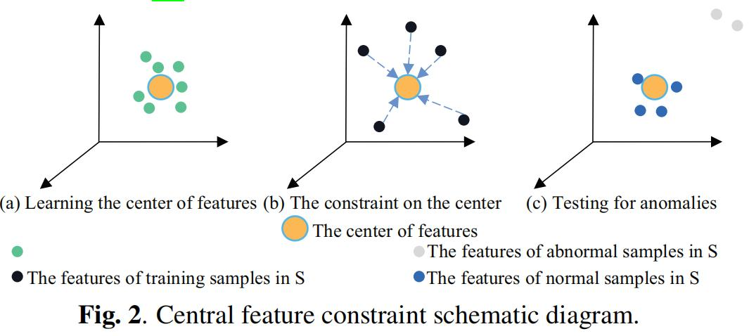
Results

Slide 5
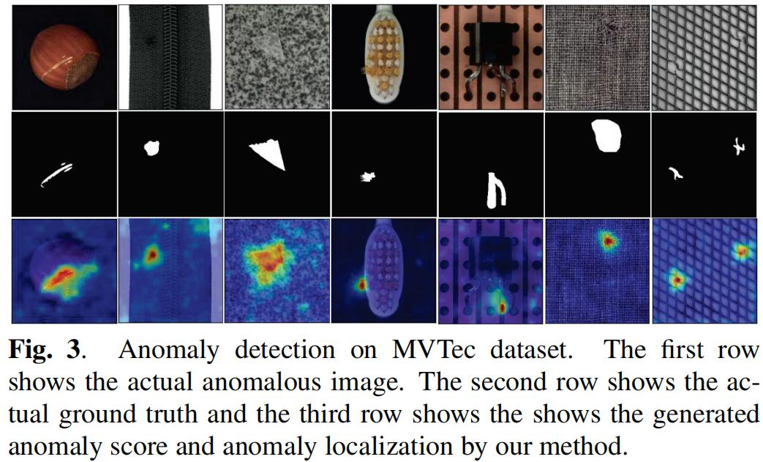
Results

Slide 6
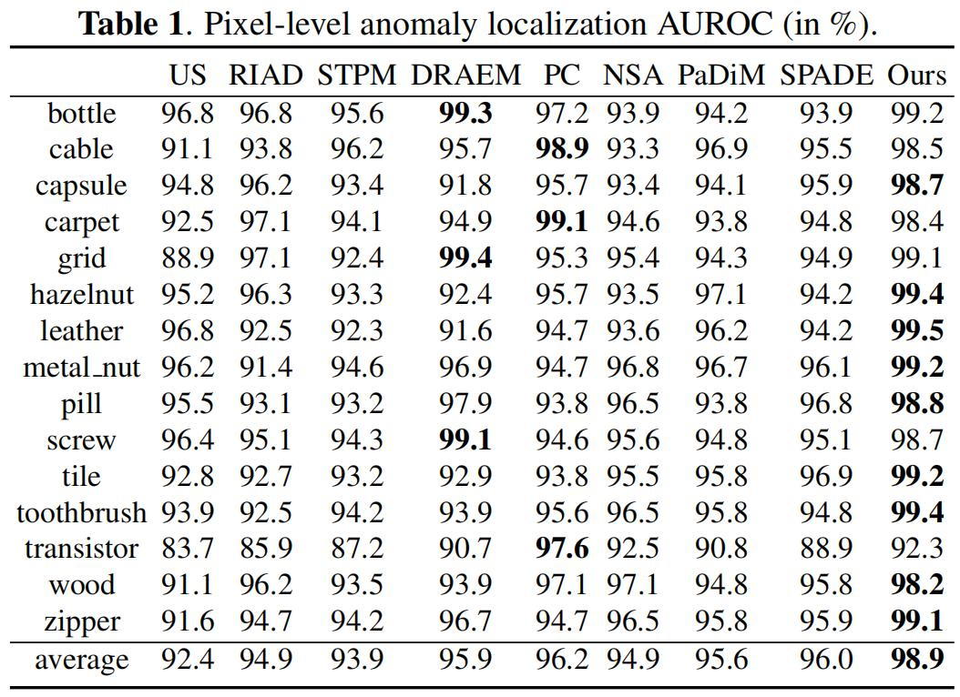
Results

Slide 7
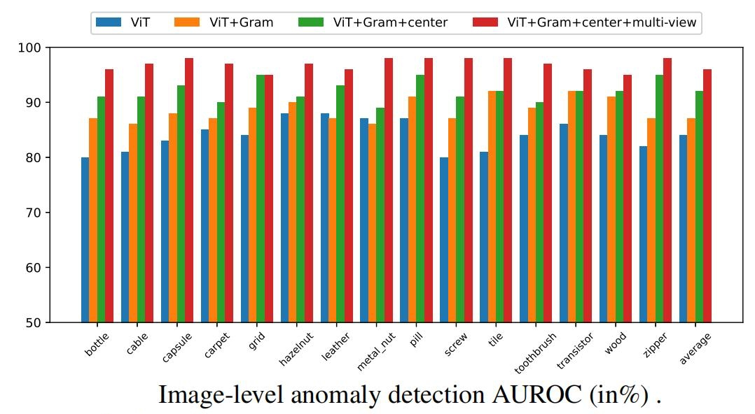
Results
Notes:
你好

Slide 8
Conclusion
A novel self-supervised anomaly detection with localization method
Feature-constrained and attention-conditioned distillation learning
Achieve considerable advantages compared favorably to the state-of-the-art baseline methods
Notes:
This paper proposes a novel self-supervised anomaly detection with localization method using feature-constrained and attention-conditioned distillation learning. Our method combines encoding consistency, central feature, and multi-view consistency constraints to fully use the features of the teacher model to instruct the student model to detect anomalies efficiently. Experiments on public datasets demonstrate that our method can achieve considerable advantages compared favorably to the state-of-the-art baseline methods on anomaly detection. Further, the ablation study provides empirical evidence for the effectiveness of each component in our method.

Slide 9
THANKS

