Slide 1
Investigating End-to-End ASR Architectures for Long Form Audio Transcription
Speaker:
Somshubra Majumdar, NVIDIA NeMo
Authors:
Nithin Rao Koluguri, Samuel Kriman, Georgy Zelenfroind, Somshubra Majumdar, Dima Rekesh, Vahid Noroozi, Jagadeesh Balam, Boris Ginsburg
{nkoluguri@nvidia.com, smajumdar@nvidia.com}

Slide 2
Agenda
• | Long form Audio and its challenges
• | Understanding the limits imposed by design choices
• | Evaluation of models
• | Interesting findings

Slide 3
Long Form Audio Transcription
How long is long?
Generally, we denote “long form audio” to range from a few minutes to several hours long audio segments.
Short Form audio (almost all training and validation datasets) ~ <= 20-30 seconds
Podcasts ~ 30-40 minutes
Meetings and Movies – 2 hours !
Duration in Minutes

Slide 4
Long Form Audio Transcription
Motivation & Challenges
Global Context Transcription: Latter parts of transcripts might refer to nouns / keywords from earlier segments.
No Transcript Post Processing: No audio chunking, Let model handle it without external support.
Offline vs Online Inference
Time and Memory consumed to infer on long audio: Autoregressive vs Non-Autoregressive Inference, Quadratic time/memory complexity of Global Attention
Accuracy vs Speed Trade-off
vs
vs

Slide 5
Long Form Audio Transcription
Scope of this work
Offline, Single Pass Inference – single encoder step, single/multiple decoder steps
Study Architectural Impact on time and memory cost
QuartzNet – Only Convolution
ContextNet – Convolution with Squeeze-Excitation
Conformer / Fast Conformer – Attention + Convolution
Study the impact of Global Context on ASR
Study the efficiency trade-offs between CTC and RNN-T models
Offline Inference
QuartzNet
ContextNet
Conformer / Fast Conformer
Global vs Local Context
CTC vs RNN-T

Slide 6
Agenda
• | Long form Audio and its use-cases
• | Understanding the limits imposed by design choices
• | Evaluation of models
• | Interesting findings

Slide 7
Impact of Architectural Choices
Types of Models
SOTA ASR Architectures can be grouped as follows:
Convolution Only
Convolution + Squeeze Excitation
Convolution + Attention

Slide 8
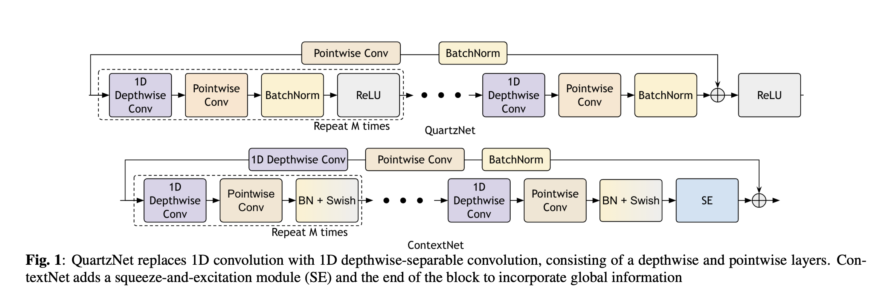
Impact of Architectural Choices
Convolutional (+ Global Context) Models
Convolutions are fast, and consume less memory
Purely Convolutional Models are highly efficient at long form inference
We study two classes of Convolutional models – QuartzNet2 and ContextNet
ContextNet adds Squeeze-and-Excitation (global averaging and rescoring) to resolve global context information

Slide 9
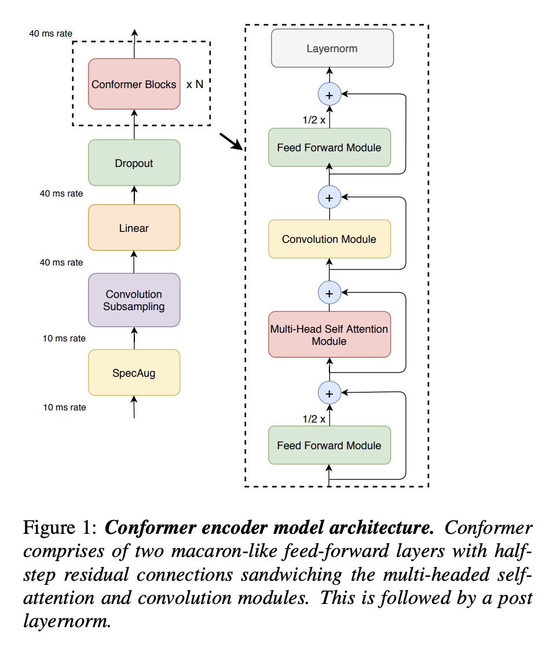
Impact of Architectural Choices
Attention Models
Global Attention (and Self Attention) has a quadratic memory cost dependent on sequence length of the input.
Very high memory consumption for audio features due to short window stride of Melspectrogram frames (10 ms usually)
1 second of audio ~ 100 audio frames 30 sec ~ 3000 frames ! 20 minutes – 120,000 frames !!
We study Conformer as the primary candidate for ASR due to its widespread use.
Gulati, A., Qin, J., Chiu, C.-C., Parmar, N., Zhang, Y., Yu, J., Han, W., Wang, S., Zhang, Z., Wu, Y., Pang, R. (2020) Conformer: Convolution-augmented Transformer for Speech Recognition. Proc. Interspeech 2020, 5036-5040, doi: 10.21437/Interspeech.2020-3015

Slide 10
Impact of Architectural Choices
Fast Conformer – The best of both worlds
Developed to sidestep the limitations of Conformer
Downsampling stride : 4x -> 8x
Conv : Full Conv -> Depthwise Separable Convs
Downsampling dimension : ndim -> 256 (capped for all model sizes)
Conv Kernel Size: 31 -> 9
Attn: Global Context -> Limited Context + Global Tokens (ala Longformer)
~Similar accuracy, ~3x faster, ~1/3 GMACs
Rekesh, Dima, et al. "Fast conformer with linearly scalable attention for efficient speech recognition." 2023 IEEE Automatic Speech Recognition and Understanding Workshop (ASRU). IEEE, 2023.

Slide 11
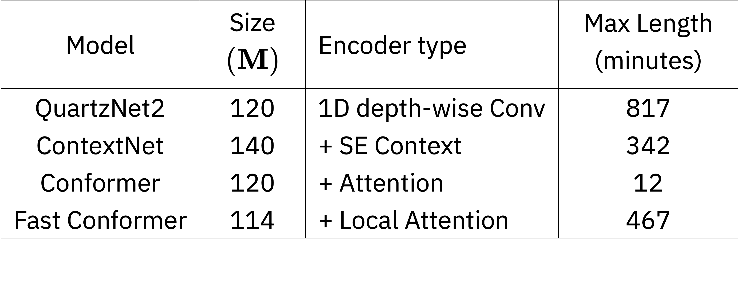
Impact of Architectural Choices
Maximum Duration Processed
Maximum audio duration on a single A6000 (48 GB VRAM)
QuartzNet2 (15x5) vs ContextNet (23x5) – Depth of model matters a LOT !
Conformer – T ~ 12 min * 60 sec * 100 frames / 4 stride ~ 18,000 for each of the 18 layers !
Fast Conformer – Local Attention mostly eliminates memory restrictions

Slide 12
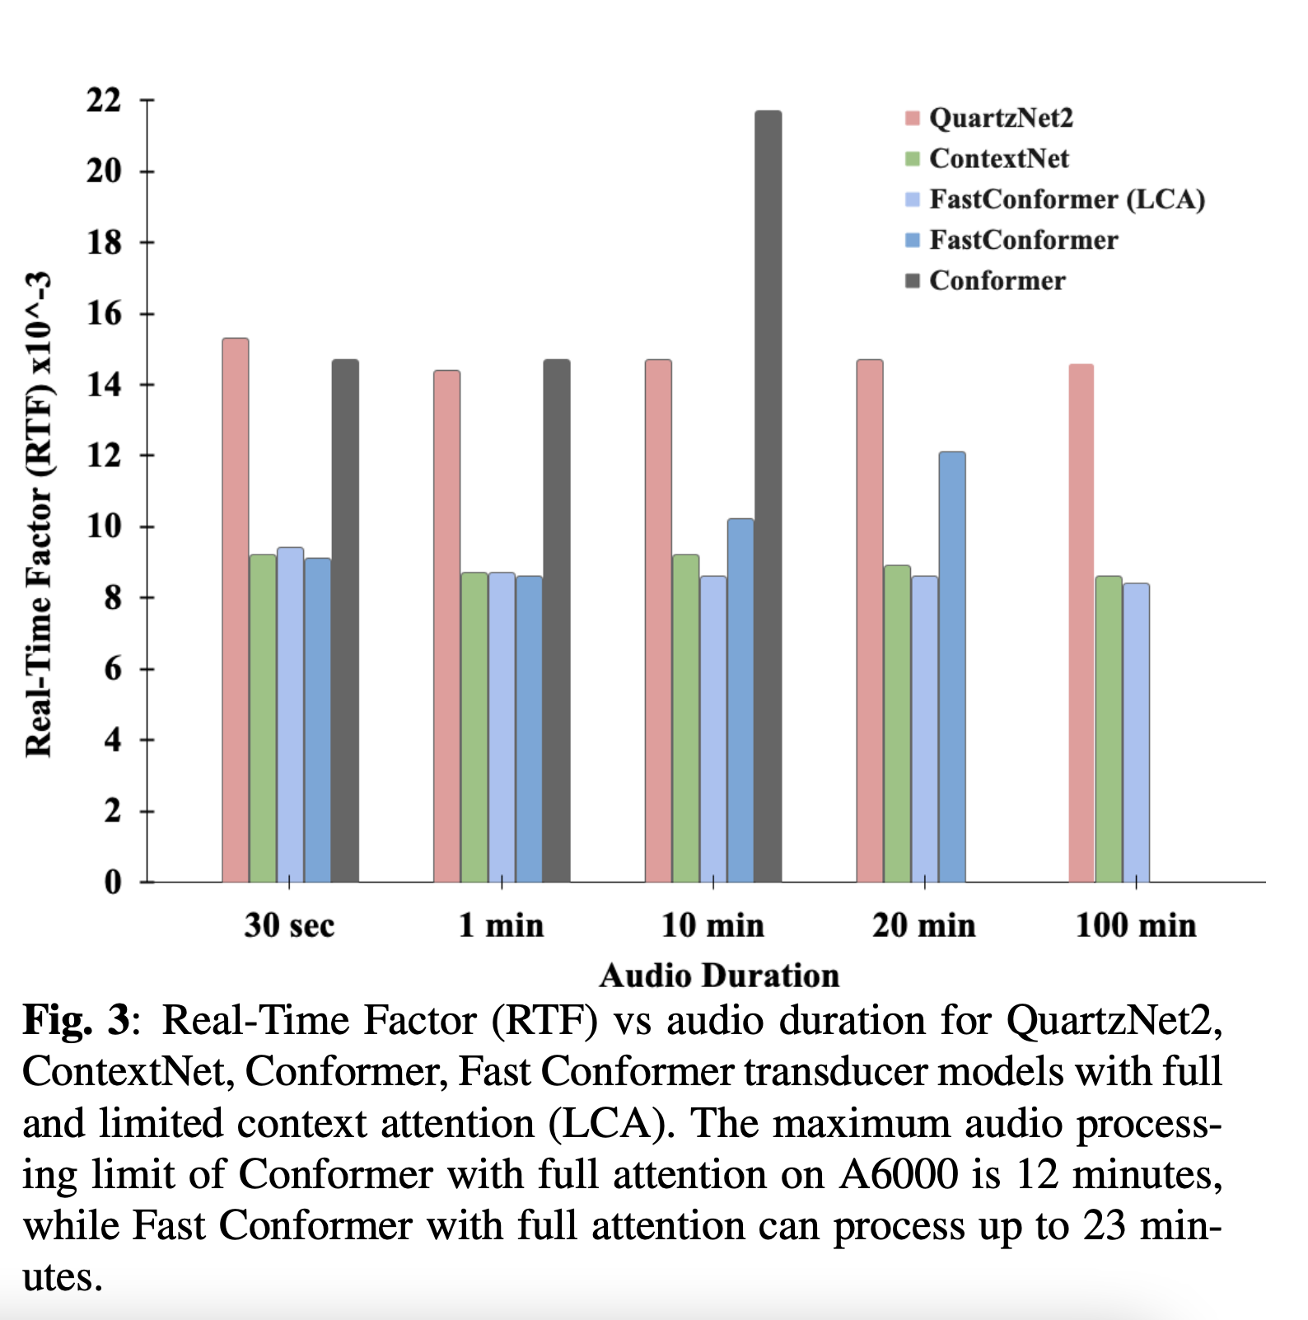
Impact of Architectural Choices
Real Time Factor
RTF = Time to transcribe audio / Total Audio Duration
Convolutional Models remain stable for long audio
Conformer (global attention) slows down around 5 min
Fast Conformer (global attention) much faster than Conformer at > 5 min, but slows down beyond 20 min
Fast Conformer (local attention) speed is stable - similar to Convolutional models, usually slightly faster than ContextNet

Slide 13
Agenda
• | Long form Audio and its use-cases
• | Understanding the limits imposed by design choices
• | Evaluation of models
• | Interesting findings

Slide 14
Training
Datasets
All types of architectures are trained on 25,000 hours of speech from NeMo ASR SET - comprised of the following
Librispeech 960
Multilingual Librispeech (Eng)
Mozilla Common Voice 7 (Eng)
Wall Street Journal
Fisher
Switchboard-1
National Speech Corpus (Singapore)
Vox Populi (Eng)
VCTK
EuroPal-ASR
12,000 hours subset of challenging samples from People’s Speech

Slide 15
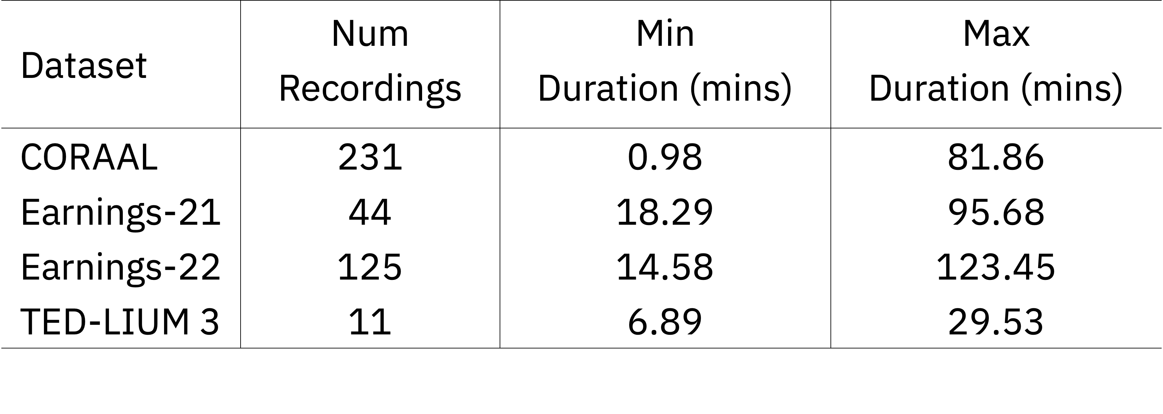
Evaluation Benchmarks
Out of Domain Evaluations on Long Form Audio
Choice of datasets – Out of distribution long audio clips
CORAAL (Corpus of Regional African American Language) – Accented speech
Earnings 21/22 – Very long duration earnings calls
TED-LIUM – Technical jargon not found in academic training sets

Slide 16
Evaluation of Models
Long Audio Benchmark
All results are with Greedy RNN-Transducer Decoding
FT: Finetuning is done on original training set (25K hours) for additional 10K steps.
GT: After FT, we add global tokens to LCA Fast Conformer and again finetune for additional 10K steps.
Takeaway –
Global Context very important for long audio transcription
Limited Context Attention + Global Token ~ Global Context Attention

Slide 17
Agenda
• | Long form Audio and its use-cases
• | Understanding the limits imposed by design choices
• | Evaluation of models
• | Interesting findings

Slide 18
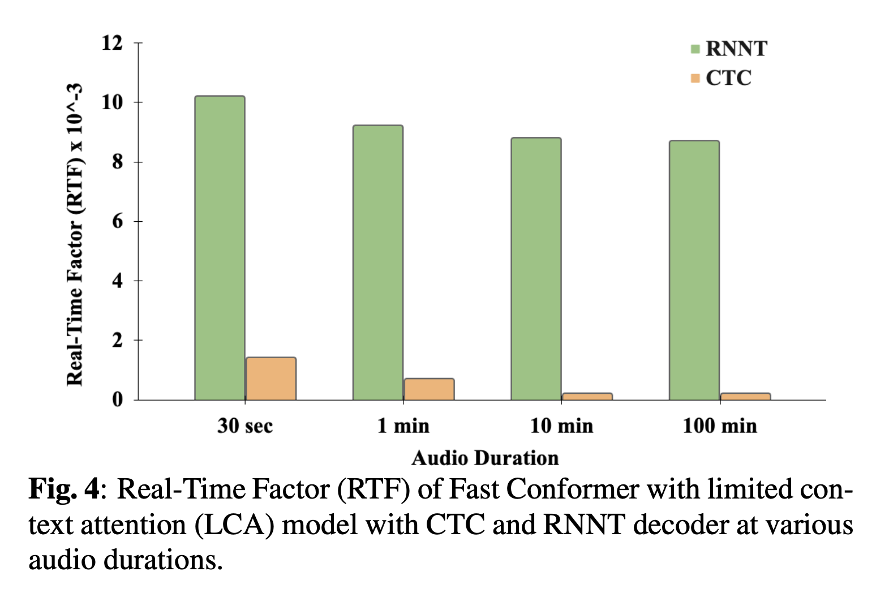
CTC vs RNN-T
Real Time Factor
Non-Autoregressive CTC Speed is 10x faster than Autoregressive RNN-T for <30 sec segment
Gap widens rapidly with longer durations (up-to 43x for 100 min !)

Slide 19
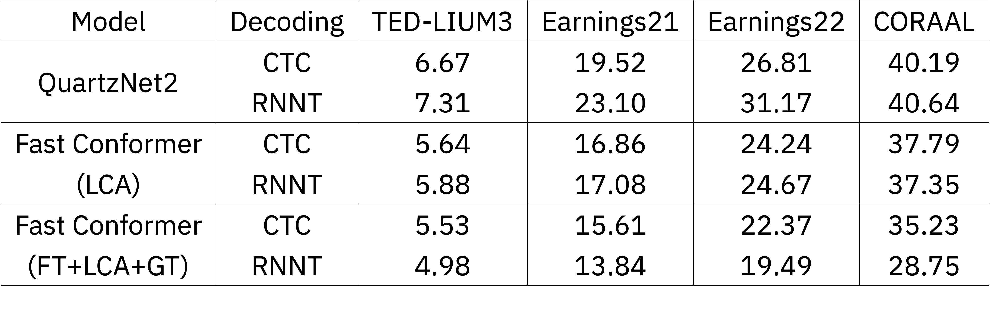
CTC vs RNN-T
WER
Q: Do we need RNN-T for its accuracy, if it costs so much time?
Ans:
Yes – but only if you finetune after LCA conversion and have global context (global tokens, global attention etc)
No otherwise – CTC obtains roughly same WER, sometimes even better than RNN-T

Slide 20
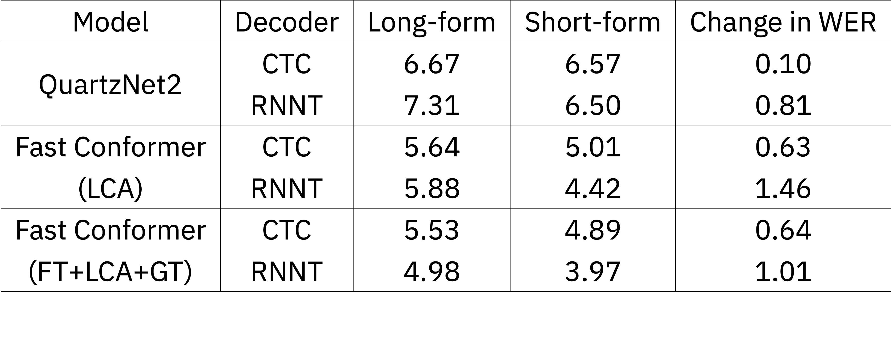
CTC vs RNN-T
Duration Robustness
Q: Which is more robust to duration changes, CTC or RNN-T?
We test on Tedlium 3, which has segmented and unsegmented version of all audio files.
Ans:
CTC is more efficient and robust to long audio extrapolation after only short segment training.
RNN-T has better WER potential, if LCA + GT is used and then finetuned on train set.

Slide 21
Conclusion
Long Audio Inference
Global Attention is a major limiter of long audio inference
Limited Context Attention + Global Tokens mostly resolve the gap between Accuracy of global attention and long audio inference
Purely convolutional models are great for ultra-long audio, but suffer in accuracy
CTC should be preferred for RTF without FT, RNN-T for transcription accuracy (after FT or FT + GT only)
Thank You !

Slide 22
Q & A

